Slide 1
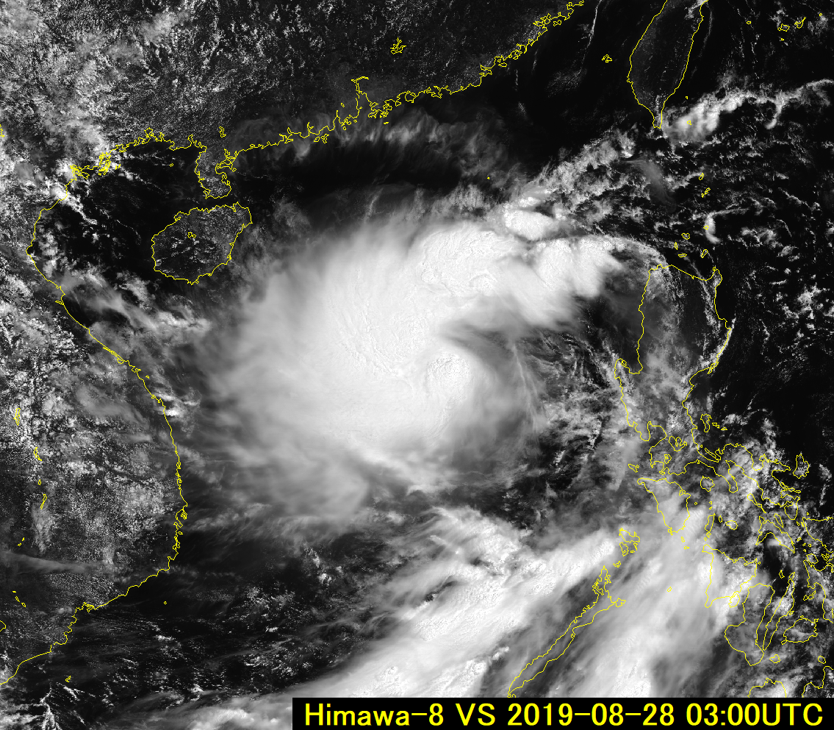
Himawari-8 / GEO-KOMPSAT-2A Wiggle 3D animation 0.64 micron visible imagery 03UTC 28th August 2019. Tropical Storm 13W Podul
animation kindly provided by Akihiro Shimizu JMA
China
Please view this animation carefully and desist if it feels uncomfortable
Philippines
Vietnam
rendered within SATAID
Please start the Power Point Slide Show to activate the animation

Slide 2
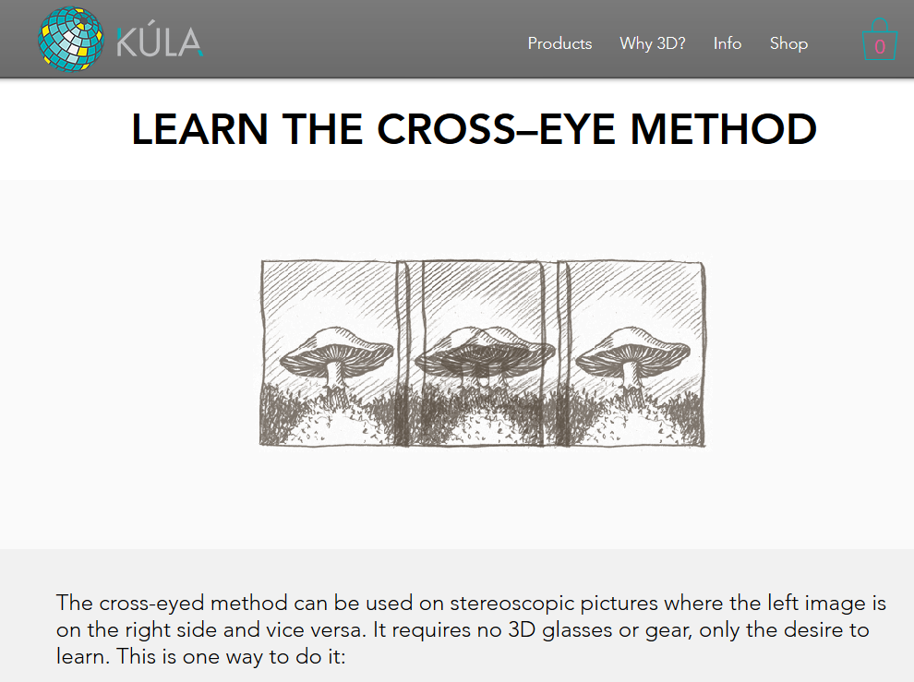
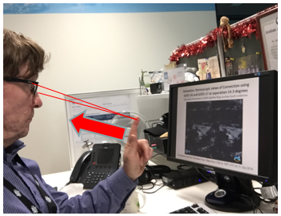
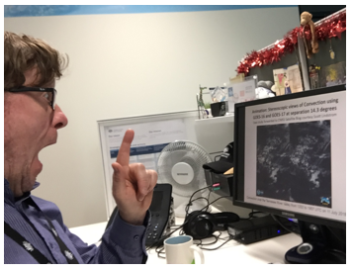
How to view stereo-pairs references
https://www.kula3d.com/how-to-use-the-cross-eyed-method
http://www.starosta.com/3dshowcase/ihelp.html

Slide 3
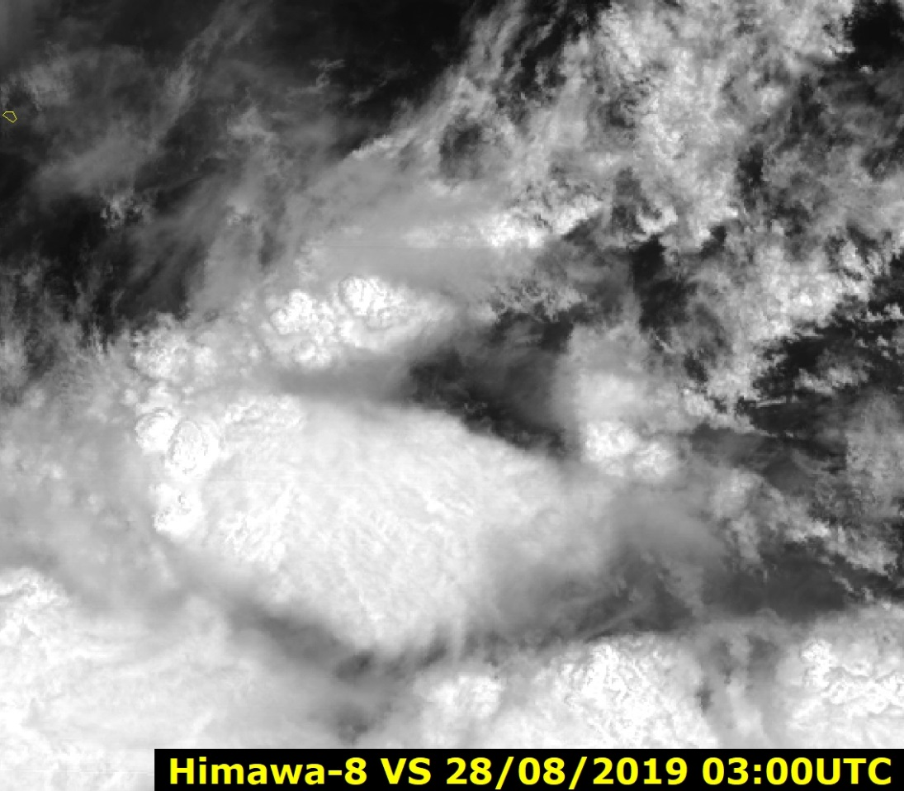
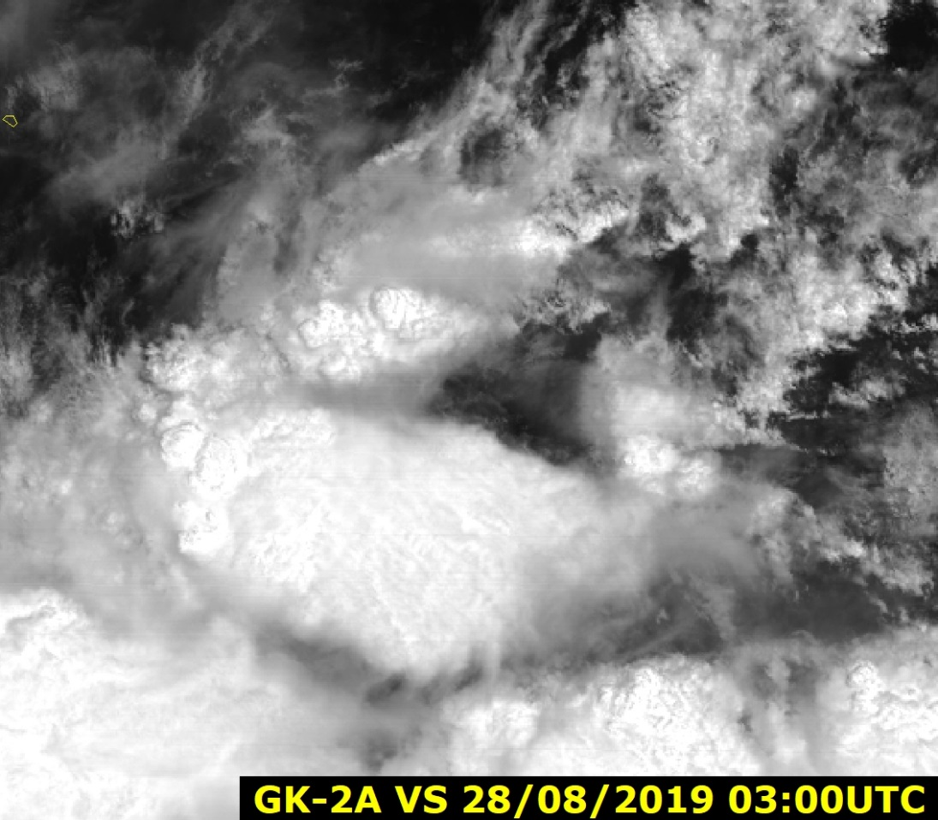
Himawari-8 / GEO-KOMPSAT-2A Stereo pair images (cross eyed viewing method) , 0.64 micron (0.5km resolution), 03UTC 28th August 2019. Thunderstorms within the inset area
images generated by Bodo Zeschke from animation kindly provided by Akihiro Shimizu JMA
images rendered within SATAID

