Slide 1
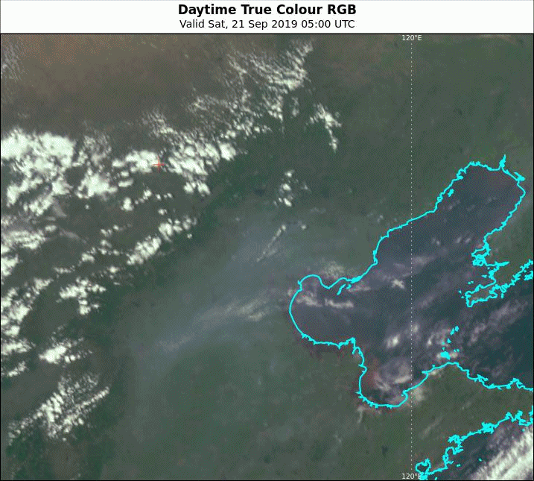
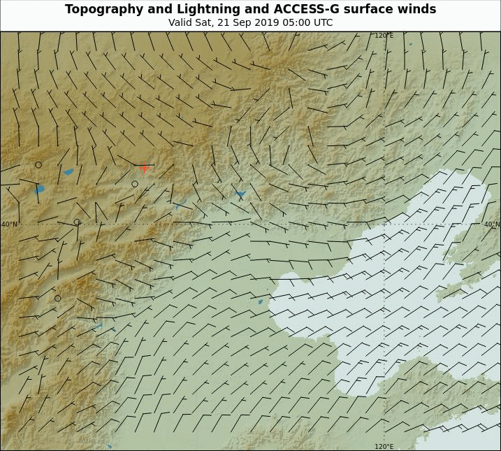
Animation: Thunderstorm development with possible ingestion of particulates 05 to 10UTC 21st September 2019
Inner
Mongolia
Beijing
Bohai Sea
Himawari-8 True Colour RGB and WeatherZone 10 minute lightning
Himawari-8 True Colour RGB and WeatherZone 10 minute lightning
animation courtesy JMA/BOM and WeatherZone
animation courtesy BOM
Please start the Power Point Slide Show to activate the animation

Slide 2
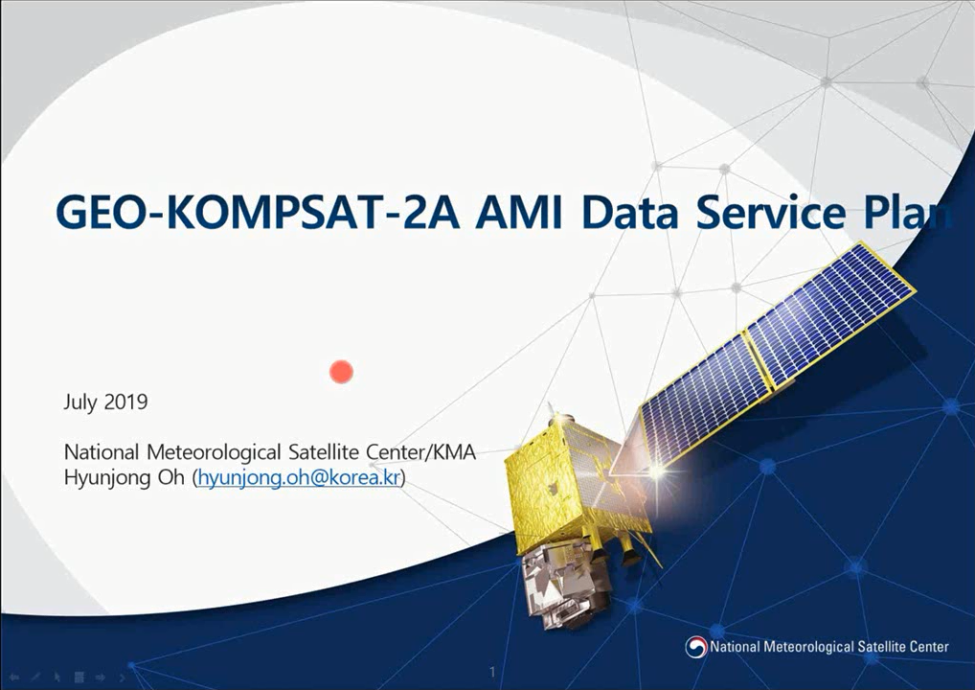
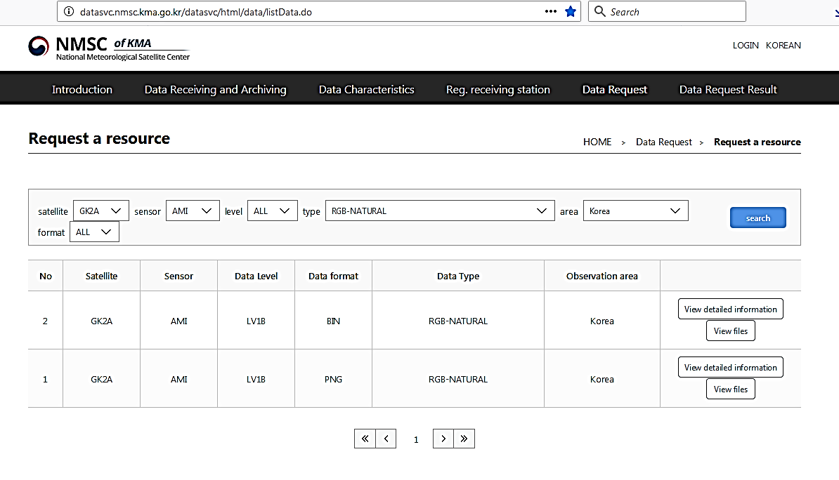
How to request GEO-KOMPSAT-2A data from the Korea Meteorological Administration http://datasvc.nmsc.kma.go.kr/datasvc/html/data/listData.do
Joint Australia Korea VLab Centres of Excellence Regional Focus Group meeting, July 2019
To obtain login and password please contact Mr. Hyunjong Oh, National Meteorological Satellite Centre KMA hyunjong.oh@korea.kr

Slide 3
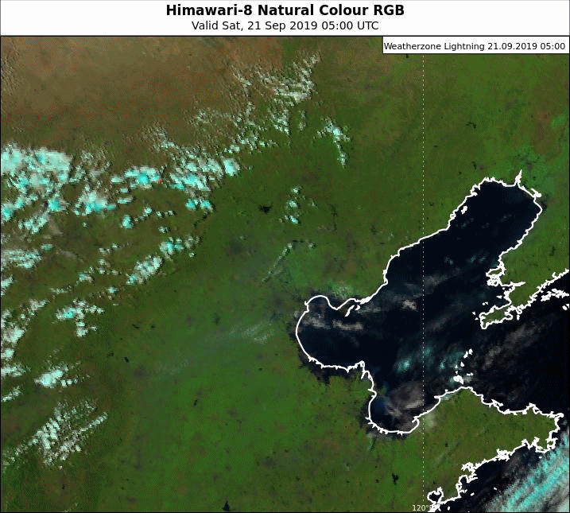
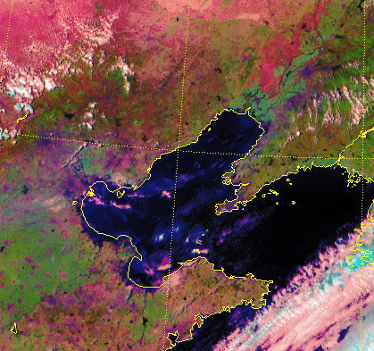
Animation: Thunderstorm development with possible ingestion of particulates 05 to 10UTC 21st September 2019
Inner
Mongolia
Beijing
Bohai Sea
Himawari-8 Natural Colour RGB and WeatherZone 10 minute lightning
GEO-KOMPSAT-2A KMA Natural Colour RGB
animation courtesy JMA/BOM and WeatherZone
animation courtesy Korea Meteorological Administration
Please start the Power Point Slide Show to activate the animation

Slide 4
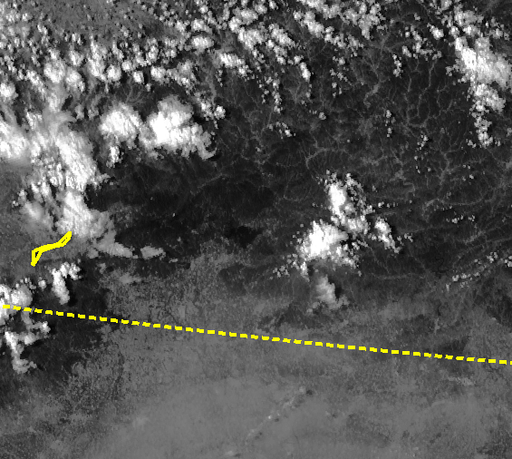
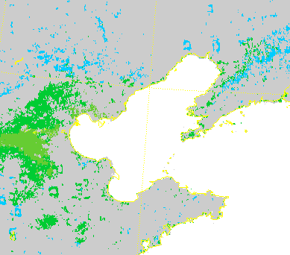
Animation: Thunderstorm development with possible ingestion of particulates 06 to 10UTC 21st September 2019
Beijing
Bohai Sea
GEO-KOMPSAT-2A 0.64 micron visible imagery
GEO-KOMPSAT-2A derived Aerosol Visibility (Experimental Product)
animation courtesy Korea Meteorological Administration
Please start the Power Point Slide Show to activate the animation

