Slide 1
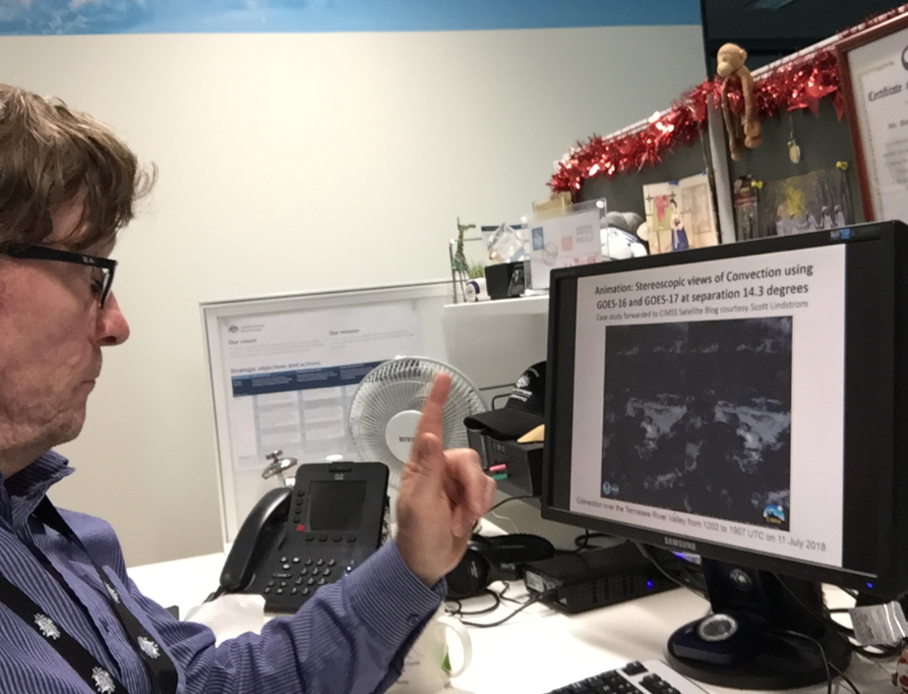
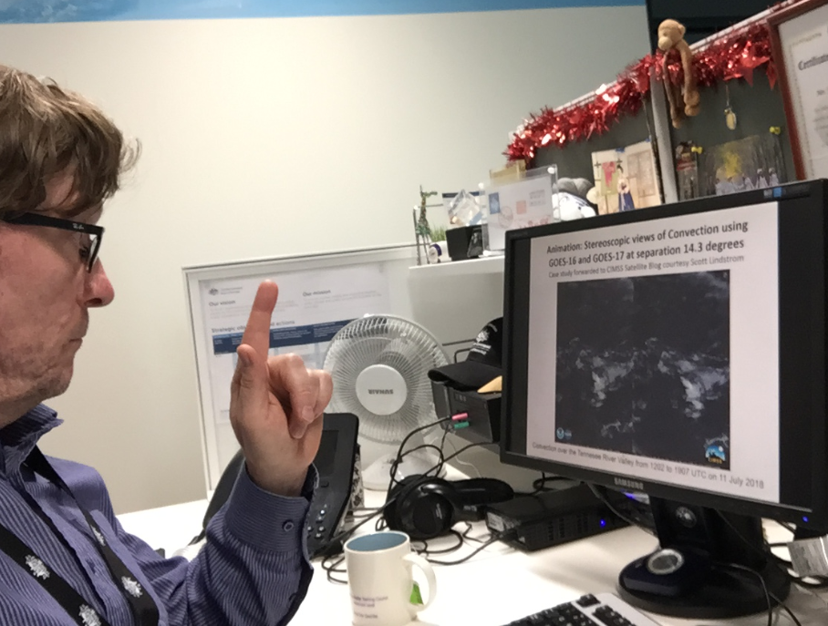
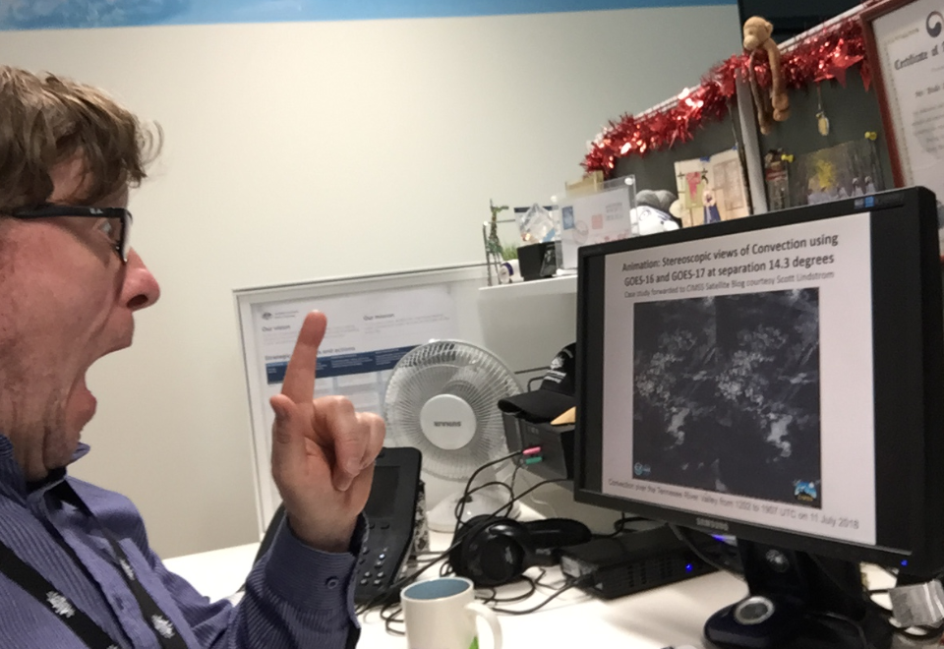
How to directly view the 3D two panel animations
A
B
C

Slide 2
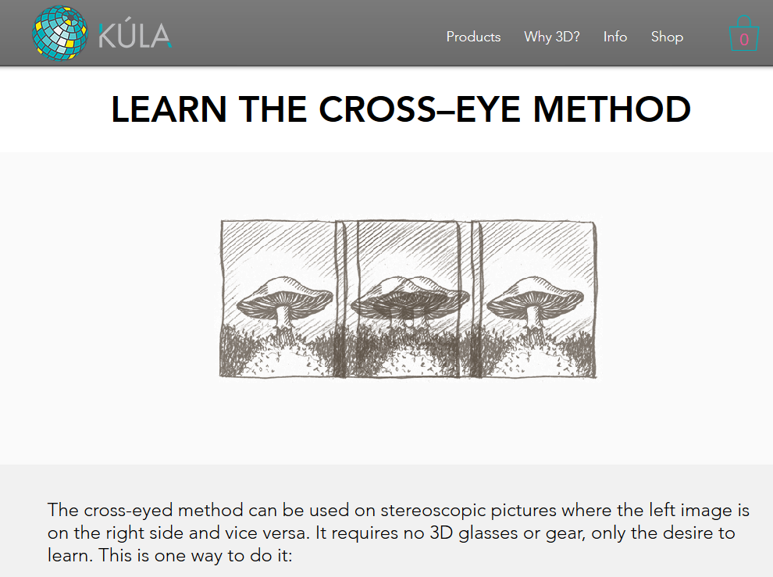
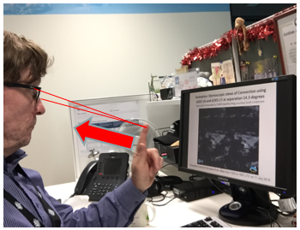
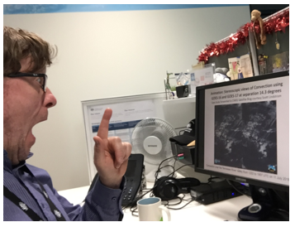
How to view stereo-pairs references
https://www.kula3d.com/how-to-use-the-cross-eyed-method
http://www.starosta.com/3dshowcase/ihelp.html

Slide 3
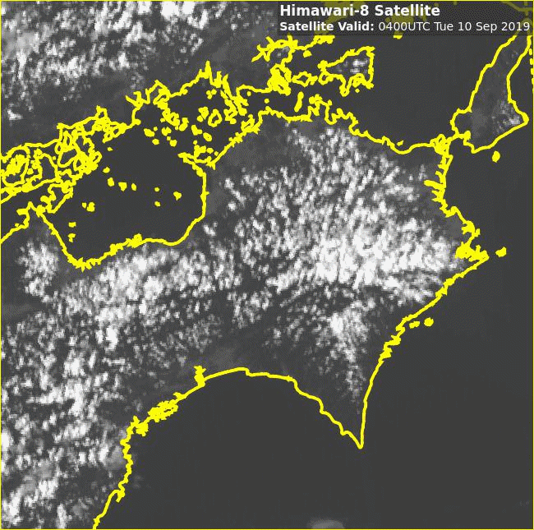
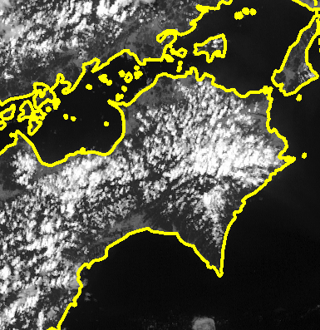
Himawari-8 / GEO-KOMPSAT-2A stereo animation. Shikoku convection, 0400 to 0910UTC 10th September 2019, 10 frames per second rocking animation
Himawari-8 data
(courtesy Japan Meteorological Agency)
GEOKOMPSAT-2A
(data courtesy Korea Meteorological Administration)
Please start the Power Point Slide Show to activate the animation

