Slide 1
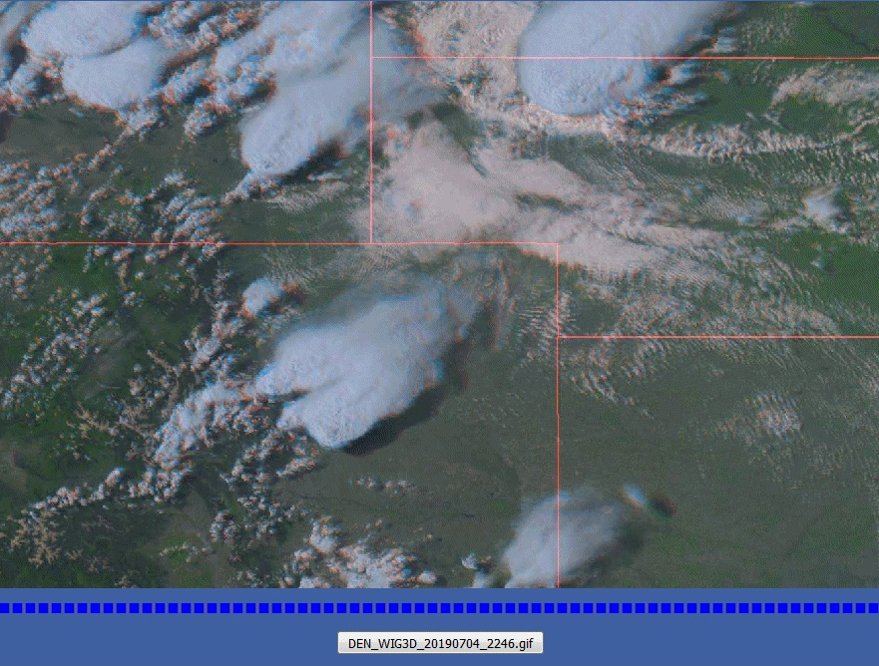
Central USA 2246UTC 4th July – 0121UTC 5th July 2019 Wiggle 3-D image loop
Please start the Power Point Slide Show to activate the animation
Kansas
animation from CONUS imagery presented by Embry-Riddle Aeronautical University

