Slide 1

Mildura dust storm, Victoria, 7th May 2019 Comparing various satellite, observation and NWP data for monitoring the dust.
Assembled by B.Zeschke
BMTC
Australian Vlab Centre of Excellence

Slide 2
The KMA 2019 Dust RGB for thin dust plumes compared to the BOM (VICRO RFC) Dust RGB
 | KMA(2019) | value | gamma
R | IR11.2 – IR10.4 | -1 to 1.6 | 0.7
G | IR10.4 – IR8.6 | 0.2 to 10 | 2.5
B | IR10.4 – IR13.3 | 8 to 16 | 1
Use 11.2 micron band instead of 12.4 micron band to reduce the impact of WV absorption after a GAMMA correction is applied. This serves to:
Show weak signals over maritime regions.
Discriminate weak dust plumes from the surface.
Use IR10.4 – IR13.3 for the Blue beam instead of the IR10.4 micron band. This serves to:
Discriminate between clear and cloudy regions at higher latitude
Discriminate dust from lower level clouds
 | BOM (VICRO RFC) | value | gamma
R | IR12.4 – IR10.4 | -6.7 to 2.6 | 1
G | IR10.4 – IR8.6 | 1 to 11 | 2.5
B | IR10.4 | 261 to 289 | 1

Slide 3
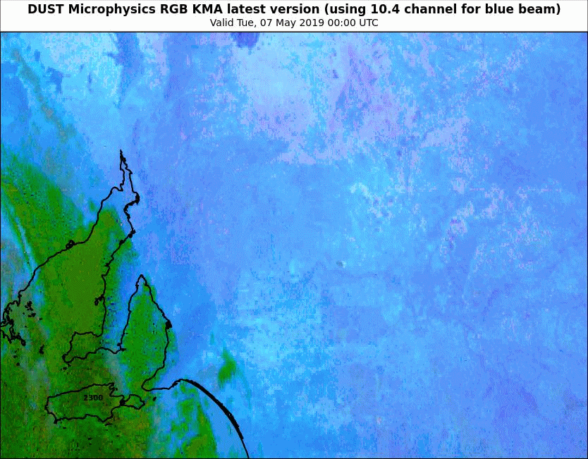
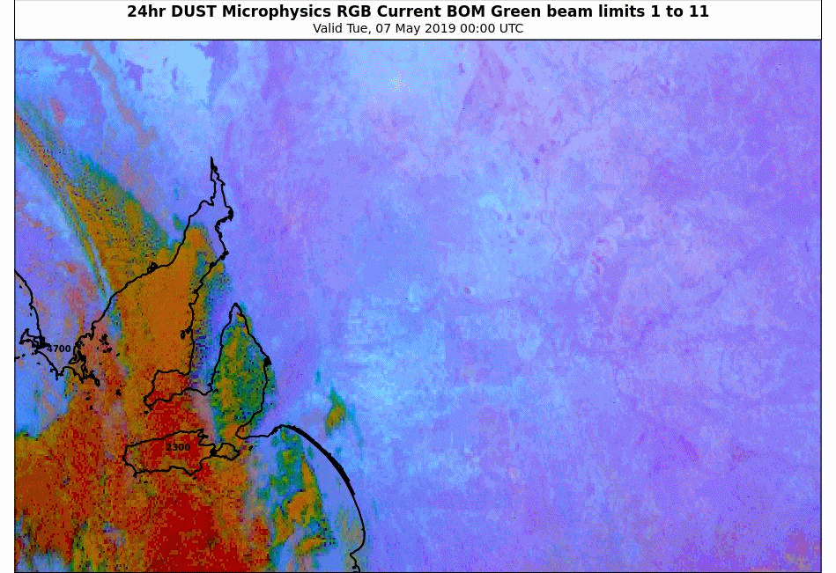
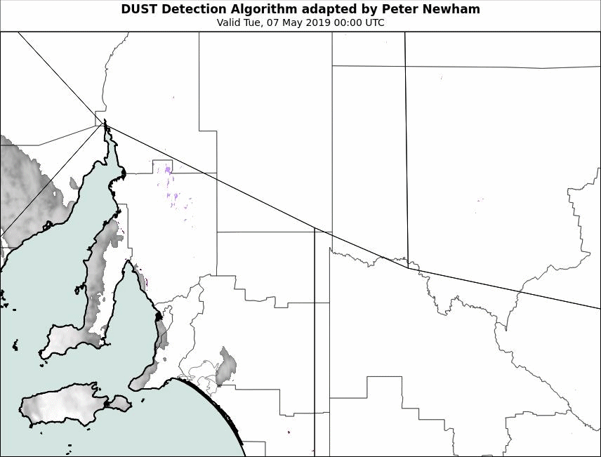
Animation: Comparing various satellite products and surface observations: the Mildura dust episode;
00 to 07 UTC
7th May 2019
(visibility in meters as yellow numbers, cloud base in feet as blue / black numbers)
KMA 2019 Dust RGB
Please start the Power Point Slide Show to activate the animation
animations courtesy JMA/BOM
Adelaide
animation courtesy BOM
BOM Dust RGB
Dust Detection Algorithm (adapted by P. Newham)
Mildura

Slide 4
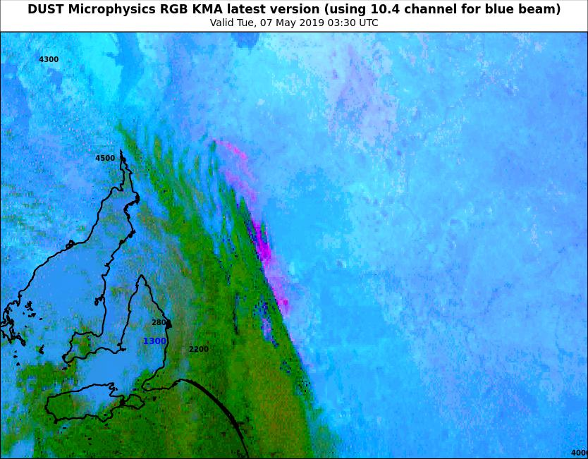
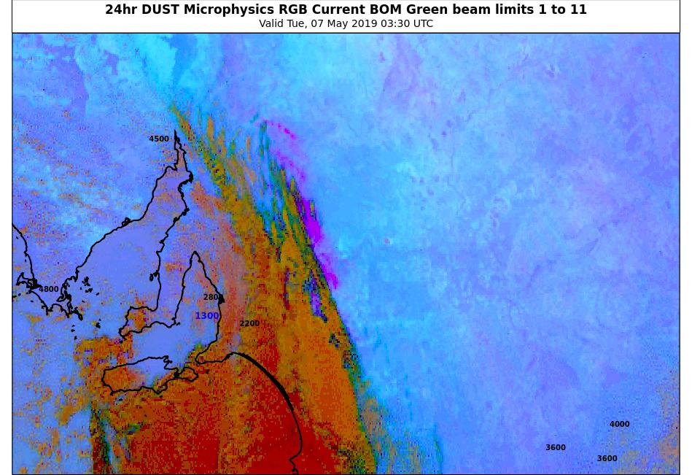
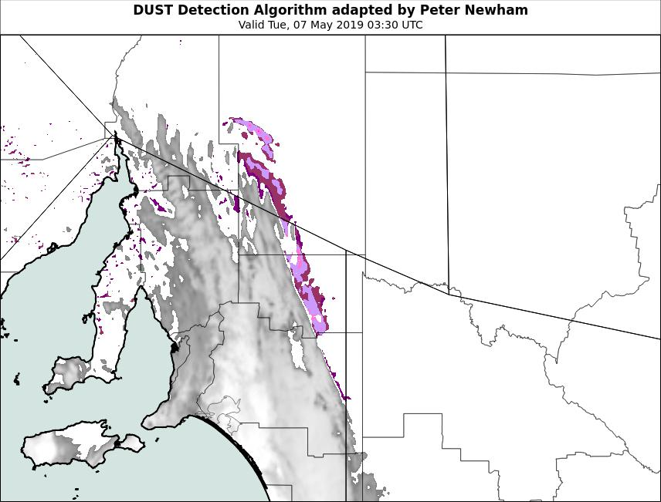
Comparing various satellite products and surface observations: the Mildura dust episode;
0330UTC
7th May 2019
(visibility in meters as yellow numbers, cloud base in feet as blue / black numbers)
KMA 2019 Dust RGB
images courtesy JMA/BOM
Adelaide
image courtesy BOM
BOM Dust RGB
Dust Detection Algorithm (adapted by P. Newham)
Mildura

Slide 5
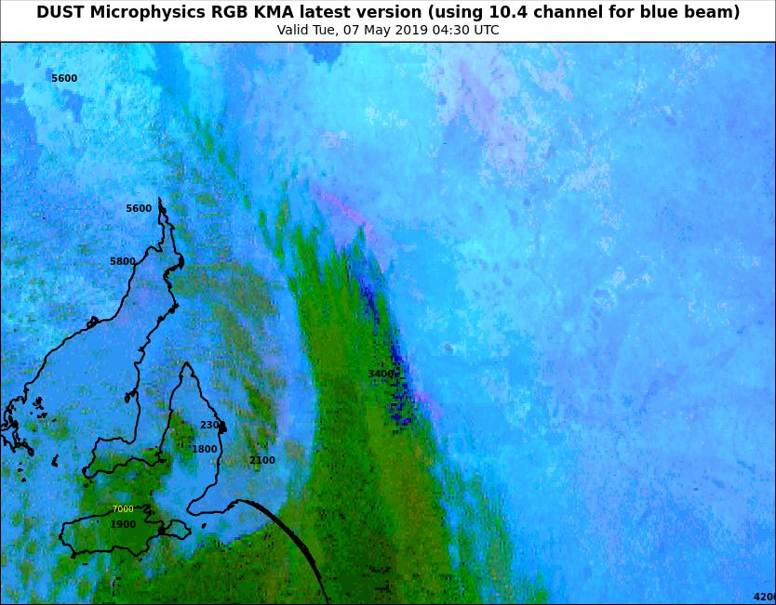
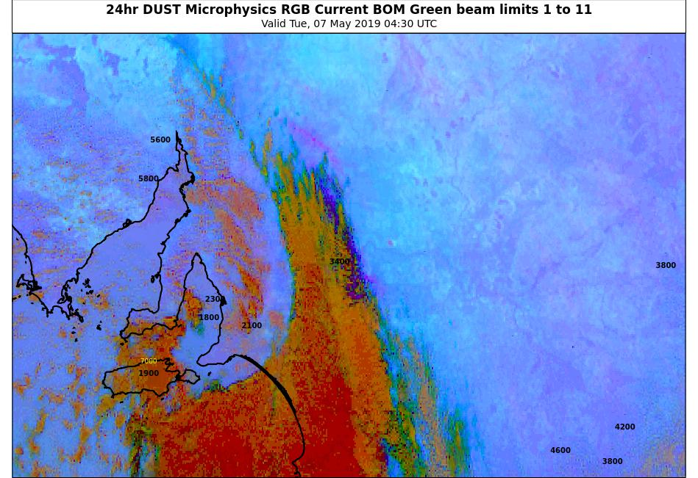
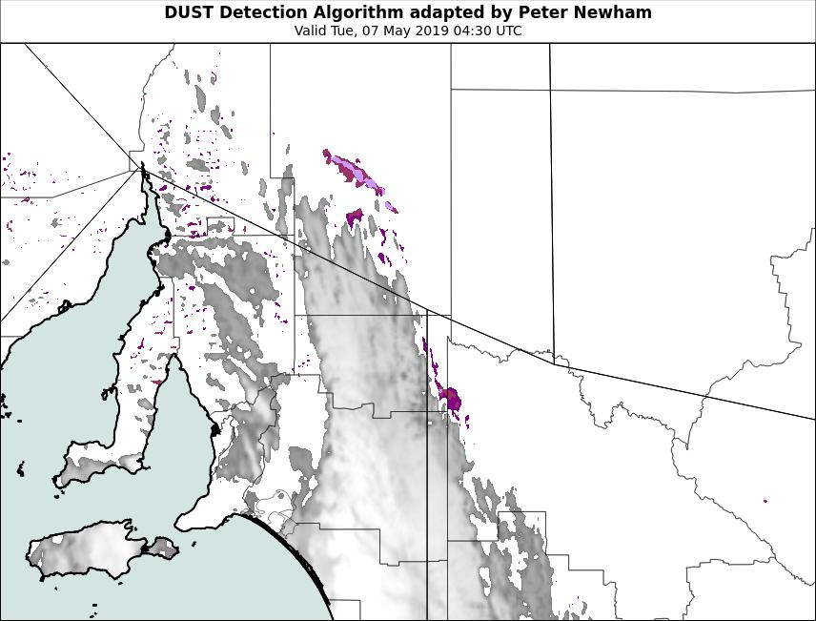
Comparing various satellite products and surface observations: the Mildura dust episode;
0430UTC
7th May 2019
(visibility in meters as yellow numbers, cloud base in feet as blue / black numbers)
KMA 2019 Dust RGB
images courtesy JMA/BOM
Adelaide
image courtesy BOM
BOM Dust RGB
Dust Detection Algorithm (adapted by P. Newham)
Mildura

Slide 6
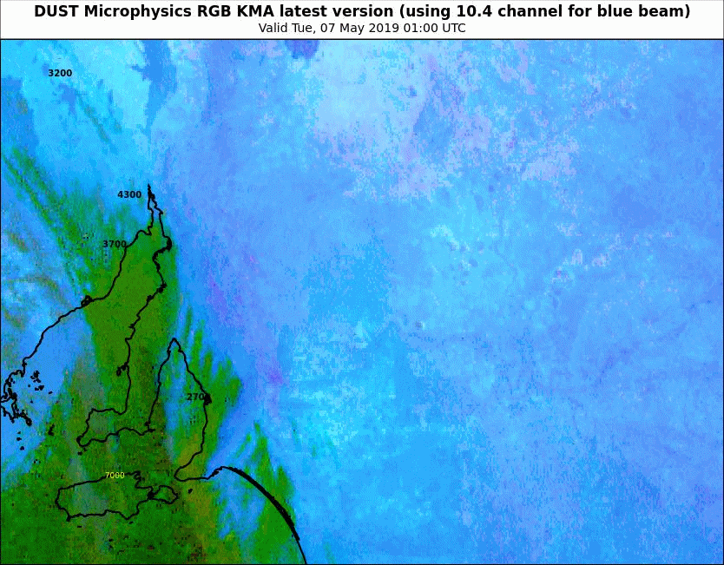
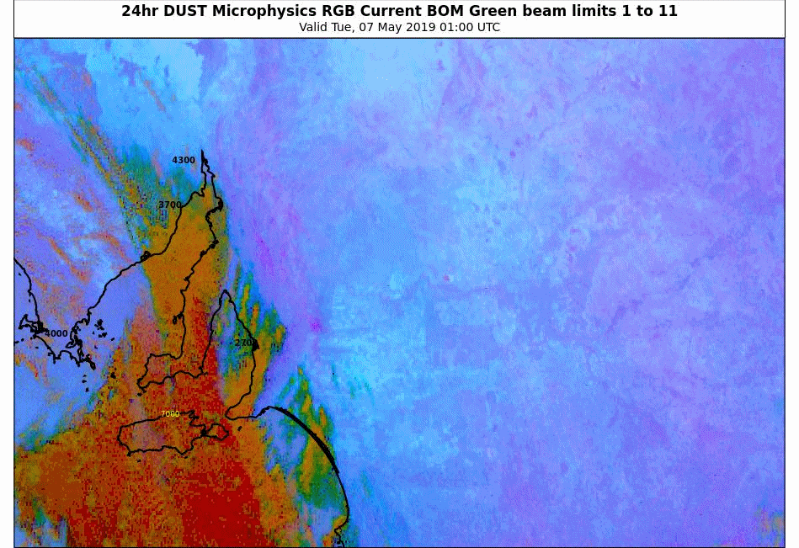
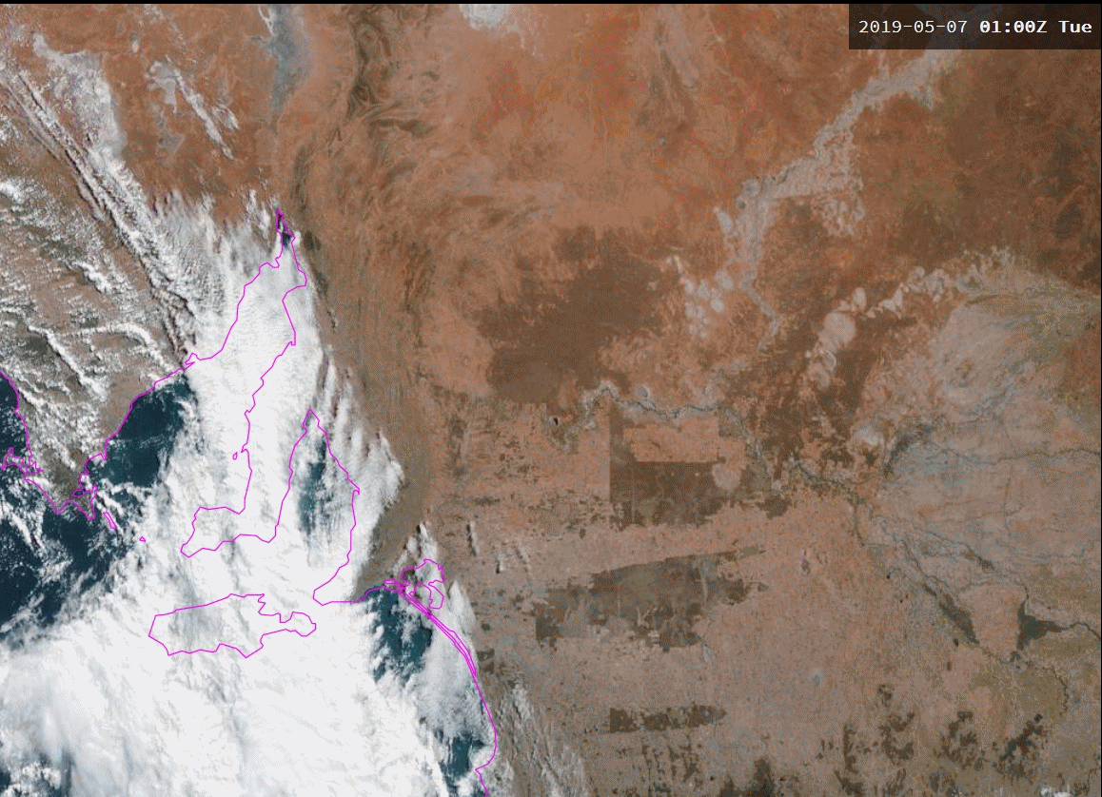
KMA 2019 Dust RGB
Please start the Power Point Slide Show to activate the animation
animations courtesy JMA/BOM
Animation: Comparing various satellite products and surface observations: the Mildura dust episode;
01 to 07 UTC
7th May 2019
(visibility in meters as yellow numbers, cloud base in feet as blue / black numbers)
Adelaide
animations courtesy JMA/BOM
BOM Dust RGB
True Colour RGB, Rayleigh Corrected
Mildura

Slide 7
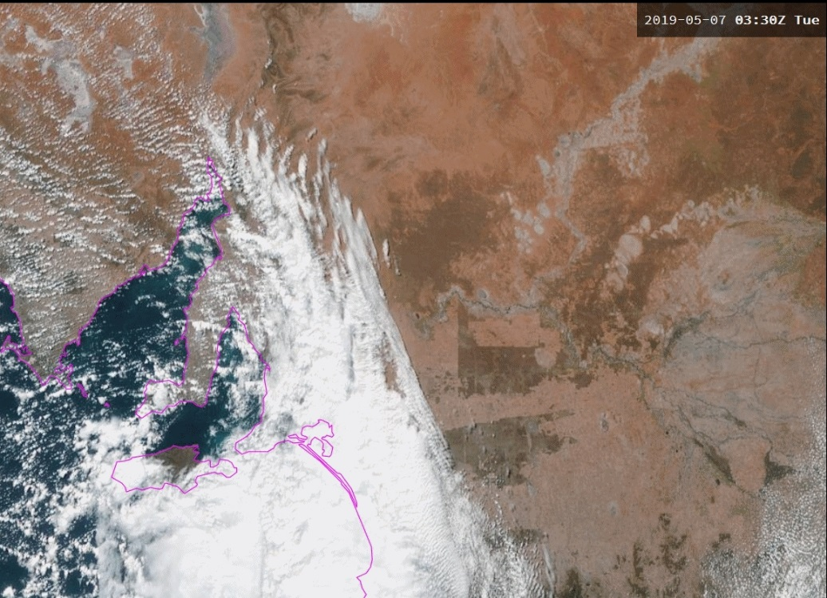
Comparing various satellite products and surface observations: the Mildura dust episode;
0330UTC
7th May 2019
(visibility in meters as yellow numbers, cloud base in feet as blue / black numbers)
KMA 2019 Dust RGB
images courtesy JMA/BOM
Adelaide
BOM Dust RGB
True Colour RGB, Rayleigh Corrected
Mildura

Slide 8
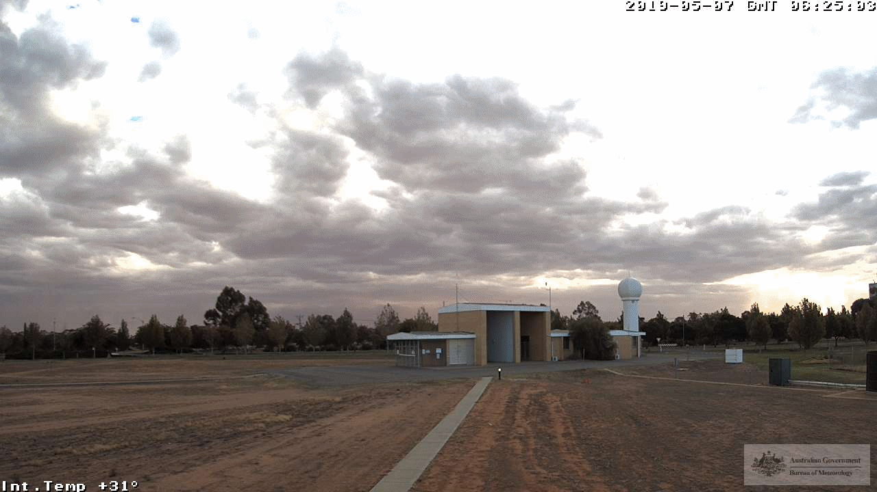
Mildura Webcam, minute interval data
0625UTC to 0704UTC 7th May 2019
animation courtesy BOM

Slide 9
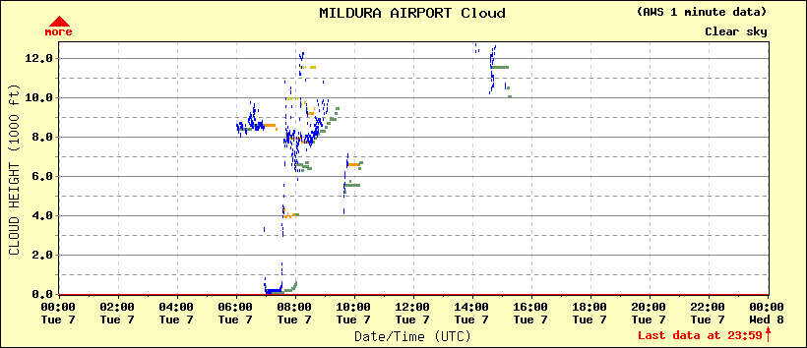
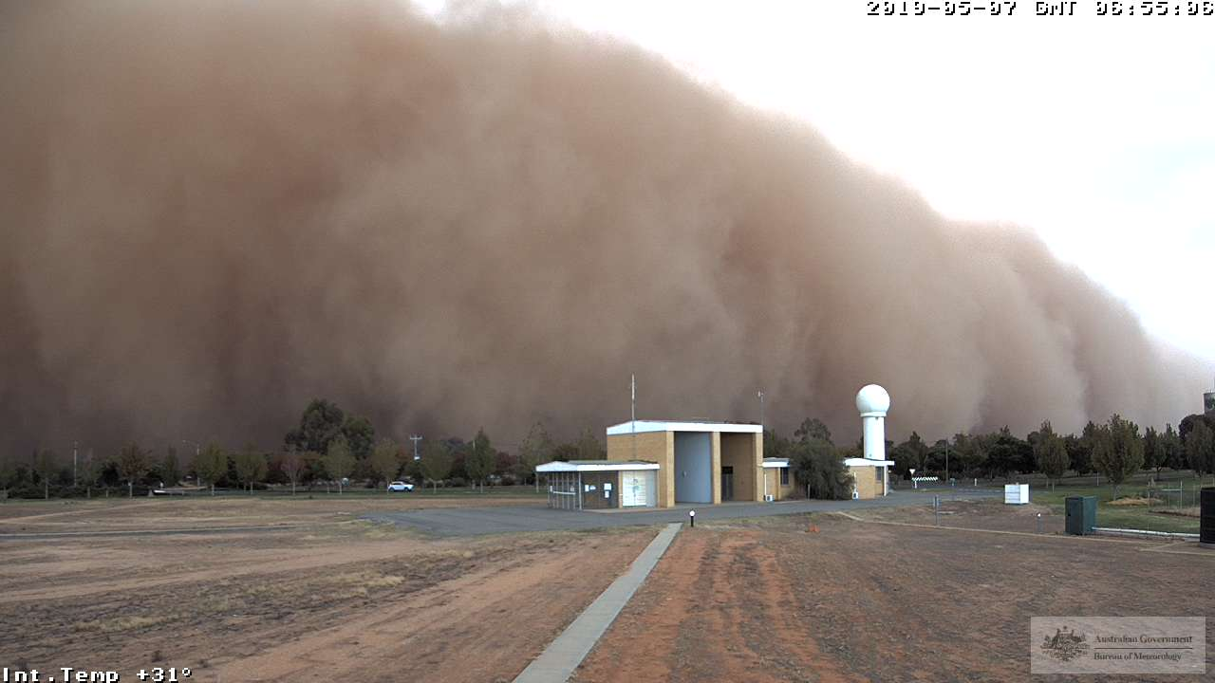
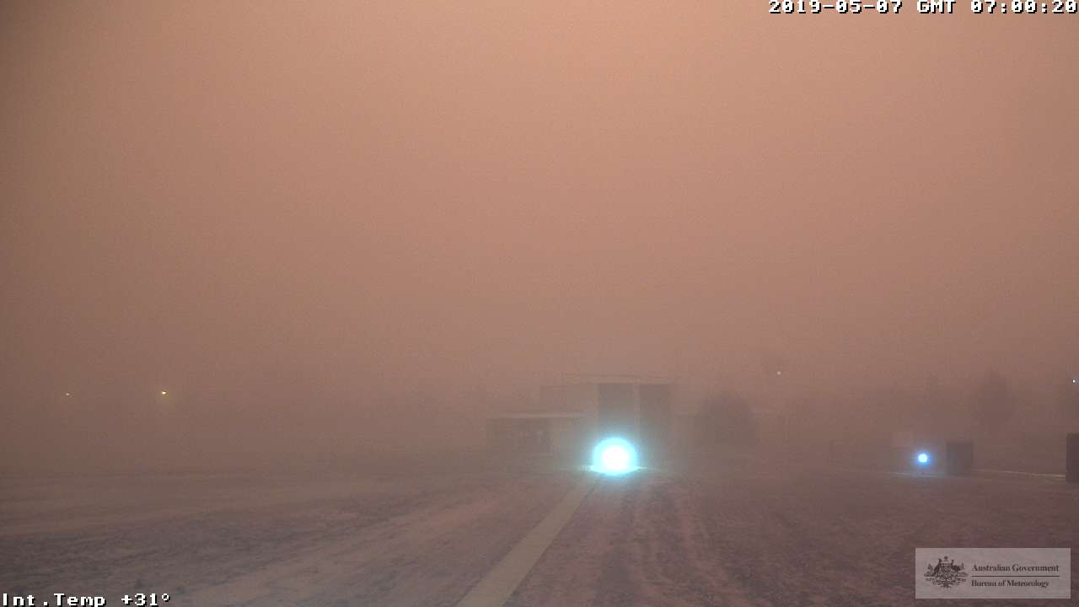
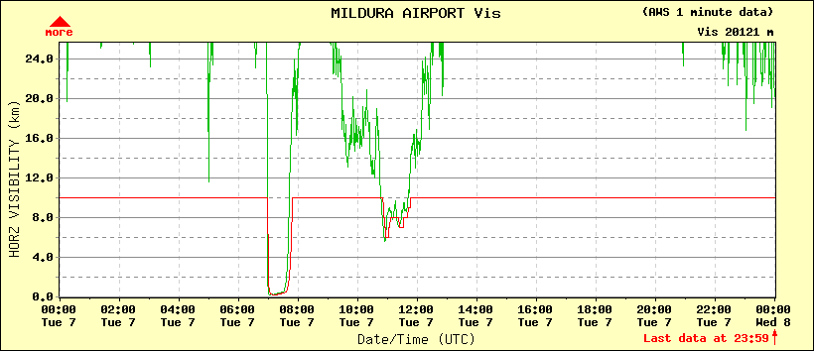
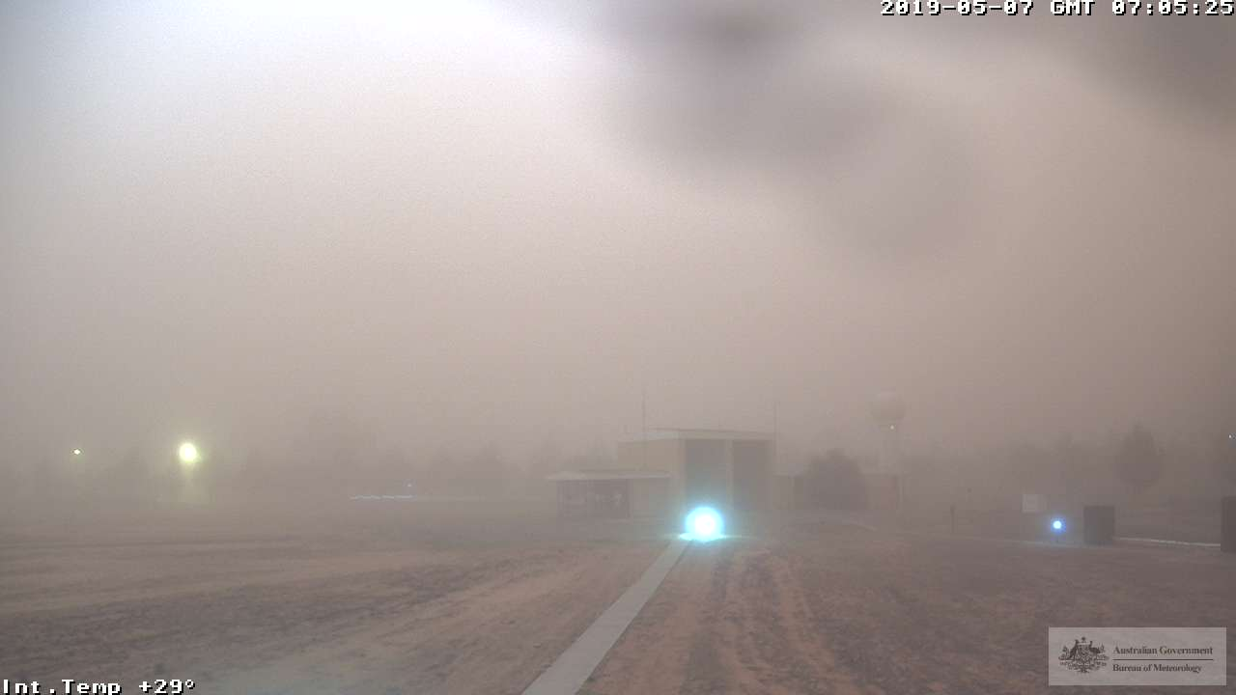
Mildura Webcam, ceilometer and vismeter data compared to webcam images
0655-0705UTC
0655UTC
0700UTC
0655-0705UTC
0705UTC
images courtesy BOM

Slide 10
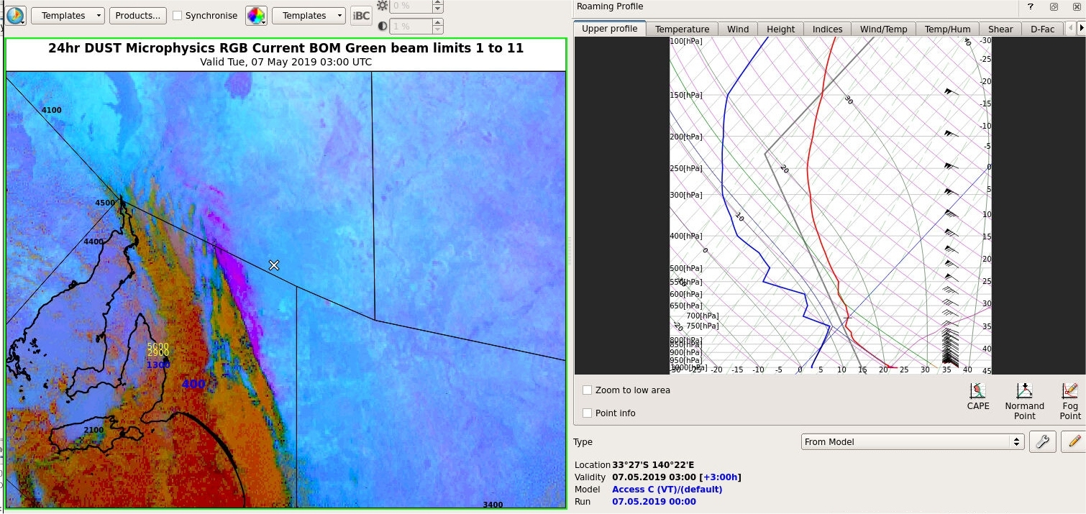
ACCESS-C model sounding data ahead of the dust storm
image courtesy BOM

Slide 11
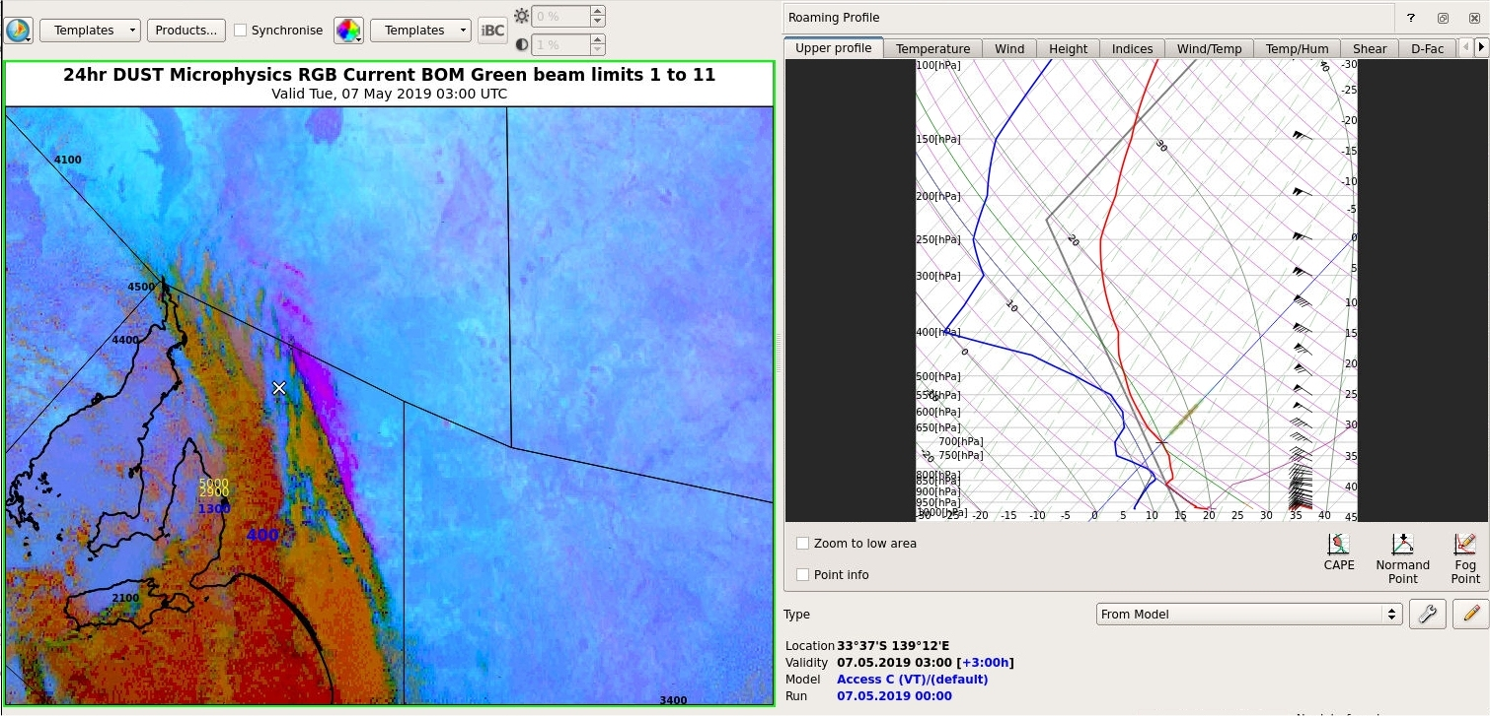
ACCESS-C model sounding data behind the dust storm
image courtesy BOM

Slide 12
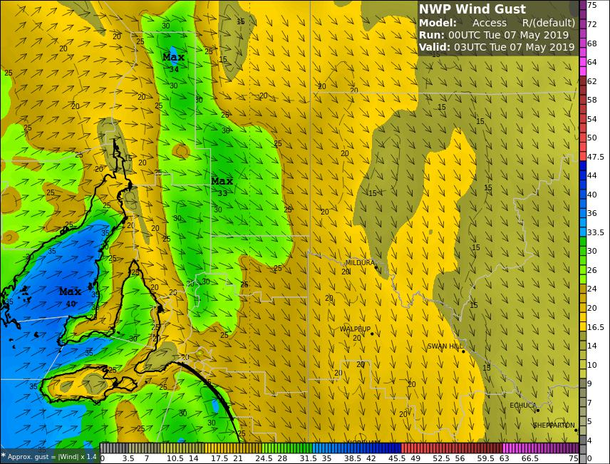
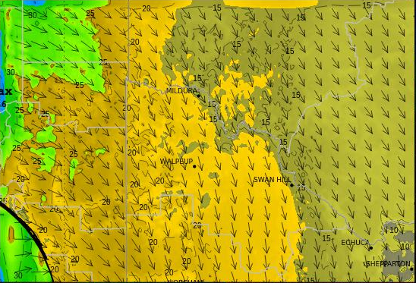
ACCESS-R and ACCESS-C Wind Gusts
(03UTC 7th May 2019)
image courtesy BOM

Slide 13
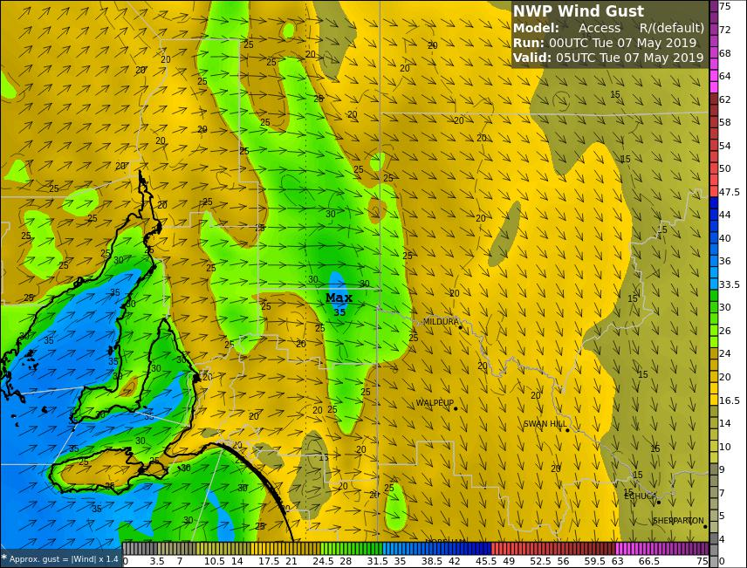
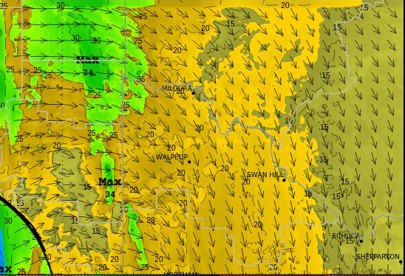
ACCESS-R and ACCESS-C Wind Gusts
(05UTC 7th May 2019)
image courtesy BOM

Slide 14
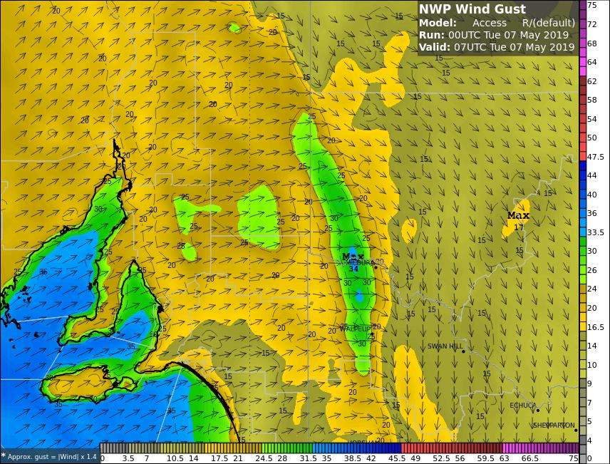
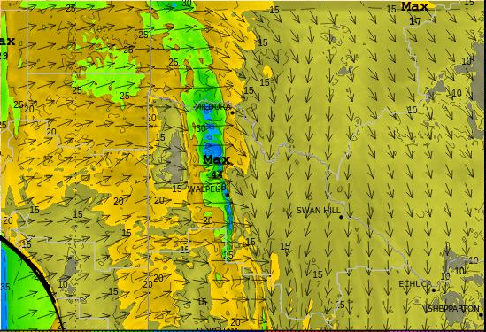
ACCESS-R and ACCESS-C Wind Gusts
(07UTC 7th May 2019) – at the time of the dust passage through Mildura
image courtesy BOM

Slide 15
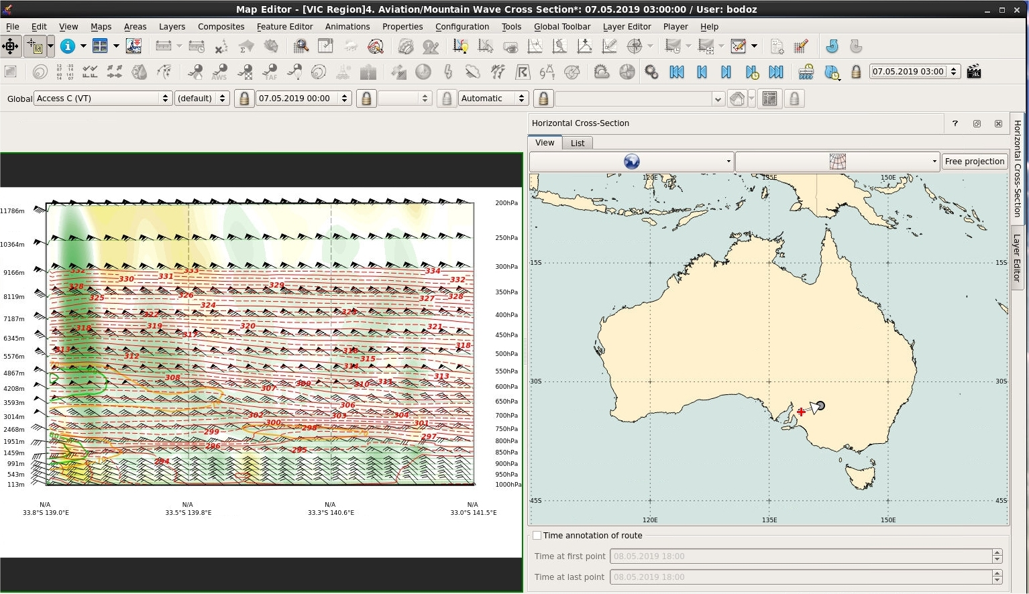
ACCESS-C Cross Section (03UTC 7th May 2019)
image courtesy BOM

Slide 16
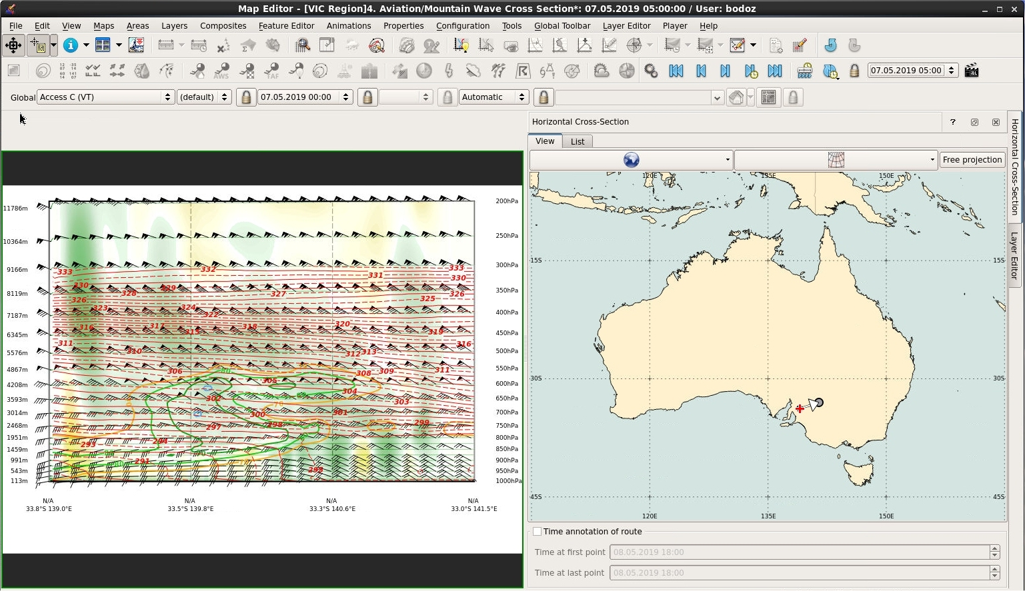
ACCESS-C Cross Section (05UTC 7th May 2019)
image courtesy BOM

Slide 17
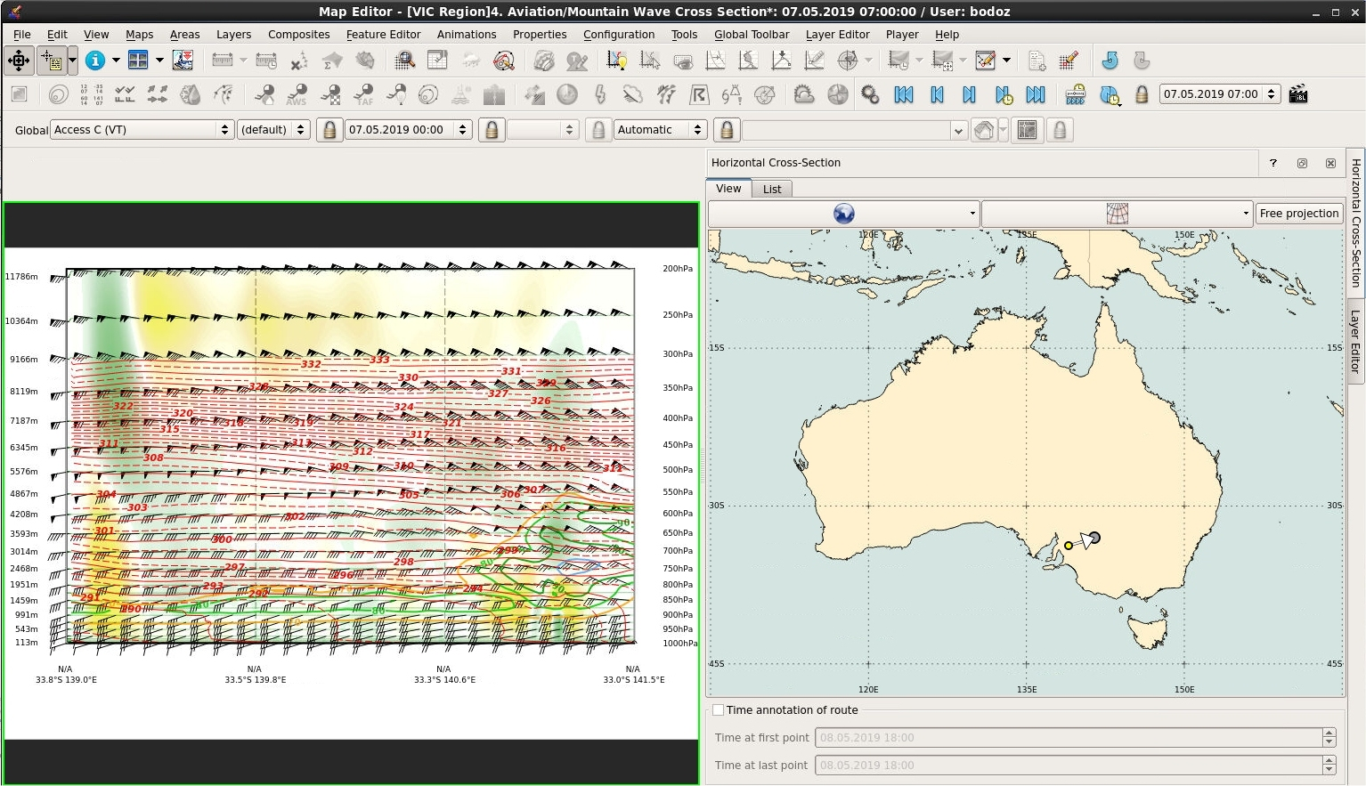
ACCESS-C Cross Section
(07UTC 7th May 2019) – at the time of the dust passage through Mildura
image courtesy BOM

