Slide 1
Nullarbor dust event, South Australia Comparing various products for monitoring dust.
18th May 2019
Assembled by B.Zeschke
BMTC
Australian Vlab Centre of Excellence

Slide 2
The KMA 2019 Dust RGB for thin dust plumes compared to the BOM (VICRO RFC) Dust RGB
 | KMA(2019) | value | gamma
R | IR11.2 – IR10.4 | -1 to 1.6 | 0.7
G | IR10.4 – IR8.6 | 0.2 to 10 | 2.5
B | IR10.4 – IR13.3 | 8 to 16 | 1
Use 11.2 micron band instead of 12.4 micron band to reduce the impact of WV absorption after a GAMMA correction is applied. This serves to:
Show weak signals over maritime regions.
Discriminate weak dust plumes from the surface.
Use IR10.4 – IR13.3 for the Blue beam instead of the IR10.4 micron band. This serves to:
Discriminate between clear and cloudy regions at higher latitude
Discriminate dust from lower level clouds
 | BOM (VICRO RFC) | value | gamma
R | IR12.4 – IR10.4 | -6.7 to 2.6 | 1
G | IR10.4 – IR8.6 | 1 to 11 | 2.5
B | IR10.4 | 261 to 289 | 1

Slide 3
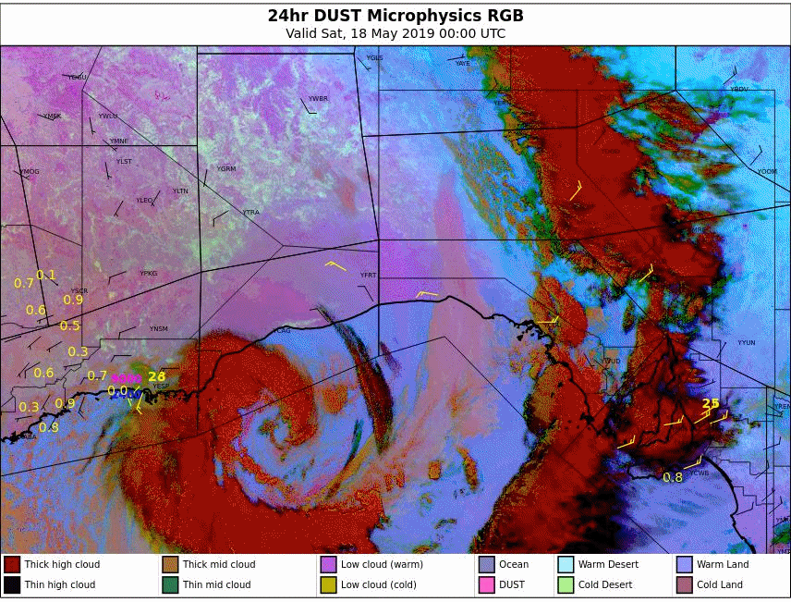
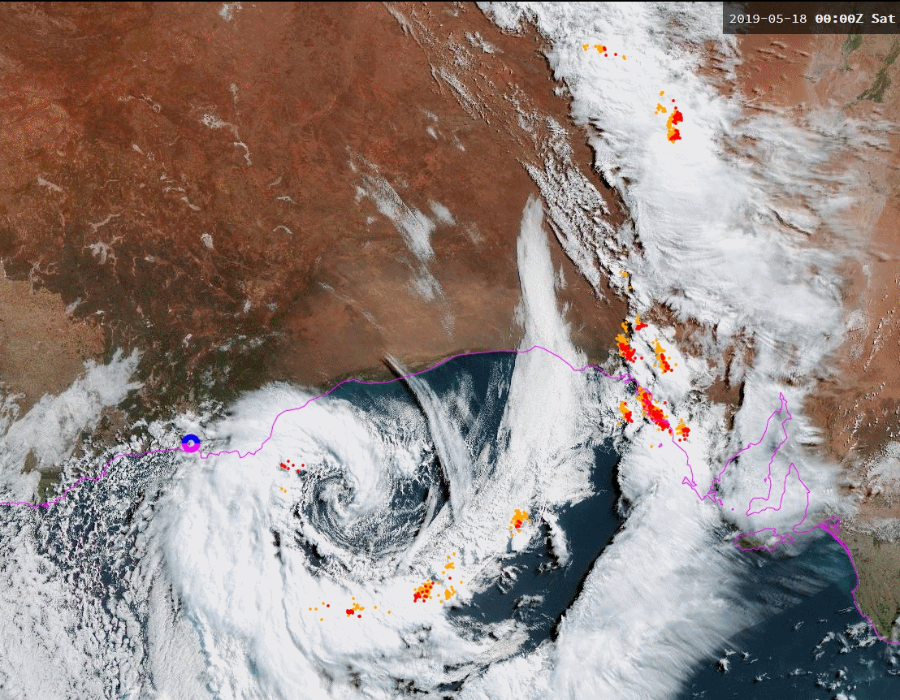
Animation: Comparing various satellite products and surface observations: the Nullarbor Dust episode; 00 to 12UTC 18th May 2019
KMA 2019 Dust RGB
Please start the Power Point Slide Show to activate the animation
Adelaide
animations courtesy JMA/BOM
BOM Dust RGB
True Colour RGB, Rayleigh Corrected

Slide 4
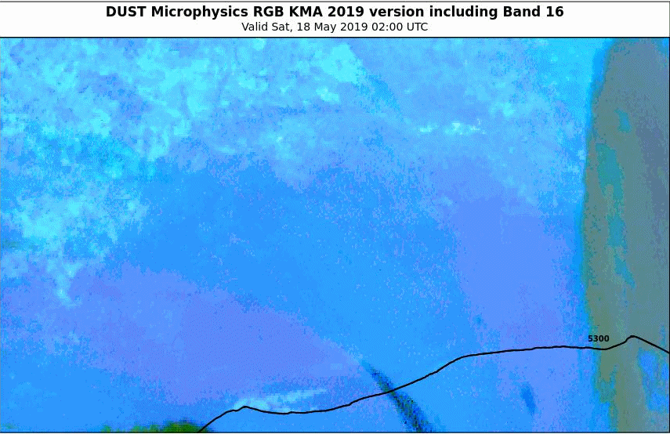
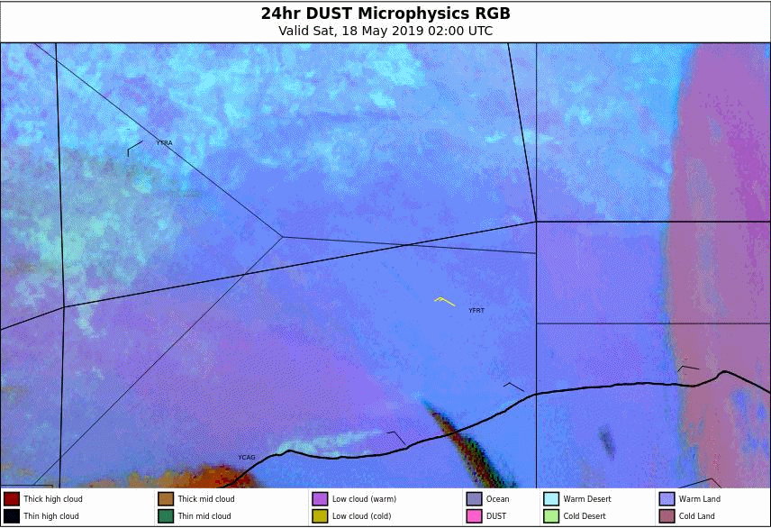
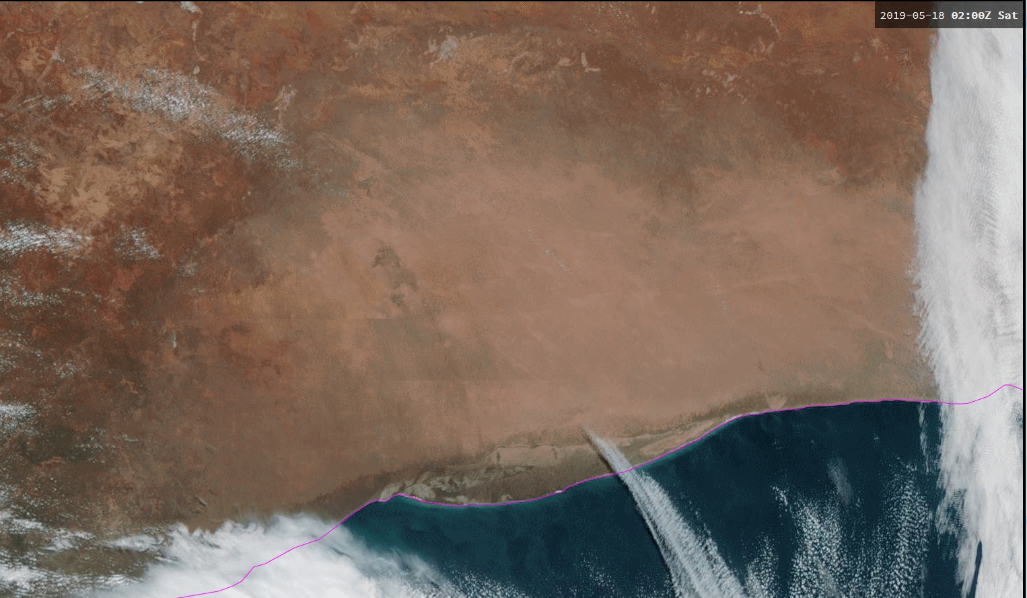
Animation: Comparing various satellite products and surface observations, detailed domain: the Nullarbor Dust episode; 02 to 05UTC 18th May 2019
Please start the Power Point Slide Show to activate the animation
KMA 2019 Dust RGB
animations courtesy JMA/BOM
Eucla
BOM Dust RGB
True Colour RGB, Rayleigh Corrected

Slide 5
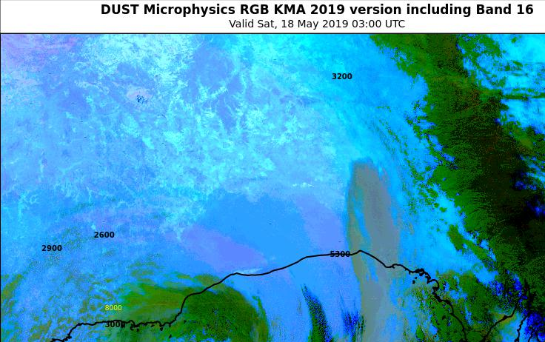
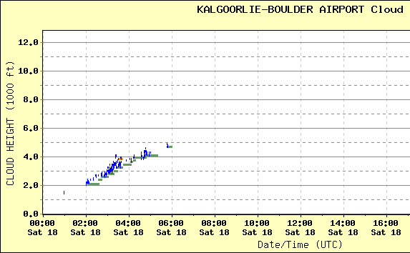
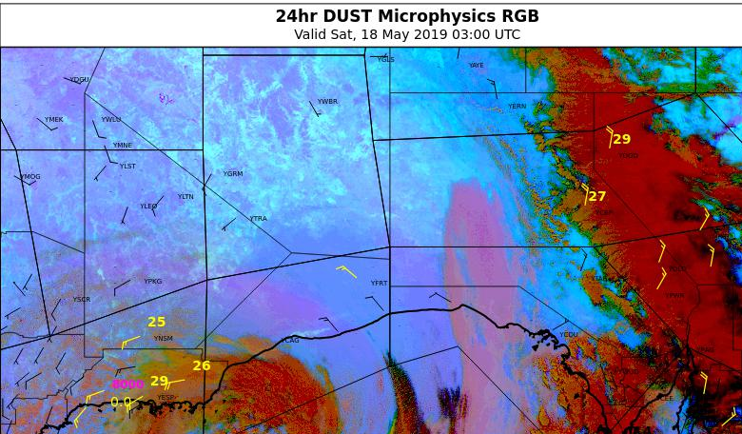
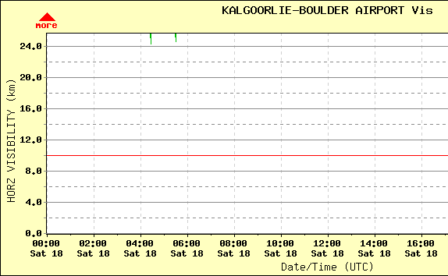
Ceilometer and Vismeter at Kalgoorlie Boulder
satellite images courtesy JMA/BOM
images courtesy BOM

Slide 6
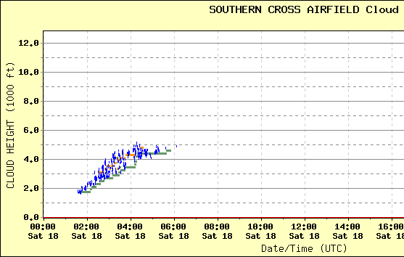
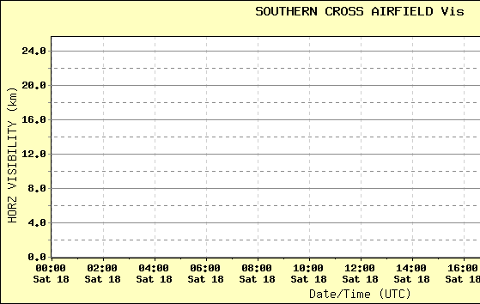
Ceilometer and Vismeter at Southern Cross
satellite images courtesy JMA/BOM
images courtesy BOM

Slide 7
Sounding inland from Eucla (E) 03UTC 18th May 2019
satellite image courtesy JMA/BOM
E
images courtesy BOM

Slide 8
Sounding near Nullarbor Roadhouse (N) 03UTC 18th May 2019
satellite image courtesy JMA/BOM
N
images courtesy BOM
Notes:
http://aifs-wa.bom.gov.au/cgi-bin/cmcgi/webdir.showtext.pl?d=/archive/aviation/2019/05/&f=aviation.20190518.txt.gz

