Slide 1
Validation of NWP model results using WV images in KMA
2019 BMTC Graduate Diploma of Meteorology
PARK, Hye Sook
Senior Researcher
Satellite Analysis Division
NMSC/KMA

Slide 2
1. Application of satellite Data to NWP model
2. Validation of NWP model results using WV images

Slide 3
Application of Satellite data to NWP

Slide 4
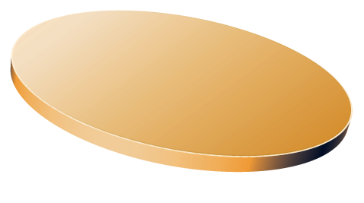
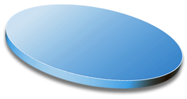
The main factors for the weather forecasting
Socrative Question 1:
Among three factors in the left diagram, which one is the list in important order for the weather forecasting?
NWP > Observation > Forecasters
Observation > NWP > Forecasters
Forecasters > NWP > Observation
NWP > Forecasters > Observation
NWP
Observation
Forecasters

Slide 5
The main factors for the weather forecasting
NWP > Observation > Forecasters
Performance of NWP
40%
28%
Forecasters
Observation data
32%

Slide 6
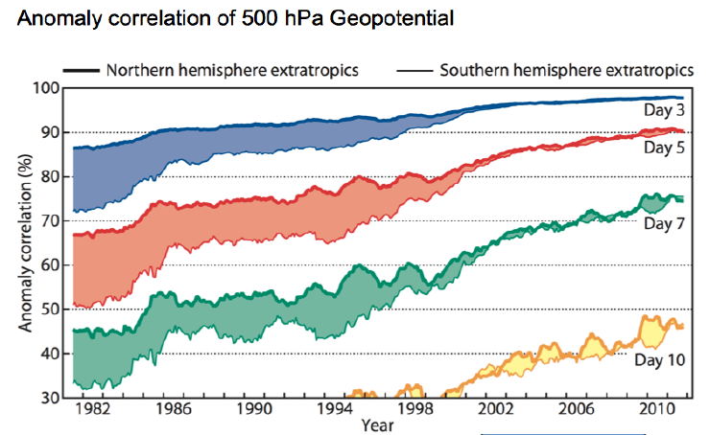
Importance of satellite data to the NWP models
- As data from NOAA-15 polar orbiting satellite (launch, 1998) assimilated to the NWP model, and assimilation method changed to 4D-Var from 3D-Var,
➔ Accuracy of NWP model had increased in the early 2000’s, especially for the Southern Hemisphere

Slide 7
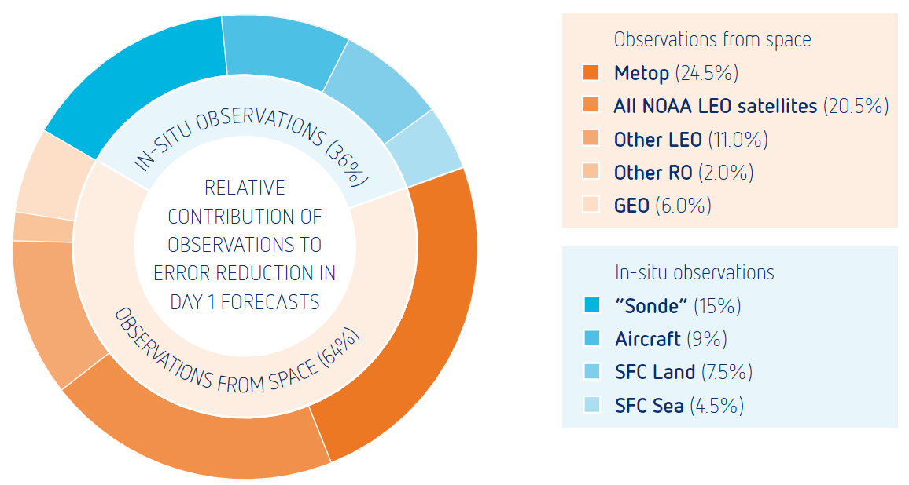
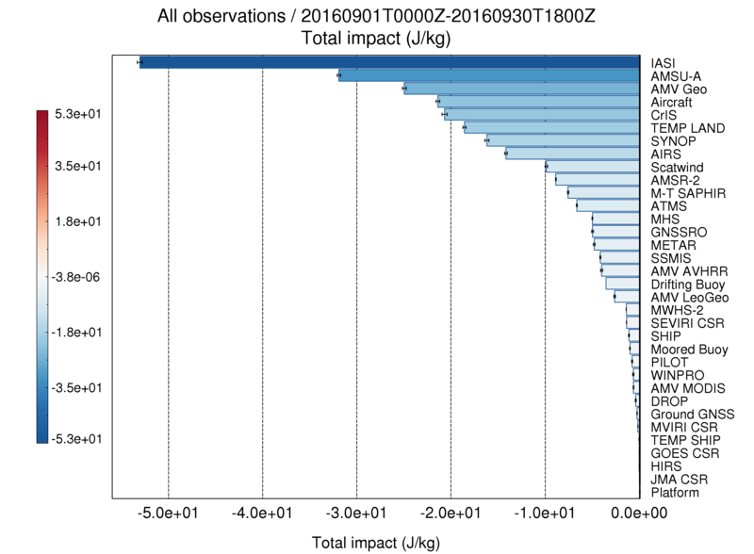
Importance of satellite data to the NWP models
Ref : GODEX Met Office(2016) ‘Forecast Sensitivity Observation Impact’
Ref : EUMETSAT(2014) ‘The case for EPS/METOP
Second-generation : cost benefit analysis’
Relative Contribution of Satellite data to Error reduction in NWP
(1day forecasts) increases : 64%(2014) ➔ 75%(2016)
Other ground based observations : total 36%

Slide 8
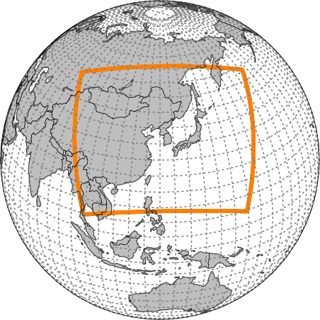
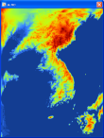
KMA’s NWP System (2019)
KMA’s operational models are based on Unified Model from UKMO.
Global
Resolution
N1280L70(UM)
(~10km / top = 80km)
Target Length
288hrs (00/12UTC)
87hrs (06/18UTC)
Initialization : Hybrid Ensemble 4DVAR
Local
Resolution
1.5~4km L70(UM)
(1188×1148 / top=39km)
Target Length : 36hrs
Initialization : 3DVAR
Local EPS
Resolution
3km L70(UM)
(460×482 / top = 39km)
Target Length : 72hrs
Members : 12
Global EPS
Resolution
N400L70(UM)
(~32km/ top = 80km)
Target Length : 288hrs
Members : 49
Regional (stop in 2019)
Resolution
12kmL70(UM)
(0.11°x0.11° / top=80km)
Target Length : 87hrs (6 hourly)
Initialization : 4DVAR
UM: Unified Model by Met-Office
EPS: Ensemble Prediction system

Slide 9
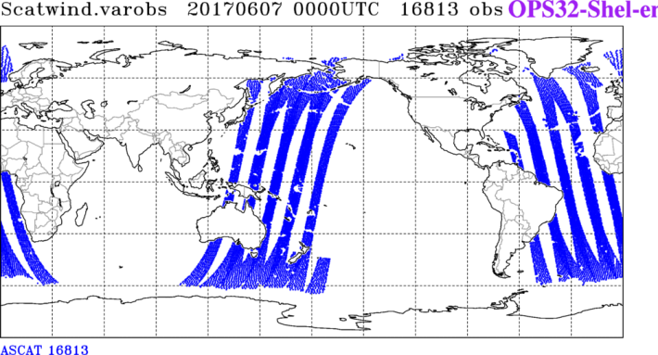
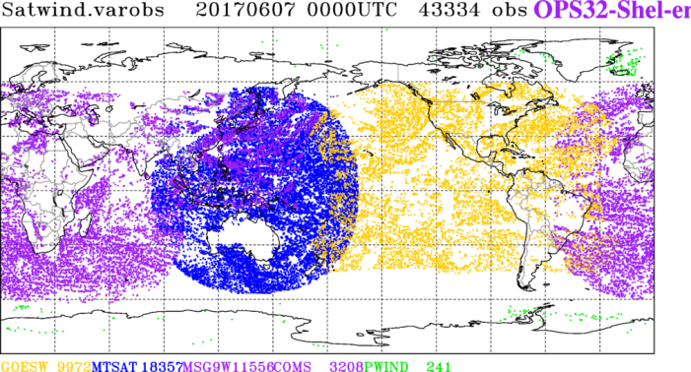
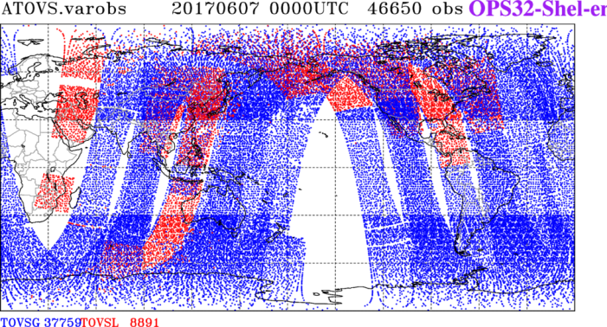
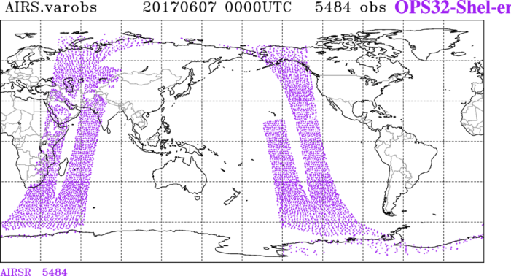
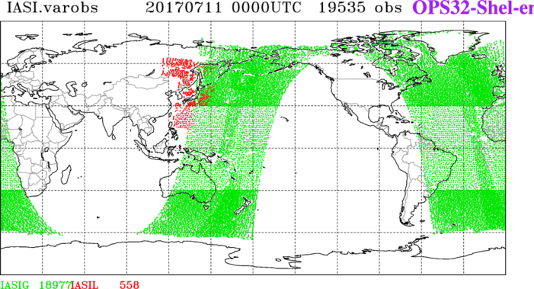
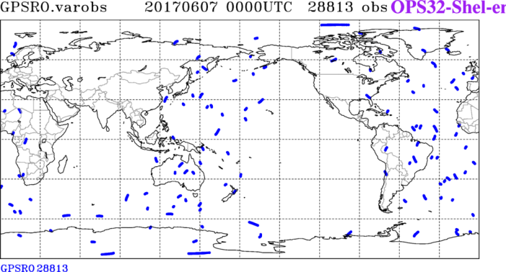
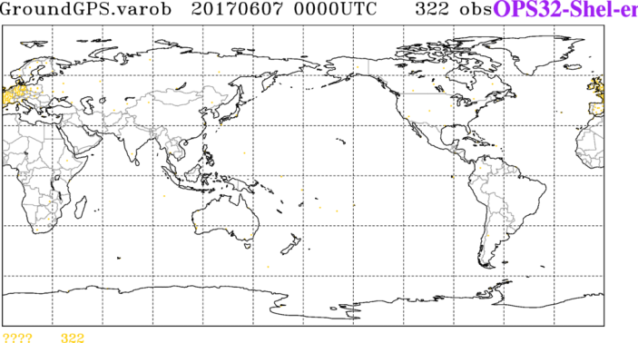
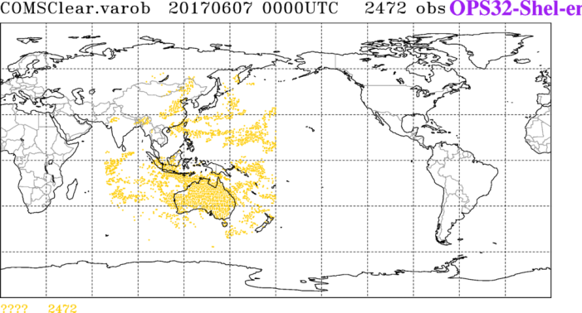
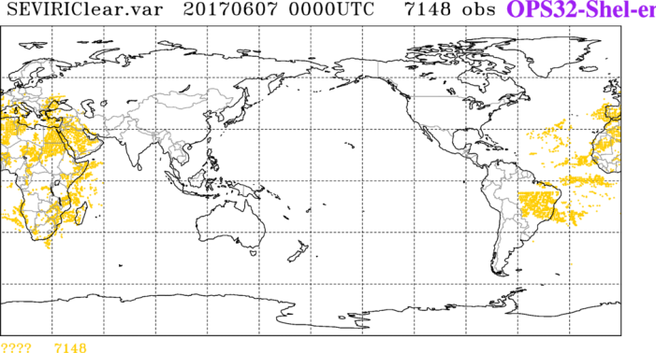
Satellite data used in Unified Model(UM)
[ KMA UM ]

Slide 10
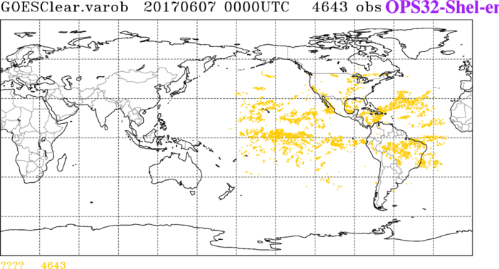
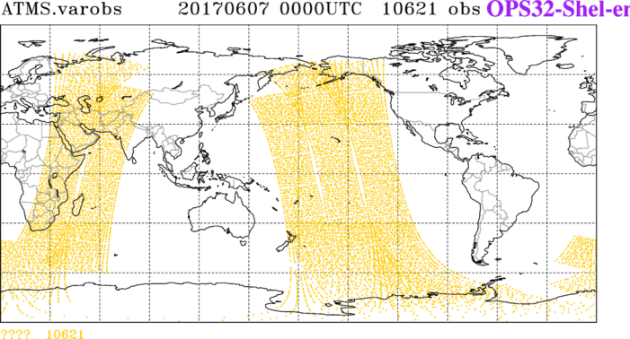
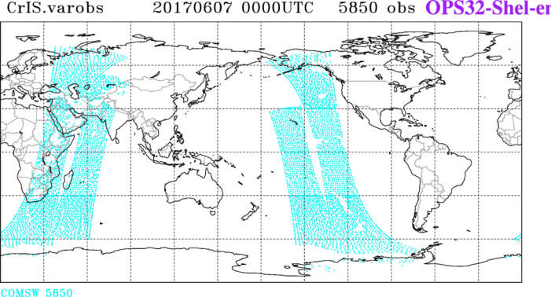
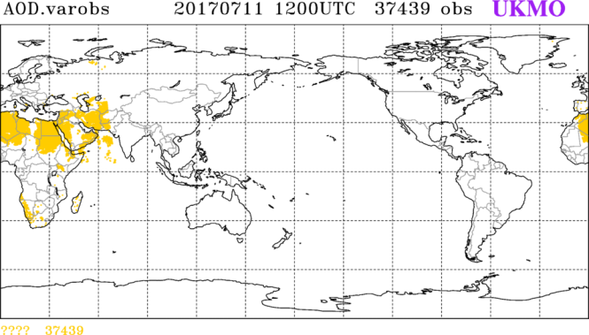
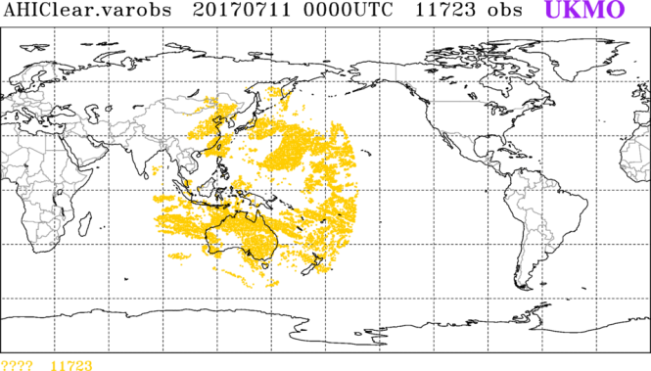
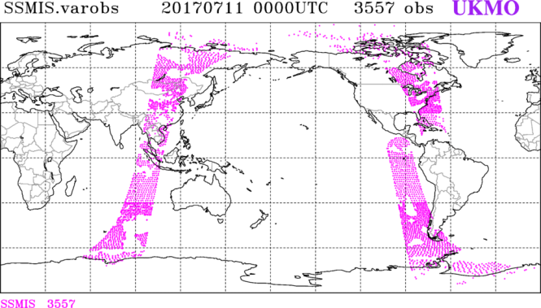
Satellite data used in UM
MW
+
[ UKMO UM ]
MWHS-2
MT-Saphir
AMSR-2
UKMO : United Kingdom Met-Office

Slide 11
Satellite data used in NWP(2017.10)
Observation type Satellites NWP models*
AMSU/MHS radiances 3 NOAA + Metop-A/B G, R
HIRS clear radiances 3 NOAA + Metop-A/B G, R
AIRS clear radiances Aqua G, R
IASI clear radiances Metop-A/B G, R
ATMS & CrIS radiances S-NPP G
MTSAPHIR Megha-Tropiques G
AMSR2 GCOMS-W G
MWHS FY-3A G
Geo CSRs COMS, Himawari-8, GOES-15, Meteosat-8 G
AMVs-geo COMS, Himawari-8 G, R
GOES-15, Meteosat-8/11 G
AMVs-polar Aqua, Terra, NOAA, Metop-A/B G, R
AMVs-LeoGeo G
ASCAT sea-surface winds Metop-A/B G, R, L
GNSS-RO bending angles 6 COSMIC, Metop-A/B G, R
TANDEM-X, TerraSAR-X, GRACE-A
G-GTS ZTDs G
SSTs OSTIA G
ASCAT soil moisture Metop-A/B G
Snow cover NOAA IMS G
SSMI/S sea ice DMSP G
*G=Global, R=Regional, L=Local area model

Slide 12
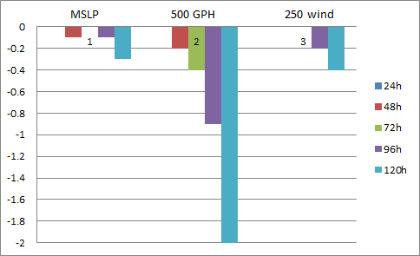
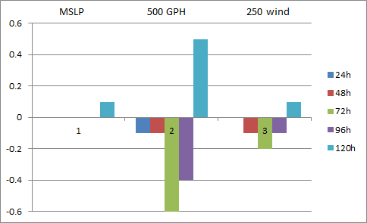
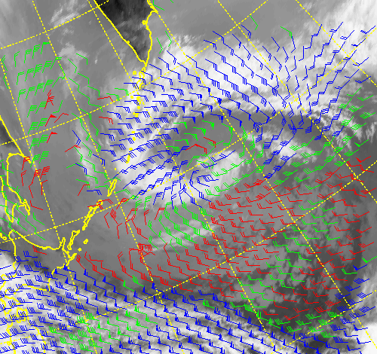
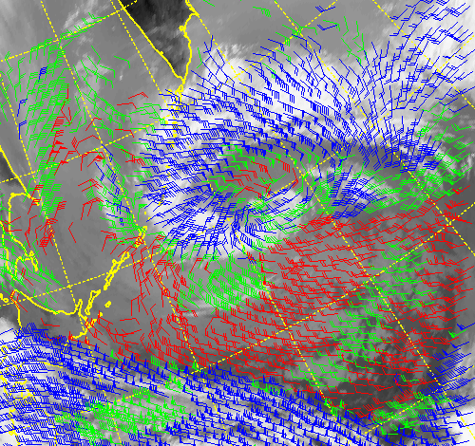
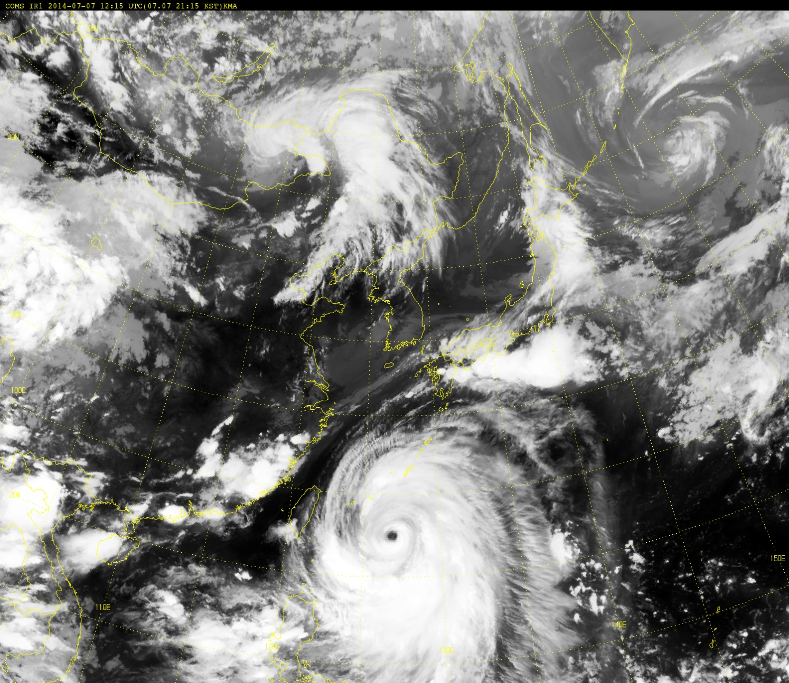
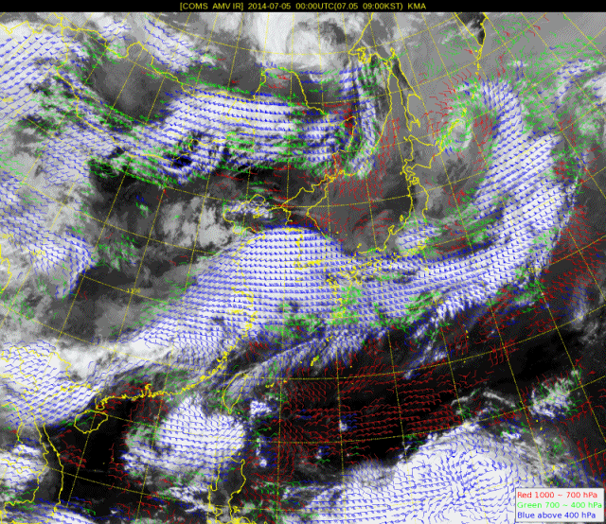
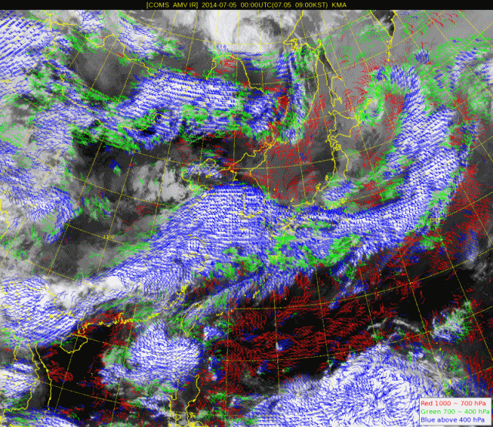
Assimilation of COMS data – Atmospheric Motion Vector(AMV)
Assimilated in KMA global system since Dec. in 2011.
Improve qualities of COMS AMV :
- Target size : 24x24 (AMV24)
➔ 16x16 (AMV16)
Positive impacts, RMS error reduction
for MSLP, GPH, and wind
-Impact is larger for longer forecast time
Impacts on Global Model
Positive
Negative
Positive
NH
SH
AMV24
AMV16
AMV24
AMV16

Slide 13
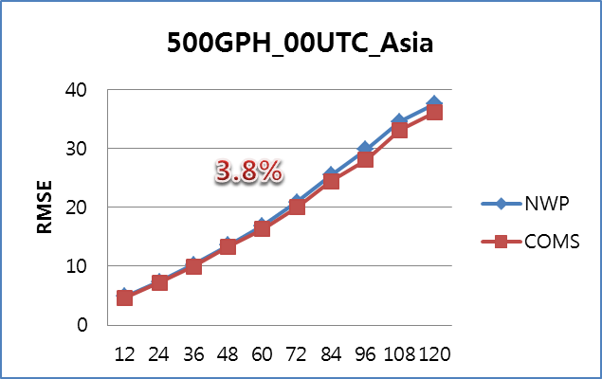
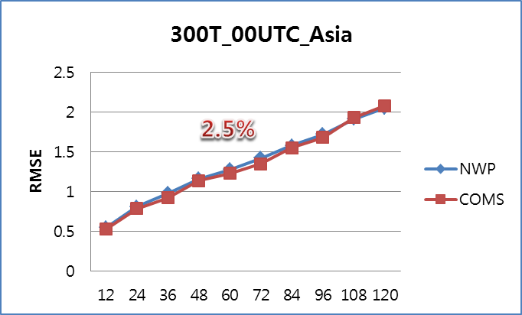
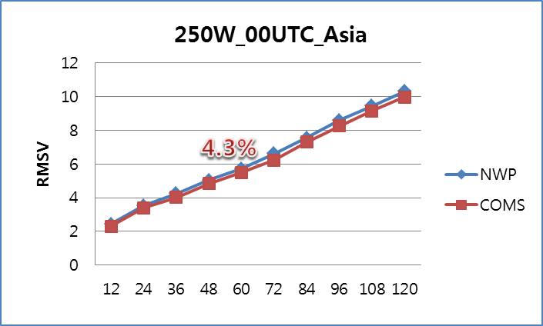
Assimilation of COMS data – Clear Sky Radiance(CSR)
Assimilated in KMA global system since Jun. in 2013.
CSR: mean BT of clear pixels in 7x7 pixel (use only 100% clear, WV)
Positive impact on East Asia
<December in 2012>
CSR algorithm Update (2018.3)
- Resolution : 7X7 pixel (28km) → 1 pixel (4km)
- Refined cloud detection for WV CSR
➔ produce WV CSR over the low-level clouds which do not affect the radiance
WV CSR (OLD)
WV CSR (NEW)

Slide 14
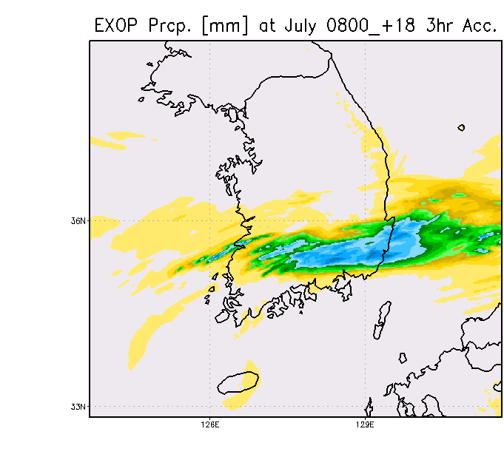
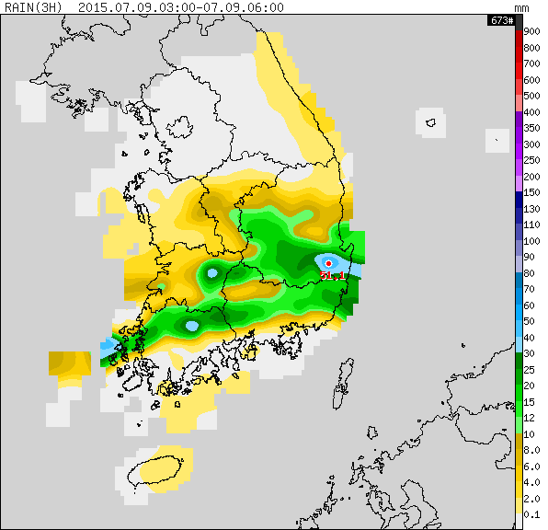
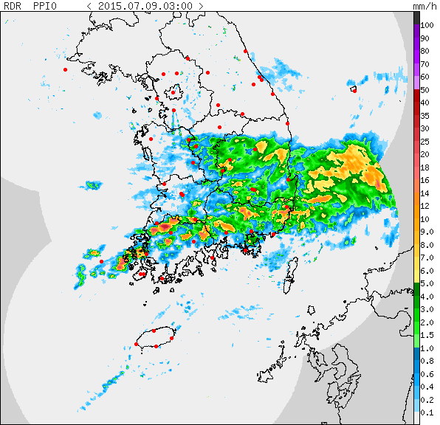
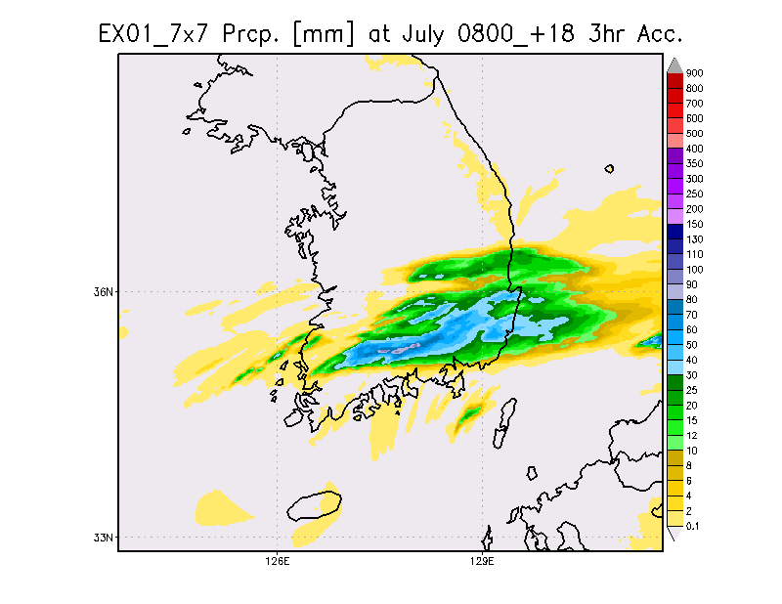
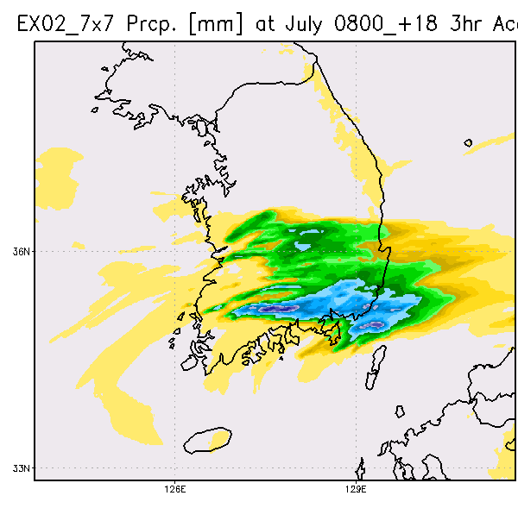
Impact on Local Model
Assimilation of COMS data – Clear Sky Radiance(CSR)
Precipitation(3 hours accumulation (mm))
Rain gauge
OPER
(without CSR)
Radar
WV
WV+IR
The operational model without CSR forecasted much narrower rain band
By adding CSR data, the rain band became broader.
< Courtesy of NMC/KMA >

Slide 15
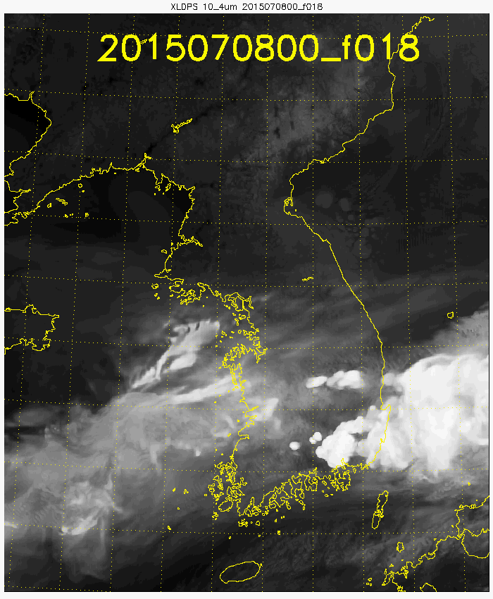
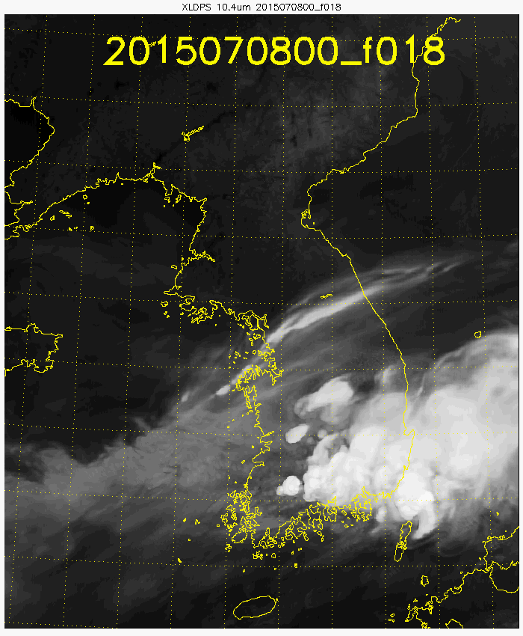
Assimilation of COMS data – Clear Sky Radiance(CSR)
Impact on the simulated satellite Imagery from the NWP
Observation (Himawari-8)
Simulation(Operation,
without CSR)
Simulation
(with CSR of WV+IR)
The operational model without CSR forecasted the cloud too small
The heavy rain clouds can be simulated more realistically (red), and
cirrus bands(blue) are newly produced by using COMS CSR

Slide 16
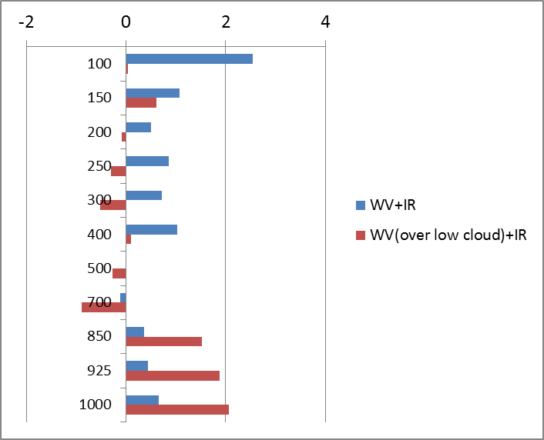
Assimilation of Himawari-8 : CSR
Verification of the impact against ECMWF
[Improvement rate of forecast RMSE (%)]
(hPa)
Overally, assimilation of CSR from Himawari-8
showed very positive impacts for the forecasts
By adding WV over the low level clouds, forecast error reduced especially in the lower
atmosphere
Positive

Slide 17
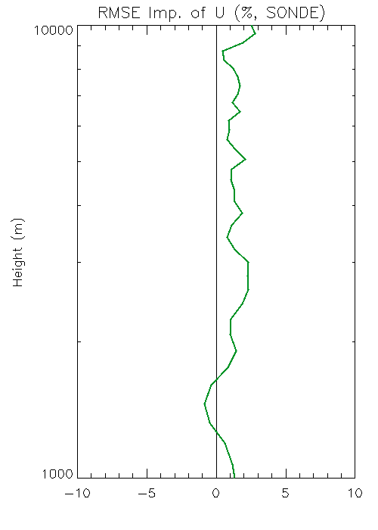
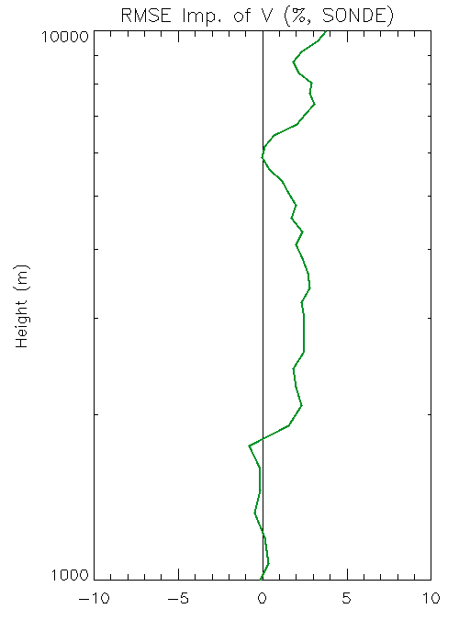
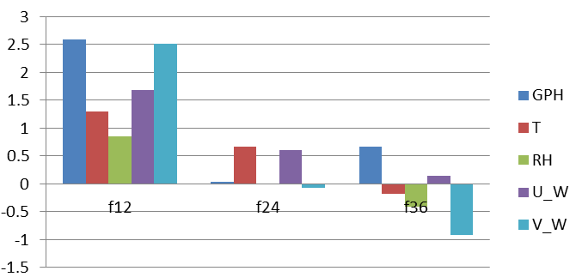
Assimilation of Himawari-8 : Atmospheric Motion Vector(AMV)
Impact of Himawari-8 AMV on the Local Model
- VIS, IR and WV (only cloudy, 6.8 ㎛)
Improvement rate of Forecast RMSE (%), against ECMWF
O-B reduction
Positive
(m)
Forecast hour
Forecast error decreased especially for the early forecast time
Wind in the background fields improved (O-B reduced)
* Background fit of radio sonde observation

Slide 18
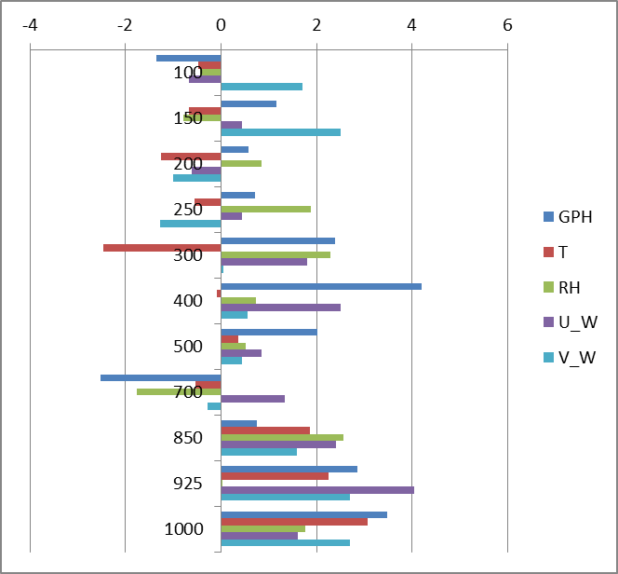
Assimilation of Himawari-8 : both CSR and AMV
Verification of the impact against ECMWF
[Improvement rate of RMSE (%), against ECMWF]
(hPa)
Very positive to reduce forecast error
by assimilating clear/cloudy information
using both CSR and AMV from Himawari-8
➔ The impacts are higher in the lower atmosphere
Positive

Slide 19
Validation of
NWP model results
using WV images

Slide 20
Synoptic Application of WV images
The moist and dry regions in the WV image and the boundaries between them often relate to significant upper-level features and thus it is sensitive to the following upper level dynamical features
① Jet stream
② Deformation field
③ Upper trough/ridge pattern
④ Darkening
(upper level PV anomaly)
⑤ Variation of thickness
Useful
Nowcasting Tool !!
Credit JinkyuWoo(2018)

Slide 21
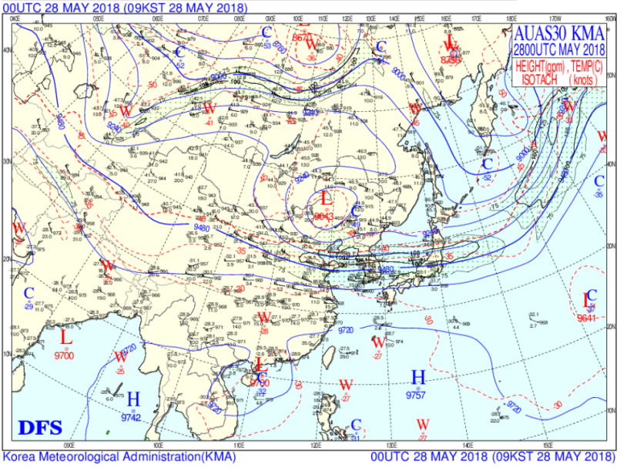
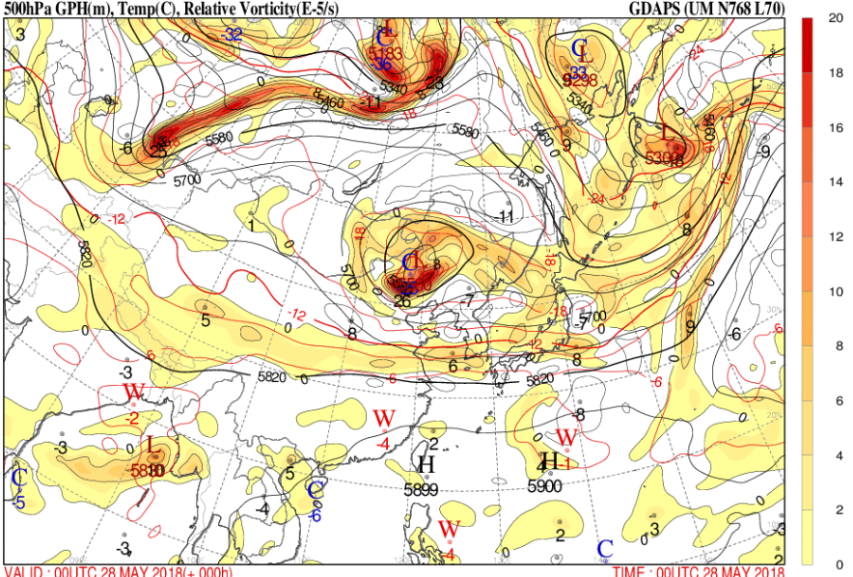
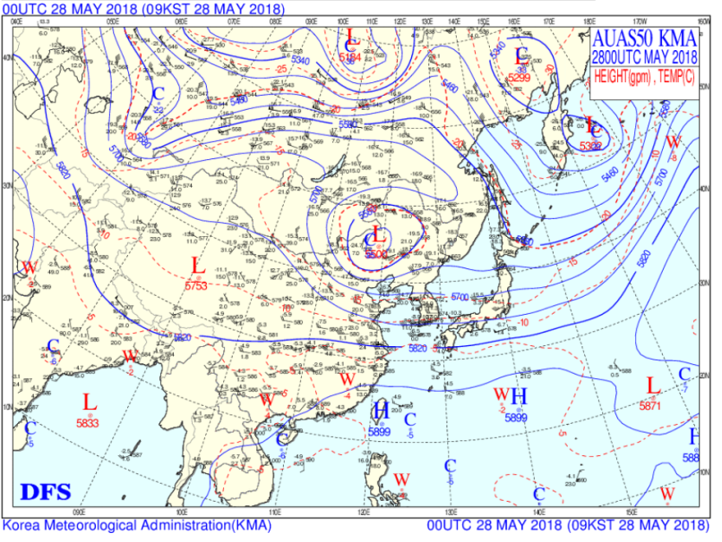
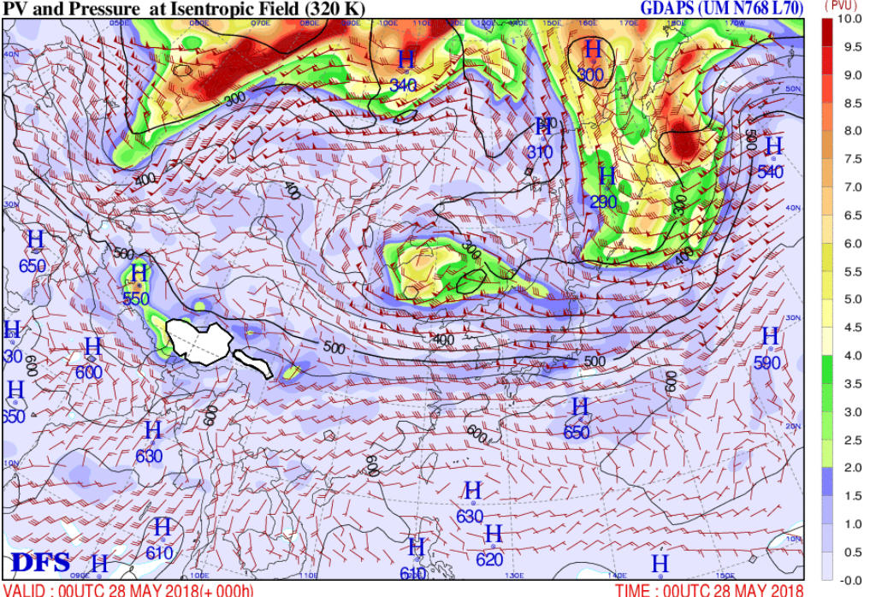
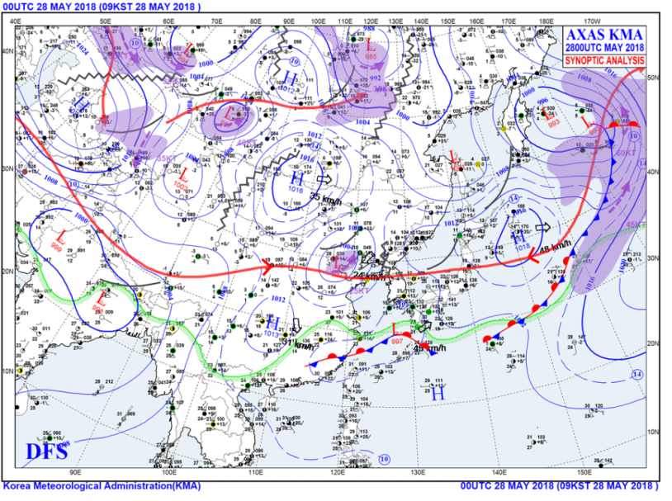
Synoptic analysis
300hPa
Jet stream
Vorticity
max
500hPa
Cut off Low
surface
High
Potential vorticity

Slide 22
NWP assessment for better weather forecasting
NWP
40%
NWP models is the most important tool for most forecasters, especially beyond 24 hours
Yet, the NWP results should be assessed by comparing it to synonymous real-time observations before using NWP results in forecast, because NWP error can make a big forecast error.
NWP assessment can make a difference in the final forecasts
28%
Forecasters
Observations
32%
How to Assess NWP with WV images?
➔ Compare WV imagery with certain NWP variables

Slide 23
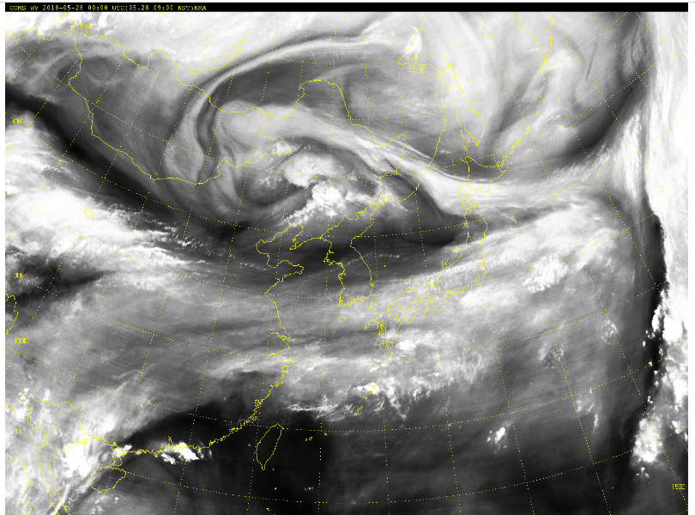
Various NWP fields
To monitor or detect the appearance and evolution of dynamical structures at the synoptic scale,
Satellite image need to be linked to
conservative NWP outputs which show
dynamics of upper-troposphere
Superimposition between operational
model fields and satellite image is useful
COMS WV(00UTC May 28th, 2018)
A. 500hPa pressure
A. Vorticity & Vorticity advection
C. Potential Vorticity
at Isentropic Field(320K)

Slide 24
Dynamical NWP variable – Potential Vorticity
Potential Vorticity (PV) is a way of looking at atmospheric flow because the properties of PV allow its use as a tracer in upper-level dynamics, which is crucial in mid-latitude synoptic developments.
- PV is a product of the absolute vorticity and the static stability
- PV is conserved following the motion for adiabatic frictionless motions
- Climate distribution of PV shows discontinuity of PV around the tropopause
➔ Define Dynamical tropopause as surface of constant PV = 1.5 PVU/ 2PVU
A superimposition of isentropic PV maps with WV image can be a crucial diagnostic tool for understanding dynamical processes in the atmosphere..
00UTC Mar. 8th , 2019

Slide 25
Identify the best NWP field(s) for comparison to WV
Socrative Question 2:
Which field would be better for comparison to WV image ?
500hPa heights overlay
1.5 PVU Heights(Dynamical Tropopause) overlay
A.
B.
00UTC Mar. 8th , 2019
Notes:
The general pattern of the isoheights matches near the Korean Peninsula and NE china However, the correlation is limited. This doesn’t show the consecutive deformation pattern at the north of Monglia (BaiKal lake)
B. Where the heights are higher, the water vapour imagery has lighter colors. And where the heights are lower, the colors are darker.
strong gradient of PVU followed well to the WV at the east Japan sea and displayed the chain of vorticities with high PV near the Baikal lake
However, There are some lacking gradients in the large dark band in Manjulia

Slide 26
Identify the best NWP field(s) for comparison to WV
Socrative Question 3:
Does the 1.5PVU overlay show similar patterns, shapes, and gradients as the water vapour imagery? (Choose the best answer.)
a) Yes, almost everywhere on the image (> 80%).
b) Yes, in some places, but not everywhere (> 50% but < 80%).
c) Yes, within limited areas (> 20% but < 50%).
d) No, there is little to no correlation between the two.
Notes:
A. The general pattern of the isoheights matches near the Korean Peninsula and NE china However, the correlation is limited.

Slide 27
Identify the best NWP field(s) for comparison to WV
Socrative Question 3:
Does the 1.5PVU overlay show similar patterns, shapes, and gradients as the water vapour imagery? (Choose the best answer.)
a) Yes, almost everywhere on the image (> 80%).
b) Yes, in some places, but not everywhere (> 50% but < 80%).
c) Yes, within limited areas (> 20% but < 50%).
d) No, there is little to no correlation between the two.
ANSWER
Notes:
A. The general pattern of the isoheights matches near the Korean Peninsula and NE china However, the correlation is limited.

Slide 28
Socrative Question 4:
What are some possible reasons for the mismatch between the 1.5 PVU surface and the water vapour imagery? (Select all)
a) Greater detail in the water vapour imagery due to higher resolution than the model
b) Due to model spin-up, the features found in the water vapour imagery haven't had
a chance to occur yet.
c) There are diabatic processes occurring in the observations that went
unaccounted for in the NWP or data assimilation.
d) The features or their effects in the water vapour imagery are too high to be seen
on the 1.5 PVU surface.
e) Contour interval isn't the same from the water vapour imagery to the field plotted
on the 1.5 PVU surface.
Notes:
a) a horizontal grid spacing of Model is about 10km, yet the water vapour imagery has a horizontal resolution of 4km. Because of this, there will likely be minor errors in the NWP comparisons.
c) PV doesn't include diabatic processes directly, and the models don't pick up well on all diabatic processes in the data assimilation process.
Because of this, areas of diabatic processes in the water vapour imagery would be missed in the NWP output.
e) Because of software limitations, the contour interval in the PV heights won't be able to match the gradients/contouring in the water vapour imagery. This is only a minor problem.

Slide 29
Socrative Question 4:
What are some possible reasons for the mismatch between the 1.5 PVU surface and the water vapour imagery? (Select all)
a) Greater detail in the water vapour imagery due to higher resolution than the model
b) Due to model spin-up, the features found in the water vapour imagery haven't had
a chance to occur yet.
c) There are diabatic processes occurring in the observations that went
unaccounted for in the NWP or data assimilation.
d) The features or their effects in the water vapour imagery are too high to be seen
on the 1.5 PVU surface.
e) Contour interval isn't the same from the water vapour imagery to the field plotted
on the 1.5 PVU surface.
ANSWER
Notes:
a) a horizontal grid spacing of Model is about 10km, yet the water vapour imagery has a horizontal resolution of 4km. Because of this, there will likely be minor errors in the NWP comparisons.
c) PV doesn't include diabatic processes directly, and the models don't pick up well on all diabatic processes in the data assimilation process.
Because of this, areas of diabatic processes in the water vapour imagery would be missed in the NWP output.
e) Because of software limitations, the contour interval in the PV heights won't be able to match the gradients/contouring in the water vapour imagery. This is only a minor problem.

Slide 30
Making Comparison for Validation- 1. WV & PV
Overlaying 1.5PVU surface on a graysacle WV image
Sometimes 2.0PVU surface will work equally well depending on your latitude
Typically, 1.5PVU is better in colder months and 2.0PVU is better for warmer months
Compare the NWP initialization (f00 or t+0) with the same time in water vapour imagery
A
B
[What have to be compared]
Compare the locations of major synoptic features
Find three types of mismatches between WV imagery and PV fields
- [location/spatial] , [magnitudes/heights], [temporal]
ex) [Location] Mesoscale or smaller diabatic processes are often not matched well (location A)
[Magnitude] compare WV gray shading with the number of PV contours/gradients (location B)
Courtesy of VISIT training module
Notes:
The 1.5 PVU surface works best in mid-latitudes, in and around the jet streams, and outside of anti-cyclones and old lows.

Slide 31
Making Comparison for Validation- How to interpret
Courtesy of VISIT training module
Notes:
The 1.5 PVU surface works best in mid-latitudes, in and around the jet streams, and
outside of anti-cyclones and old lows.

Slide 32
Making Comparison for Validation- Find mismatches
WV
Credit : COMET & EUMETSAT
PVU
Greenland
A
Finland
sweden
C
B
England
France
• Location A: the dry area east of southern Greenland (magnitude [too large in PV, not extended far
enough east])
• Location B: the PV anomaly over Denmark (location[too far north compared to dry conveyor belt maximum])
• Location C: the PV anomaly in western Russia (location [too far east in PV], and magnitude
[too deep in PV])

Slide 33
Making Comparison for Validation- Find mismatches
WV
Credit : COMET & EUMETSAT
PVU
Greenland
Finland
D
sweden
England
E
France
• Location D: the warm conveyor belt over Sweden and Finland (location [not tilting far enough
east in PV], and magnitude [consistent field where water vapour field is changing])
• Location E: the jetstreak aimed toward the southern UK and Northern France
(magnitude [dark area not represented well in PV])

Slide 34
Making Comparison for Validation- 2. WV & SWV
What is Synthetic Water Vapor(SWV) image ?
- Simulated WV image, which is generated through a radiation transfer algorithm
that processes NWP model-derived vertical temperature and humidity profiles
Why use the SWV imagery ?
- SWV imagery is looks like the observational product to which forecasters are accustomed.
What have to be compared ?
- Mismatches between WV imagery and PV fields : temporal, location/spatial, and
magnitudes/heights
➔ The comparison typically makes it easier to understand what features the model is
generating.
WV
SWV
00UTC April 23rd , 2019

Slide 35
Making Comparison for Validation- Find mismatches
SWV
Credit : COMET & EUMETSAT
WV
Greenland
Finland
A
D
sweden
B
C
denmark
England
France
• Location A: the dry area east of southern Greenland (magnitude [too dark in SWV])
• Location B: the moist area south of the previous area (magnitude [too smoothed in the SWV])
• Location C: the dry area in western Russia (magnitude [too dark in SWV])
• Location D: the warm, moist conveyor belt over Sweden and Finland
(magnitude [too light in SWV] and location [extended too far west in SWV])

Slide 36
Making Comparison for Validation- Find mismatches
SWV
Credit : COMET & EUMETSAT
WV
Greenland
Finland
F
sweden
denmark
England
France
E
• Location E: the jetstreak aimed toward the southern UK and Northern France
(magnitude [not enough contrast in the SWV, and too consistent in tone across the moist
side of the jet] and location [SWV doesn't extend the moisture far enough on the south side
of the moisture plume])
• Location F: the expanse of the convective clouds associated with the vorticity maximum west of
Norway/north of Scotland (magnitude [too broad an area of too higher of a moisture value]).

Slide 37
Making Comparison for Validation- Find mismatches
Forecasted SWV field (+03h)
110°E
COMS/WV
110°E
A
A
B
B
C
C
D
D
E
E
03UTC Feb. 21st, 2019
Location A : Vorticity at the southeast of Mongolia is stronger than SWV
Location B : Cyclonic circulation at the middle China is stronger but clouds are weaker than SWV ➔ Clouds will developing stronger than SWV expected.
Location C : SWV can’t simulate the clouds at the southeast China
Location D : Upper trough at the south China move more slowly than WV
➔ South Korea will be affected by the carrot like clouds faster than SWV expected
Location E : moist band at south sea of China is weaker than WV

Slide 38
Making Comparison for Validation- Find mismatches
COMS/ WV
WV-SWV
95E
B
+ value both for dry and moist area
A
Forecasted SWV field (+12h)
90E
00UTC Feb. 17th 2019
Vorticity at the center of cut-off low in the south Mongolia is stronger
in real situation than SWV.
Moist area is also stronger than SWV
B. Dry area is extended westward than SWV
➔ The intensity of cut-off low will be more stronger than model expected
12UTC Feb. 16th, 2019

Slide 39
When to adjust?
[ Three NWP error situations ]
1. WV = PV & PV ≠ SWV (orange)
Use WV and PV for forecasting.
Forecaster can just ignore SWV,
because SWV is derived from a different
radiative transfer model
possible vertical moisture differences can be
the wrong reason for SWV
2. WV ≠ PV & PV = SWV (green)
The model is in error
Need to correct Model using the WV image
if forecasters intend to use model outputs
3. WV =SWV & SWV ≠ PV (purple)
Assessment is most complex
Errors are present, but we can't tell their
source because SWV (often from a separate
model) agrees with the WV though the
original NWP output is in error
The best thing to do is to choose a different model.
This diagram is derived from the works of Santurette and Georgiev (2005).

Slide 40
References
Chapter 5
Use of Water Vapor Imagery
to Assess Numerical Weather
Prediction Model Behavior and
to Improve Forecasts
COMET module
Assessing NWP from Water Vapor Imagery
Published by Academic Press
Copyright © 2016, 2005 Elsevier Inc.

Slide 41
Thank you!

