Slide 1
Determination of Tropical Cyclone Center Position and Intensity at KMA : Dvorak Technique
2019 BMTC Graduate Diploma of Meteorology
PARK, Hye Sook
Senior Researcher
Satellite Analysis Division
NMSC/KMA
Notes:
I’m Jae-dong Jang, Director of Satellite Analysis Division, National Meteorological Satellite Center, KMA.
It’s my honor to meet you all in this memorable AMS annual meeting.
Today I’ll give you short briefing about KMA’s space program especially focused on the satellite utilization.

Slide 2
1. Determination of TC Center Position
2. Analysis of TC intensity Using Dvorak Technique
- CI number and related numbers
3. TC intensity information
- Central Pressure, Maximum wind speed
- Radius of 15m/s and 25m/s

Slide 3
1. Determination
of TC Center Position

Slide 4
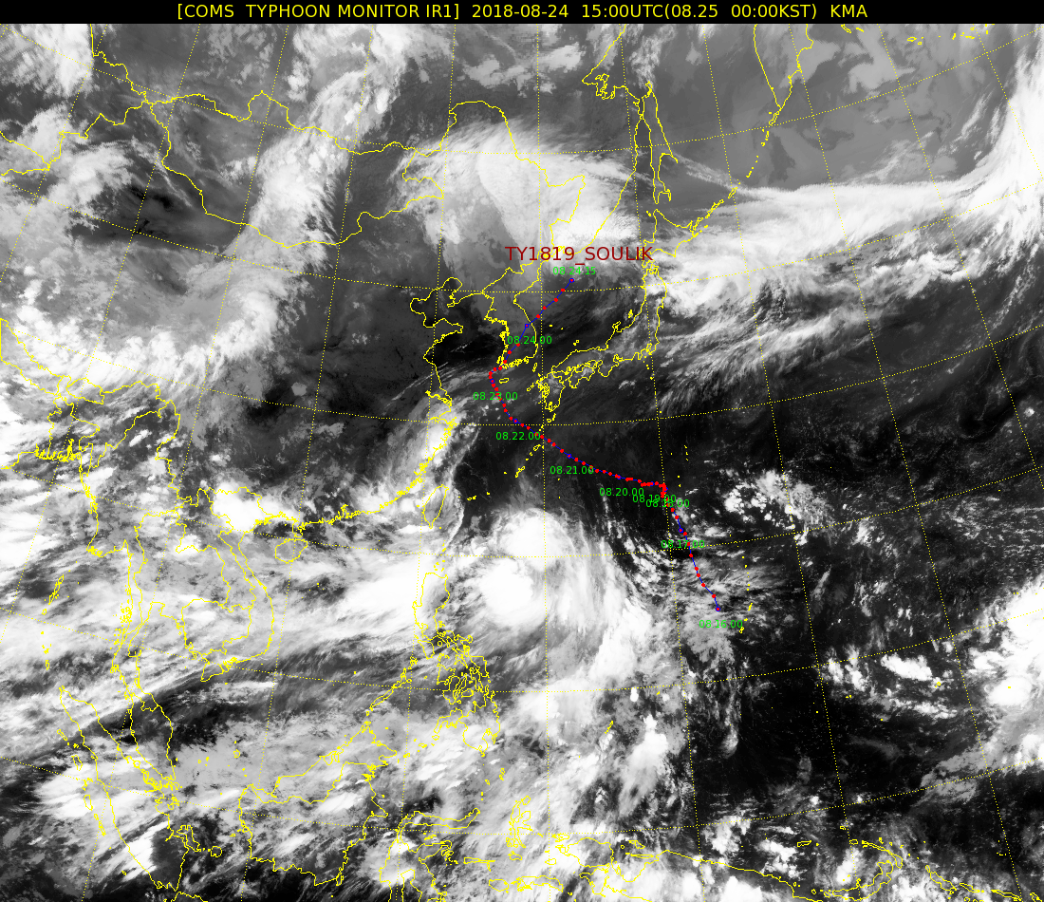
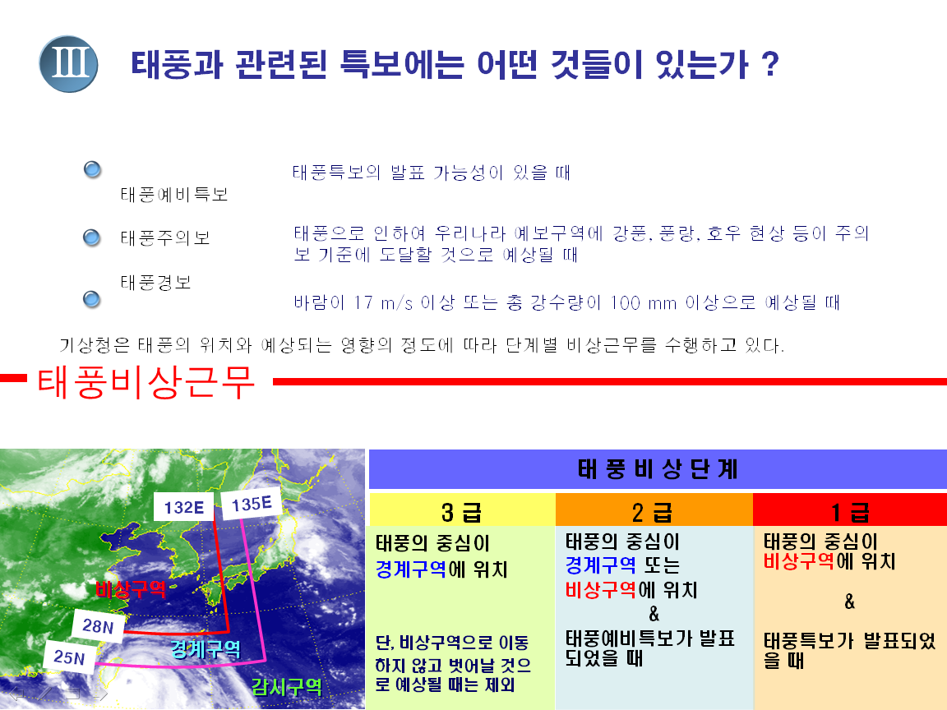
Tropical Cyclone Analysis in KMA
National Typhoon Center analysis and forecast all TCs and TDs over the NW Pacific Ocean
(Warning)
(Watching)
Monitoring
Region: (Lat)0°N ~ 60°N, (Lon) 100°E ~ 180°
TC is named as soon as the wind speed in a TC attains 34 knots
Tropical Cyclone advisory
- Center Position, direction and speed of movement
- Central Pressure, Maximum wind speed and wind distribution
- 24, 48, 72, 96 and 120-hour forecast of central positions
- forecasts of intensity and wind distribution
- Prognostic reasoning
Notes:
Since April 2011, COMS has been operated and distributed its data to the end-user over the Asia-Pacific region via broadcast as well as landline.
In March 2018, its official mission life time is over and approved extension of its operation mission by two year to March 2020.

Slide 5
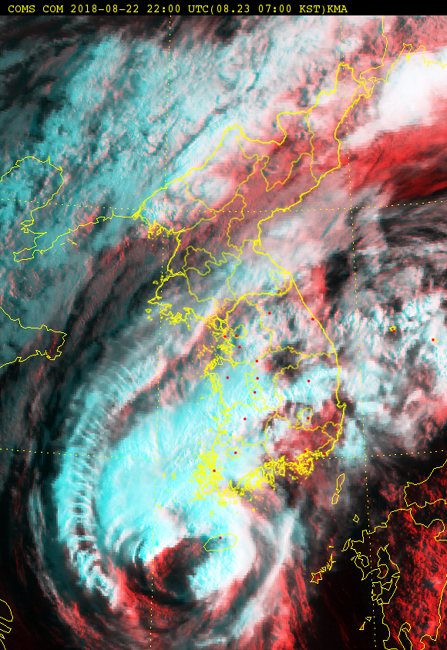
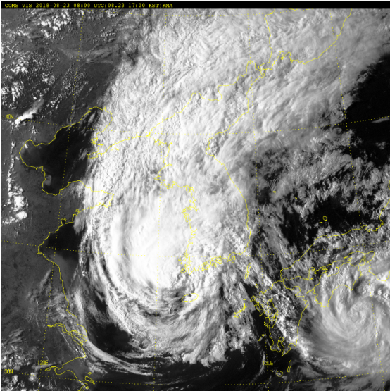
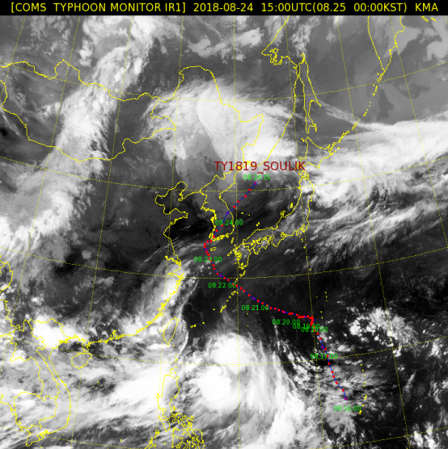
Tropical Cyclone Analysis Information in NMSC
Analysis all TCs every 3hrs from the genesis to dissipation
Loop1
Pattern of TC(eye, band, shear etc)
TC center position (speed/direction)
TC Intensity(CI : Current Intensity)
Minimum sea level pressure
Maximum sustained wind(by Koba Scale)
Radius of 30knots wind
Typhoon ‘SOULIK(1819)
TY1819
Soulik
TY1820
Cimaron
Observational frequency : 8 times/hour
Notes:
Those bunch of satellite information are practically utilized by many sectors within KMA. KMA is supporting its NWP group with top priority, and the collaboration showed quite promising results by now.
<AMV24 algorithm uses 24x24 pixel target size and regular target selection method, but AMV16 algorithm uses 16x16 target size and optimal target selection method.>
AMV16 produces wind vector every 8 pixel interval, so it provides more realistic wind feature especially on the cloud edge region and around the typhoon center with higher resolution.
And, KMA updated cloud detection for the WV Clear Sky Radiance (CSR) as well.
The number of WV CSR products increased, because they were produced over low level cloud which did not influence on the WV radiance.
The CSR data utilization on the local area model showed promising result.
This presents the rainfall case study on July 2015. The operational model forecasted the rain band too narrow, but by adding CSR data, the rain band became broaden.

Slide 6
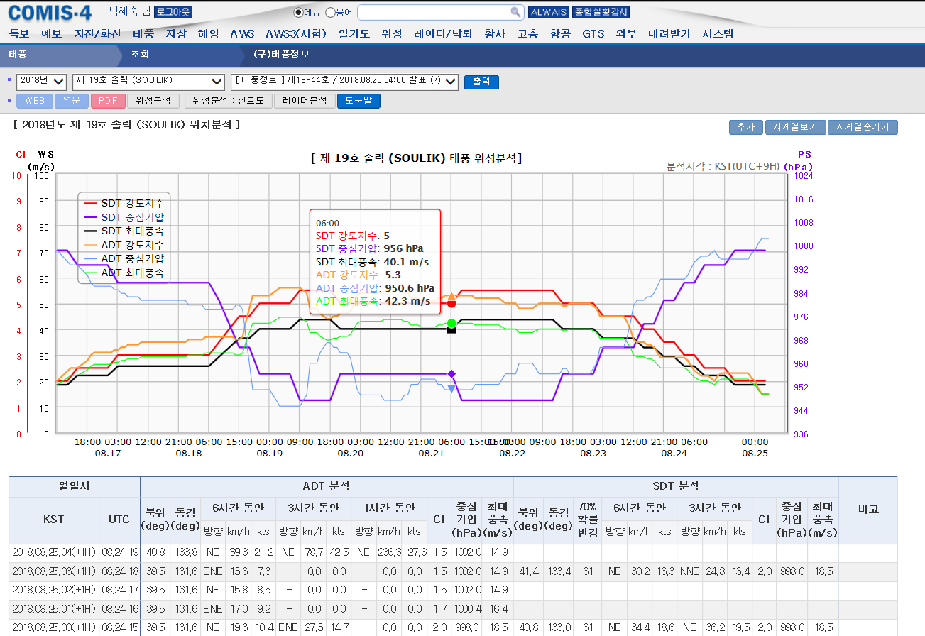
Tropical Cyclone Analysis Information in NMSC
Provide TC information from Advanced (every 1 hr) and Subjective(every 3hr) Dvorak Technique to typhoon forecasters via intranet service
TY1819
Soulik
Notes:
Those bunch of satellite information are practically utilized by many sectors within KMA. KMA is supporting its NWP group with top priority, and the collaboration showed quite promising results by now.
<AMV24 algorithm uses 24x24 pixel target size and regular target selection method, but AMV16 algorithm uses 16x16 target size and optimal target selection method.>
AMV16 produces wind vector every 8 pixel interval, so it provides more realistic wind feature especially on the cloud edge region and around the typhoon center with higher resolution.
And, KMA updated cloud detection for the WV Clear Sky Radiance (CSR) as well.
The number of WV CSR products increased, because they were produced over low level cloud which did not influence on the WV radiance.
The CSR data utilization on the local area model showed promising result.
This presents the rainfall case study on July 2015. The operational model forecasted the rain band too narrow, but by adding CSR data, the rain band became broaden.

Slide 7
Typical patterns of Tropical Cyclones
CB cluster
Shear
Generating stage
Band
CDO
Developing stage
EYE
CDO
Mature stage
CDO
Shear
Extro-tropical Cyclone
Weakening stage

Slide 8
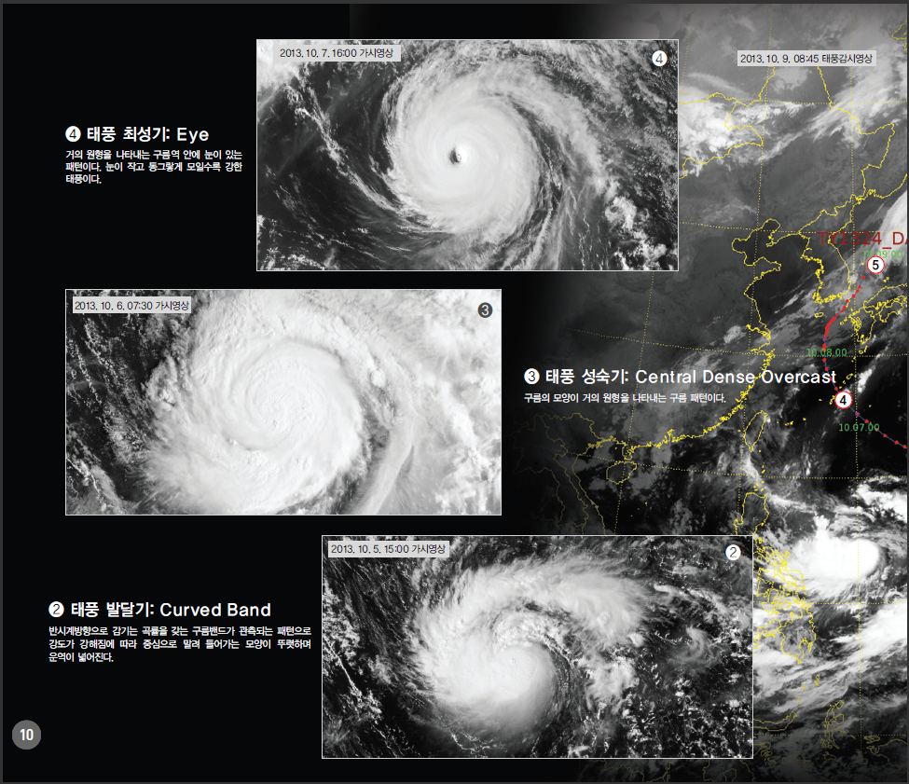
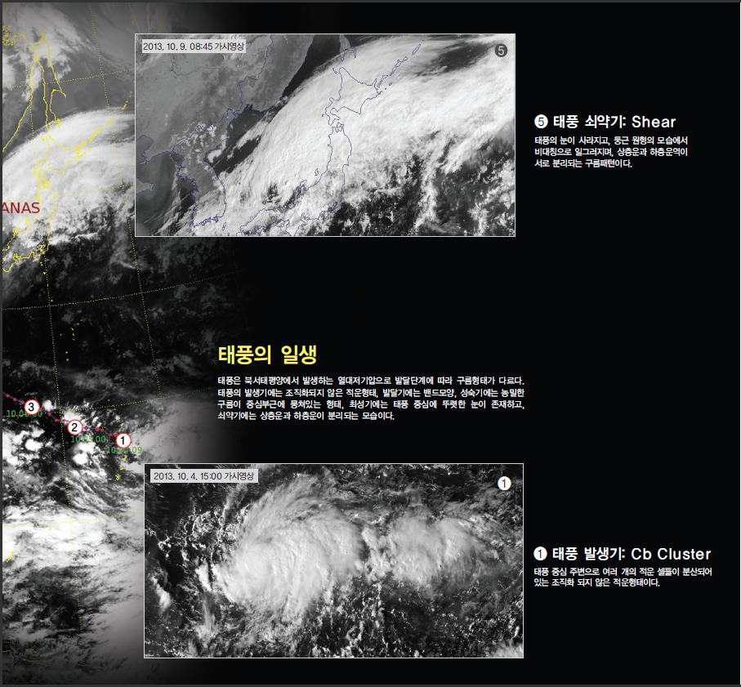
Typical Lifetime of TCs near the Korea
The Korea Peninsula is located at mid-latitude where TCs are usually weak
Cloud pattern is mostly Shear pattern during the Weakening or Decaying stage
TY 1324 DANAS
Mature
Decaying
Mature
Life Time of Typhoon DANAS(TY1324)
Developing
Generating
Generating ➔ Developing ➔ Mature ➔ Weakening
①Cb Cluster ➔ ②Curved Band ➔ ③CDO ➔ ④EYE ➔ ⑤SHEAR

Slide 9
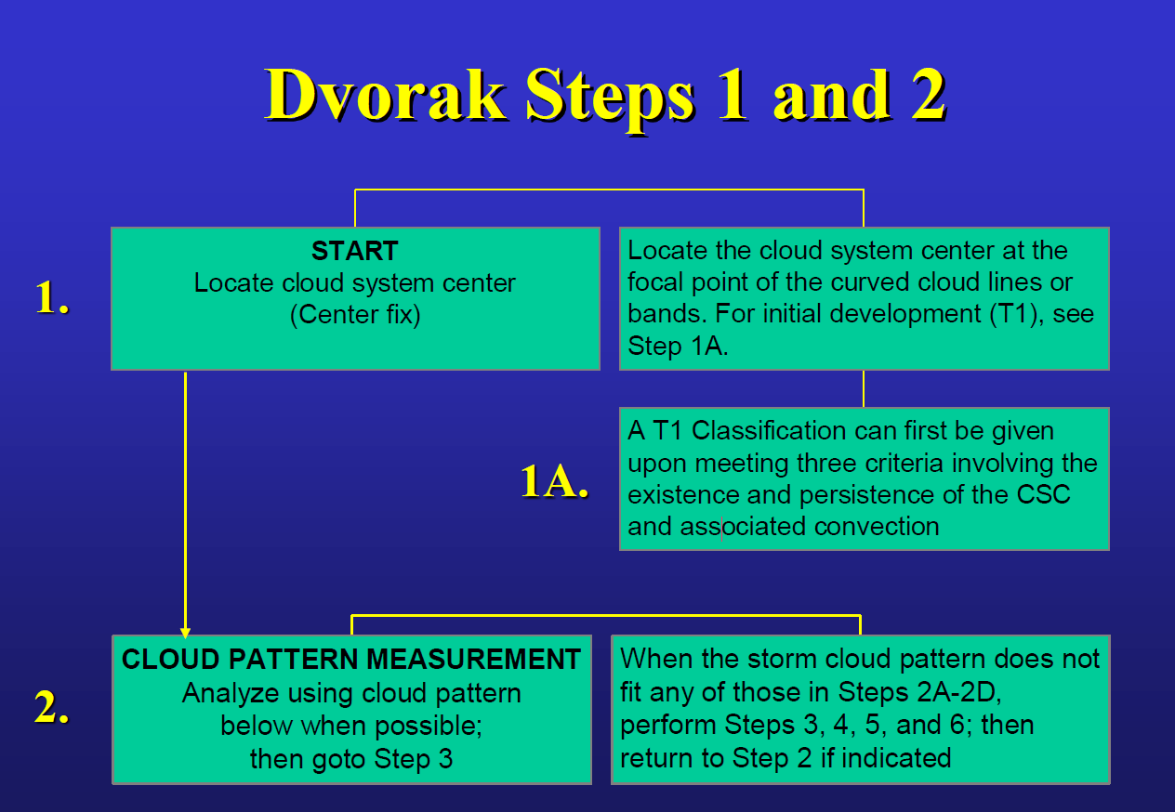
How to Determine TCs’ Center Position
Cloud System Center(CSC) : The center of the disturbance or cyclone.
It is usually defined by an eye, a low level circulation center, or by other cloud features
Method 1 : Using looping of images for 3~6 hours can show the circulation associated with a TC
or disturbance and make center fixing easier
➔ It does not guarantee a correct center location!!
Method 2 : Use other types of imagery (ex. Microwave, Scatterometer, surface observation)
and enhancements can help for finding the CSC
Step 1: Determine Cloud System Center
Step 2 : Define Cloud Pattern
Step 3: DT for each Pattern
Step 4: PT
Step 5: MET
Step 6 : FT
Step 7 : CI
Step 8 : Central Pmin, Vmax
Intensity
Image Courtesy by Jack Beven(2018, NHC)
Notes:
High spatial resolution images provide detailed views of cloud-top structure
Frequent temporal sampling from GEO, typically 30 ~15 min to 2~10min frequency for rapid-scan, allows looping of images to better estimate TC position, motion and wind velocity.
Passive microwave imagers such as SSMI, SSMIS, TMI, GCOM-W1 etc are not strongly affected by cloud droplets and ice particles, but are sensitive to precipitation. These instruments can "see" through the cloud top into the TC to characterize the structure of rain bands and the eye wall. These data are extremely useful in determining the position of the low-level center, and in monitoring structural changes, including during rapid intensification (Velden and Hawkins 2010).

Slide 10
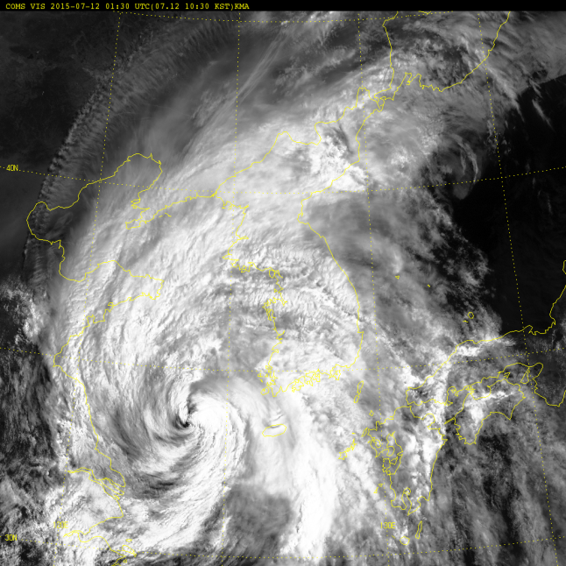
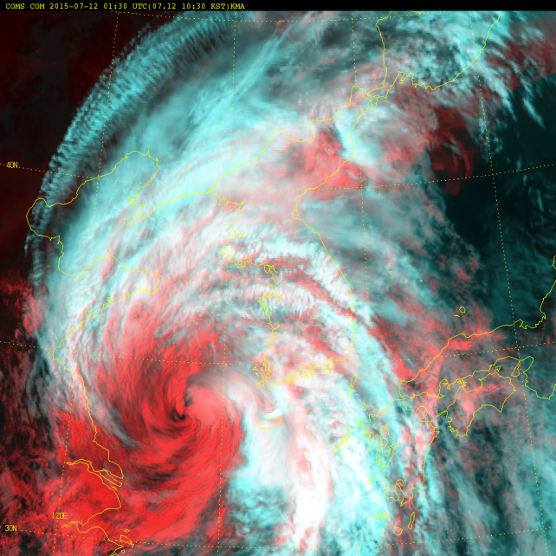
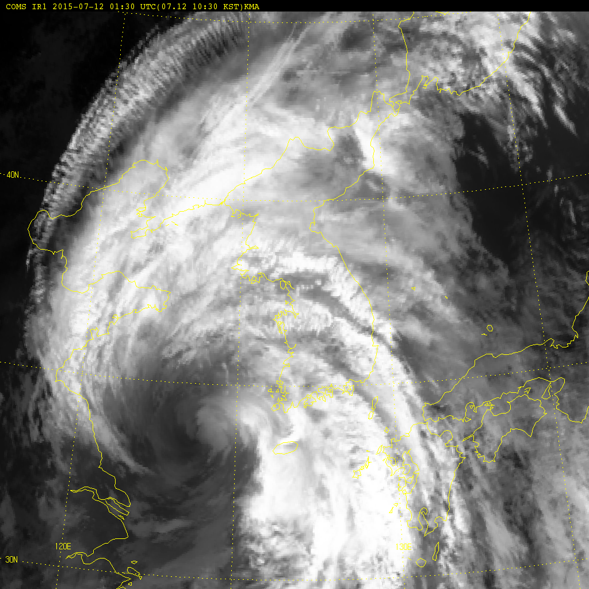
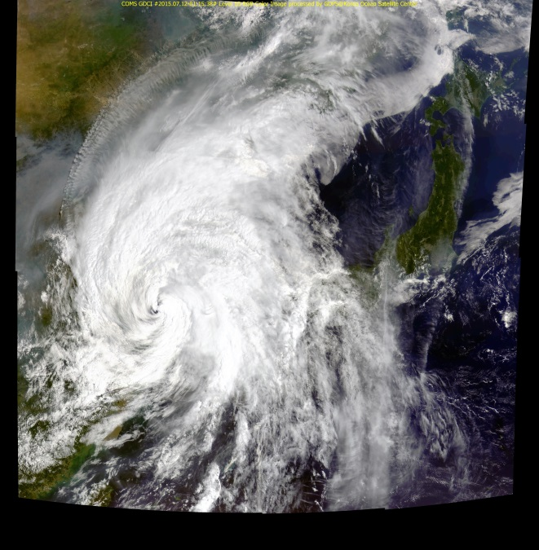
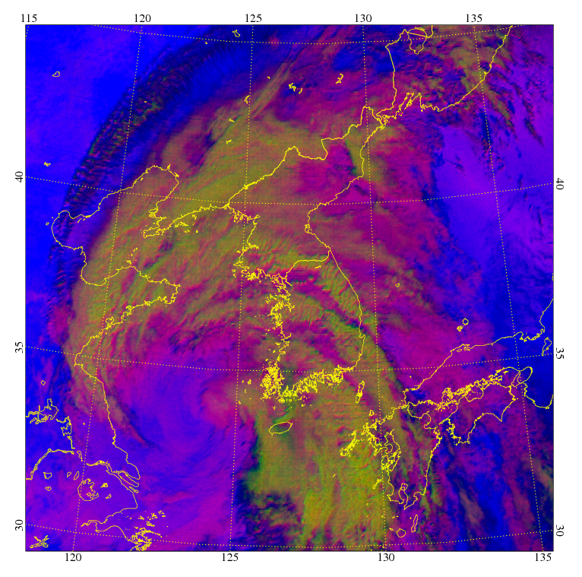
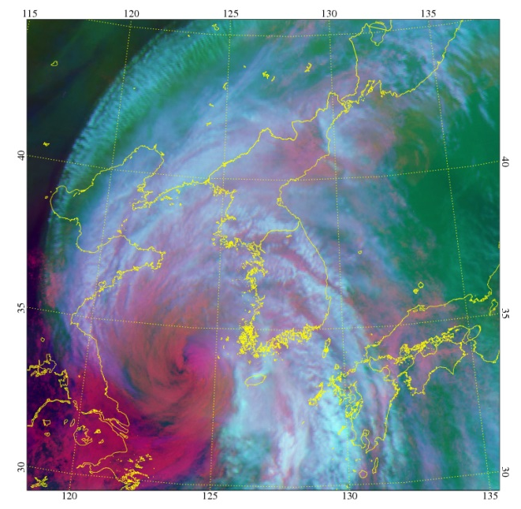
Determination of TCs’ Center Position
Generally use various COMS Images and looping
COMS (VIS)
COMS (VIS+IR)
COMS (IR)
Convective cloud
Low cloud
COMS (GOCI)
COMS Convective Cloud RGB ( IR1+ IR2+WV)
COMS WV RGB image
(VIS, WV, IR1)
01:30UTC July 12, 2015(Chan-hom, 1509)
Notes:
High spatial resolution images provide detailed views of cloud-top structure
Frequent temporal sampling from GEO, typically 30 ~15 min to 2~10min frequency for rapid-scan, allows looping of images to better estimate TC position, motion and wind velocity.
RGB images are also useful to determine the TC center by distinguishing lower level circulation from high-level clouds
However,
VIS/IR data should be used along with other sources of information (reconnaissance, microwave imagery, scatterometer, radar, etc.) to avoid ambiguities in the eye position
due to thick, less organized clouds obscuring surface features in early stages of TC development, and when upper-level cloud features separate and obscure the low-level center (Hawkins et al. 2001; Edson et al. 2006).

Slide 11
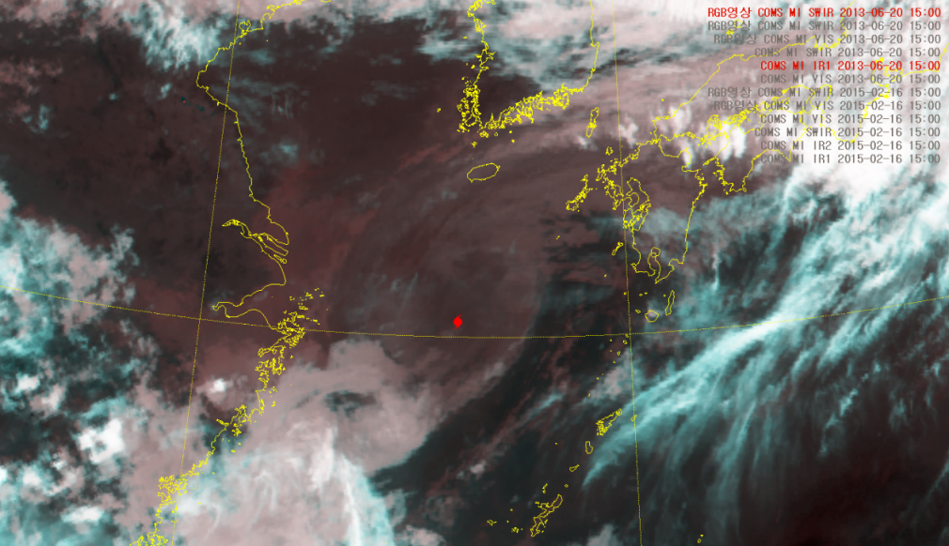
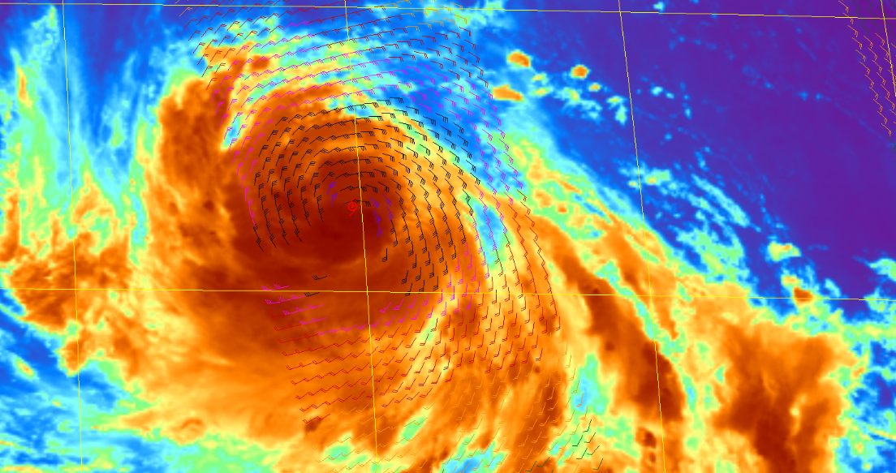
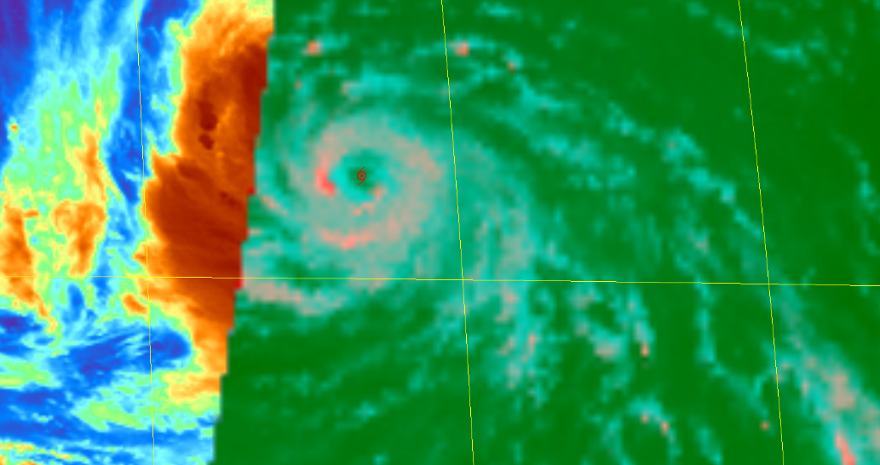
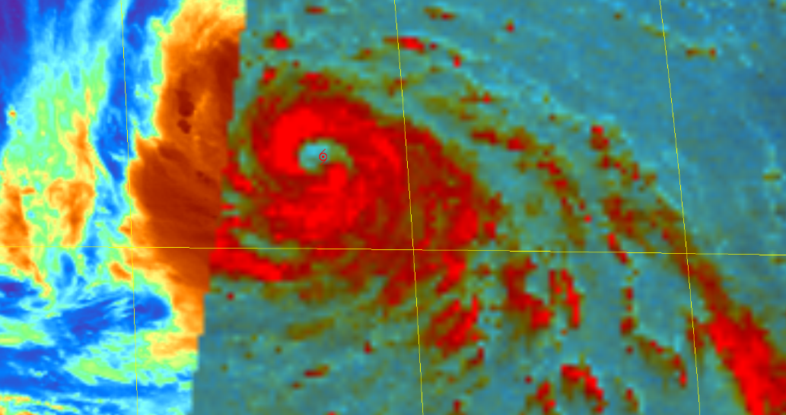
Determination of TCs’ Center Position
During Nighttime : Use the MW and other RGB images together
Center of cyclonic vorticity (nighttime)
Center of ASCAT SSW with convective cloud
Low level clouds can be detected better in SWIR than IR1 at night
Sea surface winds from Scattrometers are useful to estimate center position
COMS/SWIR+IR1 RGB
COMS EIR+ASCAT SSW
Center of convective cloud line or eye wall with MW
Center of convective cloud line or eye wall with MW
COMS EIR+GCOM W1/AMSR2 (36GHZ)
COMS EIR+GCOM W1/AMSR2(89GHZ)
Notes:
Passive microwave imagers such as SSMI, SSMIS, TMI, GCOM-W1 etc are not strongly affected by cloud droplets and ice particles, but are sensitive to precipitation. These instruments can "see" through the cloud top into the TC to characterize the structure of rain bands and the eye wall. These data are extremely useful in determining the position of the low-level center, and in monitoring structural changes, including during rapid intensification (Velden and Hawkins 2010).

Slide 12
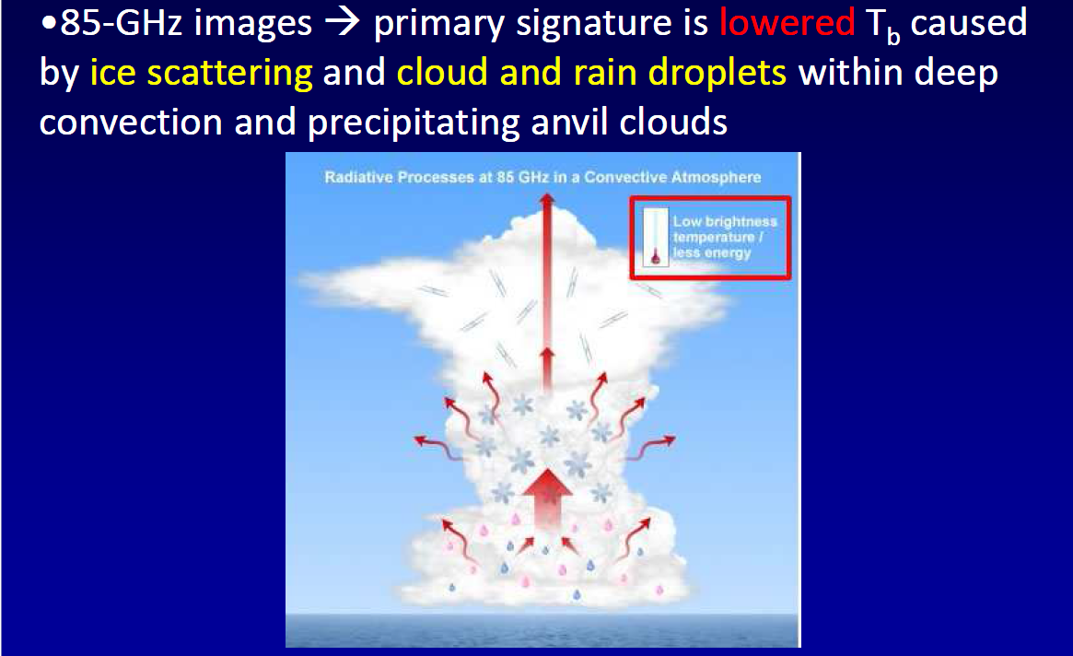
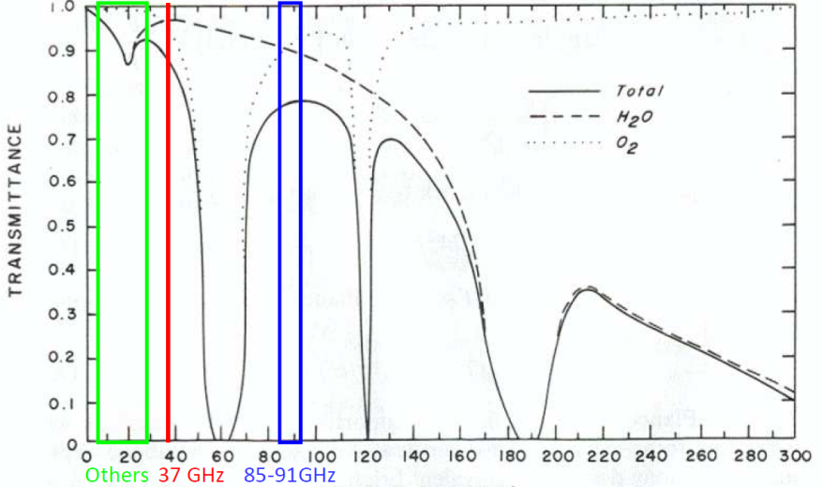
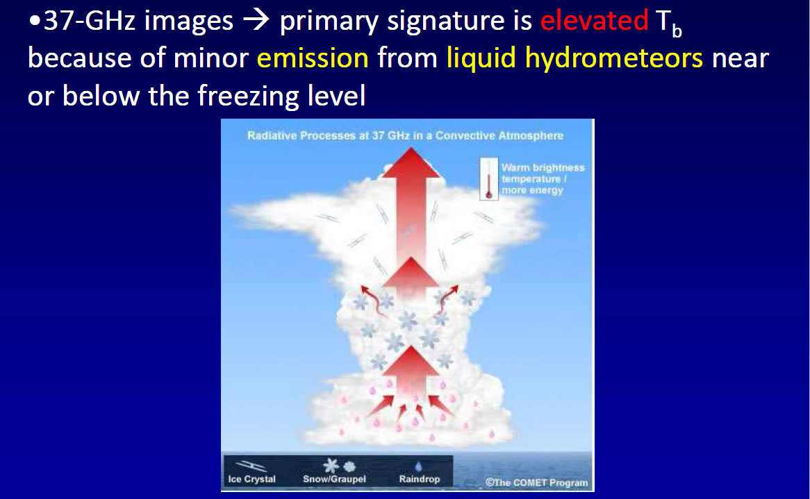
Reference : Microwave images
Microwave Transmittance
Image courtesy COMET
Reference
Image courtesy COMET

Slide 13
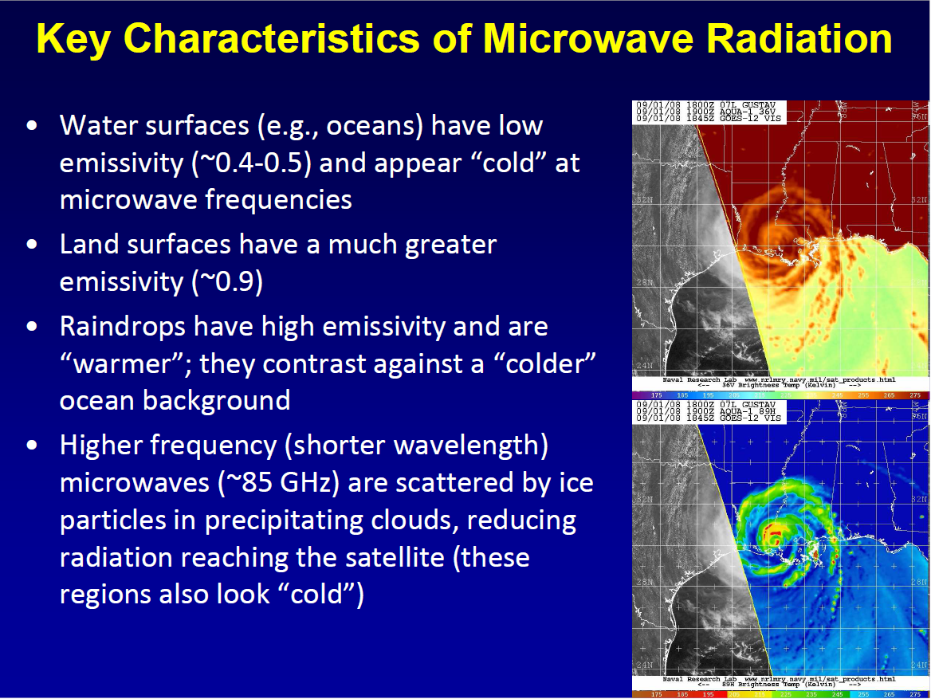
Reference : Microwave images
Reference
courtesy Stacy R. Stewart & John Cangialosi(HNC, 2018)

Slide 14
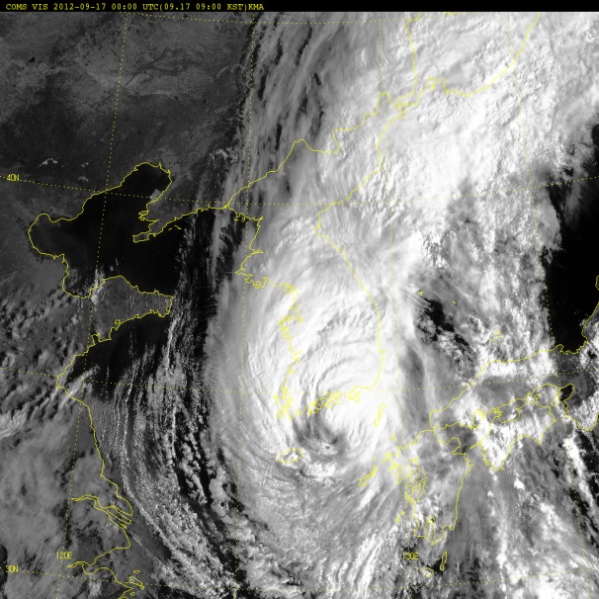
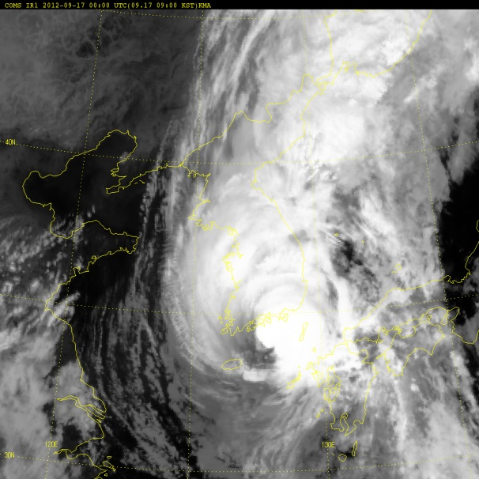
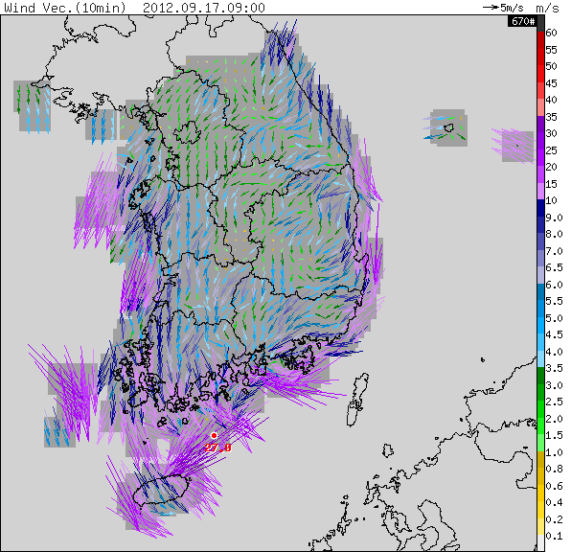
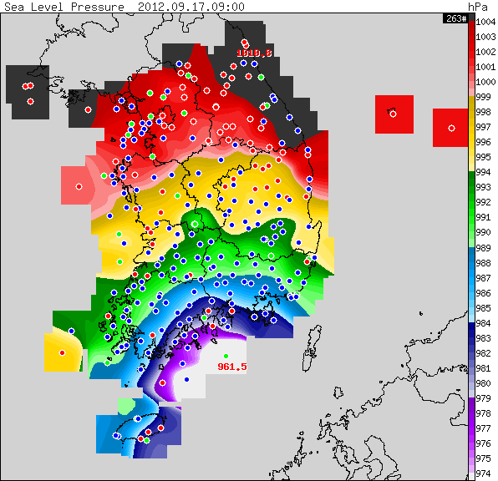
Determination of TCs’ Center Position
COMS(VIS)
COMS(IR)
Using surface observation data near the Korean Peninsula
AWS Pressure
AWS Wind
AWS Wind
34.0N, 128.1E
00:00UTC Sept. 17, 2012(SANBA, 1216)
Notes:
Surface observations are generally available over land, but include data from buoys and other measuring systems that may extend over coastal waters. Surface networks include synoptic and automatic weather stations, rain gauge networks, tide gauges, moored buoys, ships, etc. The surface networks are most useful for landfalling and nearshore TCs, as ships try to avoid these storms. The surface variables of greatest relevance to TCs include surface pressure, sustained wind speeds and gust speeds, rain rate and accumulation, storm surge, and significant wave height.
Land-based weather radar observations are relatively limited because of the infrequent occurrence of landfalling TCs within range of a coastal or inland radar site once it makes landfall. However, on the occasion when this does occur, radar observations provide nearly continuous position information for TCs as they approach the coast and are useful for diagnostic forecast verification for several impacts associated with TCs.

Slide 15
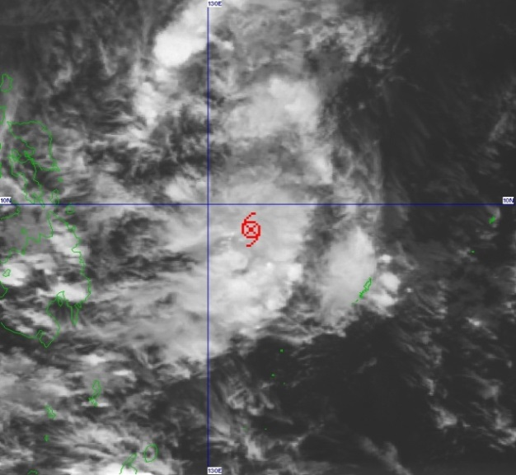
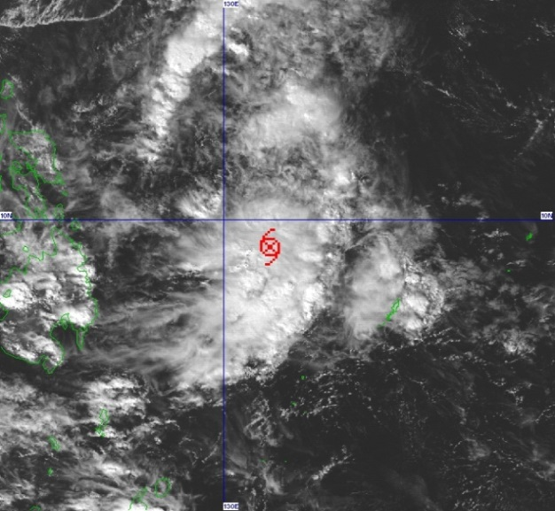
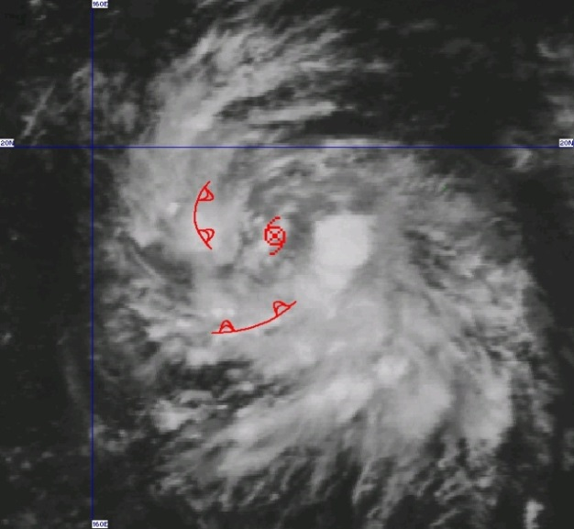
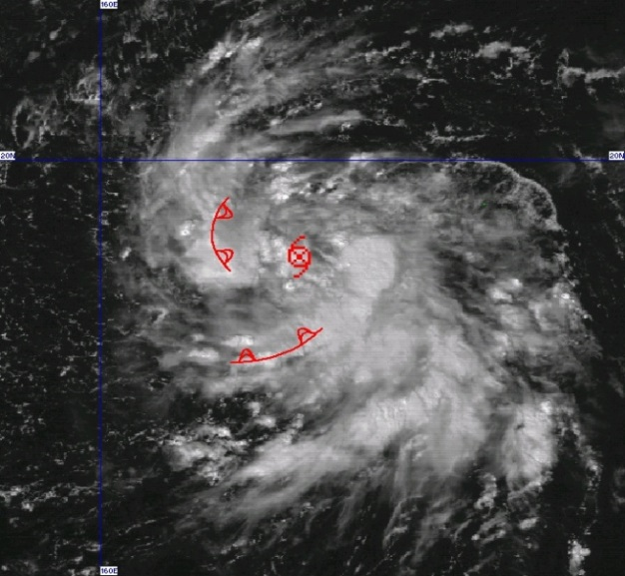
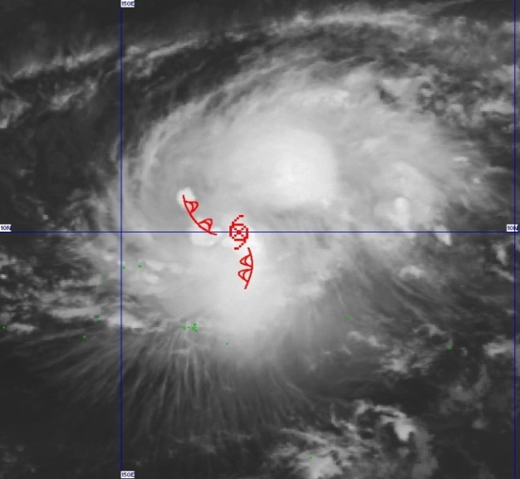
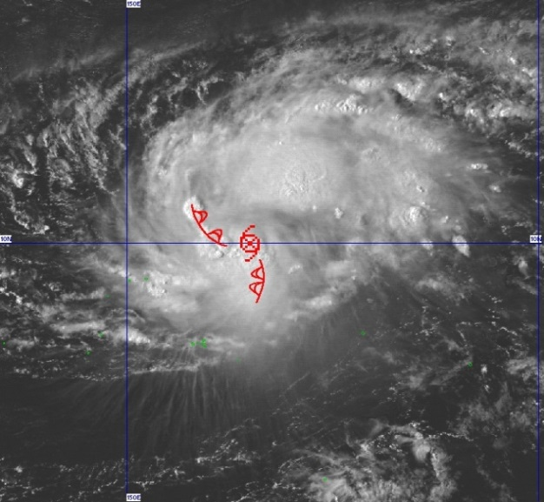
Case Study 1 (Cb-Cluster Pattern, beginning stage)
Evolution from unorganized to organized
Unorganized
organized
Cb-cluster with mild
cyclonic circulation are
scattered
Cb-cluster is organized
and rotation center is
relatively clear

Slide 16
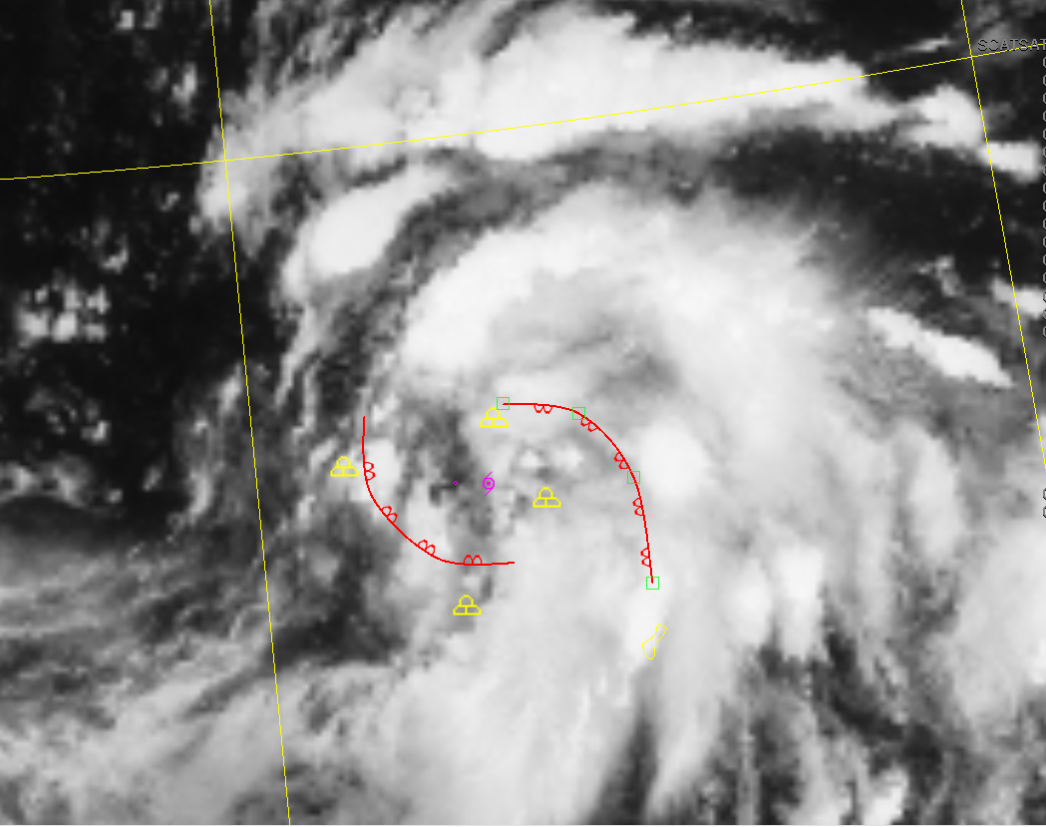
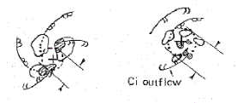
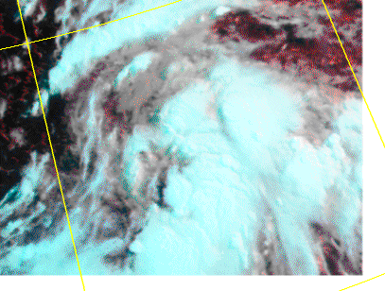
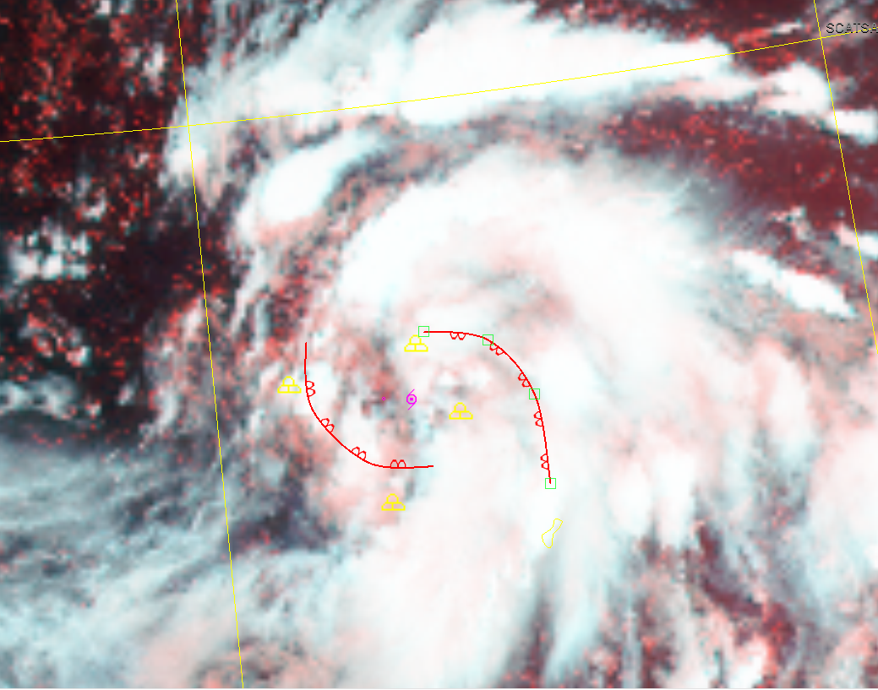
Case Study 1 (Cb-Cluster Pattern, beginning stage)
COMS IR 23:45UTC Aug. 15th 2018
Soulik(TY1819)
1. Find the cyclonic circulation of mid to high level clouds(white)
COMS COMP(IR+VIS)
(Loop2) 21~23:45UTC, Aug. 15th , 2018
2. Find cyclonic circulation of the low-level clouds(red)

Slide 17
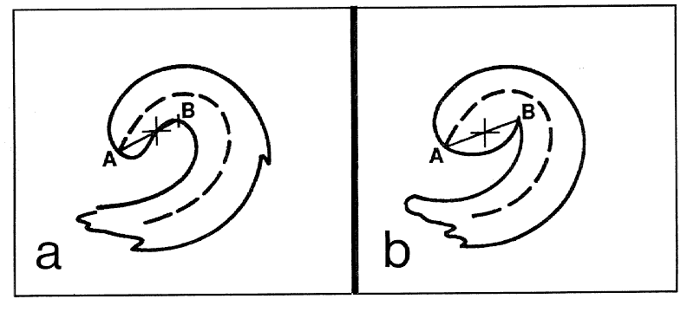
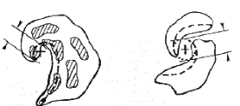
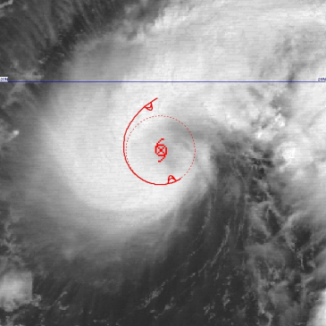
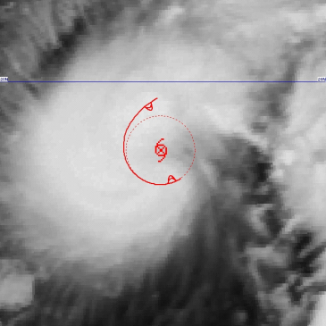
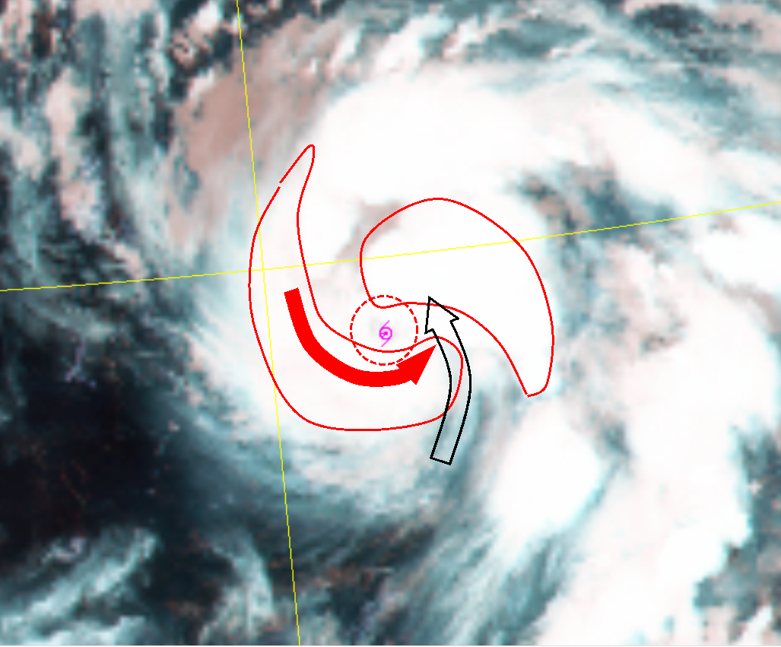
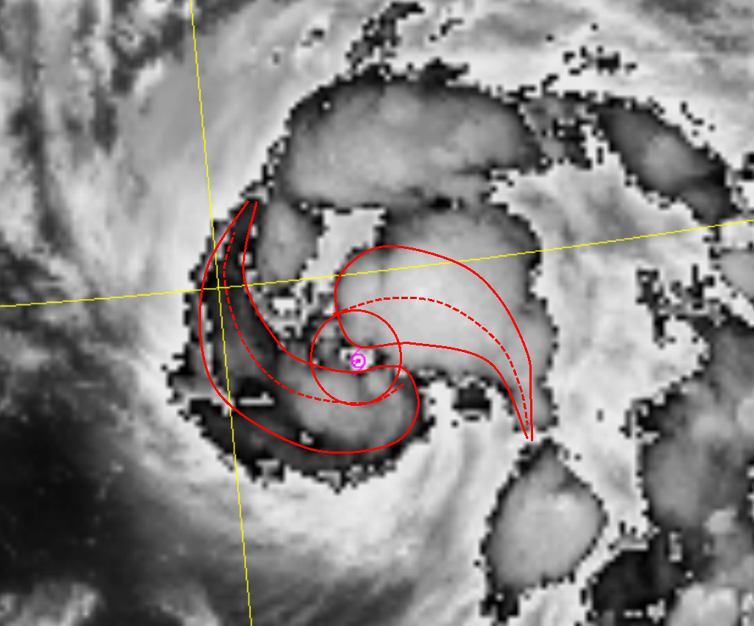
Case Study 2 (Curved Band Pattern)
Clearly curved band with comma head
Unclearly curved band
Dry slot
VIS
IR
Soulik(TY1819)
11:45UTC Aug. 16th 2018
Connect comma head (A) and slit (B) intruded by warm air
Determine the center at the high temp. gradient point of coldest clouds near the middle of A and B
Curved bands
New developed
Curved bands
Draw circle(red) using two cyclonic curves of convective cloud bands

Slide 18
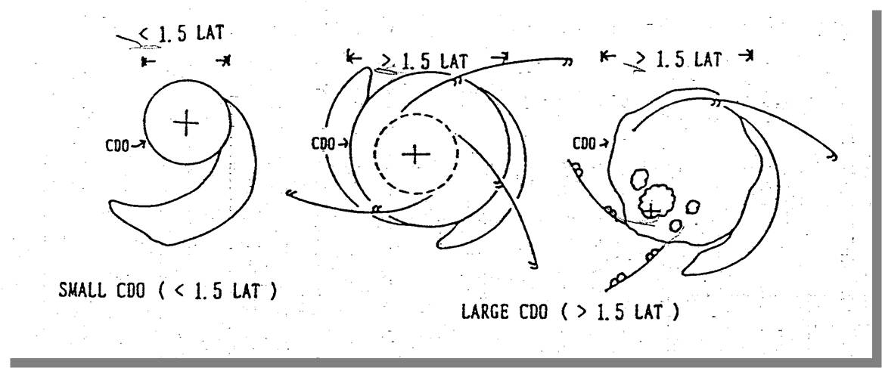
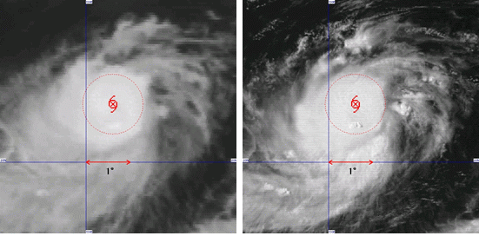
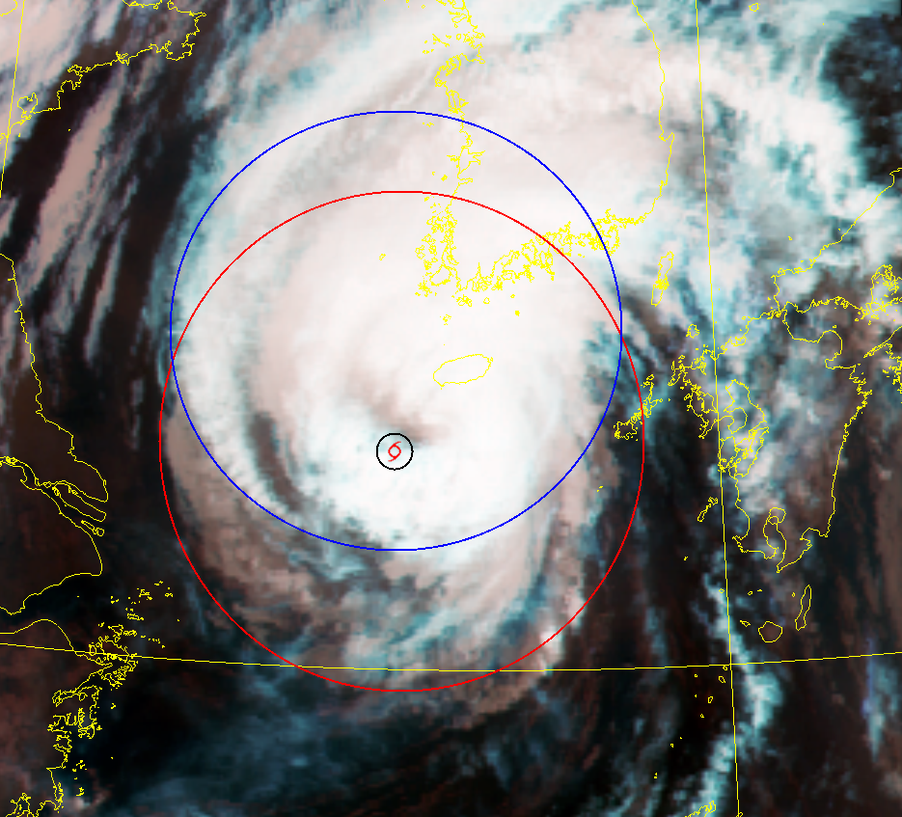
Case Study 3 (CDO pattern)
Center is covered by dense convective clouds with at least one sharp edge
If the size of CDO is below 1.5 degree, center will be the center of CDO
If the size of CDO is above 1.5 degree, center is determined by the lines of cirrus blown out from the top of CDOs,
or one of the CDO among several different size
of CDOs.
Distinct small CDO
Indistinct CDO pattern
17:45UTC Aug. 22nd 2018
Soulik(TY1819)➔
As TC became weakened,
the EYE pattern turned to indistinct CDO pattern
Covered by mid-high level clouds
Estimate the 1st possible center area using the loops for 6~12 hours including clear center pattern (blue circle)
Find 2nd circle of circulation of lower-level clouds (red) using latest 4hours looping ➔ determine final center

Slide 19
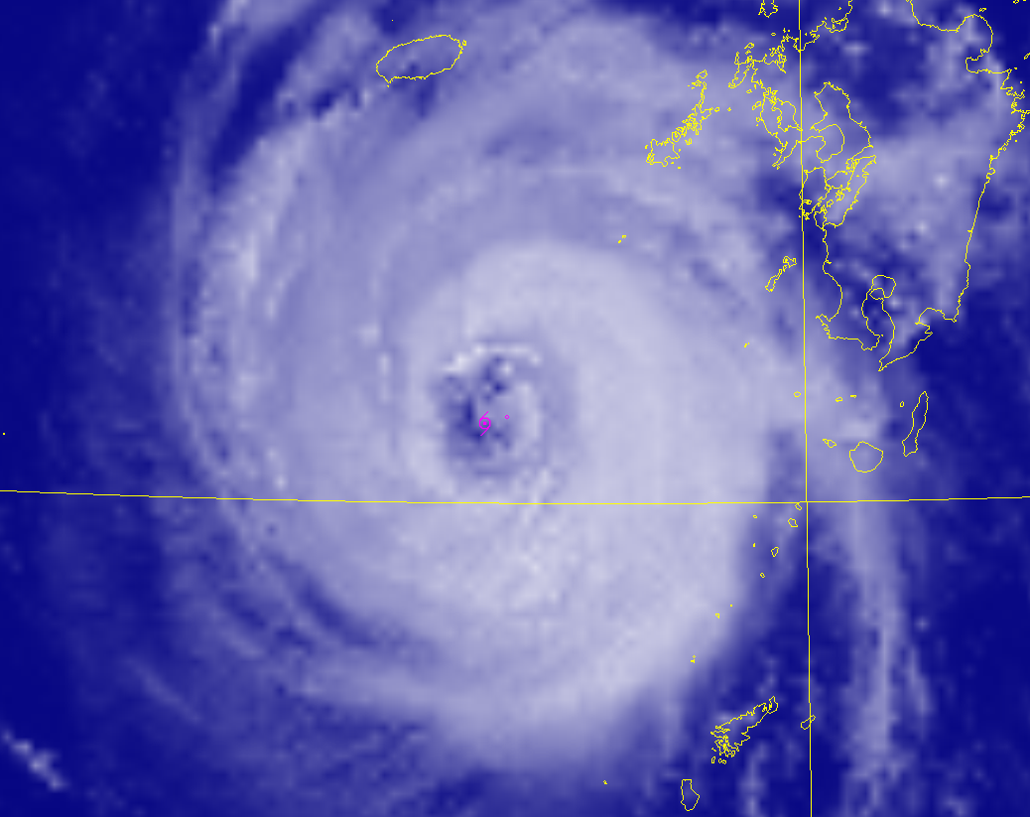
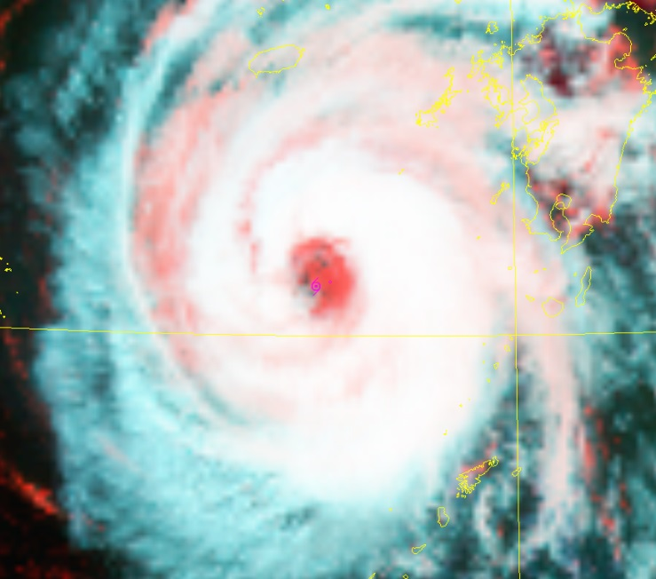
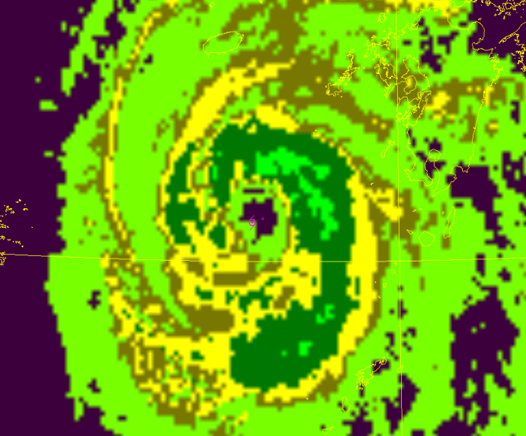
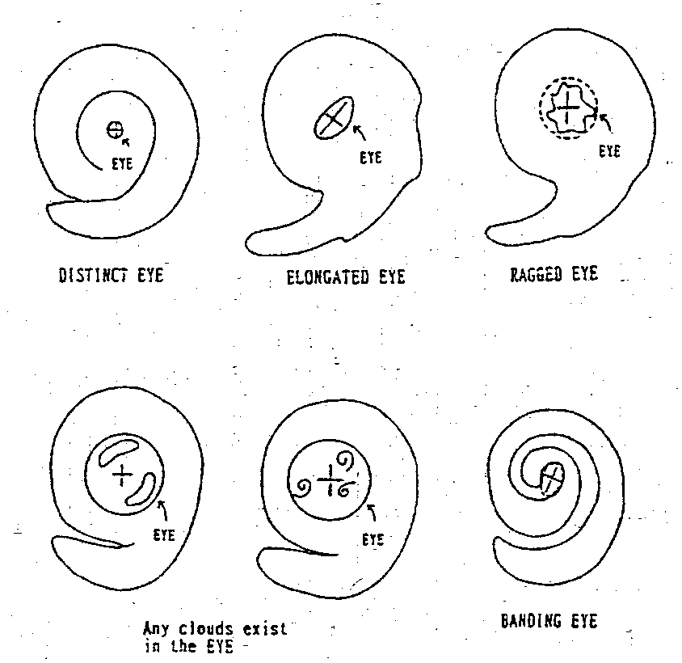

Case Study 4 (EYE pattern)
Colder TBB
COMS VIS
COMS COMP(IR+VIS)
COMS EIR
Soulik(TY1819), 02:45UTC Aug. 22nd 2018
Lower level clouds
Eye
Ragged Eye pattern :
When the shape of eye is irregular or cloud exist in the eye,
CSC can be determined at the circulation center of lower-level clouds in the eye

Slide 20







Case Study 5 (Shear Pattern)
Dense cloud deviates from the CSC determined by low level cloud lines
Very difficult to find the low level circulation especially during the nighttime (low reliability)
Use surface observation when TC located in land or
coastal area.
Loop3 ( 02~05:45UTC, Aug. 23rd , 2018)
Soulik(TY1819), 05:45UTC Aug. 23rd 2018
COMS Enhanced IR
COMS COMP(IR+VIS)
Determine the center of vortex in the head of well developed convective clouds
Find the circulation center of lower level clouds using the curvature line
Determine CSC as the meeting point of 1 & 2

Slide 21



Case Study 5 (Shear Pattern)
Separation of low-level clouds from upper level cloud due to the intrusion of dry air from the south west to the CSC
Open area appeared in the low level clouds at the downwind side of Taeback mountain due to the dissipation of low level clouds
CSC can be located at the meeting points of several cu lines in the low level clouds
Dry air
05:45UTC Aug. 24, 2018(Soulik, 1819)
Mountain range
COMS COMP loop4
(03~05:45UTC, Aug.,24th 2018)

Slide 22

Exercise 1 : Pattern Recognition
COMS IR loop 5
(12~14:45UTC, Aug.,23rd 2018)
Socrative Question 1:
What’s the pattern of Typhoon Soulik?
Band pattern
Shear pattern
CDO pattern
Eye pattern
Notes:
Surface observations are generally available over land, but include data from buoys and other measuring systems that may extend over coastal waters. Surface networks include synoptic and automatic weather stations, rain gauge networks, tide gauges, moored buoys, ships, etc. The surface networks are most useful for landfalling and nearshore TCs, as ships try to avoid these storms. The surface variables of greatest relevance to TCs include surface pressure, sustained wind speeds and gust speeds, rain rate and accumulation, storm surge, and significant wave height.
Land-based weather radar observations are relatively limited because of the infrequent occurrence of landfalling TCs within range of a coastal or inland radar site once it makes landfall. However, on the occasion when this does occur, radar observations provide nearly continuous position information for TCs as they approach the coast and are useful for diagnostic forecast verification for several impacts associated with TCs.

Slide 23







Exercise 1 : Pattern Recognition (Aug 23rd 2018)
09UTC : CDO
12UTC
14:45UTC
18:00UTC
21:00UTC
23:45UTC (Shear)

Slide 24

Shear Pattern –Potential error
Hurricane Harvey (1981)
The previous day
Overnight
Surprise!
Caution!!
Motions of high level clouds can complicate center fixing,
especially when using IR imagery
or if the system is tilted
Image Courtesy by Jack Beven(2018, NHC)

Slide 25

Exercise 1 : Center position decision
COMS IR loop 5
(12~14:45UTC, Aug.,23rd 2018)
Socrative Question 2:
Where do you think the CSC located at 14:45 UTC on Aug 23rd 2018 ?
West coastal of Julrabuk-do
South west of Julranam-do
East of Julranam-do
12~14:45UTC, Aug.,23rd 2018
A
B
C
Notes:
Surface observations are generally available over land, but include data from buoys and other measuring systems that may extend over coastal waters. Surface networks include synoptic and automatic weather stations, rain gauge networks, tide gauges, moored buoys, ships, etc. The surface networks are most useful for landfalling and nearshore TCs, as ships try to avoid these storms. The surface variables of greatest relevance to TCs include surface pressure, sustained wind speeds and gust speeds, rain rate and accumulation, storm surge, and significant wave height.
Land-based weather radar observations are relatively limited because of the infrequent occurrence of landfalling TCs within range of a coastal or inland radar site once it makes landfall. However, on the occasion when this does occur, radar observations provide nearly continuous position information for TCs as they approach the coast and are useful for diagnostic forecast verification for several impacts associated with TCs.

Slide 26



Exercise 1 – Center point decision(Nighttime )
COMS IR loop 5
(12~14:45UTC, Aug.,23rd 2018)
15:00UTC Aug. 23, 2018(Soulik, 1819)
Satellite center(35.8N, 126.7E)
Big difference!!
Surface center(34.8N, 126.6E)
COMS(IR) + Surface Pressure
[RADAR : Radial Velocity = 0 line]
34.8°N, 126.6°E
SITE 1 : KSN (Height: 1.4km)
SITE 2 : MHS (Height: 1.2km)
CSC is the center of minimum sea level pressure from surface observation distribution
Landing at the south(34.6N, 126.4E) of Mokpo around 14UTC on Aug. 23rd
Notes:
Surface observations are generally available over land, but include data from buoys and other measuring systems that may extend over coastal waters. Surface networks include synoptic and automatic weather stations, rain gauge networks, tide gauges, moored buoys, ships, etc. The surface networks are most useful for landfalling and nearshore TCs, as ships try to avoid these storms. The surface variables of greatest relevance to TCs include surface pressure, sustained wind speeds and gust speeds, rain rate and accumulation, storm surge, and significant wave height.
Land-based weather radar observations are relatively limited because of the infrequent occurrence of landfalling TCs within range of a coastal or inland radar site once it makes landfall. However, on the occasion when this does occur, radar observations provide nearly continuous position information for TCs as they approach the coast and are useful for diagnostic forecast verification for several impacts associated with TCs.

Slide 27

2. Analysis of
TC intensity
(Dvorak technique)

Slide 28
Dvorak Technique
The Dvorak Technique quantifies TC intensity on a 1-8 scale (at 0.5 intervals) called T-Numbers, which are used in a variety of ways.
The final output of the technique is the Current Intensity (CI) number.
The CI number is driven by the Final-T (FT) Number.
In turn, the FT is driven by the Data-T (DT) number, the Model Expected-T (MET) number, and the Pattern-T (PT or PAT) number.
The DT is often created from other sub-numbers.
Center Position
DT(Data T)
MET(Model T)
PT(Pattern T)
Band
Central Pressure
CDO
Maximum Wind
CI Number
Final Tropical
Number
Eye
15m/s wind
Constraints!!
Shear
25m/s wind

Slide 29


Dvorak Checksheet (EIR)
Why are there constraints?
Weak systems sometimes lose all convection during the diurnal minimum
Cloud patterns for weak systems sometimes look unrealistically strong
Strong systems sometimes don’t intensify as quickly as the cloud pattern suggests
In weakening systems, the decay of winds and pressures usually somewhat lags behind that of the cloud pattern
Issue of constraints can be quite controversial

Slide 30
FT constrains are different from countries
KMA, JMA (Dvorak Original) For Northwest Pacific Ocean | National Hurricane Center(NHC) for Atlantic Ocean
Storms with T< 4.0 : change of 0.5 over 6hrs | For early development : change of 0.5 T-number over 6 hrs
Storms with T ≥ 4.0 : maximum change in FT allowed over the given time periods 1.0 T-numbers over 6hrs 1.5 T-numbers over 12hrs 2.0 T-numbers over 18 hrs 2.5 T-numbers over 24 hrs | Storms above T 1.5 (24 hr or more after the initial T1, Pike NHC study) : maximum change in FT allowed over the given time periods 1.0 T-numbers over 6hrs 1.5 T-numbers over 12hrs 2.0 T-numbers over 18 hrs 2.5 T-numbers over 24 hrs
Final T-numbers must = MET-numb ±1 | Final T-numbers must = MET-numb ±1

Slide 31
Rules for Current Intensity(CI) : KMA, JMA
Dvorak Rule
• During the initial development and some stages of re-development,
CI=FT
• For the first weakening after the peak developing stage, hold the CI
to the highest FT during the preceding 12hrs
because, surface vorticity is convserved for a time, even though cloud features decay.
• After that, CI is 1.0 above the current FT for the weakening stage
(CI= FT + 1.0).
However, if the change of FT-number for 24hours is 0.5, CI number is 0.5
above the FT-number (CI=FT+0.5)
• CI is never < FT!
Only for JMA and KMA
• When TCs are landed after the peak development, CI is same as FT number(CI=FT)
• When TCs are redeveloping after the peak development, CI is same as the previous CI, However, if FT-number is higher than previous CI, FT number will be the current CI.
• When TCs are moved to the sea or ocean again after landing, maintain previous CI as current CI even though FT number is lower than previous CI

Slide 32
Example of FT and CI number
 | JTWC |  | MSC
 | T | CI | T | T’ | CI | State
1 | 5.5 | 5.5 | 5.5 | 5.5 | 5.5 | develop
2 | 6.5 | 6.5 | 6.5 | 6.5 | 6.5 | develop
3 | 7.0 | 7.0 | 7.0 | 7.0 | 7.0 | Peak
4 | 7.0 | 7.0 | 7.0 | 7.0 | 7.0 | Peak
5 | 7.0 | 7.0 | 7.0 | 7.0 | 7.0 | Peak
6 | 6.5 | 7.0 | 6.5 | 6.5 | 7.0 | Week
7 | 6.0 | 7.0 | 6.0 | 6.0 | 7.0 | Week
8 | 6.0 | 6.5 | 6.0 | 6.0 | 7.0 | Week
9 | 5.0 | 6.0 | 5.0 | 5.0 | 6.0 | Week
10 | 4.5 | 5.5 | 4.5 | 4.5 | 5.5 | Week
11 | 4.5 | 5.0 | 4.5 | 4.5 | 5.5 | Week
12 | 4.5 | 4.5 | 4.5 | 4.5 | 5.5 | Week
13 | 4.5 | 4.5 | 4.5 | 4.5 | 5.0 | Week
14 | 5.0 | 5.0 | 5.0 | 5.0 | 5.0 | Redevel
15 | 6.0 | 6.0 | 6.0 | 6.0 | 6.0 | Redevel
16 | 5.0 | 6.0 | 5.0 | 5.0 | 6.0 | Week
17 | 4.0 | 5.0 | 4.0 | 4.5 | 6.0 | Week
18 | 3.0 | 4.0 | 3.0 | 4.0 | 5.0 | Week
19 | 2.0 | 3.0 | 2.0 | 3.5 | 4.5 | Week
20 | 1.0 | 2.0
Final CI 수와 T수의 관계
CI =FT+1
Redeveloping
peak
Hold CI as the highest FT for 12hrs
CI =FT+0.5 when the change of FT is 0.5 for 24hours
CI =FT when TC is redeveloped
Hold CI for 12hrs
If, Tmax-T18=2.0 and, T12-T18=0.5
CI18 = Tmax – 1.0 = T18 + 1.0

Slide 33

Example : CI ( 6hour interval)
+1.5
/24hr
-2.0
/24hr
-1.5
/24hr
-2.0
/24hr
+1.5
/24hr
-2.0
/24hr
-1.0
/24hr
+1.5
/24hr
Image Courtesy by Jack Beven(2018, NHC)

Slide 34

Exercise 2: CI rules
Socrative Question 3:
What’s the wrong lines at the left table ?
1~7 lines
2~7 lines
1~4 lines
5~7 lines
1.
2.
3.
4.
5.
6.
7.

Slide 35

Exercise 2: CI rules
Socrative Question 3:
What’s the wrong lines at the left table ?
1~7 lines
2~7 lines
1~4 lines
5~7 lines
1.
2.
3.
4.
5.
6.
7.
Answer ) Development constraints are all broken
- For early development : change of 0.5 T-number over 6 hrs
- Storms with T< 4.0 : change of 0.5 over 6hrs
- Storms with T ≥ 4.0
1.0 T-numbers over 6hrs
1.5 T-numbers over 12hrs
2.0 T-numbers over 18 hrs
2.5 T-numbers over 24 hrs

Slide 36
3. TC intensity information

Slide 37


Estimation of Intensity based on Dvorak Technique
Center Position
DT(Data T)
MET(Model T)
PT(Pattern T)
Band
Central Pressure
CDO
Final Tropical
Number
Maximum Wind
CI Number
Eye
Shear
15m/s wind
25m/s wind
CI-P_{s} Conversion Chart
CI-V_{max} Conversion Chart
CI

Slide 38


Estimation of Intensity based on Dvorak Technique
Conversion Table was obtained from the statistical relationship between CI and Central
pressure, and CI and maximum sustained wind speed using surface observation data.
Atlantic: Dvorak Scale(1984), Northwestern Pacific: Koba Scale(1989)
Central Pressure
Maximum Sustained Wind Speed
Atlantic
(NHC, JTWC)
Northwestern Pacific(JMA,KMA)
Atlantic
(NHC, JTWC)
Northwestern Pacific (JMA, KMA)
Atlantic
(NHC, JTWC)

Slide 39





Example for P_{s} and WS_{max}
Soulik (03:00UTC Aug 23rd , 2018)
CI = 4.5,
Trend for 24 hours = W1.0
- 03UTC Aug. 22nd : CI=5.5, eye pattern
- 03UTC Aug. 23rd : CI=4.5, CDO pattern
➔ standard weakening
CI=4.5
(33.3/125.2)
08. 22. 03UTC(CI:5.5)
08. 22. 15UTC (CI:5.0)
08. 22. 21UTC(4.5)
08. 23. 03UTC (4.5)

Slide 40



Example for P_{s} and WS_{max}
Soulik (TY1819) (0300UTC Aug 23rd , 2018) CI = 4.5
Range of Ps :
975 to 955 (analysis : 965hPa)
range of Vmax :
65 to 85 kts(analysis:75kts)
Center position
Moving direction/ 3 hours
Speed 6 hours
Central Pressure(Ps)
Max. Sustained WS(m/s)
Cloud pattern

Slide 41



Estimation of strong wind areas
Radius of Storm force winds : WS ≥ 50 knots (25m/s)
Radius of gale force winds : WS ≥ 30 knots (15m/s)
Using sea surface winds form Scatterometer such as ASCAT, OSCAT , Windsat over the ocean
When surface observation data such as SYNOP or ship measurement are available, adjust the estimated strong wind area using the in-situ data
Sea surface wind distribution
00:44UTC Aug 23rd (OSCAT/SCATSAT )
COMS IR based Rmax
10:32KST(ASCAT/METOP )
• Radius of gale force areas based on satellite obs.
SE 285 km, ENE 200 km
• SYNOP observation( 03UTC)
Heuksan-do 20.7 m/s, Ganyeam: 16.9 m/s,
➔ N 120 km, ENE 244km

Slide 42


Reference) Estimation of R_{max} around TC using
Kossin et al. (2007) Method RMW_{est} = a₀ + a₁ R_{Eye} a₀=2.8068, a₁=0.8361
Lajoie and Walsh (2008) Method RMW_{est} = [ ( 1 - h ) R_{Top} + h R_{Eye} ] h=0.6
Kwon (2012) Method RMW_{est} = a₀ + a₁ R_{Top} a₀=-5.94, a₁=0.69
Clear Eye
Unclear Eye
h=0.6 → (Lajoie and Walsh, 2008)
Radius of 15m/s wind
Radius of 25m/s wind
R_{Eye} = Distance between TY’s Center and -45℃ isotherm contour
R_{Top} = Distance between TY’s Center and the lowest cloud top temperature
RMW : Radius of Maximum Wind
2013. 10. 24. 23:45UTC
15 & 25 m/s wind radius based on COMS IR
2013. 10. 25. 23:45 IR1
2013. 10. 25. 23:39 ASCAT WIND
Reference

Slide 43


TC advisory by National Typhoon Center in KMA
Korean
English

Slide 44
Dvorak Technique for TC intensity
The Dvorak technique uses patterns and measurements from satellite imagery
to estimate the strength of a tropical cyclone.
Strengths (especially over the ocean)
Consistent, relatively simple approach to a difficult task
Time proven, the primary technique for more than 15 year
Valid for all geographic regions
Patterns based on cloud response to vorticity
Highly reproducible
Better validation and confidence for the more intense storms
Weaknesses
Some aspects are too subjective
Subceptible to large errors in weaker systems T-number < 4
“spin down” times are too uniform
poor intensity estimates of very small storms “midgets” at night
Does not account for subtropical or extratropical transition
Does not compensate for large translation speeds (left to the forecaster)
Training and experience are very important because of the subjective nature of the method.

Slide 45
Thank you!

