Slide 1
Introduction
Park, Hyesook
Senior Researcher
Satellite Analysis Division / NMSC
hyesookpark@korea.kr

Slide 2
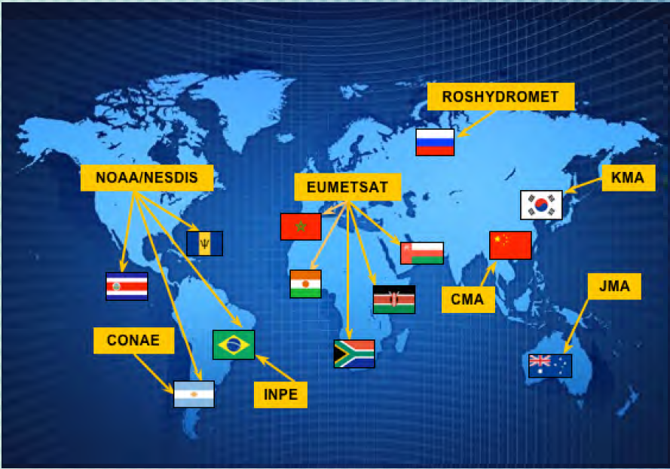
Main duty
CoEs and their supporting satellite operators (‘12.11)
RA II
(2010.11)
RA V
http:// www.wmo-sat.info/vlab
Manage the supporting of Weather forecasting by analyzing all available satellite data and product to monitor and interpret meteorological phenomena such as typhoon, cyclone system, Asian dusts, Fogs/smog, heavy rainfall etc spec
Develop new satellite data interpreting techniques by many case studies
Internal and International training in satellite Meteorology, as a contact point of CoE-KOREA

Slide 3
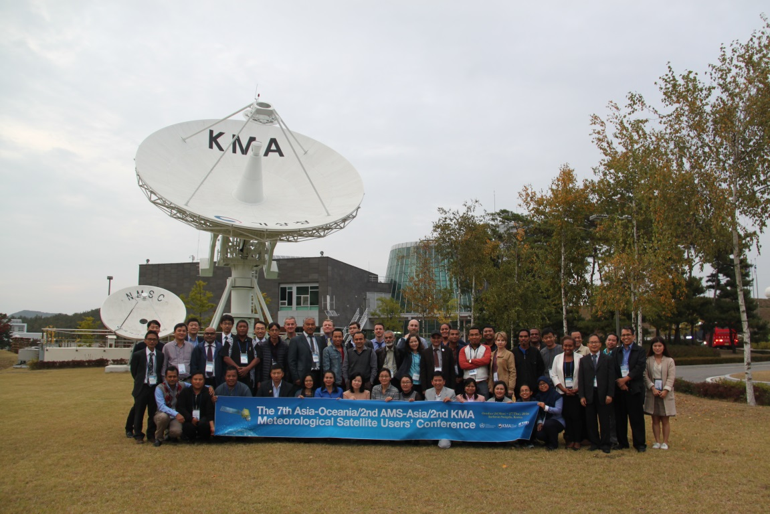
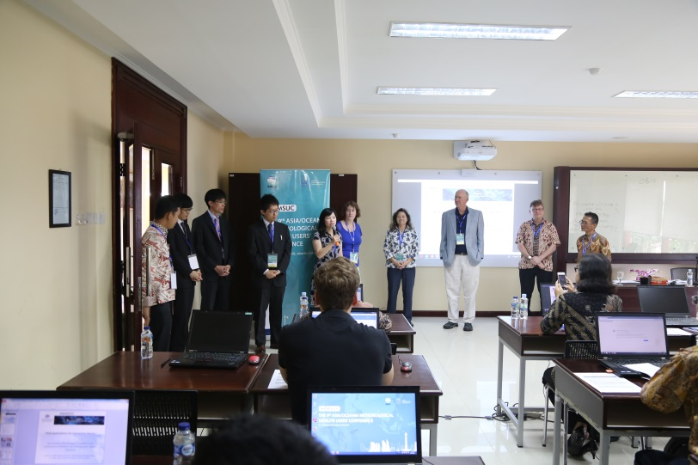
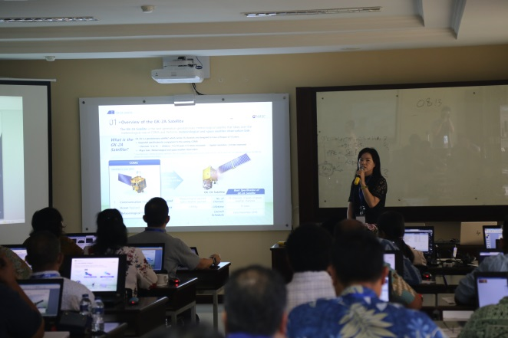
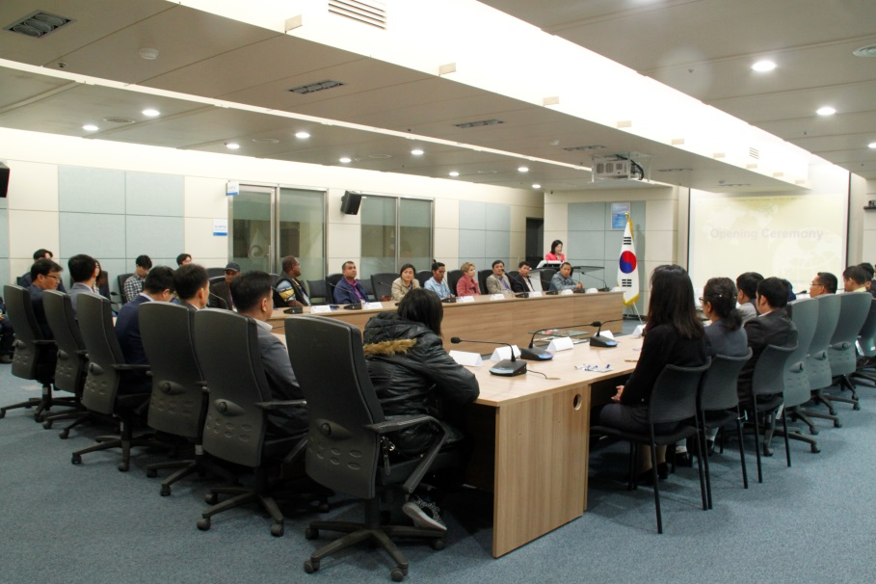
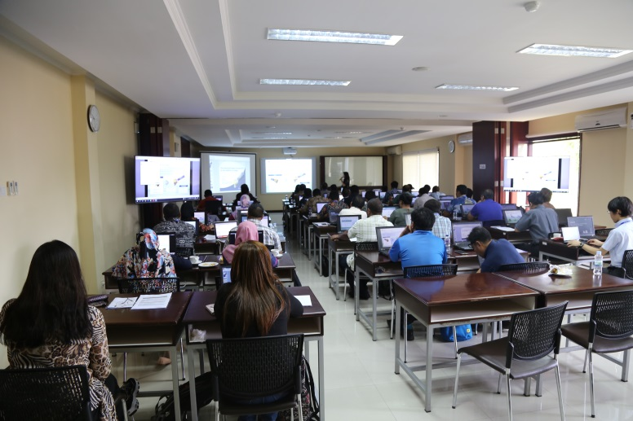
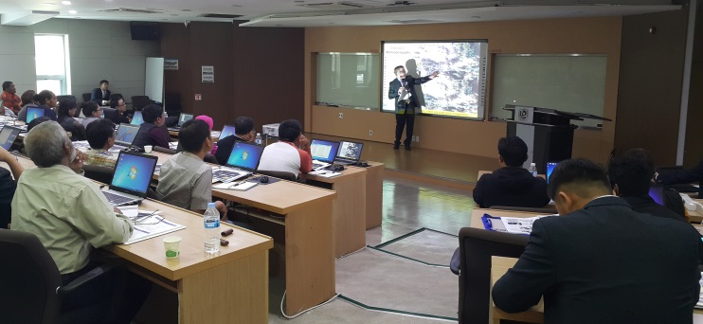
Contribution to the International training events
Host training events in AOMSUC-6 (2016)
Contribute in AOMSUC-8/Indonesia

Slide 4
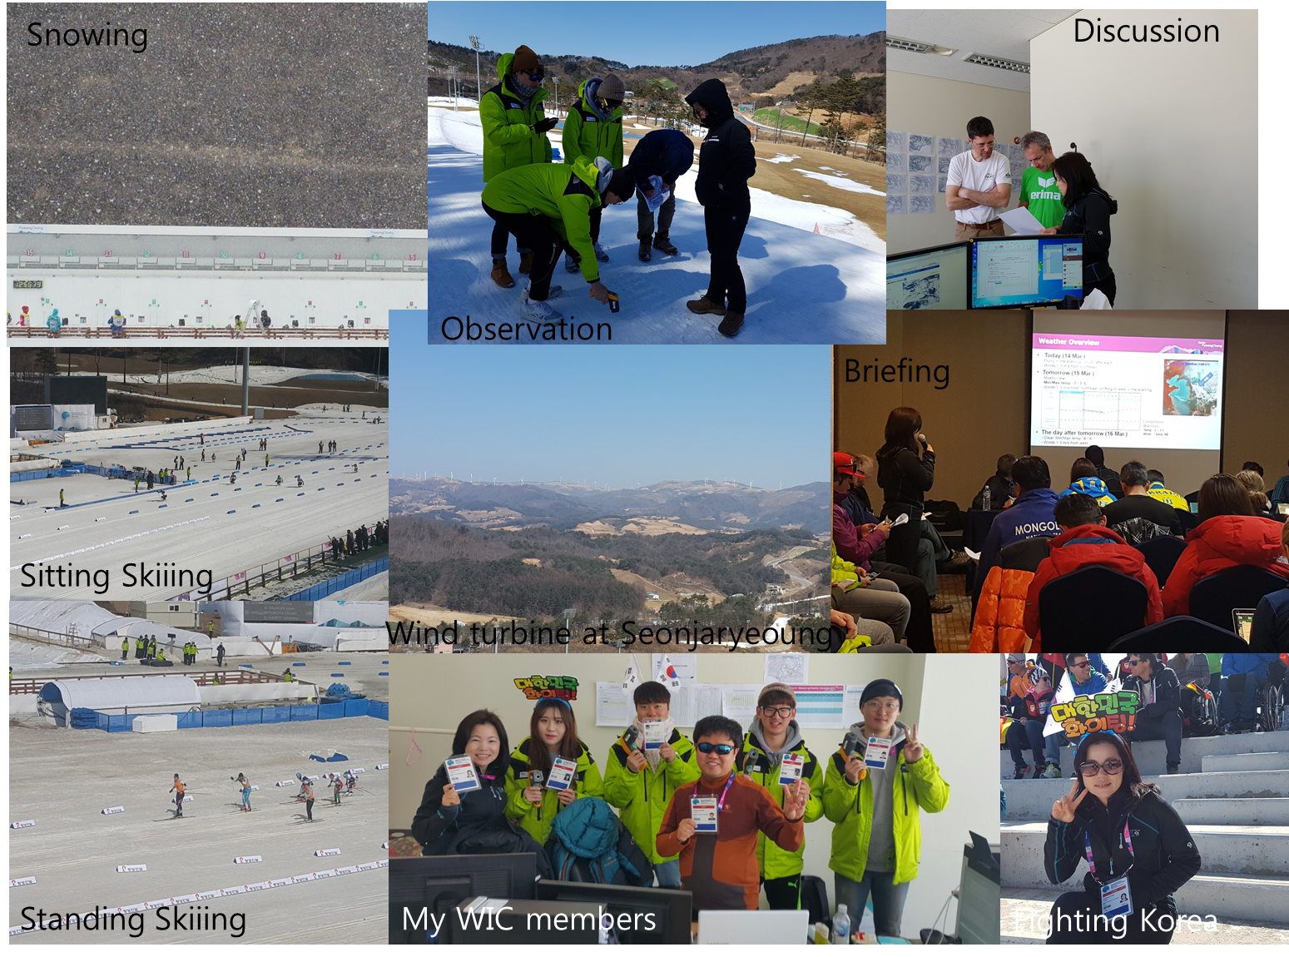
[Special mission] forecaster in Weather Information Center for Pyeungchang Winter Olymphic games in 2018
Cross-Country skiing and Nordic skiing

Slide 5
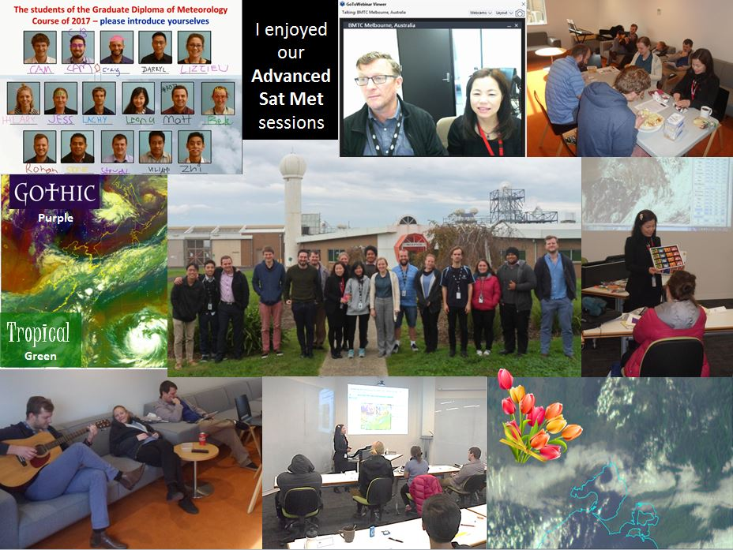
[Collaboration] Mission at BMTC/BoM in 2017

