Slide 1
Bilateral Cooperation between KMA and BoM(April 29th - May 3rd , 2019, Australia)
Current status of S-band Weather Radar Network in Korea
May 2019
Park, Hye Sook
National Meteorological Satellite Center
Korea Meteorological Administration
표지
All contents credit by Seung-Hwa Jung
In Weather Radar Center/KMA
Notes:
This time, I am going to talk about what has been changed in weather radar network in terms of ground validation of space borne radar.

Slide 2
Contents
Improvement of data processing chain
New Scanning Strategies : Low level coverage
Radar-QPE Technique : Hybrid Surface Rainfall
Notes:
I will mention about three topics; update cycle of radar, low level coverage, and radar rainfall estimation

Slide 3
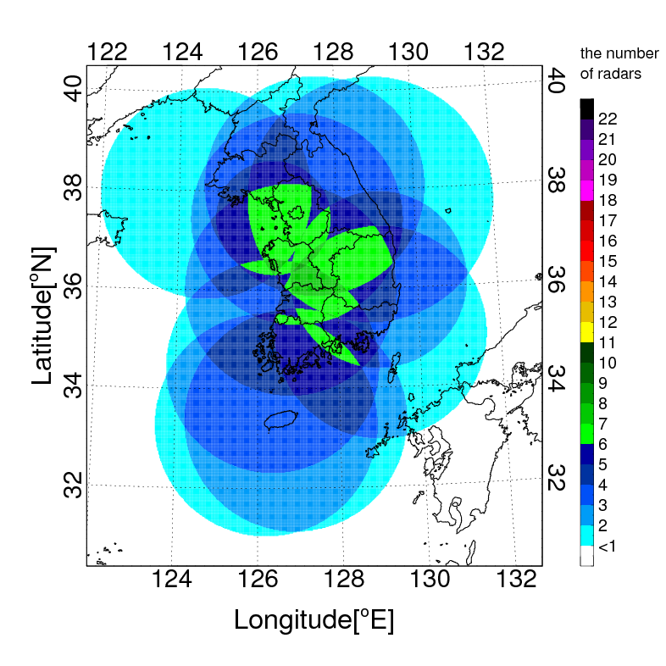
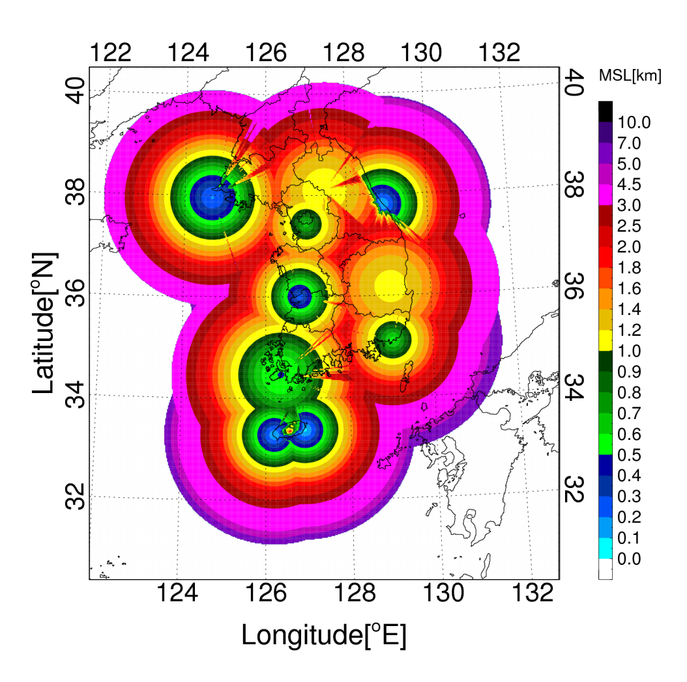
Weather Radar Network of KMA
KMA operational weather radar network
- 10 S-band Dual-Polarization radar
- Deployment along the national boundary
: wide observational coverage
- installation on the top of a mountain (max > 1.0km)
: to avoid beam blockage
- wide observational range (> 240km)
- 10 minute update cycle
- volume scan ( 9 ~ 12 elev. angles)
➔ issues : lazy update cycle, bad radar coverage at low altitude (<1km)

Slide 4
Improvement of Data Processing Chain
Conventional data processing chain
1
2
3
4
5
6
7
8
9
10
11
12
13
14
15
16
17
18
19
20
21
22
23
24
25
26
27
28
29
30
time
Volume scan
(7min)
QC
(2min)
Mosaic
(6min)
Volume scan
(7min)
QC
(2min)
Mosaic
(6min)
Volume scan
(7min)
QC
(2min)
Mosaic
(6min)
What has been changed?
Scanning interval : 10 minutes ➔ 5 minutes
Single observation range (240km) over all volume scan
➔ the observation range decreases as function of elev. Angle ➔ High PRF ➔ faster scan
The number of elevation angles : 8 ~ 11 ➔ 9 elevation angles
Employment of negative (-) elevation angle

Slide 5
Improvement of Data Processing Chain
Conventional data processing chain
1
2
3
4
5
6
7
8
9
10
11
12
13
14
15
16
17
18
19
20
21
22
23
24
25
26
27
28
29
30
time
Volume scan
(7min)
QC
(2min)
Mosaic
(6min)
Volume scan
(7min)
QC
(2min)
Mosaic
(6min)
Volume scan
(7min)
QC
(2min)
Mosaic
(6min)
New data processing chain
1
2
3
4
5
6
7
8
9
10
11
12
13
14
15
16
17
18
19
20
21
22
23
24
25
26
27
28
29
30
time
Volume scan
(4min 30sec)
Volume scan
(4min 30sec)
Volume scan
(4min 30sec)
Volume scan
(4min 30sec)
Volume scan
(4min 30sec)
Volume scan
(4min 30sec)
Transfer sweep data
(every 30sec)
Transfer sweep data
(every 30sec)
Transfer sweep data
(every 30sec)
Transfer sweep data
(every 30sec)
Transfer sweep data
(every 30sec)
Transfer sweep data
(every 30sec)
1
2
3
4
5
6
7
8
9
10
11
12
13
14
15
16
17
18
19
20
21
22
23
24
25
26
27
28
29
30
QC
(10sec)
QC
QC
QC
QC
QC
HSR1
(30sec)
HSR2
(30sec)
HSR1
HSR2
HSR1
HSR2
HSR1
HSR2
HSR1
HSR2
HSR1
HSR2

Slide 6
Contents
Improvement of data processing chain
New Scanning Strategies : Low level coverage
Radar-QPE Technique : Hybrid Surface Rainfall
Notes:
I will mention about three topics; update cycle of radar, low level coverage, and radar rainfall estimation

Slide 7
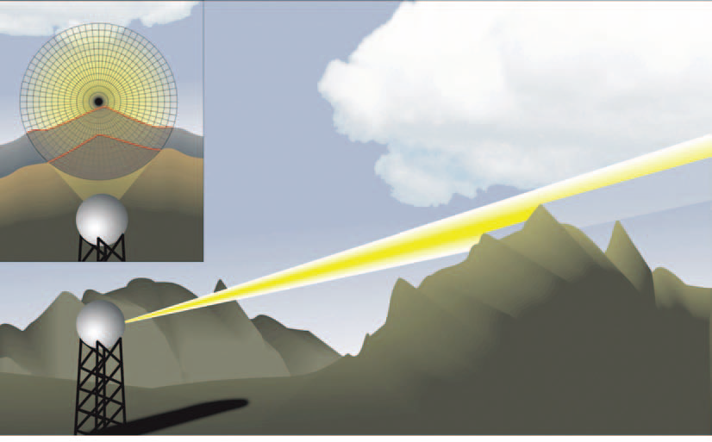
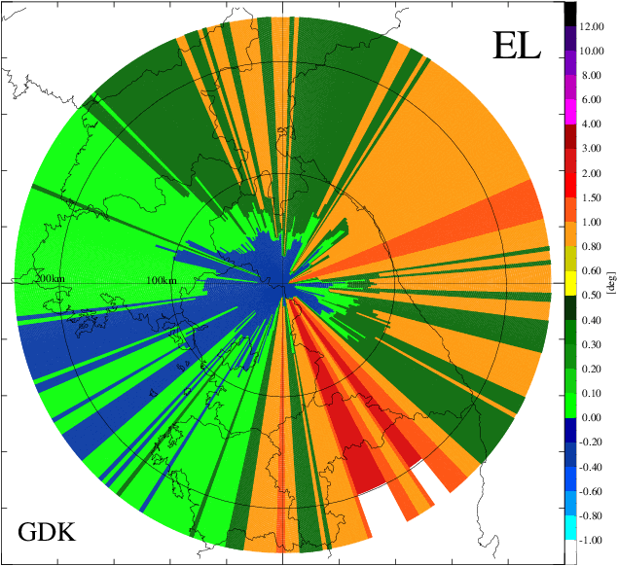
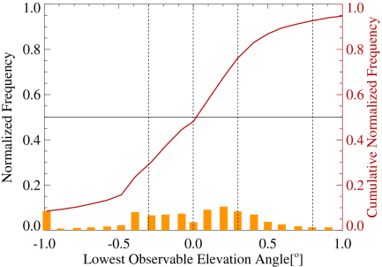
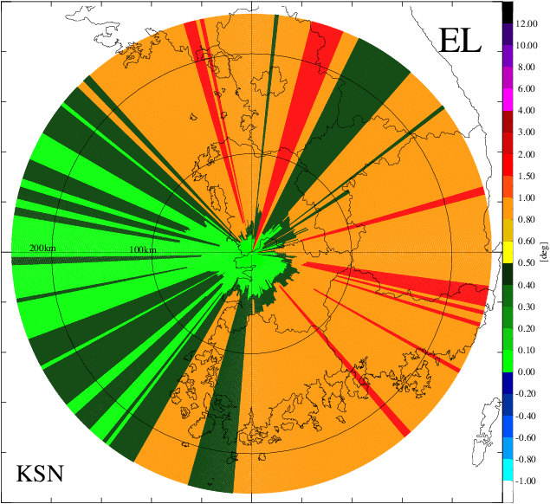
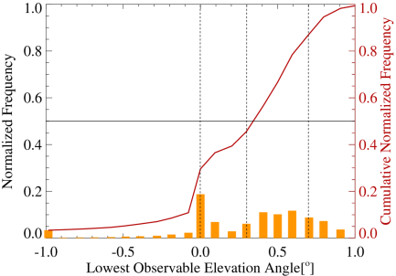
Determination of Lowest Elevation Angle
Beam blockage simulation with high vertical resolution (0.1ᵒ)
GDK
30%
From W. Krajewski, Univ. of Iowa
KSN
high vertical resolution (0.1ᵒ)
digital elevation model with 1”
standard refraction
two-way gaussian beam pattern
30%
 | JNI | PSN | KWK | GDK | KSN
Lowest elev. angle [°] | -0.1 | -0.1 | -0.2 | -0.4 | 0.0

Slide 8
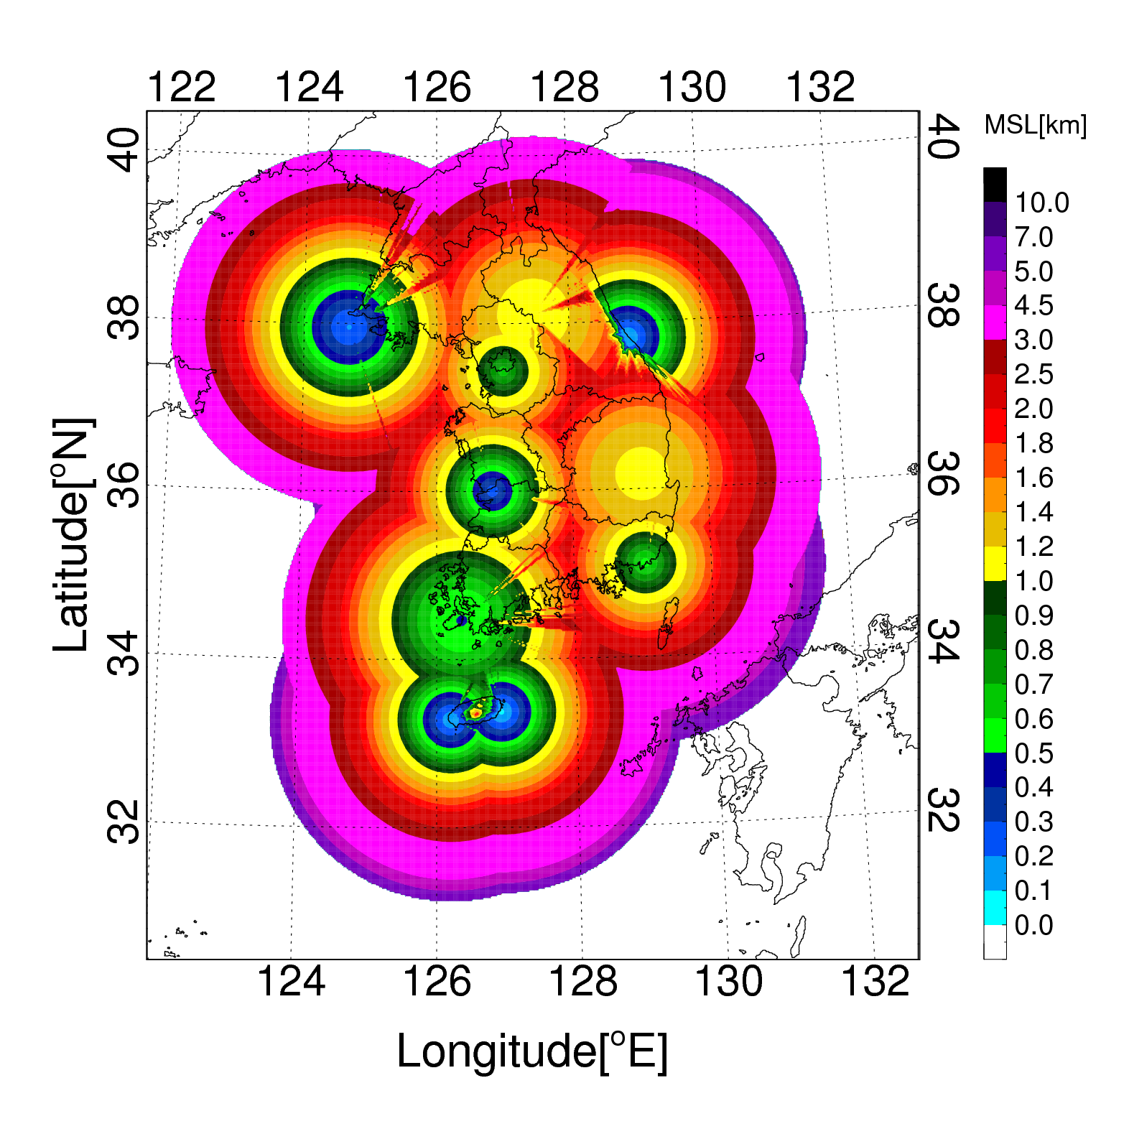
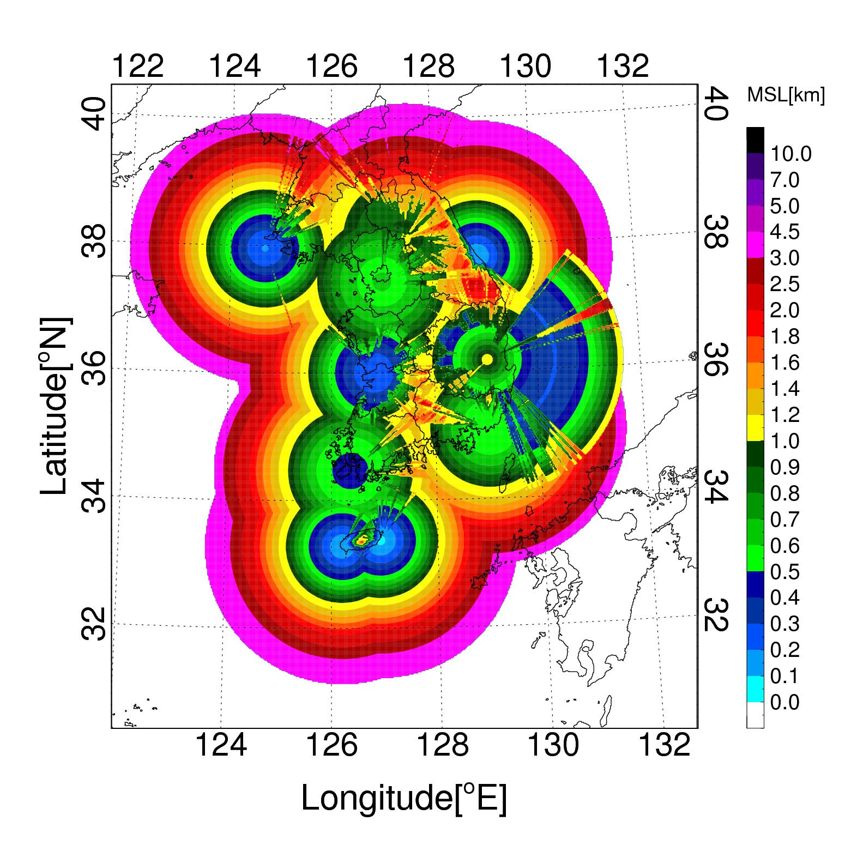
Lowest Observable Height
Existing scanning strategies (10 min)
New scanning strategies (5 min)
Low Level Radar Coverage (<1km) : 15.8% ➔ 39.8%
[%] | SSP | GNG | GSN | BRI | KSN | JNI | GDK | KWK | GDK | MYN
Existing | 6.4 | 5.2 | 7.1 | 12.6 | 5.7 | 12.3 | 2.7 | 2.0 | 0.0 | 0.0
New | 10.3 | 7.8 | 12.9 | 14.9 | 9.0 | 14.7 | 10.5 | 11.4 | 4.8 | 9.1
Diff. | +3.9 | +2.6 | +5.8 | +2.3 | +3.3 | +2.4 | +7.8 | +9.4 | +4.8 | +9.1

Slide 9
Benefit of New Scanning Strategy
1400KST at 30th January, 2018
New strategy
Elev: -0.2ᵒ
Old strategy
Elev : 0.3ᵒ
1500KST at 30th January, 2018
radar coverage at low altitude (<1km) enlarged

Slide 10
Contents
Improvement of data processing chain
New Scanning Strategies : Low level coverage
Radar-QPE Technique : Hybrid Surface Rainfall
Notes:
I will mention about three topics; update cycle of radar, low level coverage, and radar rainfall estimation

Slide 11
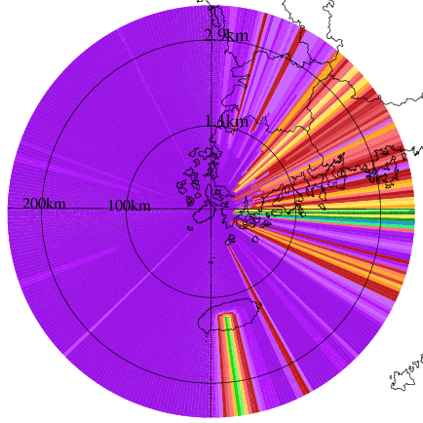
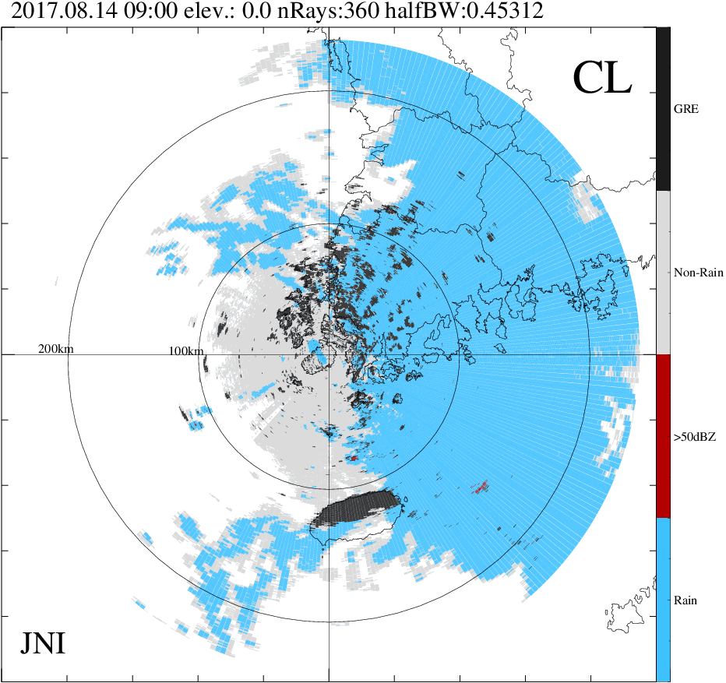
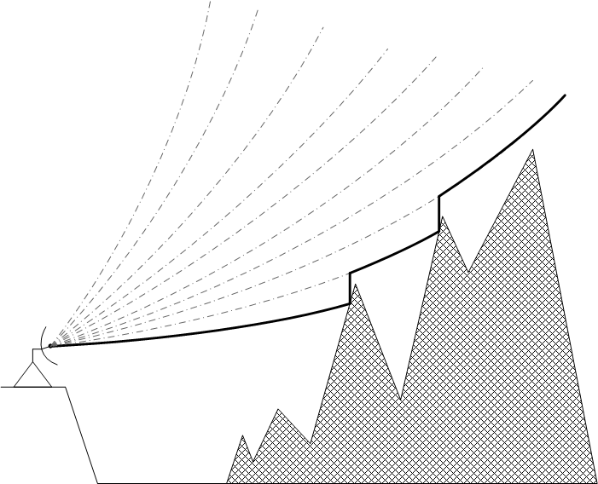
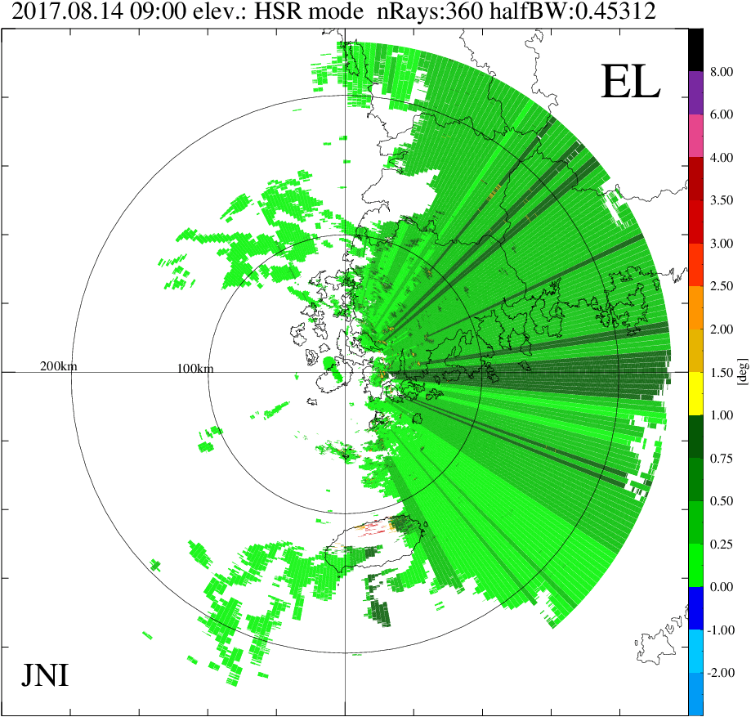
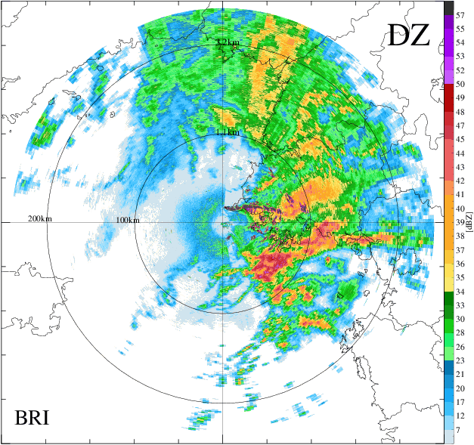
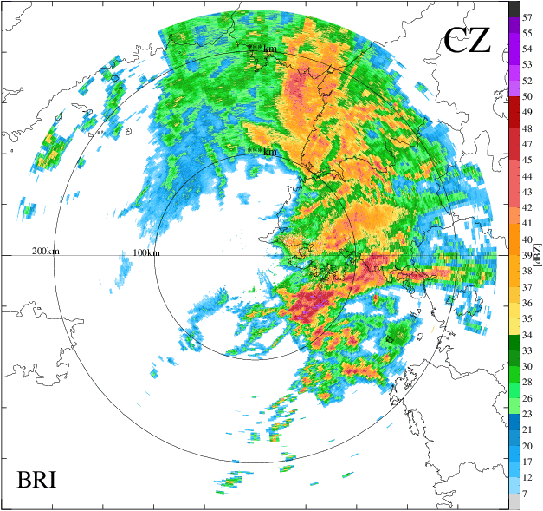
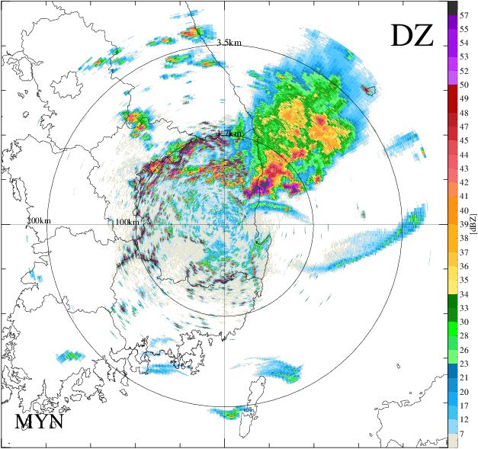
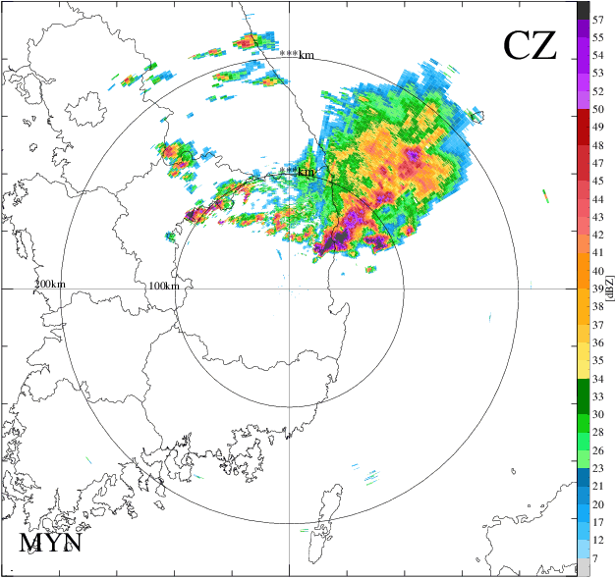
Hybrid Surface Rainfall
Rainfall Estimation Technique based on Hybrid Surface
: the rainfall estimation technique base on the lowest-observable elevation surface, in radar volume scan that immunes to radar beam blockage, ground clutter contamination and non-meteorological echoes
Chaff
blockage fraction＜10%
avoiding non-rain echo
Blocking
Ground Echo(GRE) Identification
by applying threshold of
(DZ-CZ), RH, STDEV(DZ), STDEV(CZ)
Ground
Clutter
2017/08/15 06:30KST
2017/06/01 14:10KST
PPI0
PPI0
Hyb.
PPI0
Hyb.
sea clutter
ground clutter
ground clutter
chaff
BRI
BRI
MYN
MYN

Slide 12
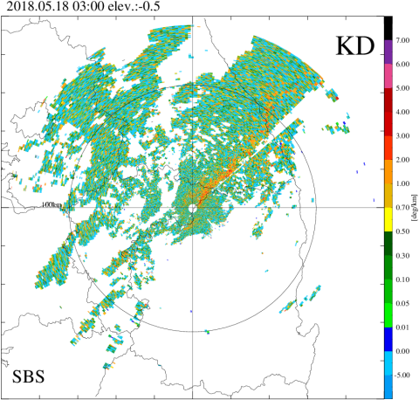
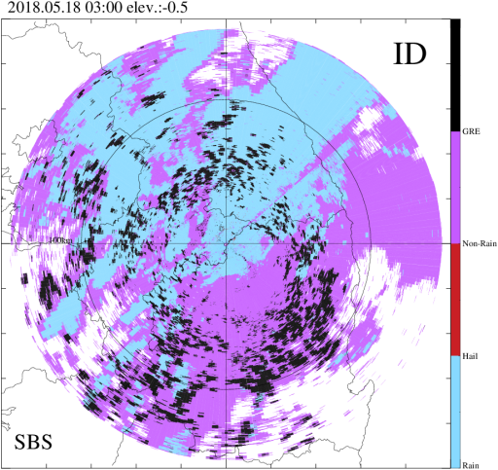
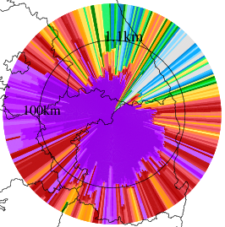
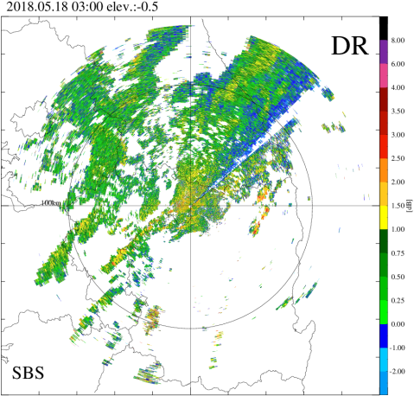
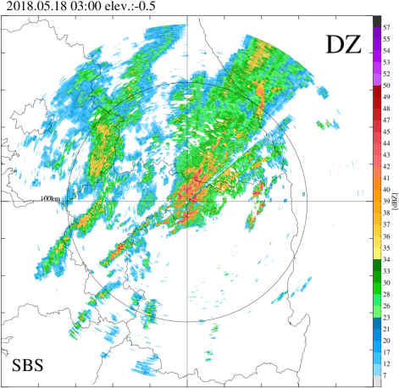
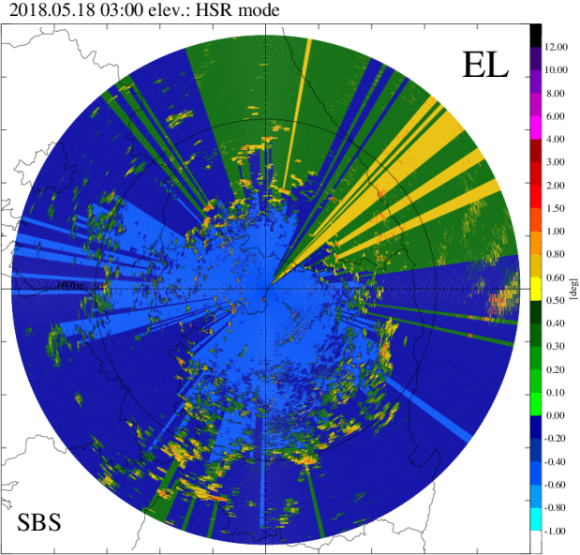
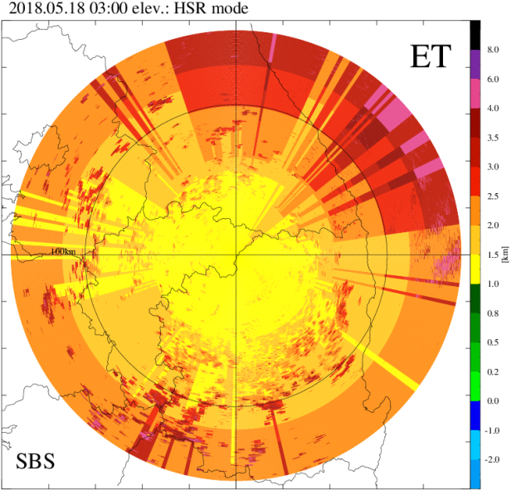
Hybrid Surface Rainfall
Identification of ground clutter
Classification of Non-meteorological echo
Blockage simulation
Construction of Hybrid Surface
강우추정을 위한 이중편파 레이더 변수
Hybrid Surface[°]
Height of Hybrid surface [km]

Slide 13
Hybrid Surface Rainfall
Identification of ground clutter
Classification of Non-meteorological echo
Blockage simulation
Construction of Hybrid Surface
DSD data of 2DVD from April 2014 to Oct. 2017
If $ZH$＞45dBZ & $KDP$＞1.3°/km,
$R\left(KDP\right)=44.63{KDP}^{0.854}$
else if$ZH$＞15dBZ $and ZDR$＞0.2dB,
$R\left(ZH,ZDR\right)=0.0121{ZH}^{0.88}{10}^{0.1·(−4.365)ZDR}$
$else R\left(ZH\right)=0.0407{ZH}^{0.628}$
$$R\left(ZH\right)$$
$$R\left(KDP\right)$$
$$R\left(ZH,ZDR\right)$$

Slide 14
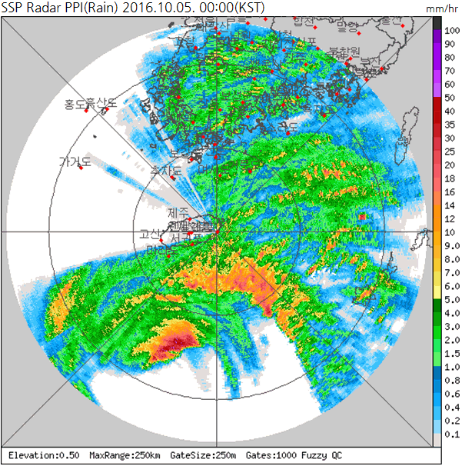
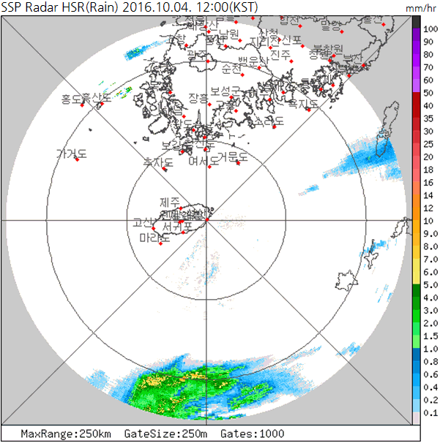
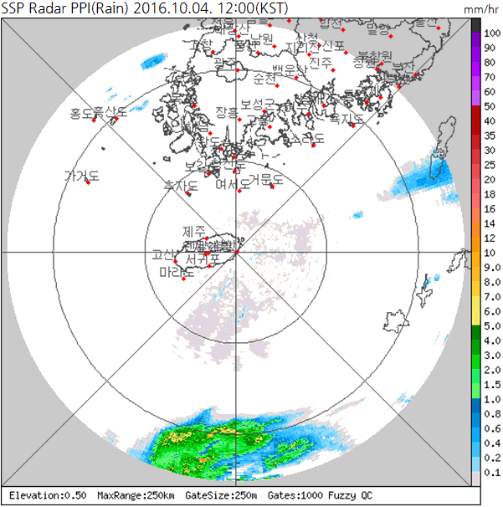
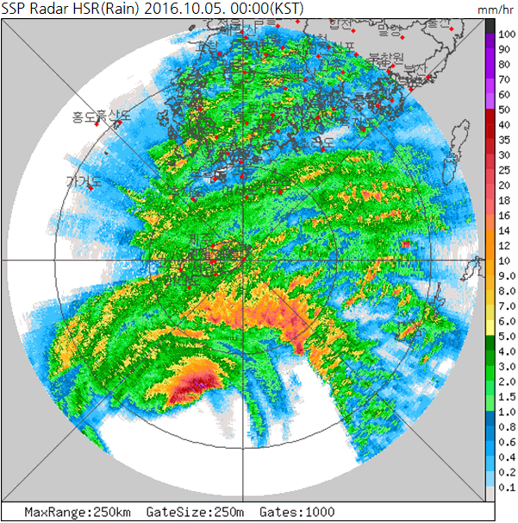
Example of Hybrid Surface Rainfall
SSP, Typhoon ‘Chaba’ (2016.10.04~05)
PPI0
HSR
Blocking area
due to Mt.Halla
→ Huge
observation gap
QPE is also improved by hybrid surface technique
not only in observation gap due to ground clutter but also in beam blockage area.

Slide 15
Summary and future works
Scanning strategies : 10minutes ➔ 5 minutes
We applied to negative (-) elevation angle
➔ radar coverage (< 1km height): 18.5% ➔ 39.8%
Volume-based data processing chain ➔ sweep-based data processing chain
➔ Service time has been dramatically reduced (15 min ➔ 3 min)
KMA’s operational radar-QPE has been changed from PPI and CAPPI to Hybrid Surface Rainfall (HSR)
➔ QPE performance : 51.8% ➔ 75.5%
Notes:
The result of QPE verification of 2017 is also similar to previous result.
QPE is also improved by hybrid surface technique not only in observation gap due to ground clutter but also in beam blockage area.

Slide 16
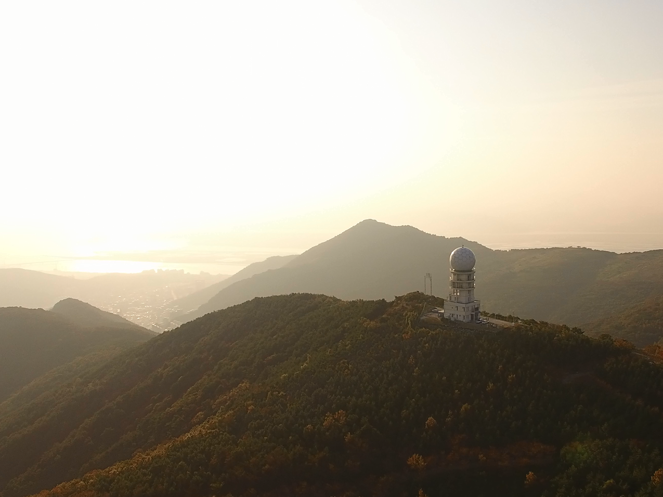
Thank you for your attention

