Slide 1
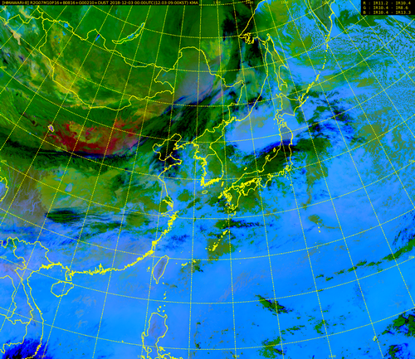
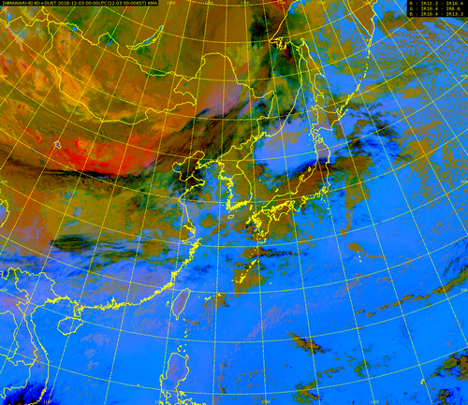
animations and imagery courtesy Korea Meteorological Administration
Different Dust RGB composites
Animation K3
A. Ver. 2019
B. Ver. 2018
Loop (00UTC Dec. 3rd ~00UTC Dec. 5th , 2018)
Please start the PowerPoint Slide Show to activate the animation

