Slide 1
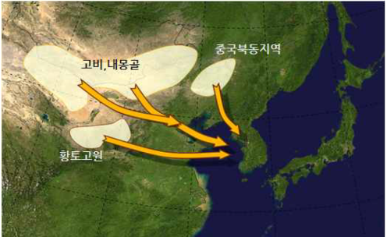
animations and imagery courtesy Korea Meteorological Administration
Satellite products for dust detection in KMA
Animation K1
Neimenggu
Inner Mongolia
Northern China
Gobi desert
Loop1-2 ( Dust events from 28th to 31st on March , 2018)
Loess Plateau
Himawari-8/ Dust RGB
COMS/Aerosol Index
Please start the PowerPoint Slide Show to activate the animation

