Slide 1
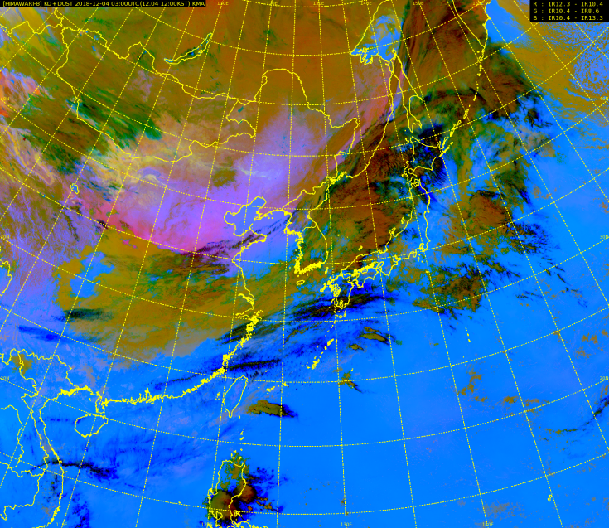
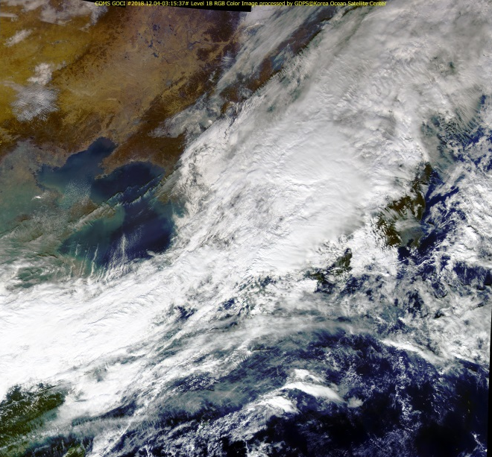
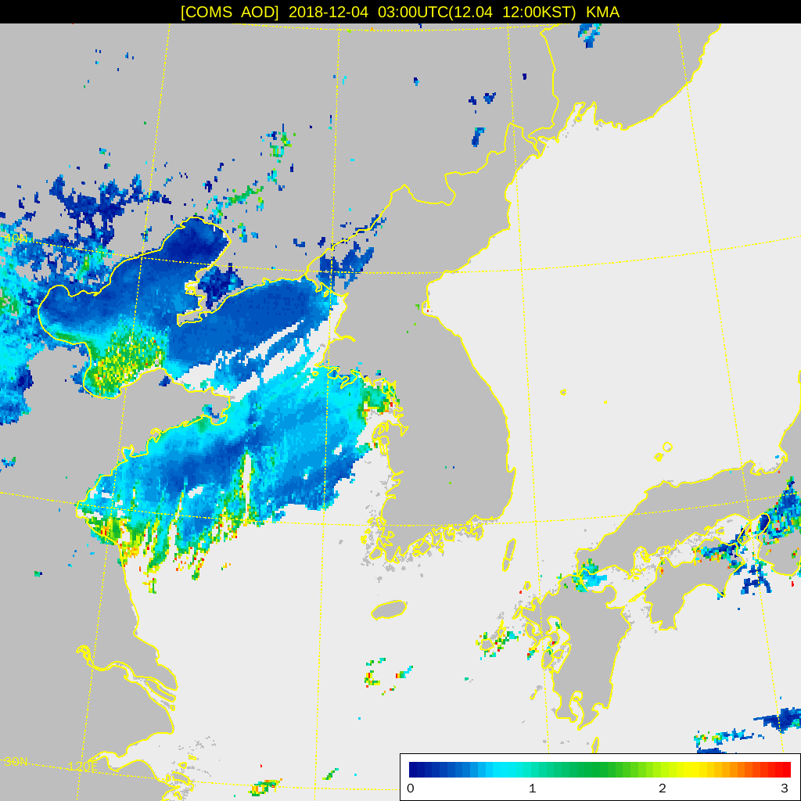
animations and imagery courtesy Korea Meteorological Administration
Motivation) Variations in Dust RGB – diurnal cycle, height and thickness
Animation K2
Dust RGB(ver.2018)
Loop3 (00UTC Dec. 03rd - 23UTC Dec. 4th, 2018)
03UTC Dec 4th, 2018
Similar color between surface and dust area
Weak signal over marine areas, especially during the winter season
COMS/GOCI True Color RGB
COMS/AOD
Please start the PowerPoint Slide Show to activate the animation

