Slide 1
Wave feature on the cloud tops of Tropical Cyclone Pola, Fiji area
12UTC to 23UTC 27th February 2019
Assembled by B.Zeschke, BMTC, Australian Vlab Centre of Excellence from information provided by Grace Legge, BNOC EWD

Slide 2
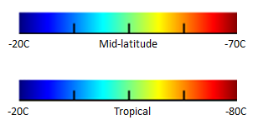
Enhanced infrared imagery (10FPS rocking animation) 06UTC to 23UTC 26th February 2019
Please start the Power Point Slide Show to activate the animation
Fiji
animation courtesy BOM/JMA

Slide 3
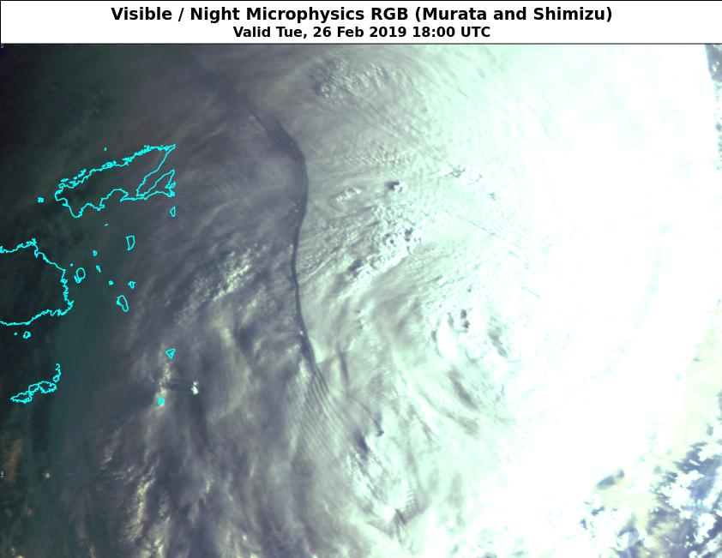
Appearance in the True Colour RGB 18UTC 26th February 2019
image courtesy BOM/JMA
Viti
Levu
Fiji

Slide 4
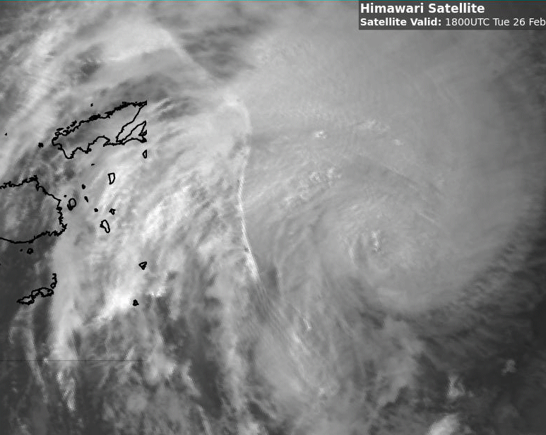
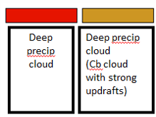
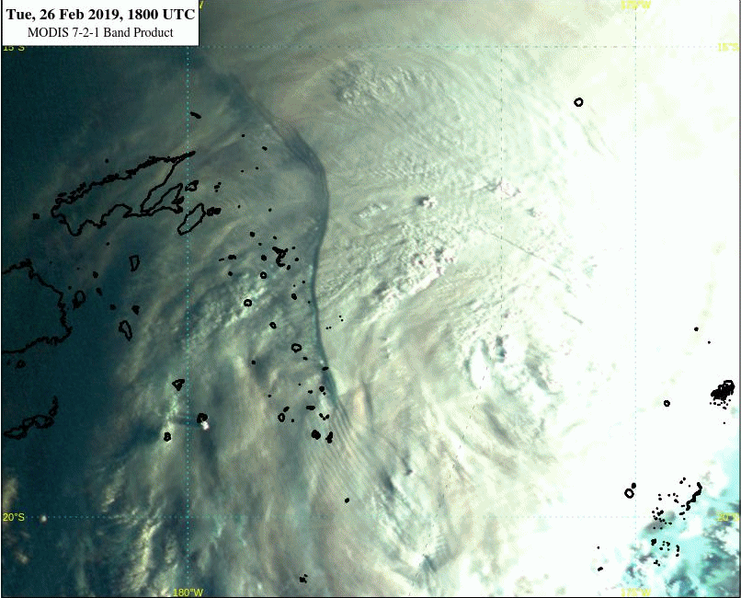
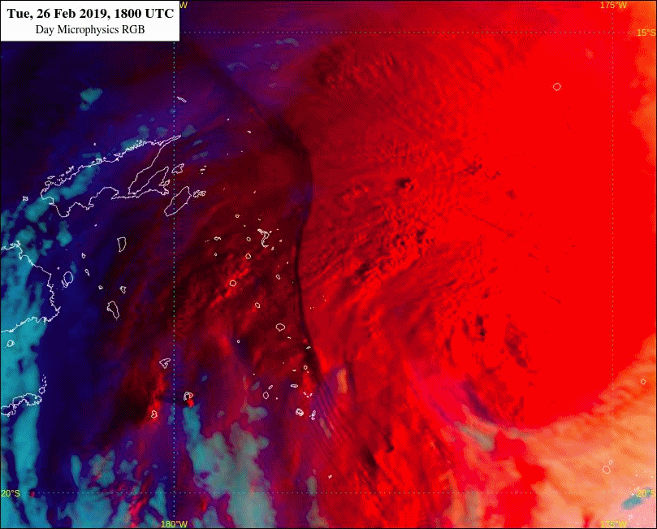
Various satellite data (5FPS animation) 18UTC to 22UTC 26th February 2019
Please start the Power Point Slide Show to activate the animation
animations courtesy BOM/JMA
Day Microphysics RGB high cloud palette
Fiji
SWIR (3.8 micron)
Fiji
Fiji
MODIS 7-2-1 product
Day Microphysics RGB

Slide 5
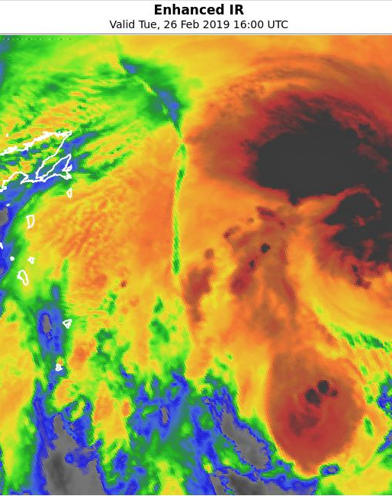
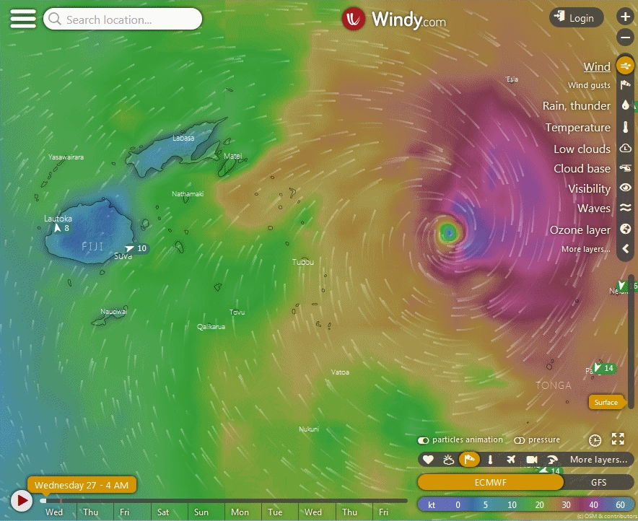
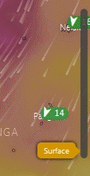
EC winds at various levels at 16UTC and enhanced IR image of the same time
Please start the Power Point Slide Show to activate the animation
Fiji
image courtesy Windy.com
image courtesy BOM/JMA

Slide 6
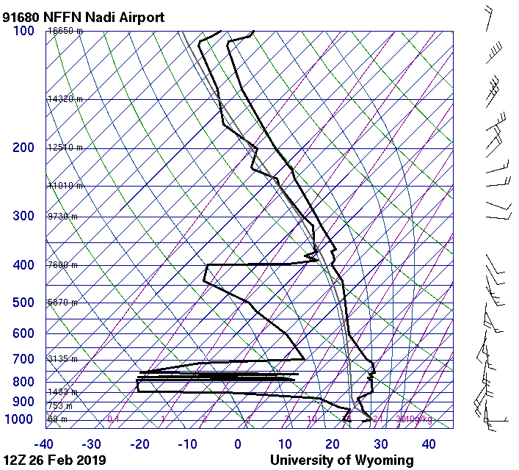
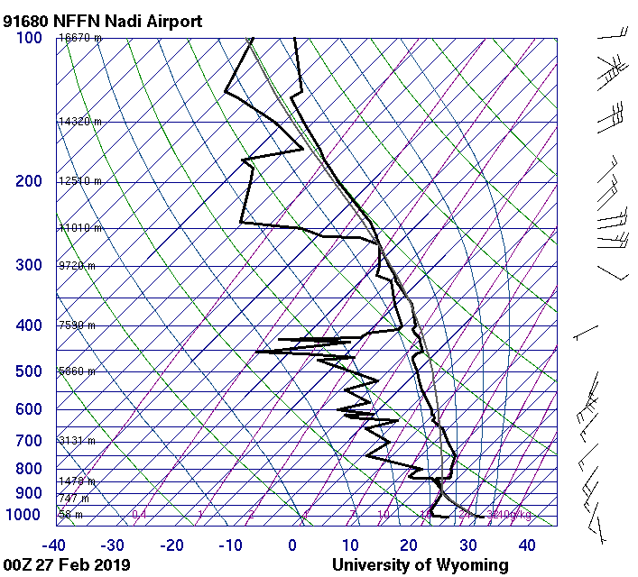
Nadi soundings, 12UTC 26th February and 00UTC 27th February
Images courtesy University of Wyoming

