Slide 1
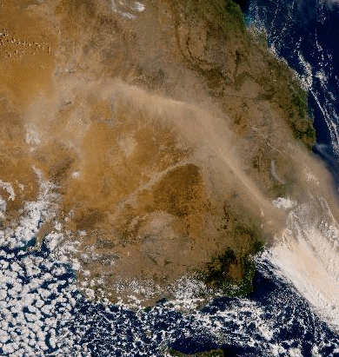
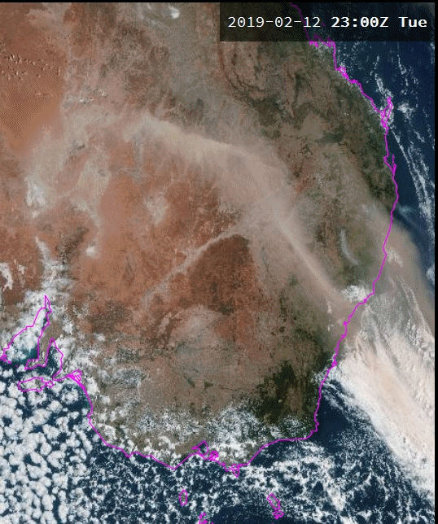
Please start the Power Point Slide Show to activate the animation
Comparing various True Colour RGB products
Australian Dust Event 2300UTC 12th February to 0730UTC 13th February 2019
animation courtesy JMA
BOM TC RGB animation courtesy JMA/BOM
Melbourne
Melbourne
JMA TCR product
BOM True Colour RGB (Panther viewer)

