Slide 1
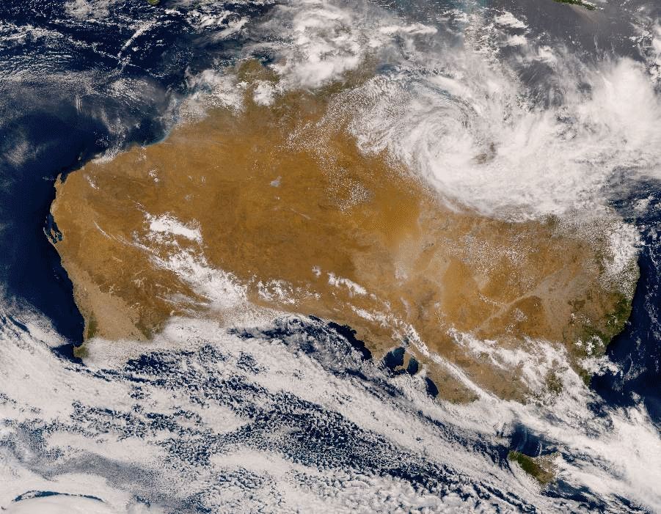
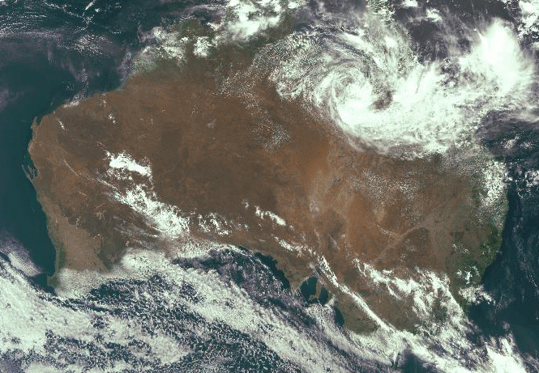
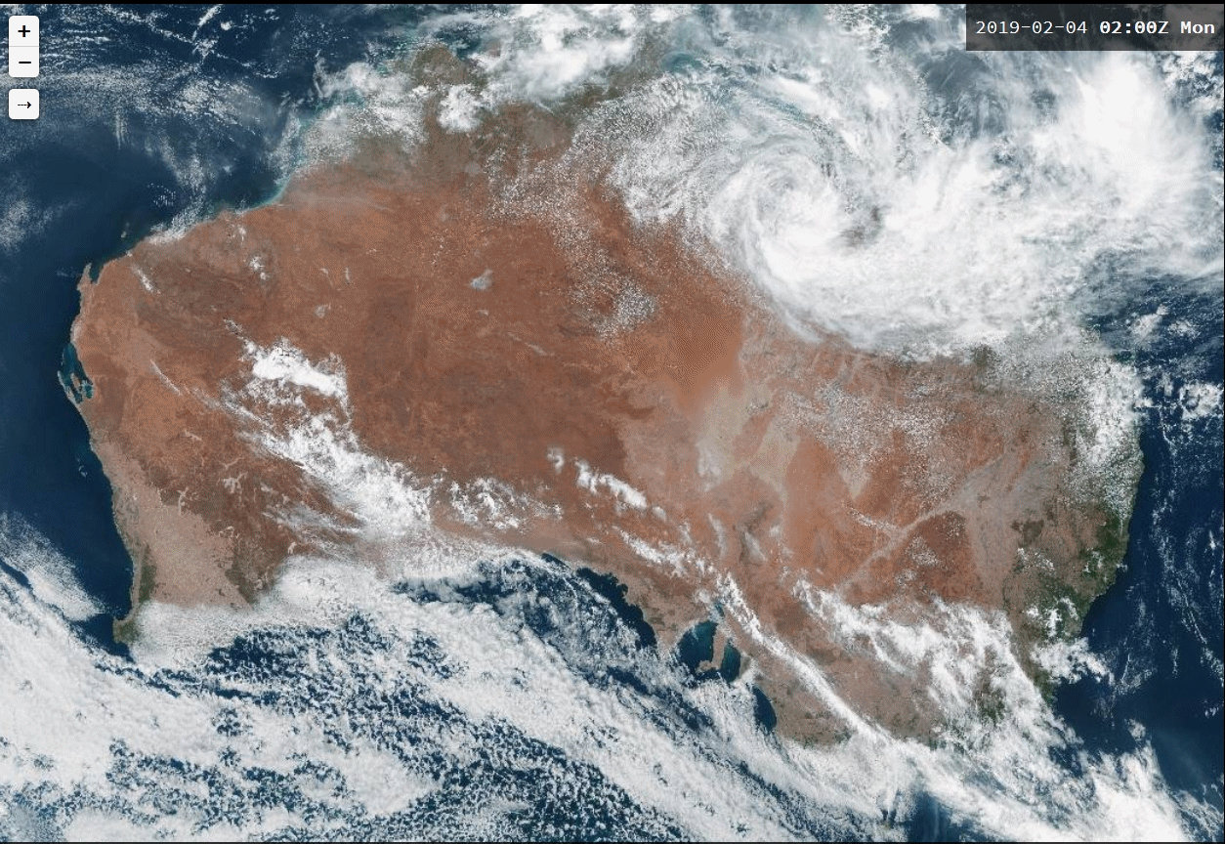
Please start the Power Point Slide Show to activate the animation
animation courtesy JMA
JMA TCR product
Comparing various True Colour RGB products
Australian continent 02 to 05UTC 4th February 2019
BOM TC RGB animation courtesy JMA/BOM
Below: BOM True Colour RGB (Visual Weather viewer), uncorrected for Rayleigh scattering
Below: BOM True Colour RGB (Panther viewer)

