Slide 1
Concentric dissipation of stratocumulus cloud in the vicinity of King Island, Bass Strait 7th January 2019
Assembled by B.Zeschke, BMTC, Australian VLab Centre of Excellence from information provided by M. Bradbury VICRO RFC, Eng Ching SARO and information obtained using Panther and Visual Weather

Slide 2
Hi all,
I'm interested in issuing a tweet about the interesting cloud/wave feature over King Island. Does anyone have a concrete idea of what's causing it? Attached is the GIF, plus A-R 04Z model trace.
Regards,
Miriam Bradbury | Meteorologist
From: Eng Ching Sent: Monday, 7 January 2019 4:11 PM To: Miriam Bradbury; MDL_synoptic_discussion Subject: Re: King Island feature [SEC=UNCLASSIFIED]
We had a discussion in Adelaide earlier on. My guess is it started with an pulse convection over King Island with compensation downward motion just outside propagating outwards as a gravity wave.
Happy to hear other plausible explanations.
Cheers
Simon E Ching Bureau of Meteorology

Slide 3
Animation provided by Miriam Bradbury
animation courtesy BOM / JMA
Please start the Power Point Slide Show to activate the animation
King Island

Slide 4
Image provided by Miriam Bradbury
image courtesy BOM
King Island

Slide 5
Animation: True Colour RGB 23UTC 6th to 06UTC 7th January 2017
animation courtesy BOM / JMA
Please start the Power Point Slide Show to activate the animation
Wilson's Promontory

Slide 6
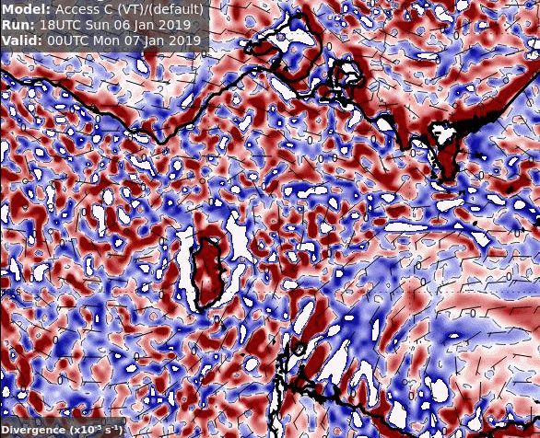
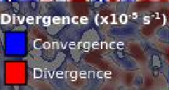
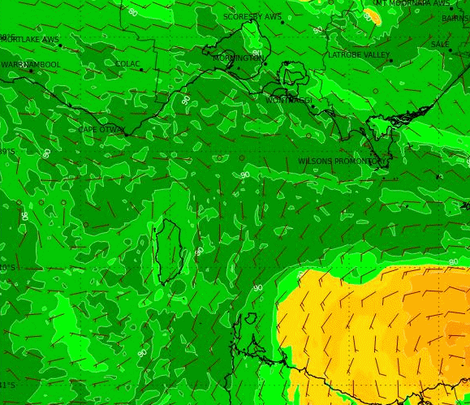
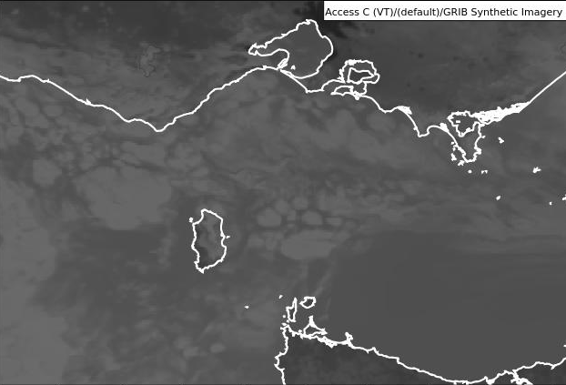
Please start the Power Point Slide Show to activate the animation
Animation: ACCESS CVT model output (18UTC 6th January analysis)
From 00UTC to 06UTC 7th January 2017
animations courtesy BOM
925hPa Convergence / Divergence
925hPa RH and wind
Synthetic Sat Data

Slide 7
ACCESS CVT cross section 00UTC 7th January 2019
image courtesy BOM

Slide 8
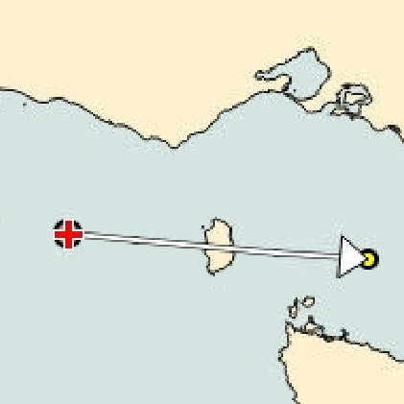
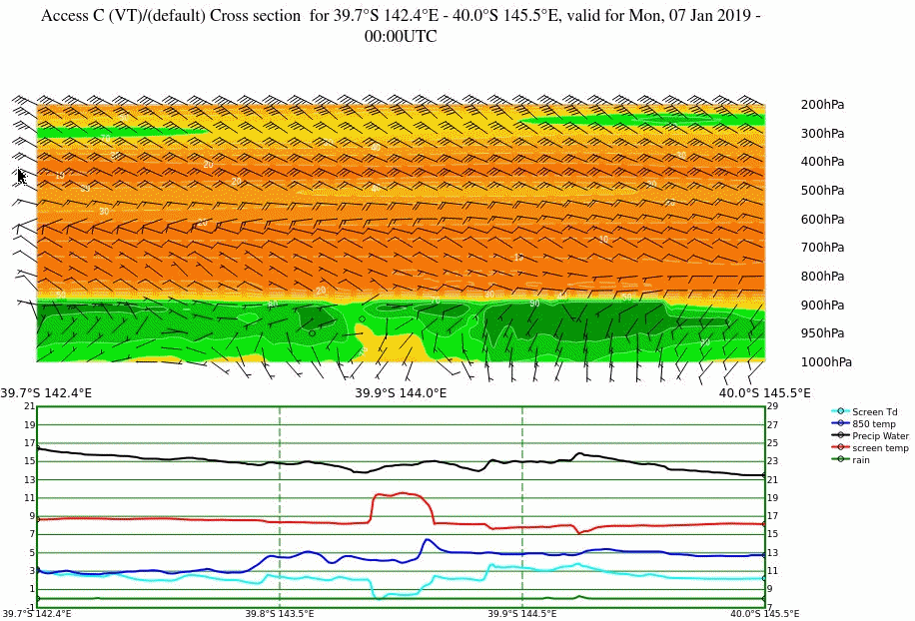
Animation: ACCESS CVT cross section as per the previous slide 00UTC to 06UTC 7th January 2019
Please start the Power Point Slide Show to activate the animation
animations courtesy BOM
Note the westward propagation of the "wave" of low 850 temp from 00 to 05UTC
Note the non-absolute scale of the bottom cross section across the animations

