Slide 1
Comparing various Ash RGB products with the JMA SO2 RGB product for the Manam eruption of the 8th December 2018
Assembled by B.Zeschke, BMTC, Australian VLab Centre of Excellence

Slide 2
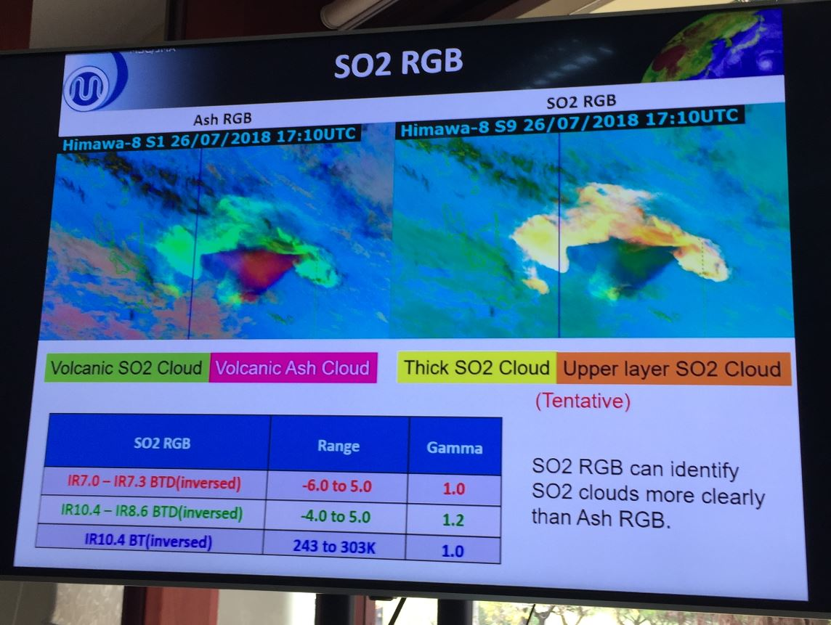
image courtesy JMA

Slide 3
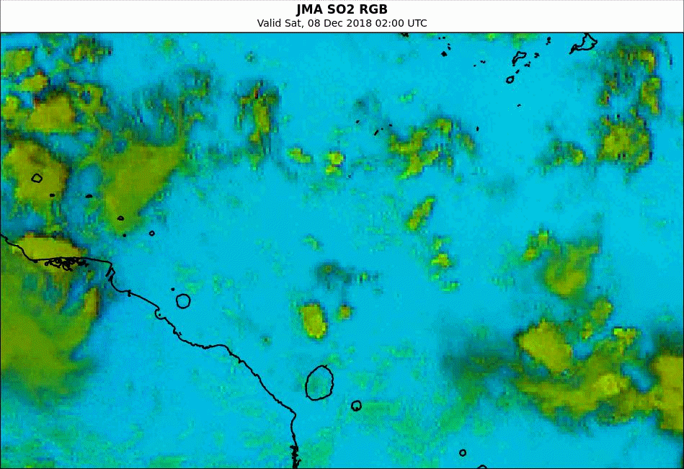
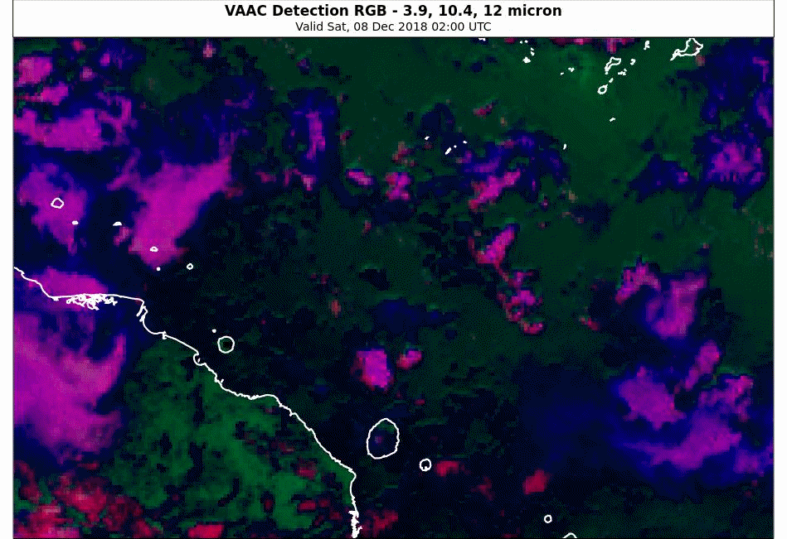
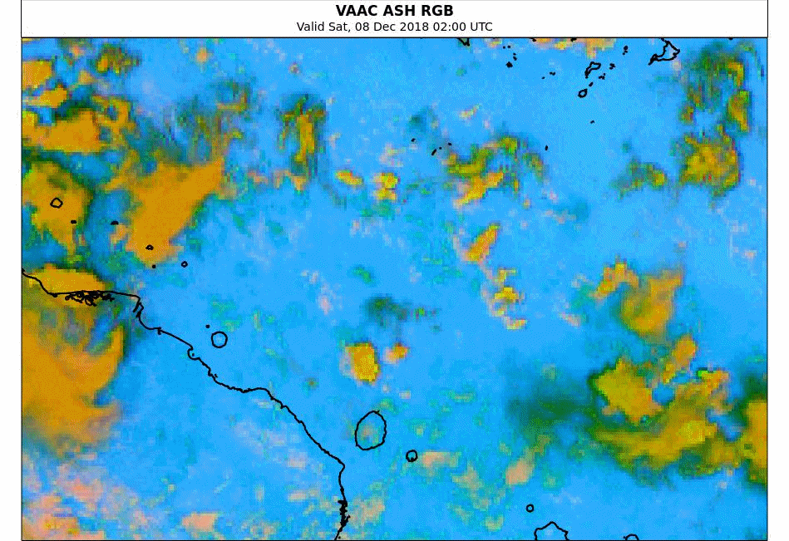
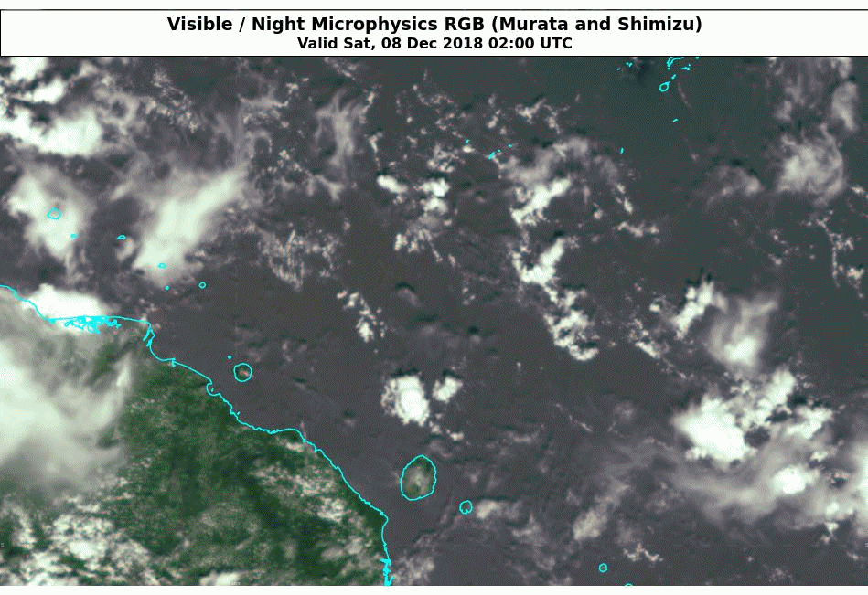
Manam eruption 02 to 12 UTC 8th December 2018
Please start the Power Point Slide Show to activate the animation
animations courtesy BOM/JMA
JMA SO2 RGB
VAAC Detection RGB
Manam
VAAC ASH RGB
True Colour RGB

Slide 4
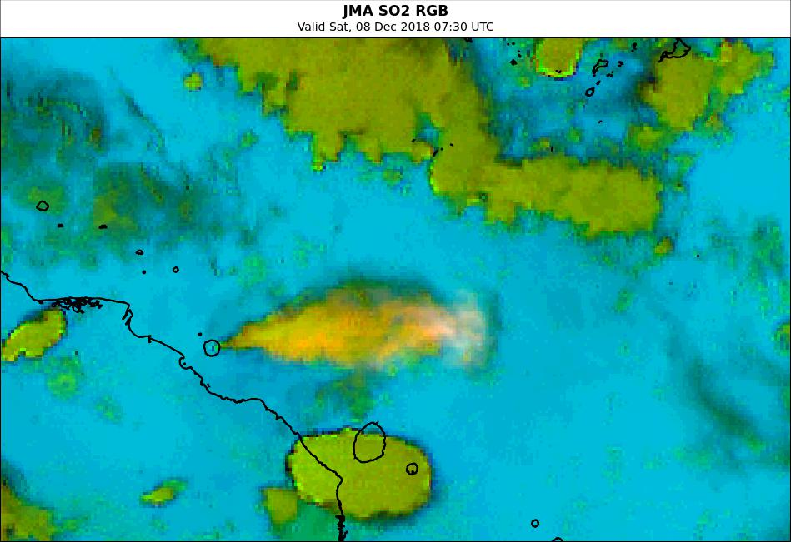
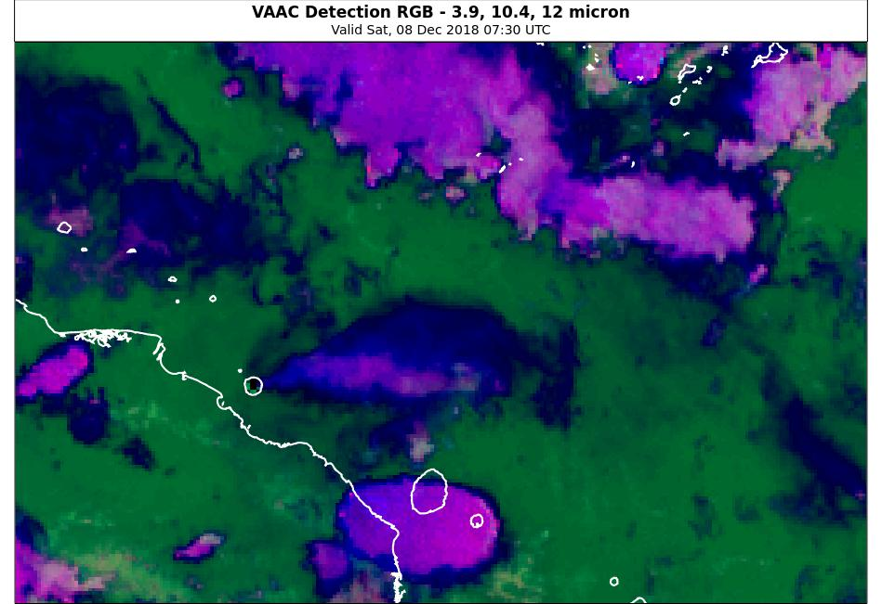
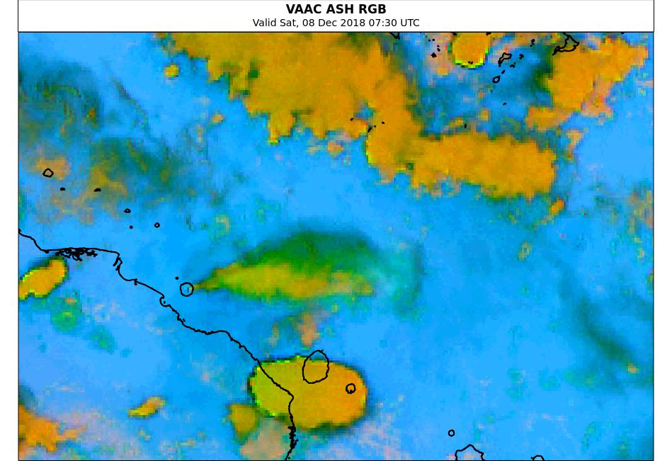
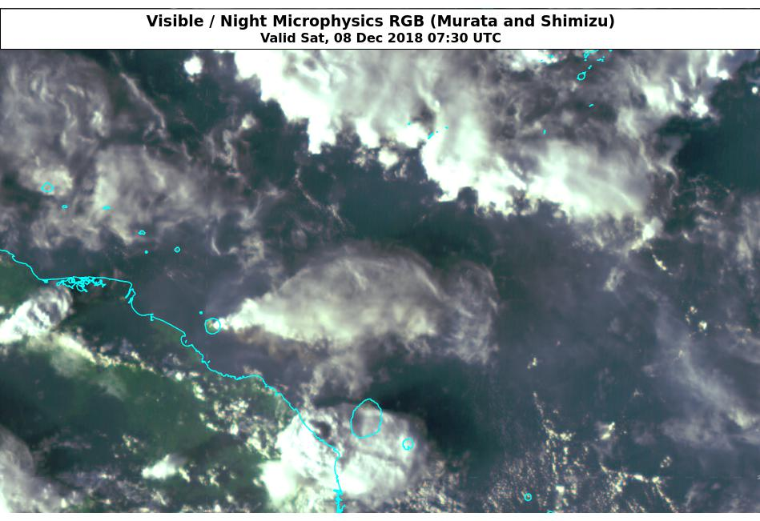
Manam eruption 0730UTC 8th December 2018
images courtesy BOM/JMA
JMA SO2 RGB
VAAC Detection RGB
Manam
VAAC ASH RGB
True Colour RGB

Slide 5
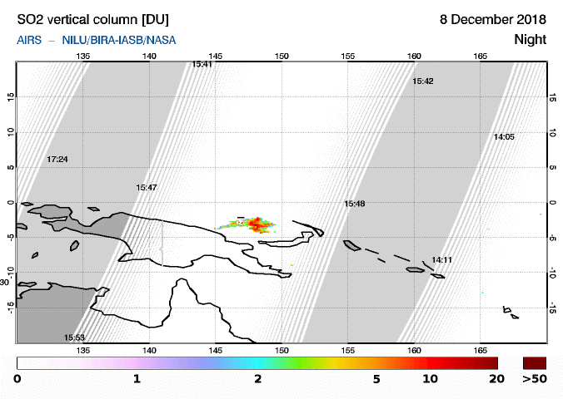
SACS SO2 imagery at night (15-16UTC)
image courtesy http://sacs.aeronomie.be/
Notes:
http://sacs.aeronomie.be/nrt/AirsOfl/2018/12.orb/08/airs_vcd20181208dc_311_lr.gif
http://sacs.aeronomie.be/

Slide 6
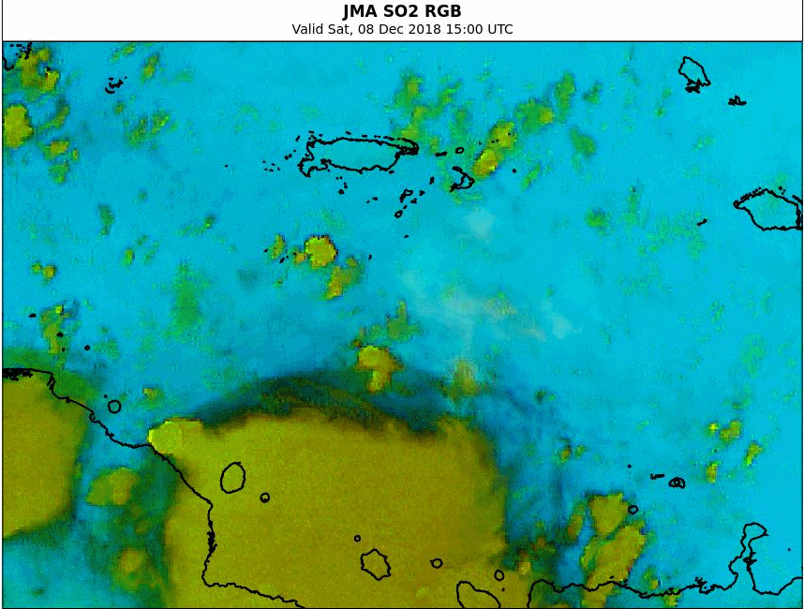
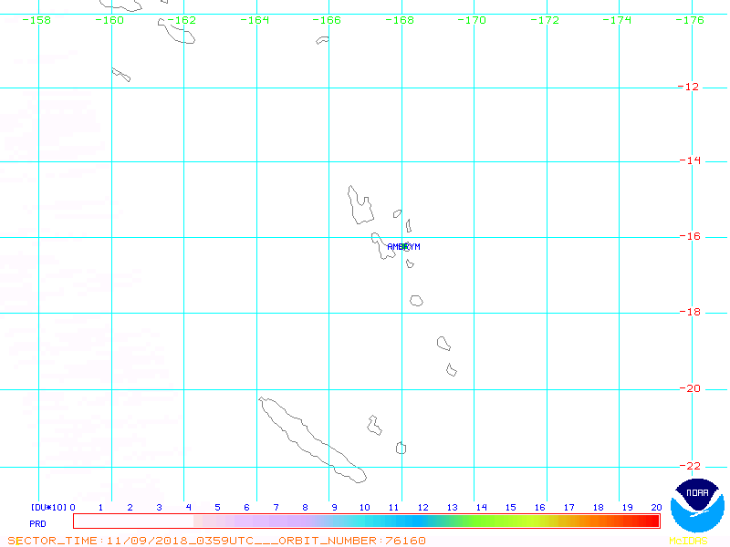
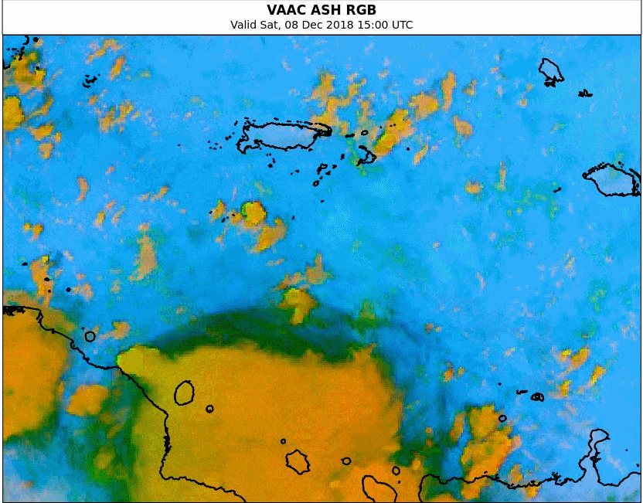
Comparison with SACS SO2 imagery at night (15 – 16 UTC)
Please start the Power Point Slide Show to activate the animation
image courtesy http://sacs.aeronomie.be/
https://satepsanone.nesdis.noaa.gov/pub/OMI/OMISO2/index.html
JMA SO2 RGB
15-16UTC 8th December 2018
animations courtesy BOM/JMA
VAAC ASH RGB

