Slide 1

Vortices within Stratocumulus cloud
Indian Ocean
01 to 07UTC 2nd December 2018
Assembled by B.Zeschke, BMTC, Australian Vlab Centre of Excellence

Slide 2
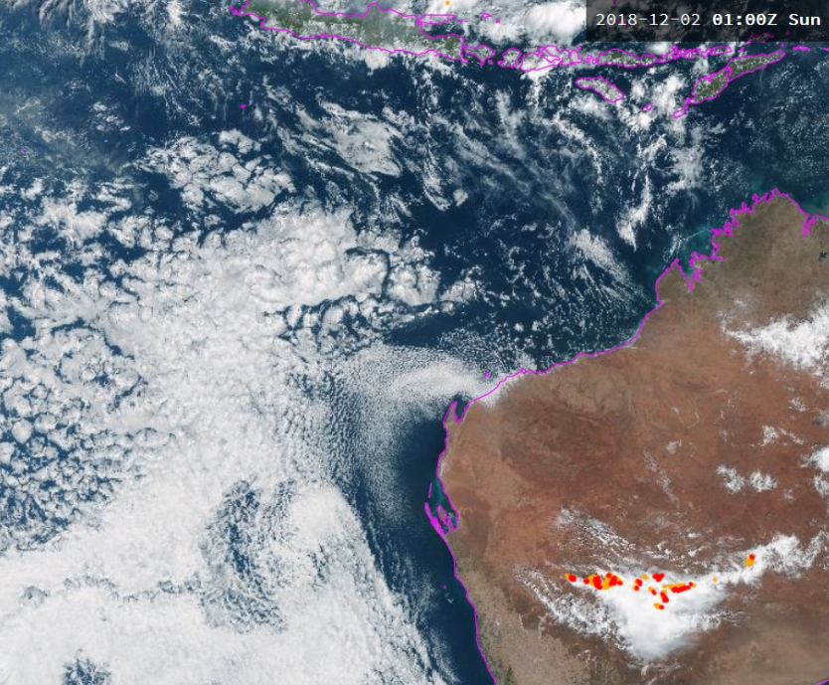
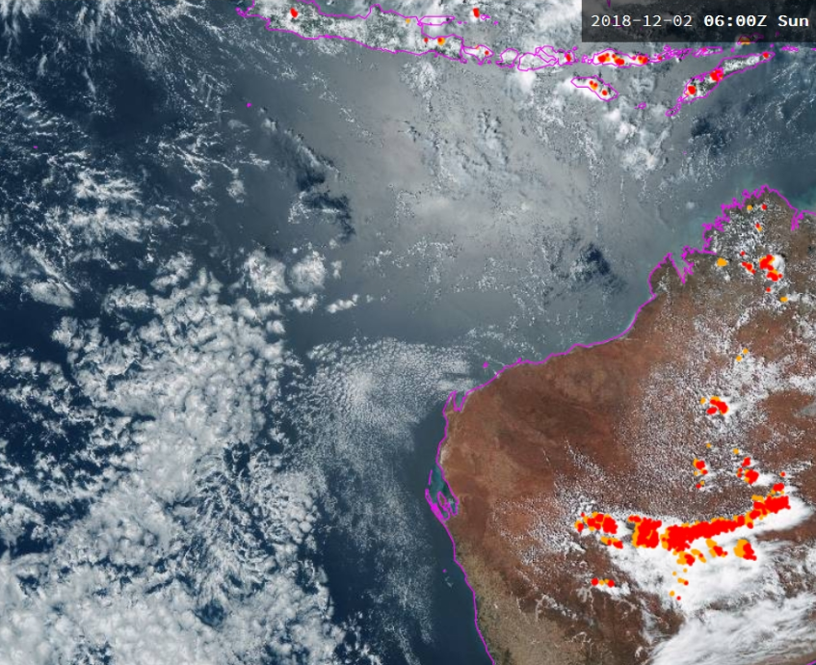
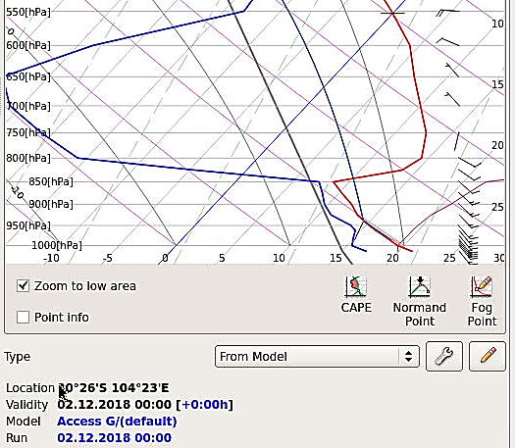
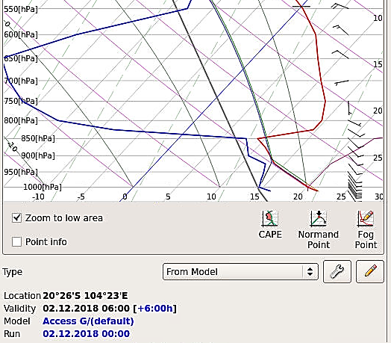
Location of interest 01 and 06UTC 2nd December 2018
animation courtesy JMA BOM
X
X

Slide 3
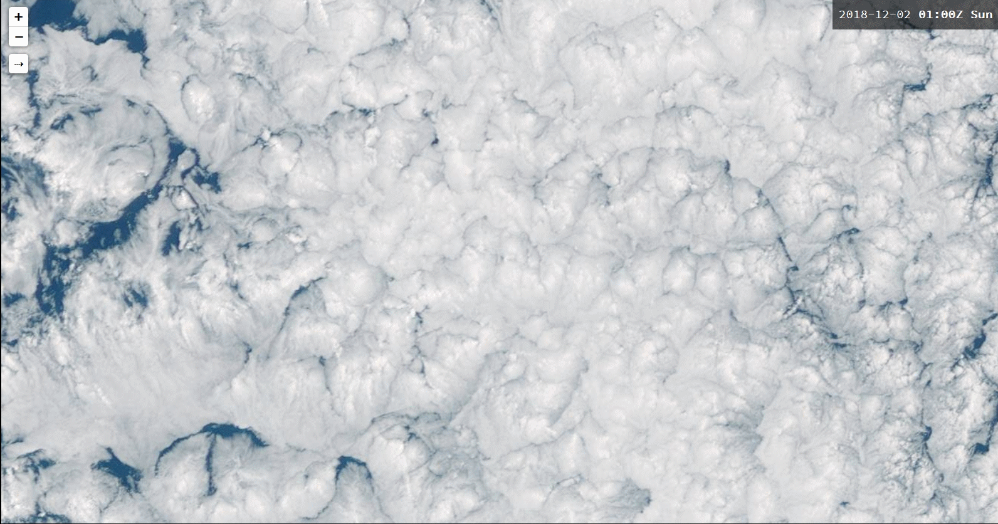
Animation 1: Vortices in Stratocumulus cloud 01 to 07UTC 2nd December 2018
10 frames per second animation
Please start the Power Point Slide Show to activate the animation
animation courtesy JMA BOM

