Slide 1
Comparing various Ash RGB products with the JMA SO2 RGB product for Ambae / Aoba, Vanuatu emission
30th and 31st October 2018
Assembled by B.Zeschke, BMTC, Australian Vlab Centre of Excellence

Slide 2
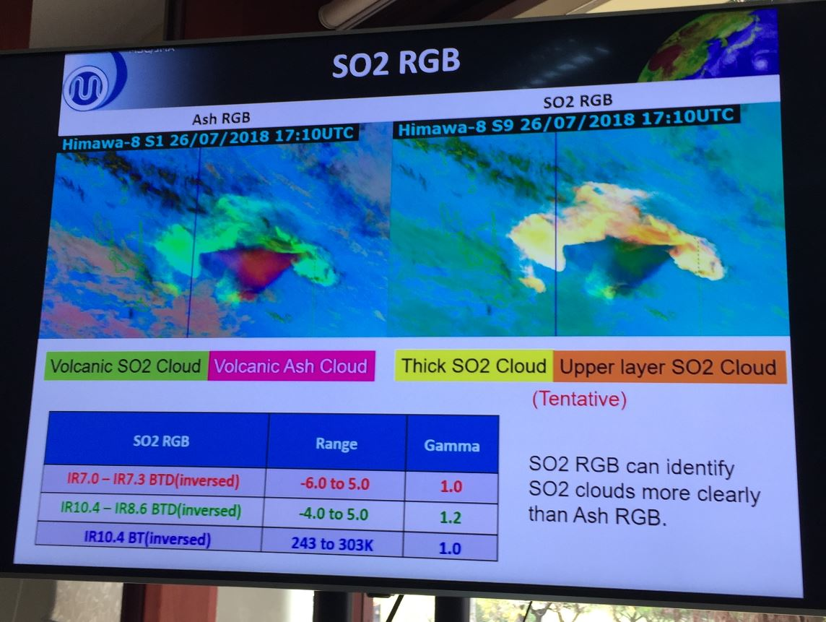
image courtesy JMA

Slide 3
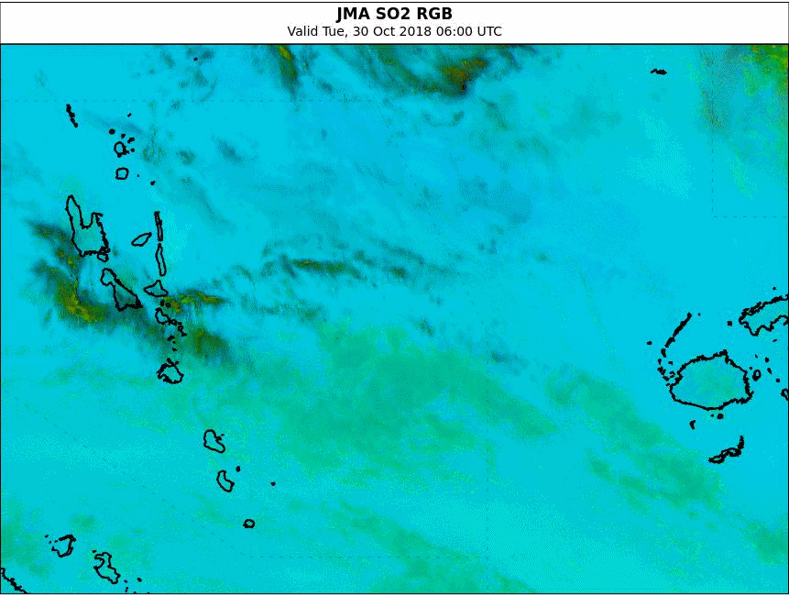
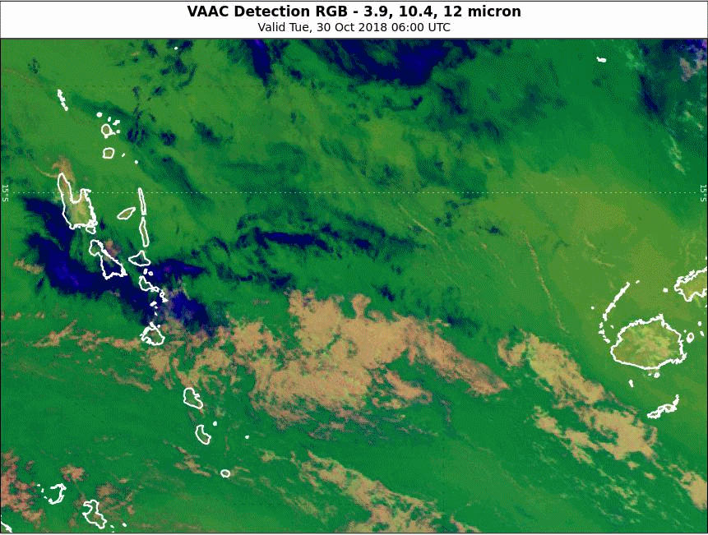
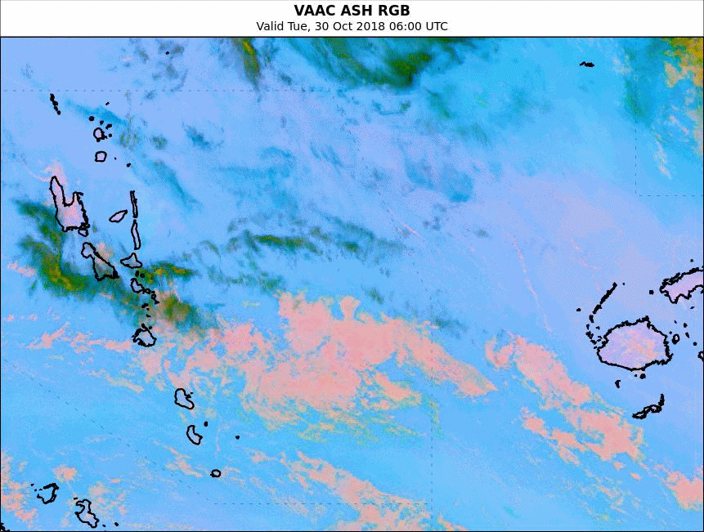
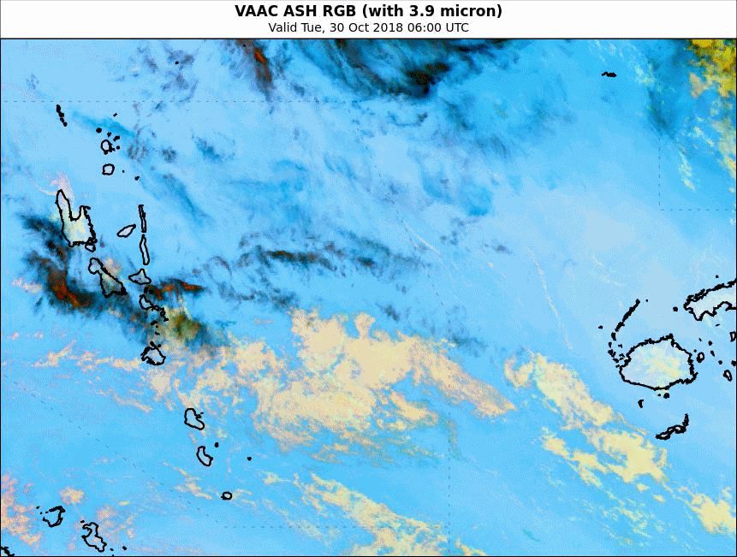
Animation: Ambae / Aoba eruption 06-18UTC 30th October 2018
Please start the Power Point Slide Show to activate the animation
animations courtesy BOM/JMA
Vanuatu
Fiji
JMA SO2 RGB
VAAC Detection RGB
VAAC ASH RGB
VAAC ASH RGB (3.9micron)

Slide 4
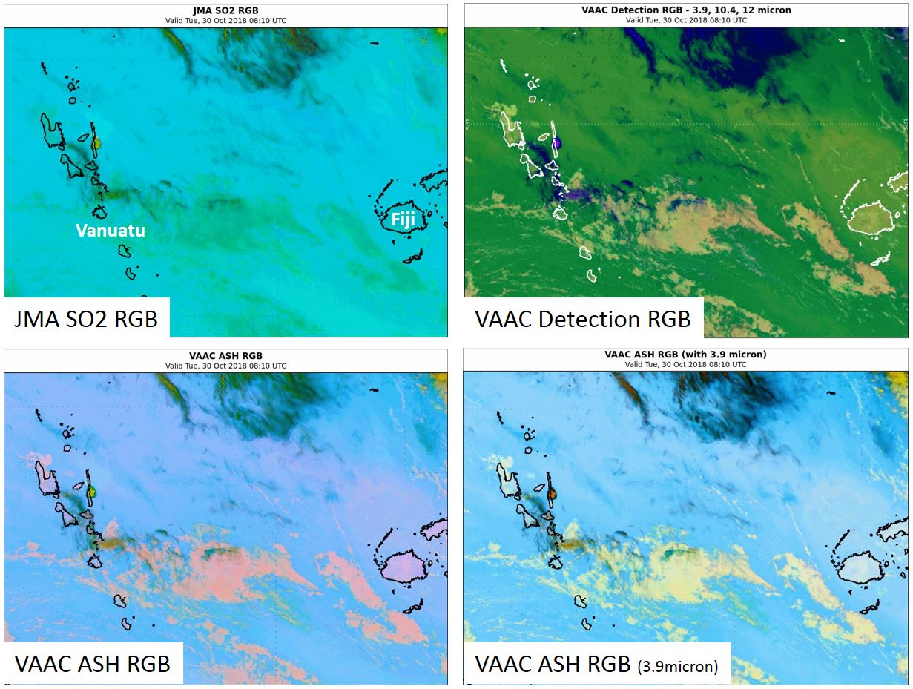
Ambae / Aoba eruption 08UTC 30th October 2018
images courtesy BOM/JMA

Slide 5
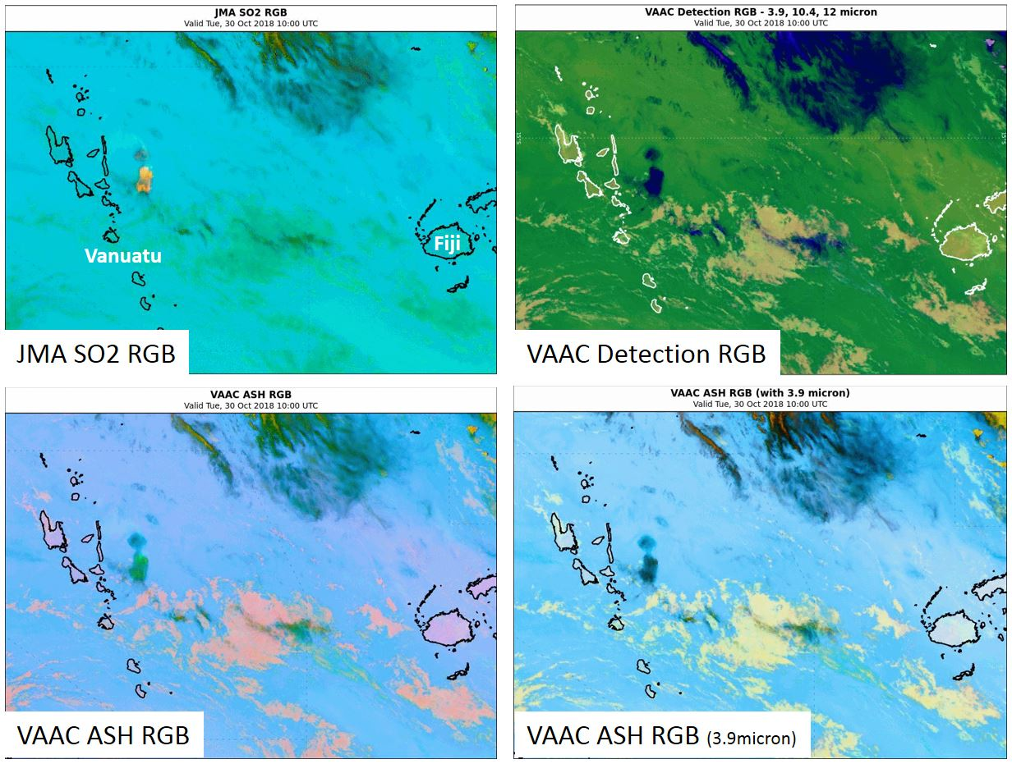
Ambae / Aoba eruption 10UTC 30th October 2018
images courtesy BOM/JMA

Slide 6
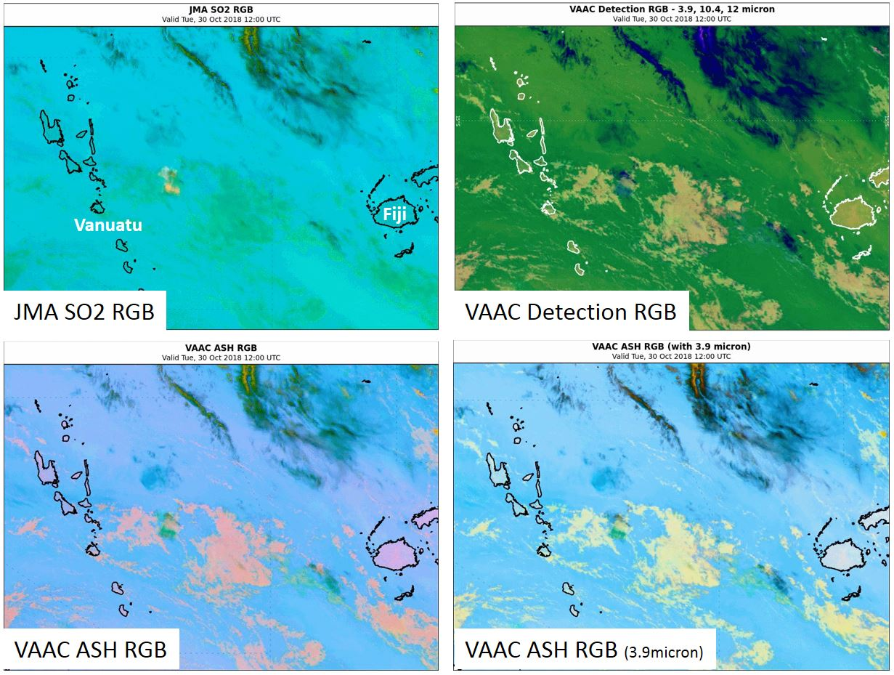
Ambae / Aoba eruption 12UTC 30th October 2018
images courtesy BOM/JMA

Slide 7
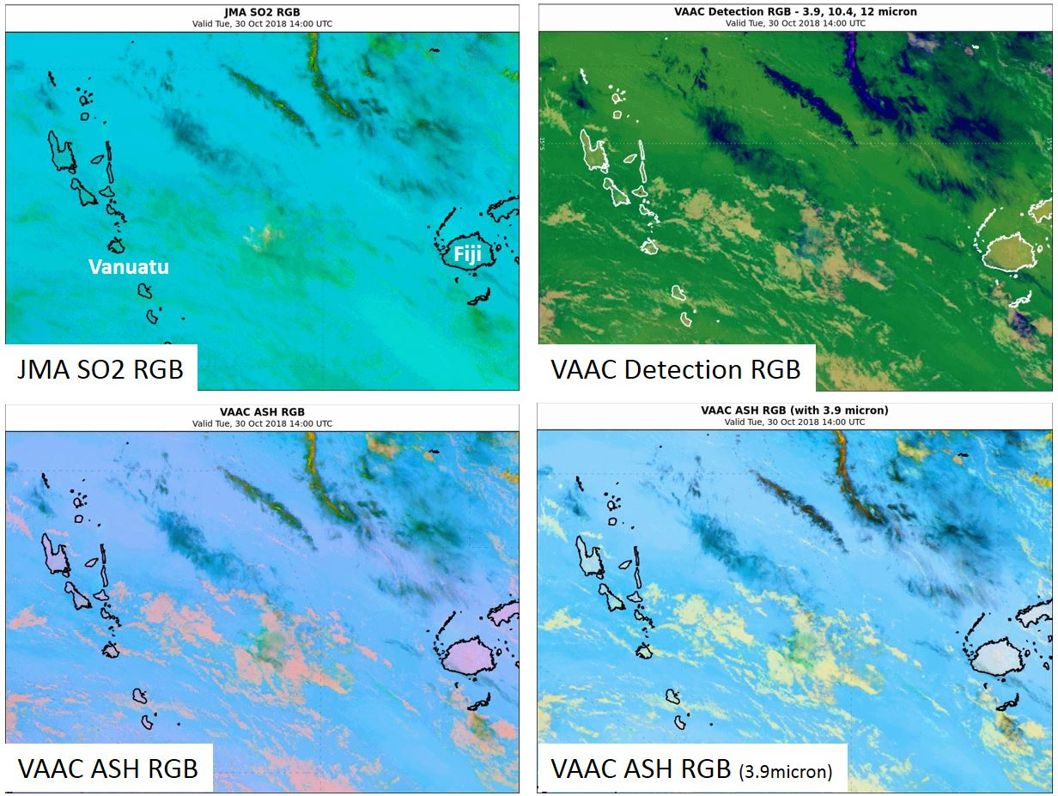
Ambae / Aoba eruption 14UTC 30th October 2018
images courtesy BOM/JMA

Slide 8
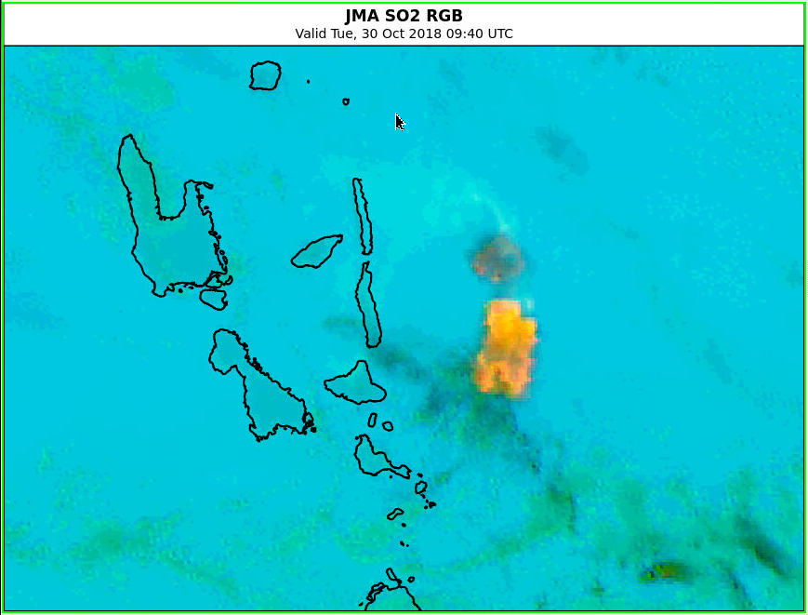
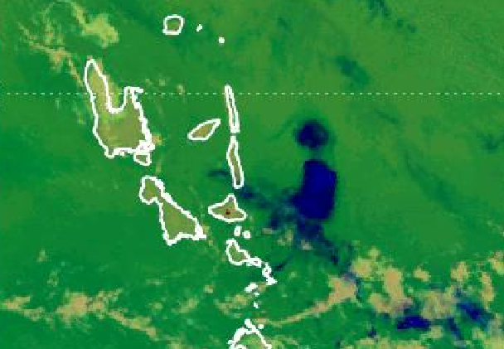
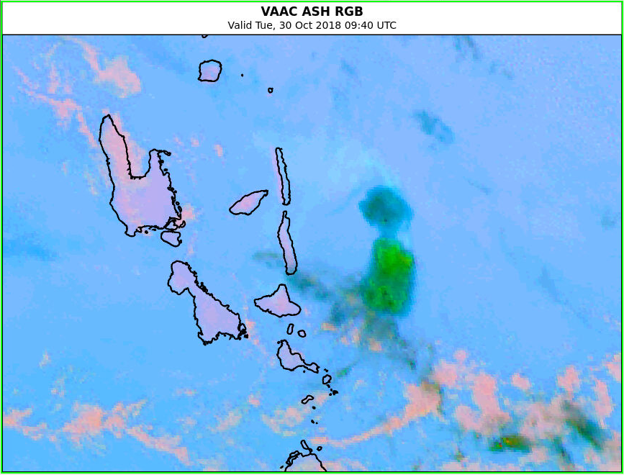
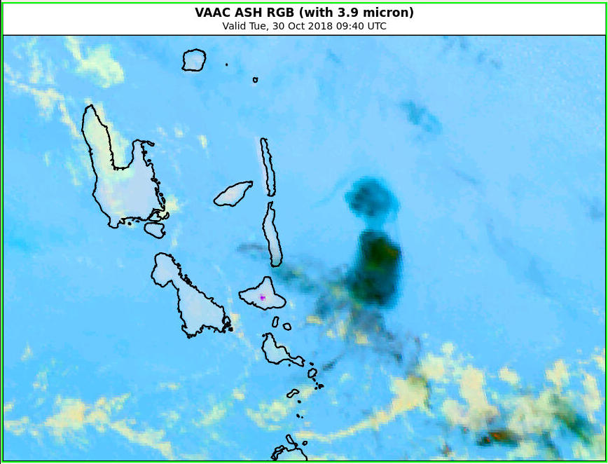
Ambae / Aoba eruption 0940UTC 30th October 2018
Vanuatu
JMA SO2 RGB
VAAC Detection RGB
VAAC ASH RGB
VAAC ASH RGB (3.9micron)

Slide 9
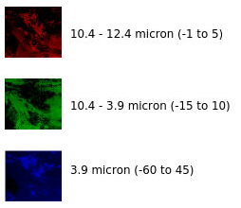
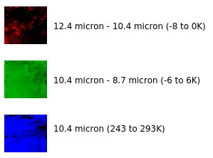
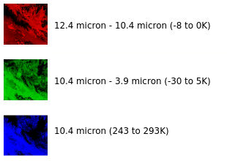
Ambae / Aoba eruption 0940UTC 30th October 2018
Vanuatu
JMA SO2 RGB
VAAC Detection RGB
VAAC ASH RGB
VAAC ASH RGB (3.9micron)

Slide 10
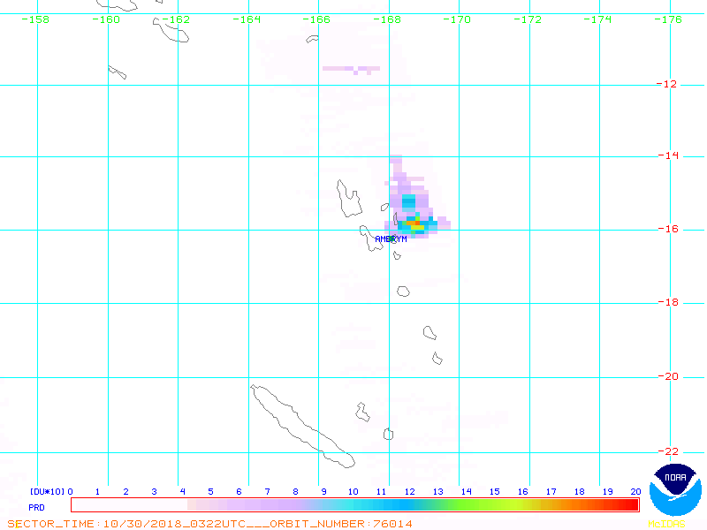
Comparison with OMI SO2 imagery
0322UTC 30th October 2018 0227UTC 31st October 2018
Note: This signal is likely associated with this case study. However, the time of the OMI overpass is too early as the eruption commenced around 07UTC 30th October.
Note: There is a very weak signal drifting to the north of Ambyn detected as light blue in the VAAC Ash RGB and JMA SO2 RGB from 14-18UTC 30th October. This does not verify this strong OMI signal.
https://satepsanone.nesdis.noaa.gov/pub/OMI/OMISO2/index.html

