Slide 1
Comparing various Ash RGB products with the JMA SO2 RGB product for Ambrym, Vanuatu degassing event of the 8/9th November 2018
Assembled by B.Zeschke, BMTC, Australian VLab Centre of Excellence

Slide 2
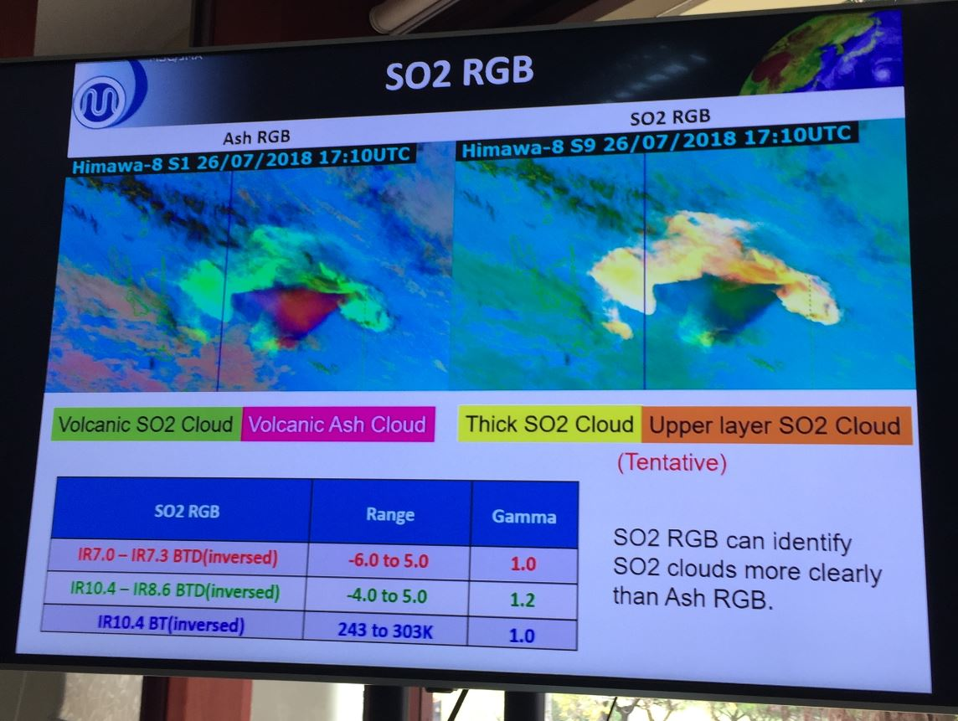
image courtesy JMA

Slide 3
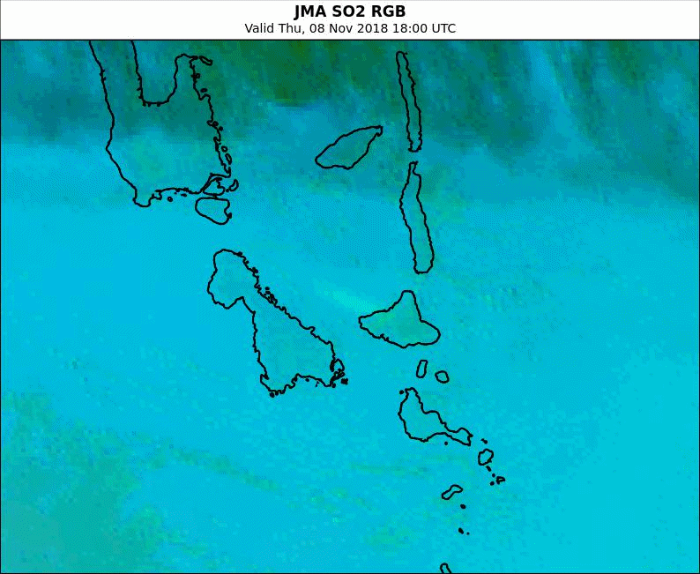
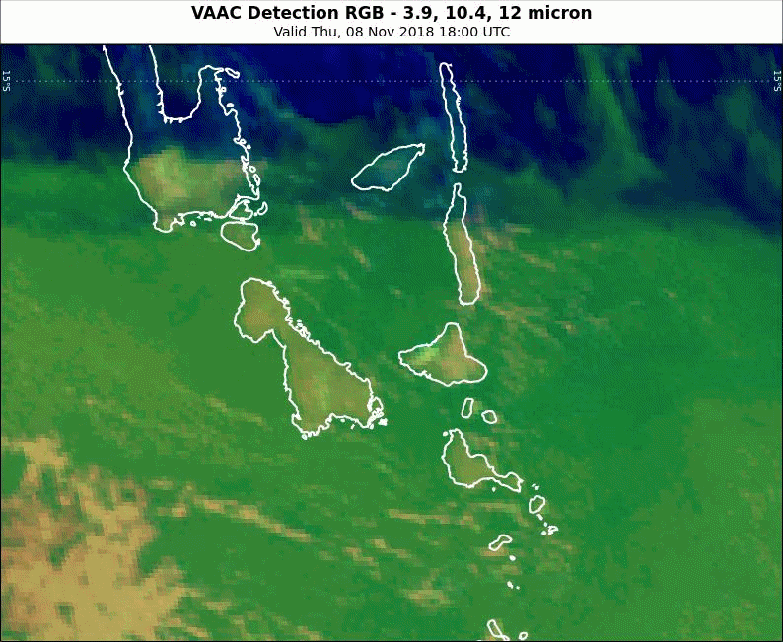
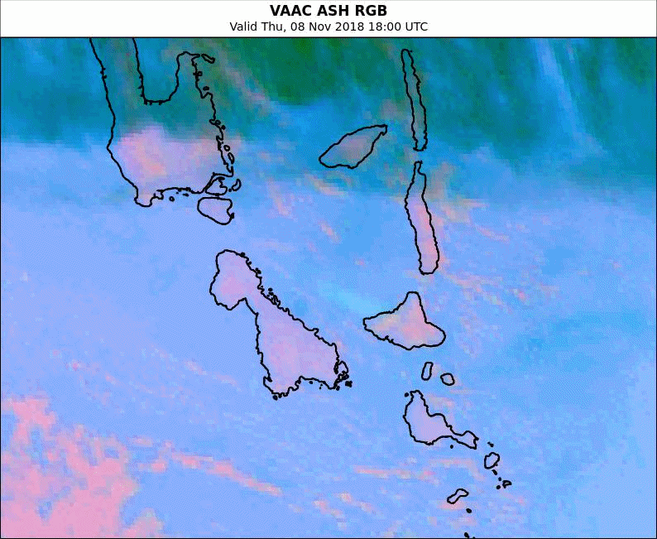
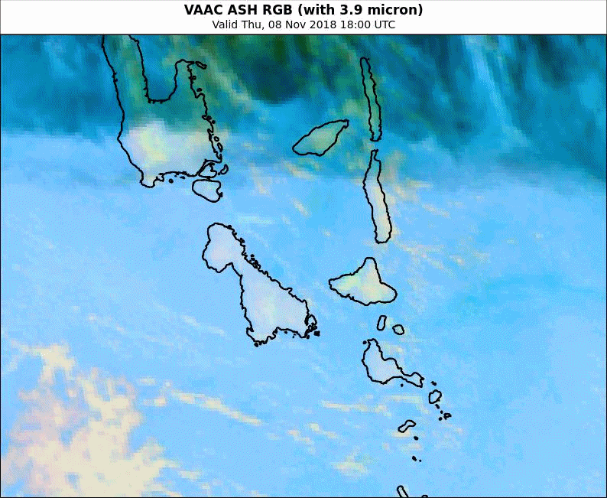
Animation: Ambrym degassing 18UTC 8th Nov -06UTC 9th Nov 2018
Please start the Power Point Slide Show to activate the animation
animations courtesy BOM/JMA
Espiritu
Santo
Espiritu
Santo
JMA SO2 RGB
VAAC Detection RGB
Espiritu
Santo
Espiritu
Santo
VAAC ASH RGB
VAAC ASH RGB (3.9micron)

Slide 4
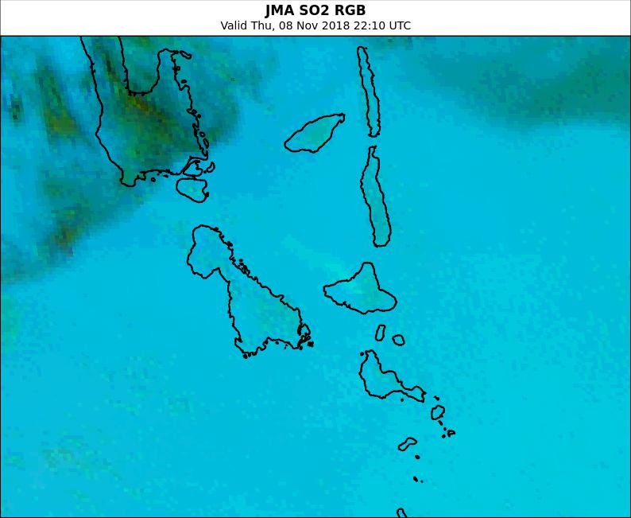
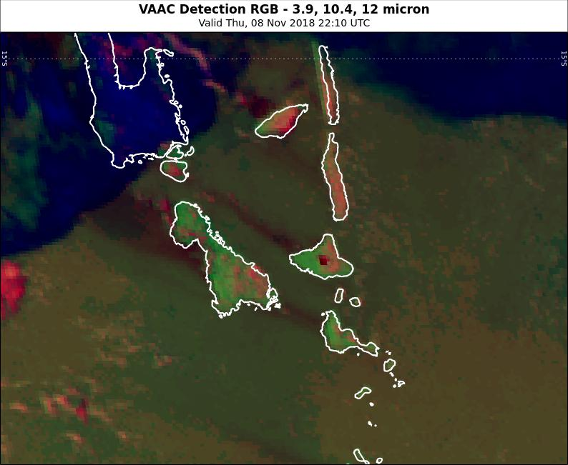
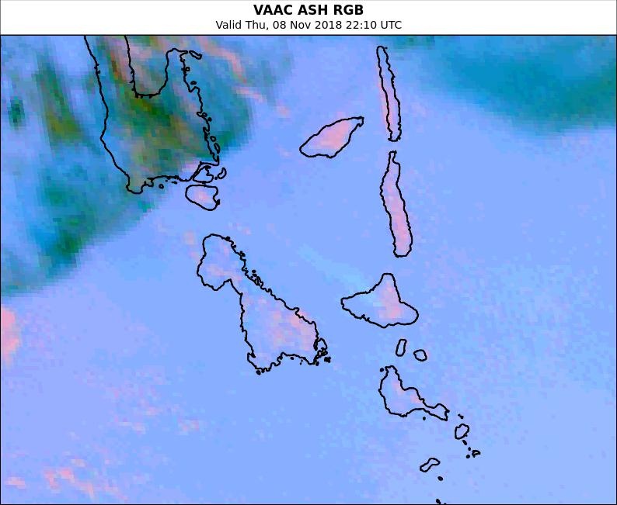
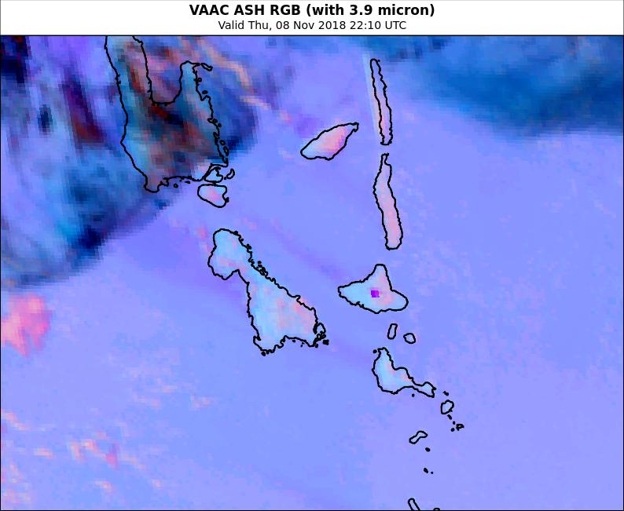
Ambrym degassing 2210UTC 30th October 2018
images courtesy BOM/JMA
Espiritu
Santo
JMA SO2 RGB
VAAC Detection RGB
VAAC ASH RGB
VAAC ASH RGB (3.9micron)

Slide 5
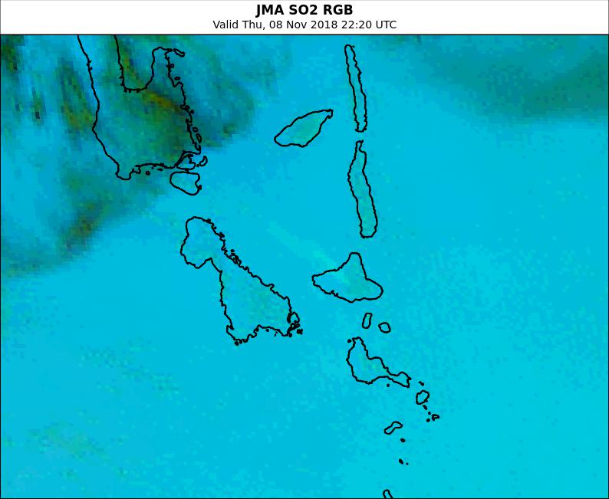
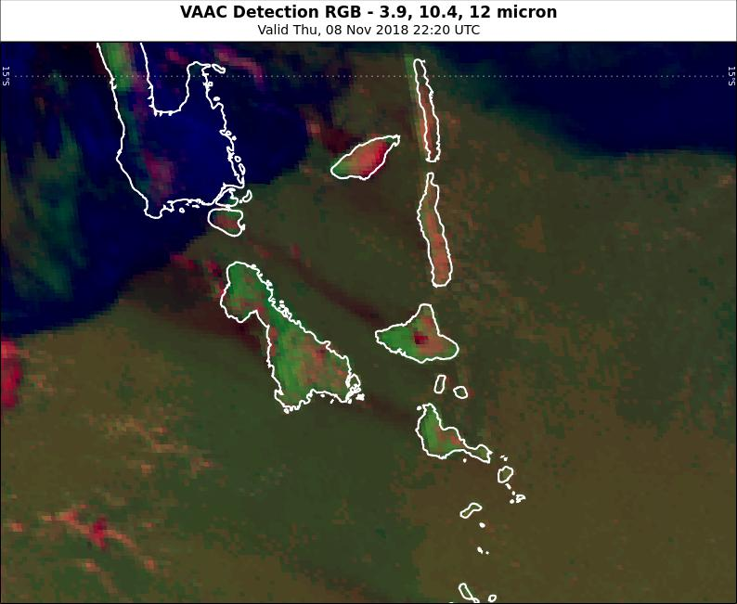
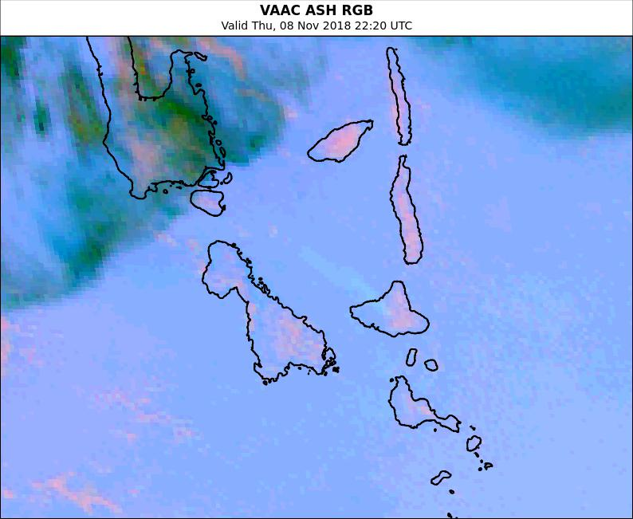
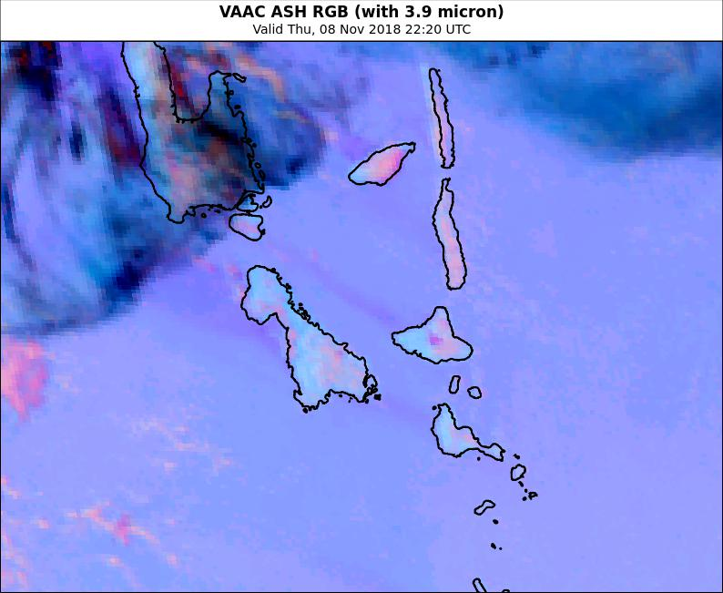
Ambrym degassing 2220UTC 30th October 2018
images courtesy BOM/JMA
Espiritu
Santo
JMA SO2 RGB
VAAC Detection RGB
VAAC ASH RGB
VAAC ASH RGB (3.9micron)

Slide 6
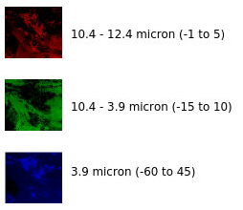
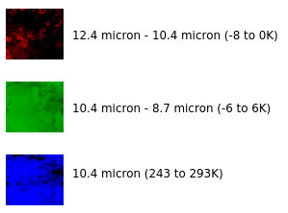
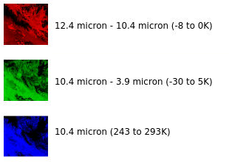
Ambrym degassing 2220UTC 30th October 2018
images courtesy BOM/JMA
Espiritu
Santo
JMA SO2 RGB
VAAC Detection RGB
VAAC ASH RGB
VAAC ASH RGB (3.9micron)

Slide 7
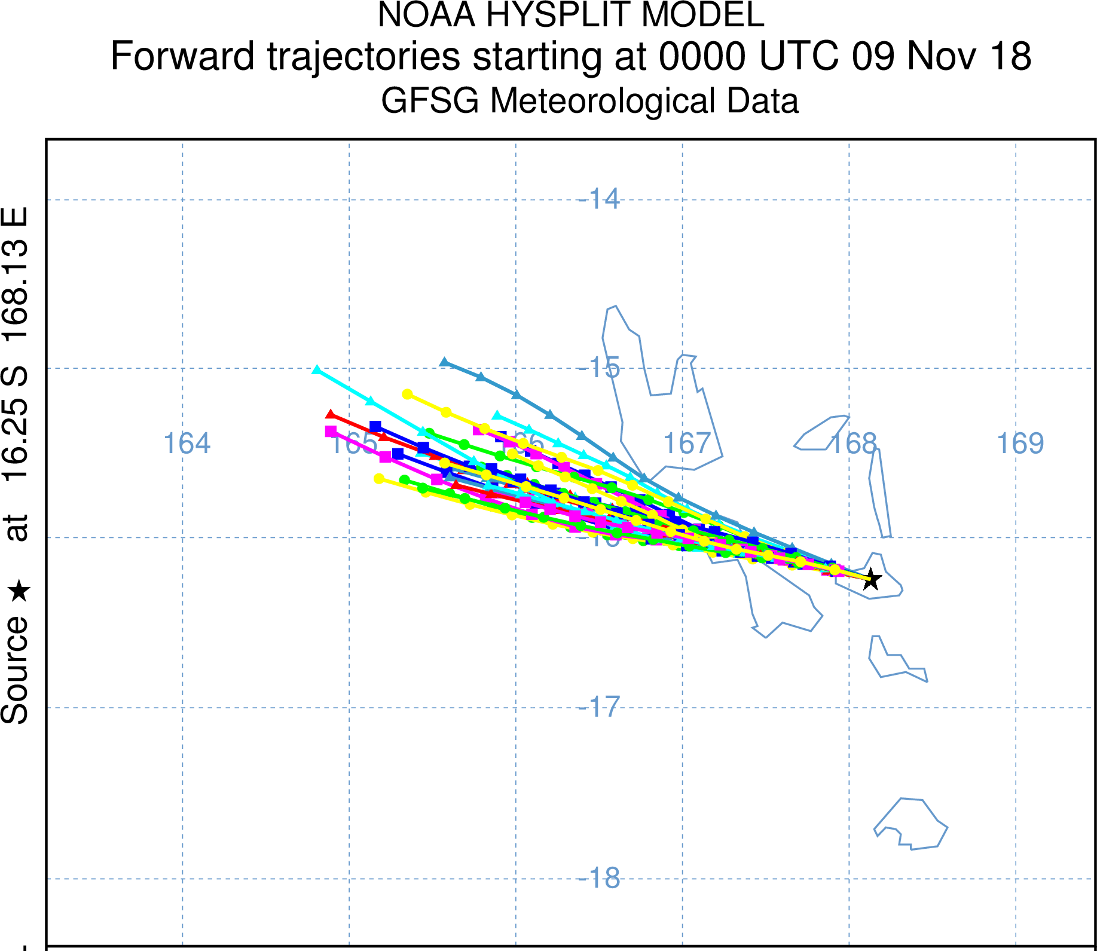
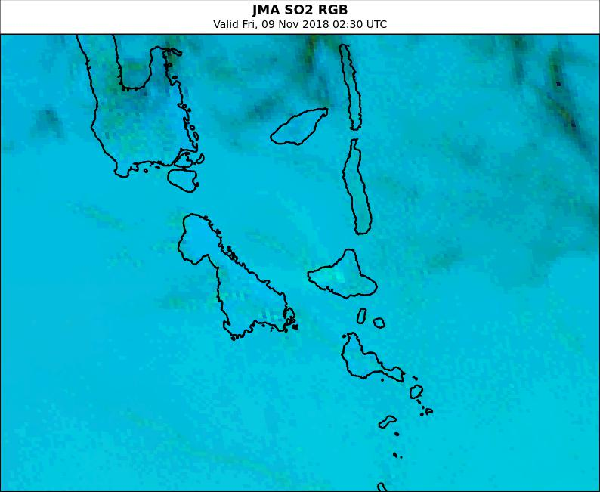
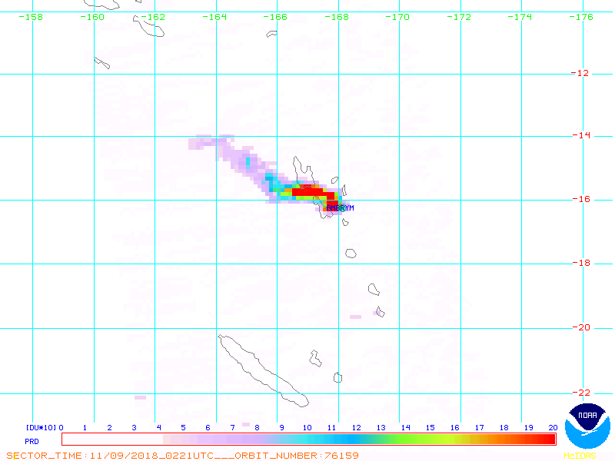
Comparison with OMI SO2 imagery and 1496m altitude trajectory
image courtesy NOAA
https://satepsanone.nesdis.noaa.gov/pub/OMI/OMISO2/index.html
Espiritu
Santo
image courtesy BOM/JMA
0221UTC 9th November 2018 0230UTC 9th November 2018

Slide 8
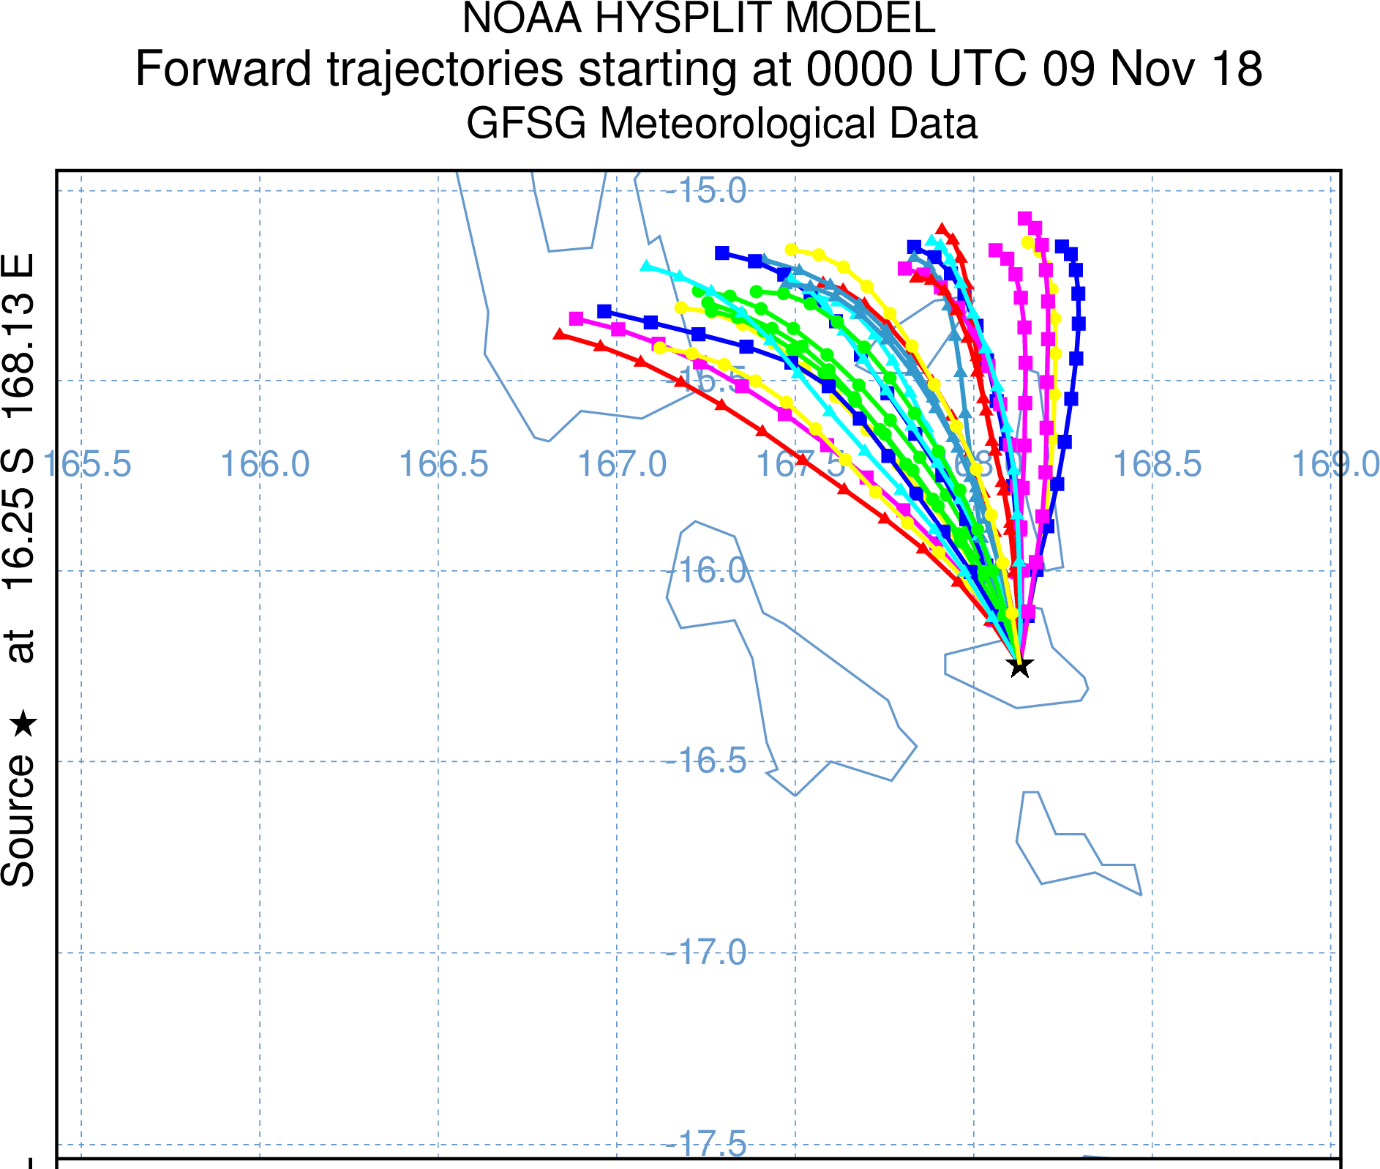
Comparison with OMI SO2 imagery and 3000m altitude trajectory
image courtesy NOAA
https://satepsanone.nesdis.noaa.gov/pub/OMI/OMISO2/index.html
Espiritu
Santo
image courtesy BOM/JMA
0221UTC 9th November 2018 0230UTC 9th November 2018

Slide 9
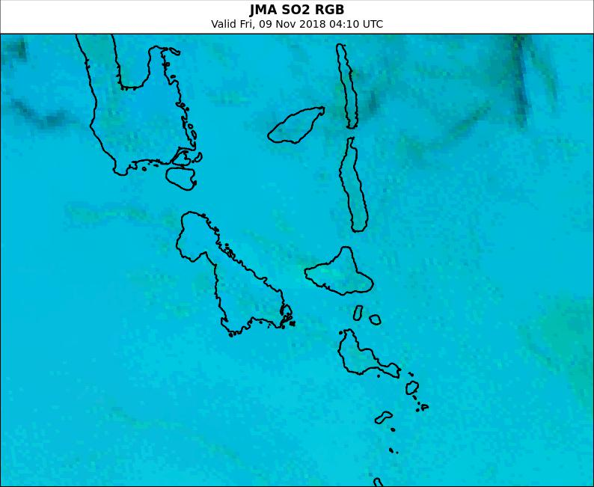
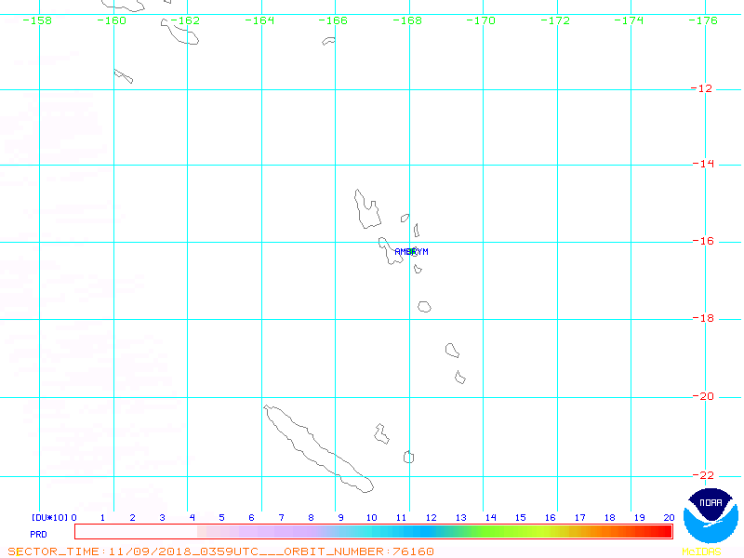
Comparison with OMI SO2 imagery at ~ 04UTC
https://satepsanone.nesdis.noaa.gov/pub/OMI/OMISO2/index.html
Espiritu
Santo
image courtesy BOM/JMA
0359UTC 9th November 2018 0410UTC 9th November 2018

