Slide 1
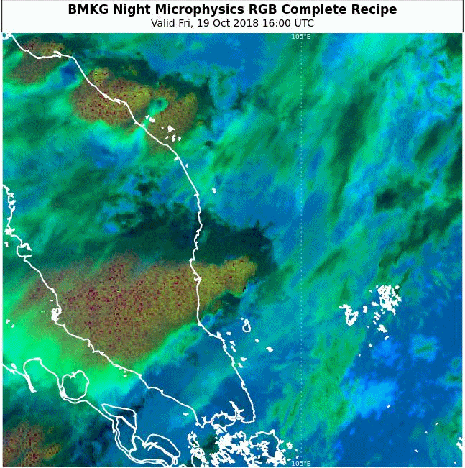
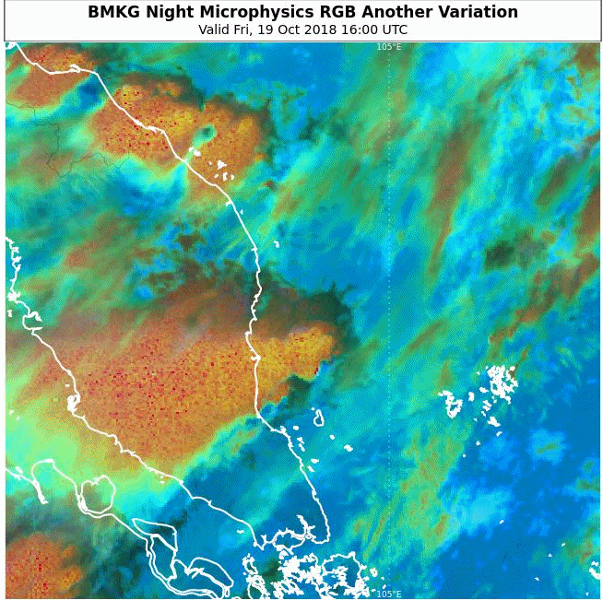
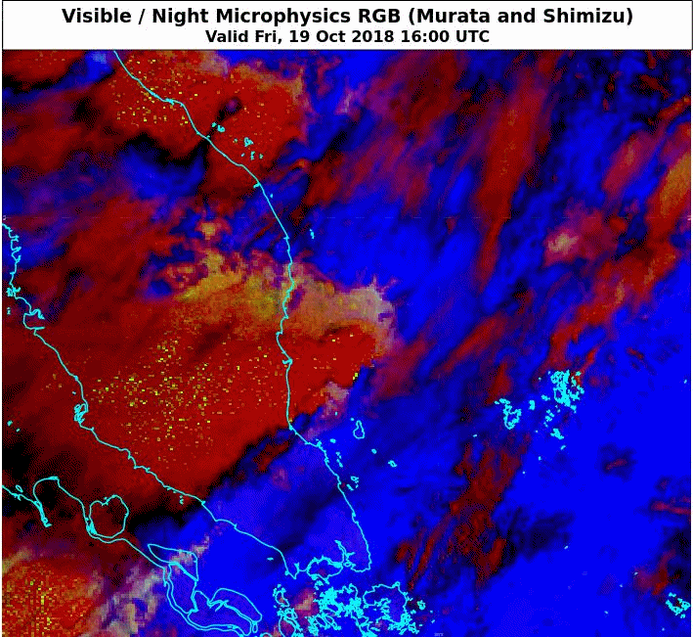
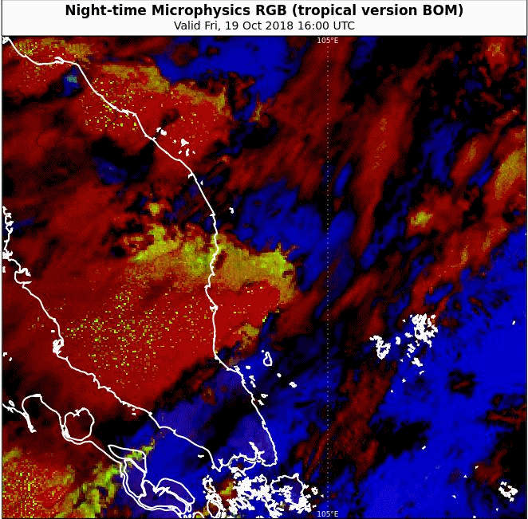
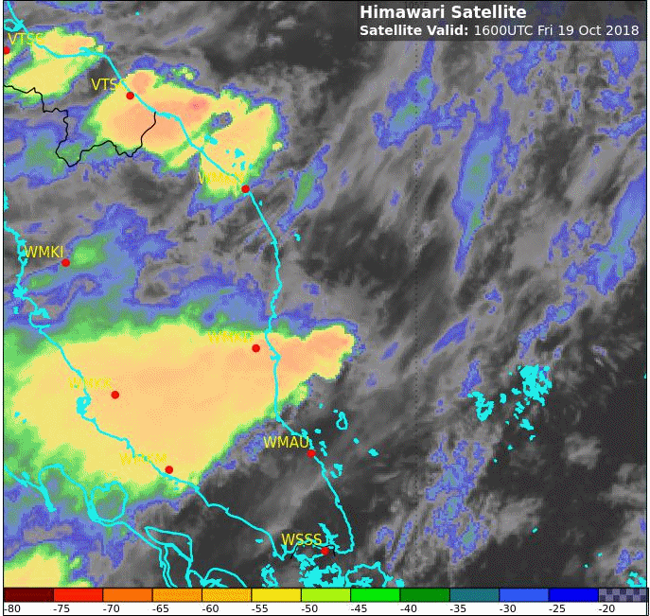
Various satellite products for night time detection and monitoring of storms and gustfront, Malaya / Singapore area 1600 to 2030UTC 19th October 2018
Please start the Power Point Slide Show to activate the animation
BMKG Indonesia Night Microphysics (Complete Recipe)
BMKG Indonesia Night Microphysics (Another Version)
animations courtesy JMA/BOM
Singapore
Night Microphysics RGB (midlat) Night Microphysics RGB (tropical) Sandwich Product (tropical)

