Slide 1

Regional Training Workshop on Preparation for Advanced Meteorological Imagers (2012. 10. 7)
Current and future satellite mission, related products, and user support
Dohyeong Kim
National Meteorological Satellite Center
Korea Meteorological Administration
dkim@kma.go.kr

Slide 2
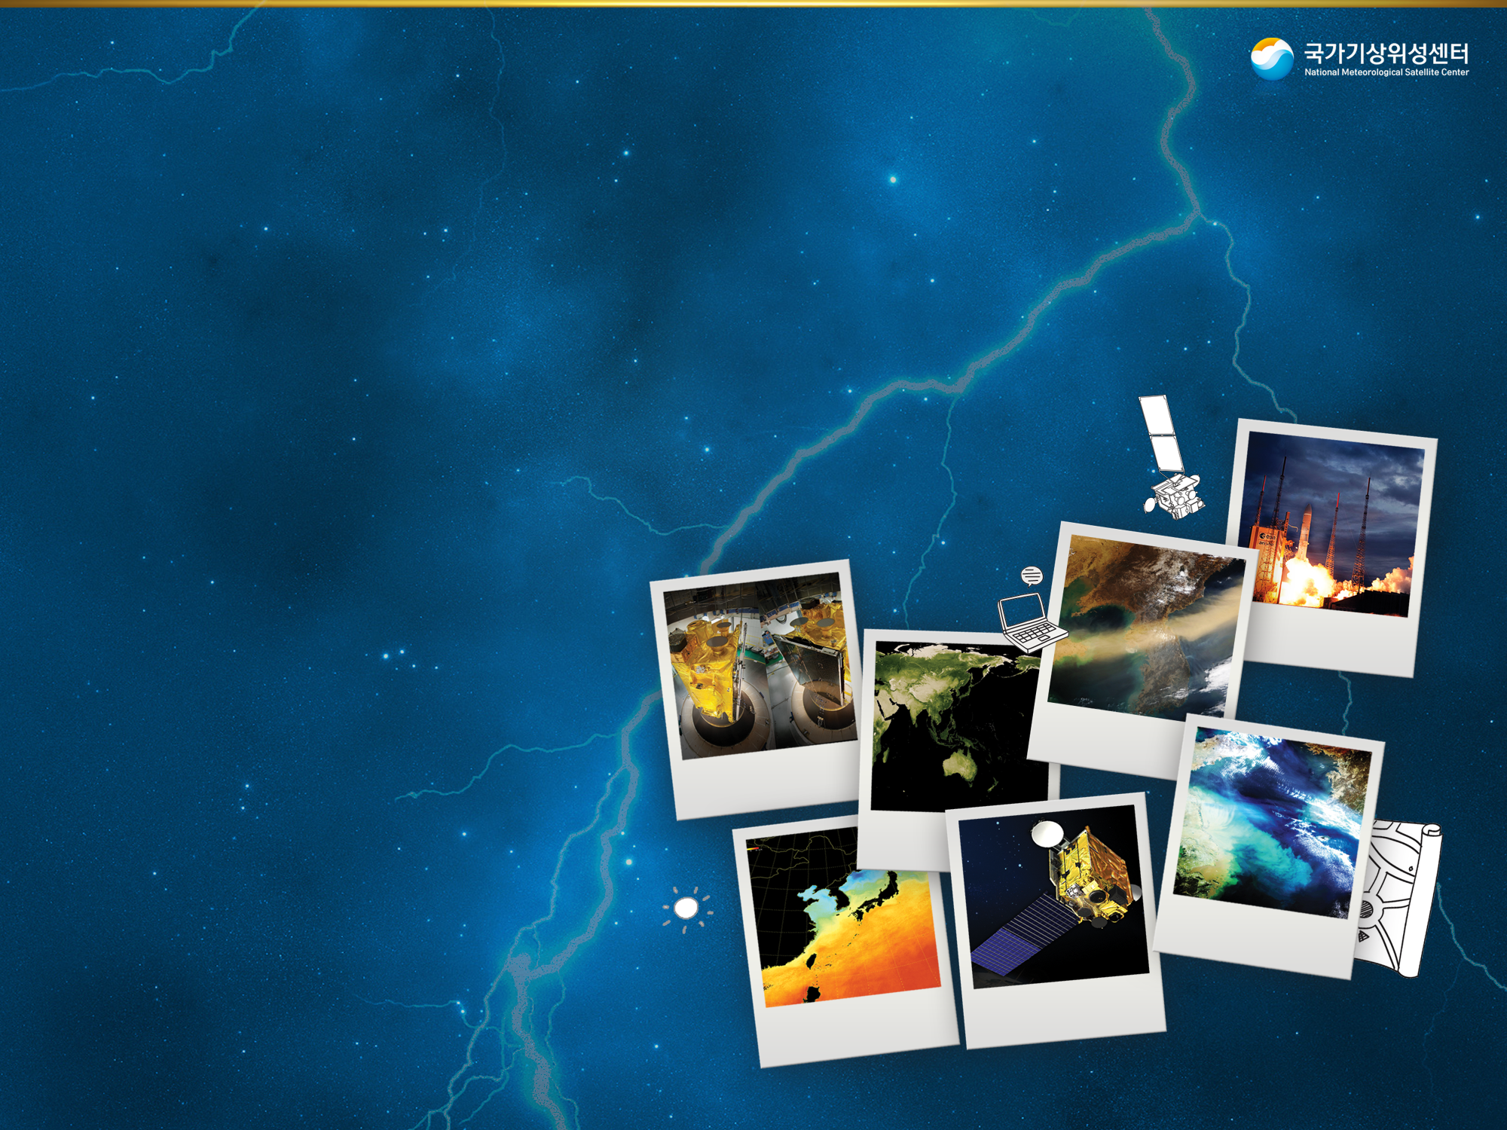
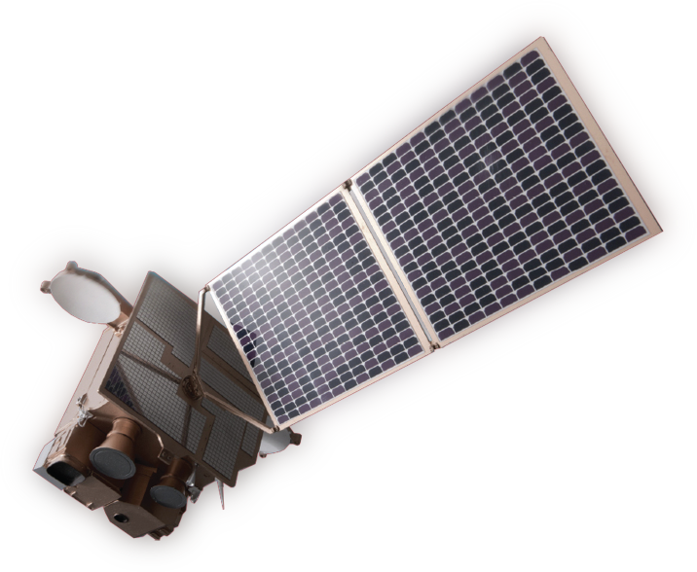
Contents
Current Status of COMS
Utilization of COMS data
Plan for Geo-KOMPSAT-2A
Notes:
The contents of this presentation are
current status of COMS,
utilization of COMS data
And plan for GEO-KOMPSAT-2A.

Slide 3
Current Status of COMS
3

Slide 4

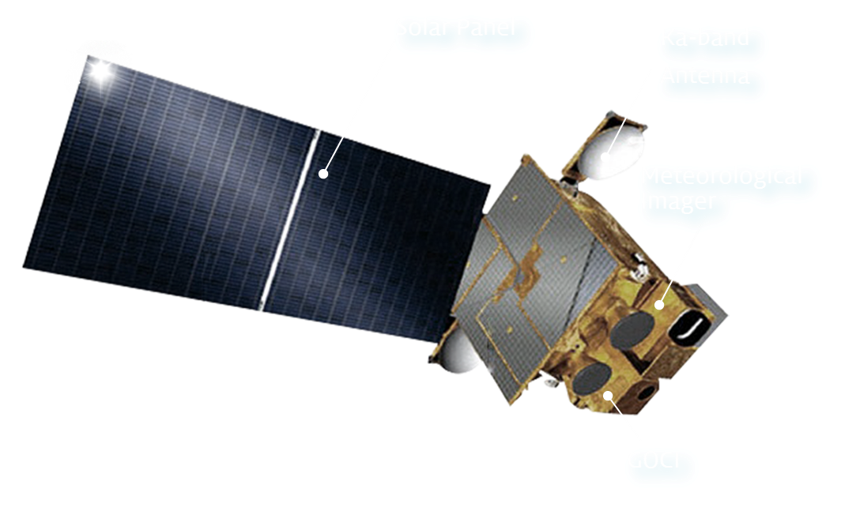

COMS Program
COMS is the first multi-purpose geostationary satellite for Korea in the application of Meteorology, Ocean and Communication
    Meteorological Mission : Continuous Meteorological Observation to support weather forecasting and early detection of severe weather phenomena
    Period : 2003 - 2010 (8 yrs)
    Orbit : 128.2°E over equator (36,000 km)
    Design life : 7 years
Communication, Ocean and
Meteorological Satellite
The channels of COMS/MI
Channel | Wavelength Range(㎛) | Center Wavelength(㎛) | Spatial Resolution(km)
Visible | 0.55~0.8 | 0.67 | 1
Shortwave IR (IR4) | 3.5~4.0 | 3.7 | 4
Water Vapor(IR3) | 6.5~7.0 | 6.7 | 4
IR1 | 10.3~11.3 | 10.8 | 4
IR2 | 11.5~12.5 | 12.0 | 4
Notes:
COMS is the first multi-purpose geostationary satellite for Korea in the application of Meteorology, Ocean and Communication. COMS have meteorological Mission for Continuous Meteorological Observation to support weather forecasting and early detection of severe weather phenomena, and developed from 2003 to 2010.
COMS settled in longitude 128.2 east degrees and has been operational since April 2011 with lifetime of 7 years

Slide 5
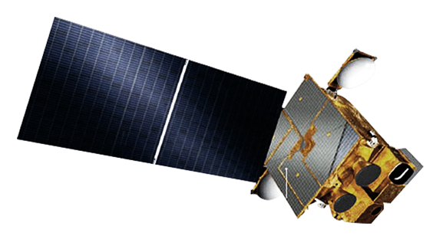

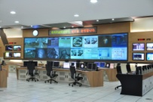









COMS Ground Segment
COMS
HRIT/LRIT
MDUS/SDUS
User Agencies
HRIT/LRIT
Raw data
TM/TC(backup)
Raw data
KMA
TM/TC
HRIT/LRIT(backup)
NWP
NMSC
KARI
(Korea Aerospace Research Institute)
Internet
HRIT (High Rate Information Transmission)
LRIT (Low Rate Information Transmission)
End User
Notes:
This slide show COMS ground segment, there are two ground stations, those are NMSC and KARI(Korea Aerospace Research Institute)
Both ground stations have facilities of satellite control, data processing and data dissemination with MDUS/SCUS.
But the main mission of KMA is data processing and dissemination while KARI’s primary mission is satellite control.
And they have complementary role when one of ground station got problem.

Slide 6
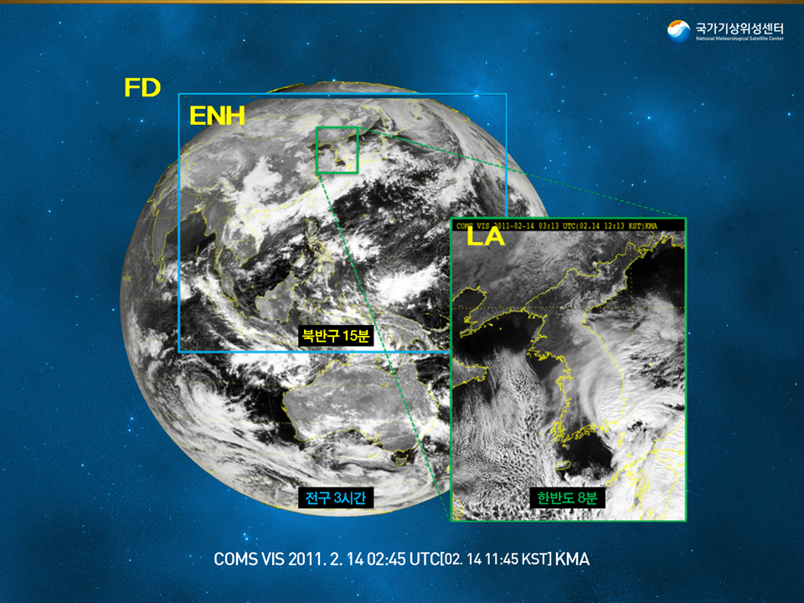
Observation Schedule for COMS
Every 30 min → 15 min
Early detection of severe weather
ENH every 15 min
FD every 3 hour
Korean Peninsular 8 times an hour
6
Notes:
Normally COMS measurement has three different modes: Full disk every 3 hours , Extended Northern hemisphere every 15 minutes and Local area 8 times an hour.
Local Area measurement mode is added in between normal COMS measurement schedule for monitoring of severe weather conditions such as the typhoon approaching near the Korea Peninsula or the intensive rainfall cases. Local Area data are provided only to KMA internal users and internet homepage.

Slide 7

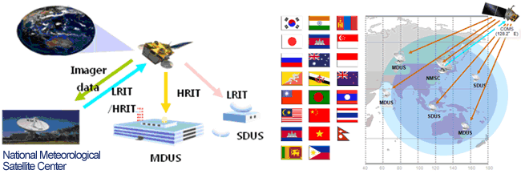
COMS Data Services (via Satellite)
COMS MI data are broadcast to MDUS/SDUS with being encrypted.
- Domestically, 3 MDUSs and 3 SDUSs have been installed at 6 organizations
- Internationally, US Air Force, Taiwan, Sri Lanka is receiving COMS MI data via Satellite
HRIT |  |  |  | LRIT
3Mbps |  | Data Rate |  | ~512Kbps
Image (VIS, IR1, IR2, SWIR, WV) Alpha-numeric text Encryption Key Message |  | Data Type |  | Image (VIS, IR1, IR2, SWIR, WV) Alpha-numeric text Encryption Key Message Level 2 Data GOCI NWP (TBD)
FD, ENH |  | Image |  | FD, ENH
MDUS (Medium Scale Data User stations) |  | User |  | SDUS (Small Scale Data User stations)
7
Notes:
For the COMS data service, KMA uses broadcast by COMS satellite and ground network;
KMA broadcasts the COMS data for the users who can receive the COMS data in real time via HRIT/LRIT using the antenna system.
The map represents the coverage of COMS data receiving over Asia Pacific region. More than 30 countries and 2.2 billion people can benefit from COMS data.
------
For direct broadcast via satellite, COMS data are usable for MDUS/SDUS with the data formats of two types, HRIT for MDUS and LRIT for SDUS. Data transmission rate are 3 Mbps and 512 Kbps, respectively.
The included data type for HRIT are MI image, alhpa numeric text,
and encryption key message, for LRIT are GOCI image and satellite meteorological products
in addition to HRIT dissemination data format type.
For both HRIT and LRIT, FD and ENH image mode are offered.

Slide 8
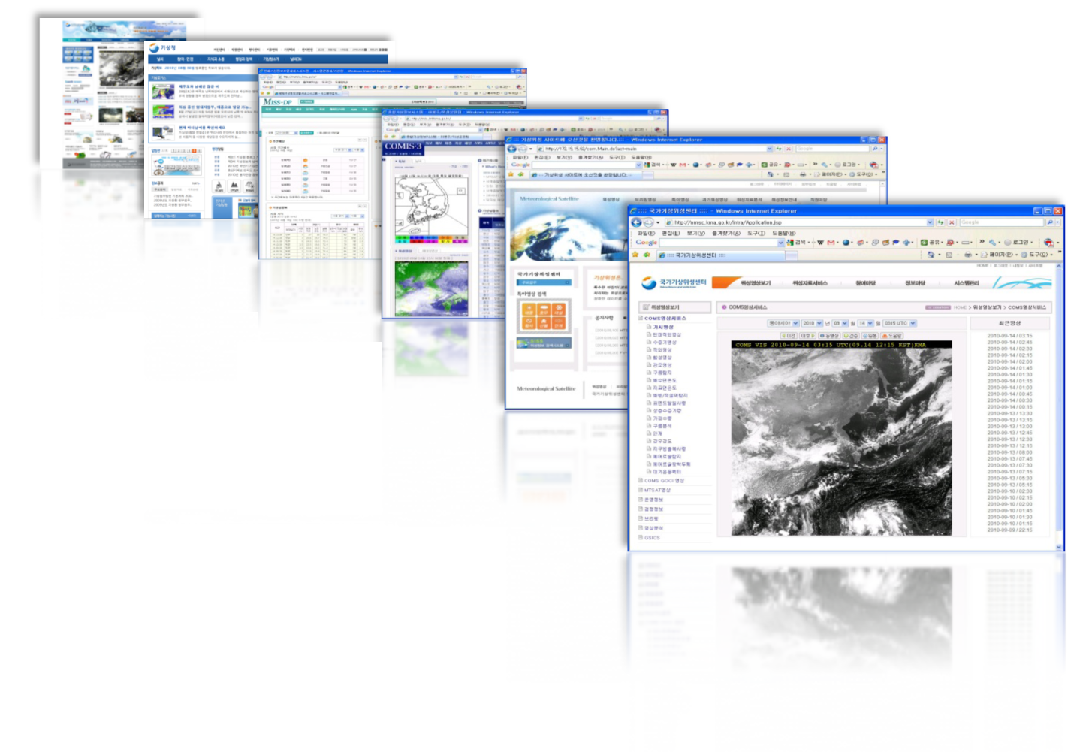

COMS Data Services (via ground network)
Service via Internet
- NMSC provides COMS Level 1B data of all five channels and Level 2 products to users by posting the processed data on NMSC Website (http://nmsc.kma.go.kr)
Service via FTP
Domestic
  - 21 domestic KMA-related organizations such as the military, broadcasting companies, disaster prevention centers and local government
International
  - EUMETSAT, CIMSS(US), Hongkong etc.
8
Notes:
KMA has also serviced COMS data via ground network.
In service via landeline, there are three types of services. For internal and cooperation organization, intranet, comprehensive WIS, and disaster prevention WIS are used.
The users in general public and expert group receive the data from KMA homepage and NMSC hompage, ftp, respectively.

Slide 9

Utilization of
COMS Data
9

Slide 10

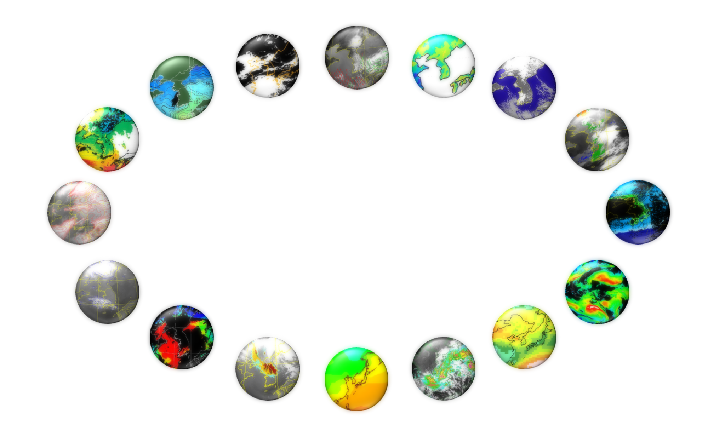
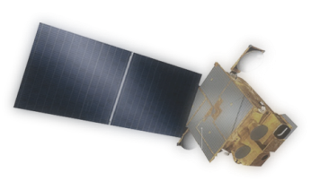
COMS Products
16 Baseline Products : Development (2003-2010) and operation (2011~)
CLD
(Cloud Detection)
AMV
(Atmospheric Motion Vector)
LST
(Land Surface Temperature)
SST
(Sea Surface Temperature)
SSI
(Sea Ice/Snow)
TPW
(Total Precipitable Water)
Fog
CTT/CTH
(Cloud Top Temperature/Height)
UTH
(Upper Tropospheric Humidity)
COMS
CA
(Cloud Analysis)
CSR
(Clear Sky Radiance)
AOD
(Aerosol Optical Depth)
INS
(Insolation)
AI
(Aerosol Index)
OLR
(Outgoing Longwave Radiation)
RI
(Rain Intensity)
10
Notes:
There are 16 baseline products of CMDPS.
KMA has been developed from 2003 to 2010 for 8 years with domestic scientists, 10 professors from 8 universities and researchers from NMIR/KMA.

Slide 11
COMS baseline Products
Group | Product Name |  | Area | Alg. Dev. | Remarks
Scene Analysis | Cloud Detection (CLD) |  | FD / ENH / LA | NIMR | Apr 2011
 | Fog Detection (FOG) |  | East Asia | NIMR | Apr 2011
 | Snow/Sea Ice (SSI) |  | FD / ENH + comp. | NIMR | Jan 2012
 | Aerosol Index (AI) |  | East Asia | Pusan NU | Apr 2011
 | Aerosol Optical Depth (AOD) |  | East Asia | YSU | Jan 2012
Cloud Information | Cloud Analysis (CLA) | Cloud Type (CT) | FD / ENH / LA | SNU | Apr 2011
 |  | Cloud Amount (CA) | FD / ENH / LA
 |  | Cloud Phase (CP) | FD / ENH / LA |  | Jan 2012
 |  | Cloud Optical Thickness (COT) | FD / ENH / LA |  | Jan 2012
 | Cloud Top Temp./Height (CTTH) |  | FD / ENH / LA | SNU | Apr 2011
 | Rainfall Intensity (RI) |  | East Asia / LA | Kangnung NU | Aug 2011
Water vapor Information | Total Precipitable Water (TPW) |  | East Asia | Kyoungpook NU | Jan 2012
 | Upper Tropospheric Humidity (UTH) |  | East Asia | Kyoungpook NU | Aug 2011
Surface Information | Sea Surface Temperature (SST) |  | FD / ENH + comp. | SNU | Aug 2011
 | Land Surface Temperature (LST) |  | East Asia | Kongju NU | Jan 2012
Radiation Information | Clear Sky Radiance (CSR) |  | FD / ENH | NIMR | Jan 2012
 | Insolation (INS) |  | FD / ENH | Pukyoung NU | Jan 2012
 | Outgoing Longwave Radiation (OLR) |  | FD / ENH + comp. | SNU | Aug 2011
Wind | Atmospheric Motion Vector (AMV) |  | Enhanced Northern Hemi. | NIMR | Apr 2011
Notes:
The table shows the detailed information of COMS meteorological products.
One of the advanced feature of CMDPS is that CMDPS has its own validation system. With this, NMSC can update the algorithm from the validation results to provide with more accurate products to users.

Slide 12
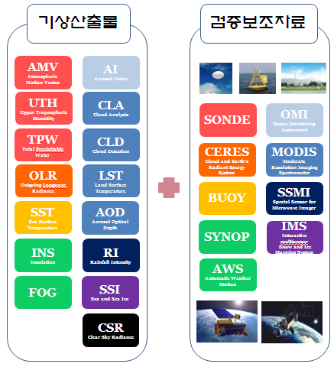
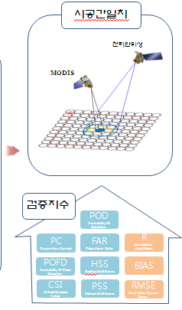
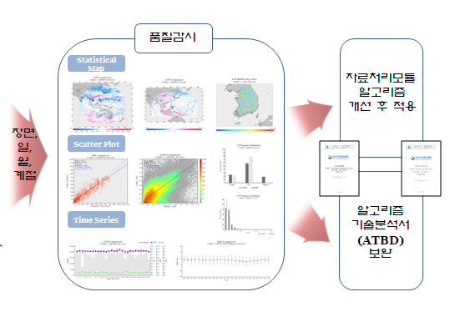
COMS data quality evaluation
Algorithm improvement, feedback and continuous effort for user satisfaction through the COMS data quality monitoring and evaluation at all times
Meteorological products quality evaluation system
Meteorological products
Ancillary data
Collocation
Quality monitoring
COMS
Application after improving data processing module
Map,
Day,
Month,
Season
Verification index
Complement of ATBD
12
Notes:
For confirming and monitoring the stability of these products’ accuracy,
We also have meteorological products quality evaluation system
for algorithm improvement, feedback and continuous effort for user satisfaction.

Slide 13
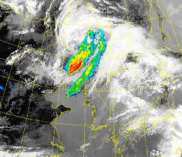
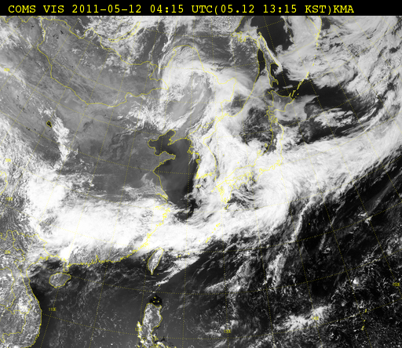
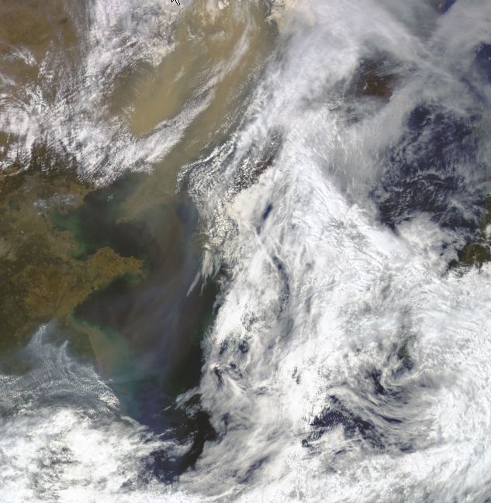
Utilization of COMS products
: Asian dust analysis
Application of Asian dust detection
COMS MI visible image
GOCI(Ocean Color) image
Notes:
This slide show one of utilization of COMS meteorological products about Asian dust analysis.
KMA monitors Asian dust through COMS MI images, application of COMS Asian dust detection algorithm,
and also GOCI provided color composition visible image.
Here GOCI is Geostationary Ocean Color imager which is the one of the three payload of COMS as you might know

Slide 14
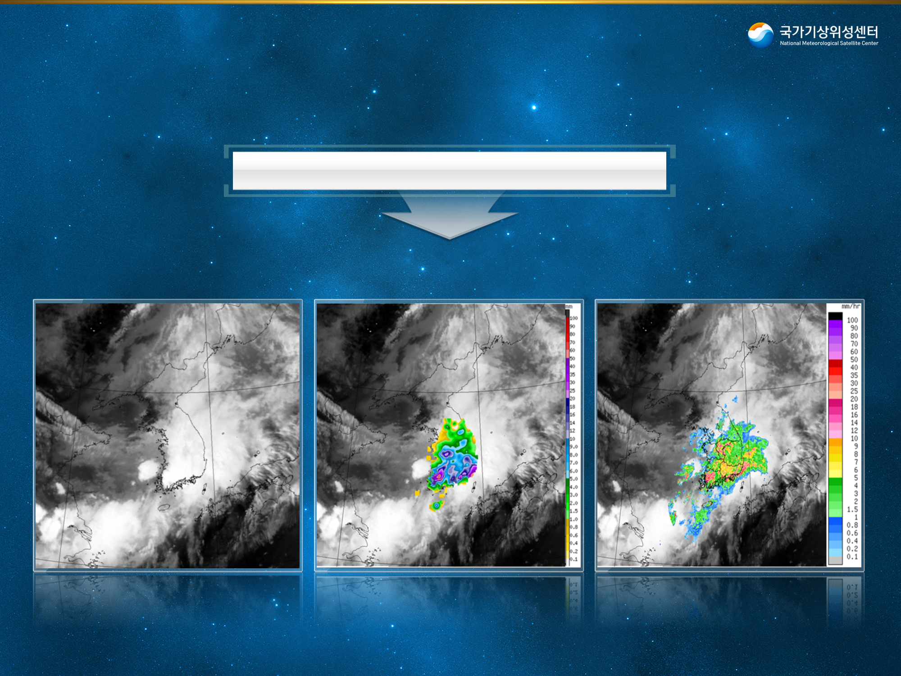
Nowcasting & Short-range Weather Forecasting
Synchronizing with COMS 10 minutes data in temporal and spatial
Integration between COMS and ground-based observation data
Infrared image
Infrared image + AWS
Infrared image + Radar
14
Notes:
For nowcasting & short-range weather forecasting,
Not just using the satellite images themselves,
KMA integrates between COMS and ground-based observation data such as AWS and/or radar image
and service these data.

Slide 15
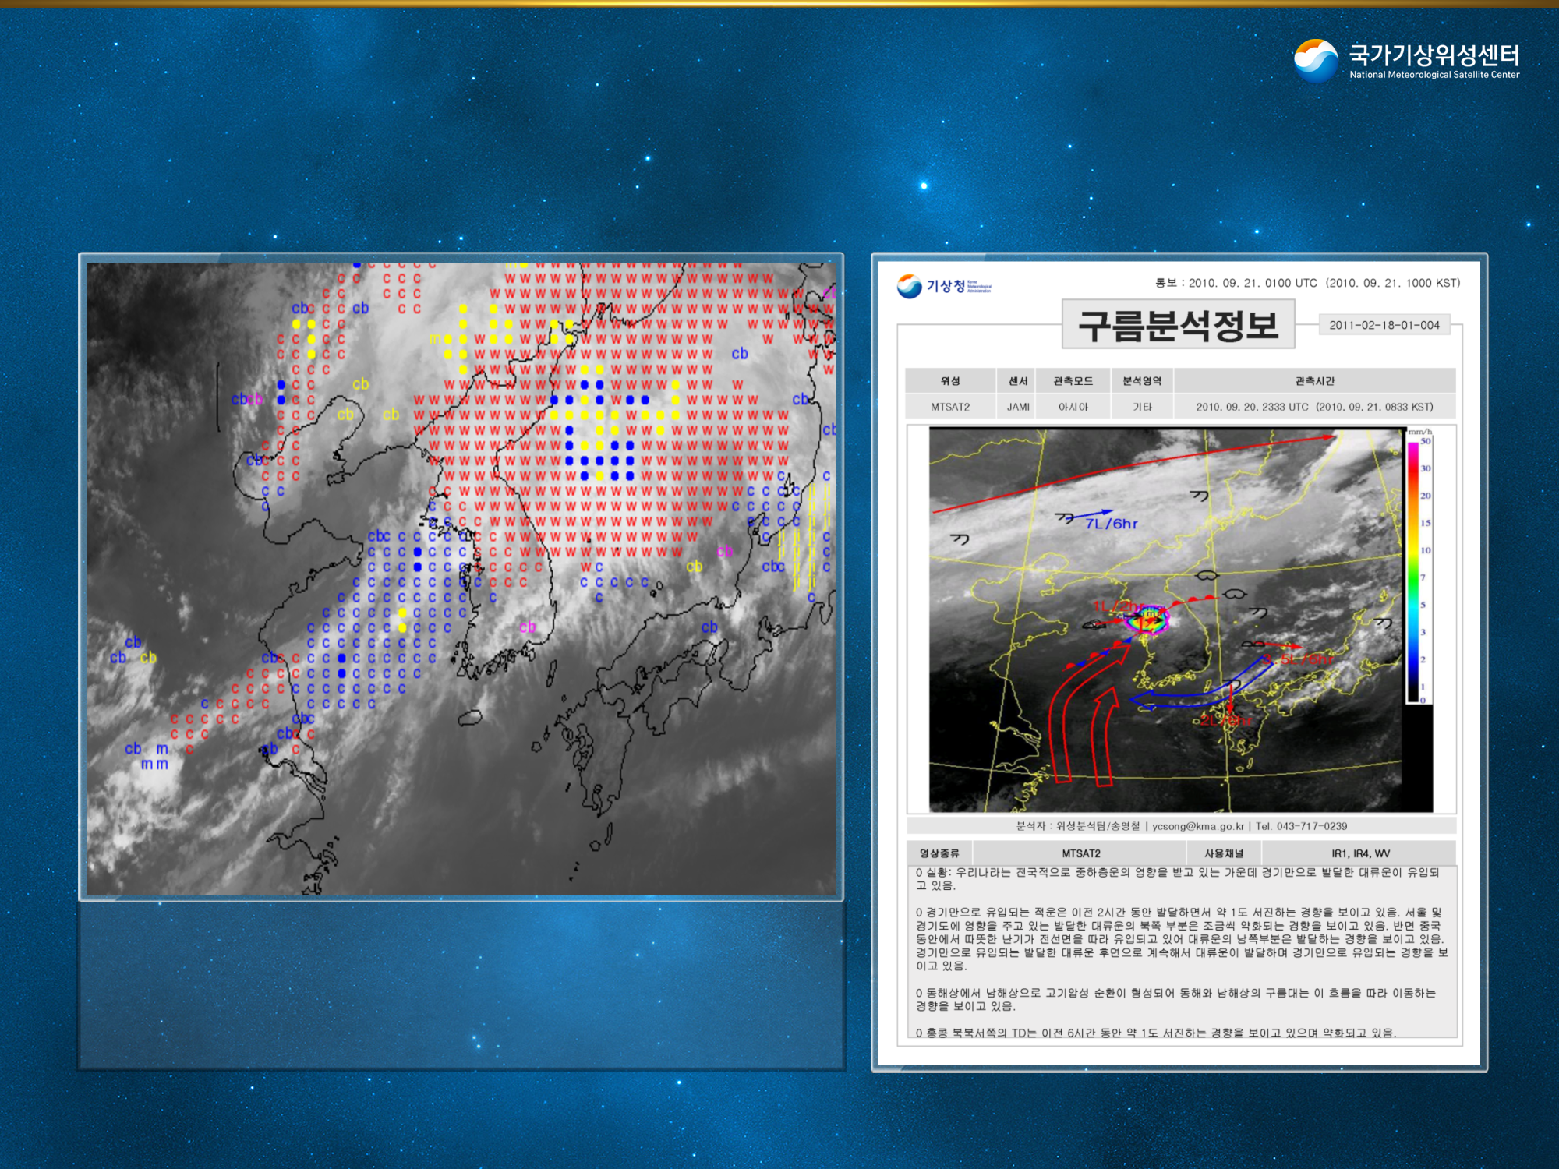
Mephanalysis information
Automatic interpretation information of satellite data(44 times/day)
Regular 4/day, severe weather 8/day
C : Cold front
W : Warm front
cb : cumulonimbus
M : Mesoscale convective system
● : convective sell
ji : front strengthening by jet
ec : intensified cumulus
z : cold move
dl : dry air injection
15
Notes:
We service mephanalysis information of automatic interpretation information from satellite images, 44 times per day.
And for cloud analysis data, regularly 4 times per day and 8 times per day in severe weather are provided to forecasters.

Slide 16
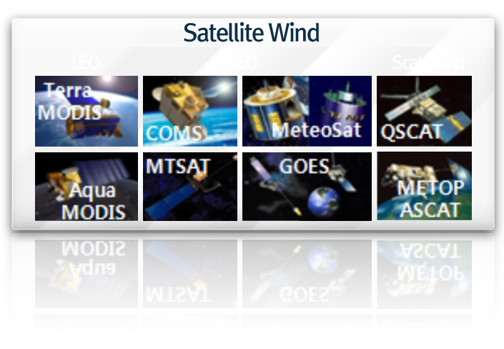
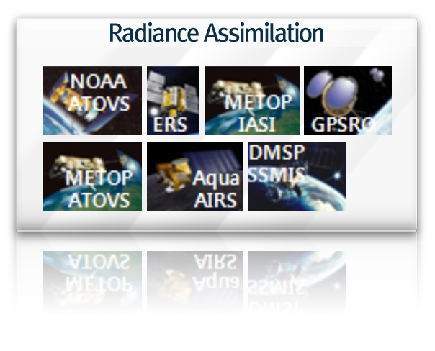
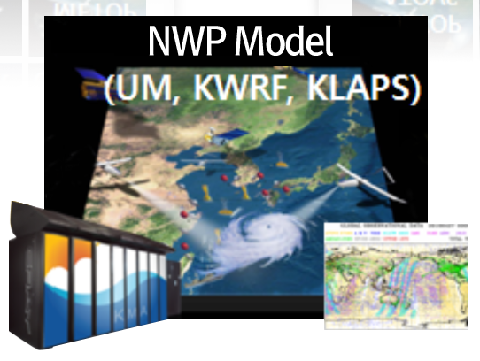
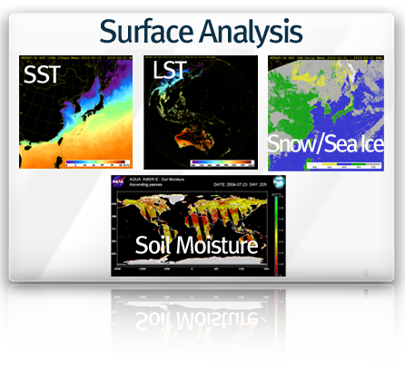
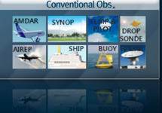

NWP Support
• COMS : AMV, CSR, SST, cloud amount, Yellow sand (Asian dust) detection, etc
• Increase of available NWP satellite data collection
• Development of data application technique
.
Improvement of NWP performance

Slide 17
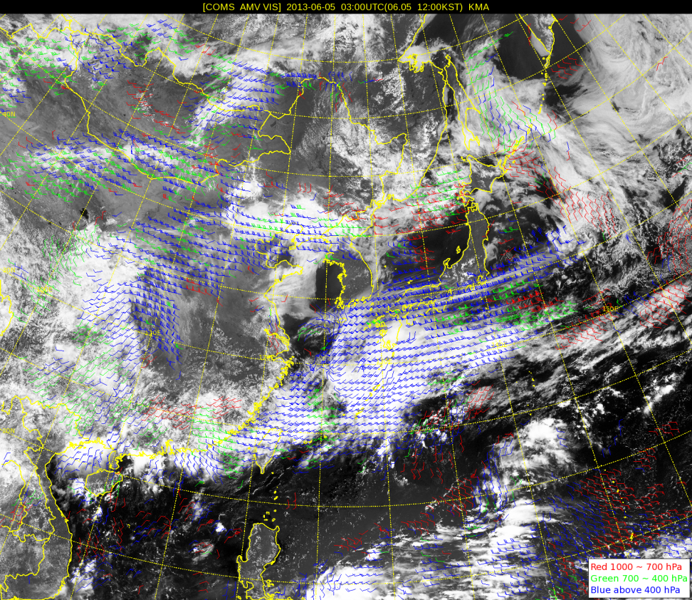
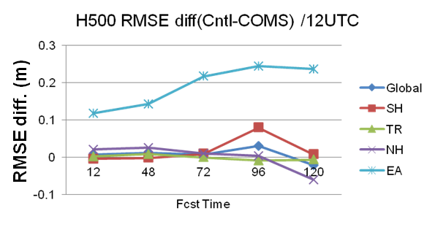
Development of techniques for supporting numerical weather prediction
Development of techniques for supporting NWP
  COMS products quality management(AMV, sea ice, snow etc.)
  NWP sensitivity test
  Analysis of characteristic of satellite data utilized in NWP
  Improving RTM simulation
Accuracy is Maximized in East Asia area
1% accuracy improvement of NWP by using COMS AMV data
Notes:
One of the important support by satellite data is the area of Numerical weather prediction model.
For supporting NWP, KMA conducts COMS products quality management for AMV, sea ice, snow etc.,
and also NWP sensitivity test, analysis of characteristic of satellite data utilized in NWP and improving RTM simulation.
By newly using COMS AMV data mainly focusing on NH in KMA’s NWP model, KMA found 1% accuracy improvement of NWP which number is meaningful and will continue to improve the techniques for supporting NWP

Slide 18
Preparation of Utilization of
Geo-KOMPSAT-2A
18

Slide 19
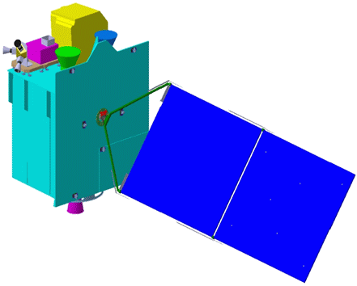
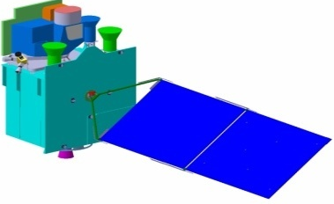
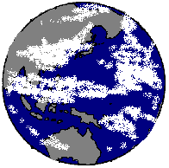

Geo-KOMPSAT-2A Program
One for the next generation Meteorological Imager
The other for the Ocean and Atmospheric Trace Gas monitoring
KMA
Meteorological Sensor
Space weather Sensor
Geo-KOMPSAT-2B
Geo-KOMPSAT-2A
Ocean /
Environmental Sensor
  2011 ~ 2017 (7 years)
Ground Segment
Data Processing System
* Preliminary study has been accomplishing in 2012
Notes:
The schematic diagram is brief introduction of development of GEO-KOMPSAT-2 program in Korea.
Differently from COMS, two separated satellites are developing. One is for meteorological mission only named GEO-KOMPSAT-2A, and the other is for ocean and environmental mission named GEOKOMPSAT-2B.
As for sub-payload of GEO-KOMPSAT-2A, KMA is developing the space weather sensor for developing the space weather monitoring system by observing the solar activities.
The program of the development of ground segment and data processing system will be kicked off in 2014. And the preliminary study has been started in 2011 and is extended to the end of this year.

Slide 20
Development of Geo-KOMPSAT-2A
Object
  Obtaining a geostationary meteorological satellite for continuous monitoring of meteorological phenomena
  Development of follow-on satellite for succession of COMS mission
Mission
  Continuing the COMS Meteorological Mission
  Improving the Severe Weather Monitoring
    Higher frequency of observation
    Retrieving the atmospheric structure (pseudo-sounding)
  Improving the support of the NWP model
    Efficient data assimilation system
  Intensifying the environment & climate monitoring
    Various surface information retrieval
    Air pollution monitoring
    Establishing long-term observation data
Notes:
As briefly described in previous slides. The objects of GEO-KOMPSAT-2A are;
1) Obtaining a geostationary meteorological satellite for continuous monitoring of meteorological phenomena
2) Development of follow-on satellite for succession of COMS mission
And the main missions are;
1) Continuing the COMS Meteorological Mission
2) Improving the Severe Weather Monitoring, the support of NWP model, and intensifying the environment & climate monitoring

Slide 21
GEO-KOMPSAT-2A payload
 | MI(COMS) |  | AMI(GEO-KOMPSAT-2A)
Channels | 5 |  | 16
Spatial resolution(km) | 1/4(VIS/IR) |  | 0.5,1/2(VIS/IR)
True color image | X |  | O
Temporal resolution(min) | 25(Full Disk) |  | 10(Full Disk)
Products | 16 |  | 52
Data rates(Mbps) | 2.6 |  | ~70
Design life(year) | 7 |  | 10
Utilization | Weather forecasting |  | + NWP + Climate model
Loaded satellites | U.S.A. | GOES-8~15 | GOES-R(ABI) | 2015
 | Japan | MTSAT-2 | Himawari-8/9(AHI) | 2014/2016
Notes:
The Advanced Meteorological Imager of GEO-KOMPSAT-2A is quite similar with ABI of GOES-R of USA and AHI of Himawari-8/9 of Japan. This table shows the comparison of specification of payloads between COMS MI and GEO-KOMPSAT-2A AMI.
The main improvements among the specification are number of channels and temporal resolution:
Firstly, the number of channels of AMI will be 16 from 5 of MI, while for spatial resolutions , 1 in visible, 4 in infrared to 0.5 in visible, 1 and 2 in infrared channels.
Secondly, the time to observe the Full Disk image will be within 10 minute comparing with about 30 minute of COM MI.
Additionally, AMI can provide the true color image using visible RGB channels during the day time. As expectedly, the number of products will be increased from 16 to 52.

Slide 22
The products and data transmission of Geo-KOMPSAT-2A
16 spectral bands
<Basic Spectral Bands>
Band No. | Band Name | Center Wavelength |  | Band Width (Max, um) | Resolution (km) | SNR | NEdT(K) (240/300K) | Radiometric Accuracy
 |  | Min(um) | Max(um)
1 | VIS0.4 | 0.431 | 0.479 | 0.075 | 1 | 250 |  | 5%
2 | VIS0.5 | 0.5025 | 0.5175 | 0.0625 | 1 | 250 |  | 5%
3 | VIS0.6 | 0.625 | 0.66 | 0.125 | 0.5 | 120 |  | 5%
4 | VIS0.8 | 0.8495 | 0.8705 | 0.0875 | 1 | 210 |  | 5%
5 | NIR1.3 | 1.373 | 1.383 | 0.03 | 2 | 300(☞) |  | 5%
6 | NIR1.6 | 1.601 | 1.619 | 0.075 | 2 | 300 |  | 5%
7 | IR3.8 | 3.74 | 3.96 | 0.5 | 2 |  | 3/0.2 | 1K
8 | IR6.3 | 6.061 | 6.425 | 1.038 | 2 |  | 0.4/0.1(*) | 1K(☝)
9 | IR6.9 | 6.89 | 7.01 | 0.5 | 2 |  | 0.37/0.1 | 1K
10 | IR7.3 | 7.258 | 7.433 | 0.688 | 2 |  | 0.35/0.12(*) | 1K(☝)
11 | IR8.7 | 8.44 | 8.76 | 0.5 | 2 |  | 0.27/0.1 | 1K
12 | IR9.6 | 9.543 | 9.717 | 0.475 | 2 |  | 0.35/0.15 | 1K
13 | IR10.5 | 10.25 | 10.61 | 0.875 | 2 |  | 0.4/0.2 | 1K
14 | IR11.2 | 11.08 | 11.32 | 1.0 | 2 |  | 0.19/0.1 | 1K
15 | IR12.3 | 12.15 | 12.45 | 1.25 | 2 |  | 0.35/0.2 | 1.1K
16 | IR13.3 | 13.21 | 13.39 | 0.75 | 2 |  | 0.48/0.3 | 1.1K
※ SNR@100% albedo, NEdT@240/300K, calibration accuracy@100% albedo/300K
☞ SNR@max radiance ≤ 100% albedo
☝ calibration accuracy@max temperature ≤ 300K

Slide 23
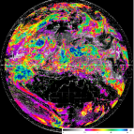
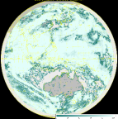
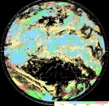
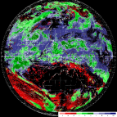
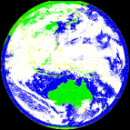
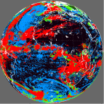
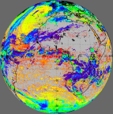
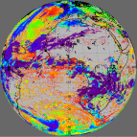
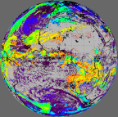
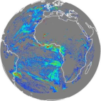
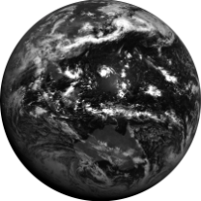
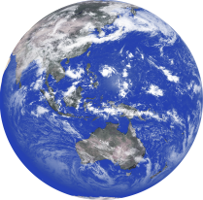
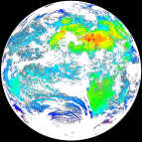
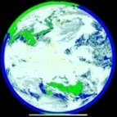
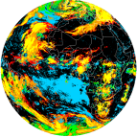
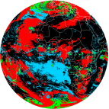
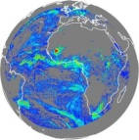
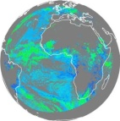

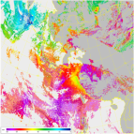
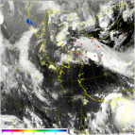
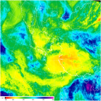
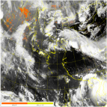










































COMS MI vs. GEO-KOMPSAT-2A AMI
4 times spatial resolution
3 times number of channels
3.5 times number of products
COMS
Geo-KOMPSAT-2A
COMS
Geo-KOMPSAT-2A
COMS
VI 1km
IR 4km
Geo-KOMPSAT-2A
VI 0.5~1km
IR 2km
1 channel
(achromatic)
4 channels
(color)
Cloud/Precipitation (5→19)
VI
4 times tempral resolution
Radiation/aerosol (5→16)
1 Hr
2 channels
SWIR
O
1 FD
4 FD
Atmospheric Motion/Conditions(3→6)
4 channels
10 channels
2 NH
10 NH
Surface information(3→11)
IR
…....
4 Korea
Every 2 min Korea
5 channels
16 channels
16 products
52 products
23
Notes:
Here is the summary of the comparison between COMS and GEO-KOMPSAT-2A.
The performance of GEO-KOMPSAT-2A is about 4 times in spatial resolution, 3 times in temporal resolution, 3 time in the number of channels and 3.5 time in the number of products.
By these improved performance, KMA can detect the Asian dust with true color image, vegetation, fire, etc, and diversify products like T/Q profile, stability indices, cloud information compared with existing COMS products.

Slide 24

Ground Segment
    Ground System development and Construction for GeoKOMPSAT-2A
    Receiving, Processing, analysis and Archiving service of meteorological and space weather data
    Completion of data dissemination in 3 min. after acquisition of image scanning
    Develop user-friendly data service system
Launched in 2010.6
Scheduled in 2017
Communication, Ocean, Meteorological Instruments
Meteorological Instruments
(Advanced Spatial, temporal resolution)
COMS
GEO-KOMPSAT-2A
Advanced processing performance
Applying the newest IT Technologies
Providing several service
Space Weather data processing system including control system
Creation of Satellite data hub
COMS Ground Station
Follow-on Ground Station
Constructed in 2009.4
Being Constructed in 2016
National Meteorological Satellite Center
    ➔ Preliminary study in 2011, Foundation design in 2012 and Operation techniques study(on going) in 2013 for ground system development
Notes:
Another important component for GEO-KOPMSAT-2A is development of “Ground Segment”
The main missions of ground segment system for GEO-KOMPSAT-2A are;
First, Receiving, Processing, analysis and Archiving service of meteorological and space weather data
And accomplishing Satellite control mission.
For the proper and effective accomplishment of mission of Ground Segment, and economic and optimal system construction, KMA is carrying out the “Preliminary study” for ground system throughout this year.

Slide 25



Development of GEO-KOMPSAT-2A Ground Segment
Outline
Development of GeoKOMPSAT-2A ground segment
  - Develop Level 2 products algorithms
  - Develop meteorological/space weather data processing system
  - Construct satellite control system
  - Develop data management and service system
  - Integration test & normal operation preparation
Period : 2014 ~ 2018 (5yrs)
Application
Enhance forecast/climate monitoring based on high resolution measurements
  - Develop ISDAS(Interactive Satellite Data Analysis System) and Web-based Typhoon Analysis system
Generate 52 meteorological products & apply and combine them to hydrology, agriculture, disaster prevention etc.
Support satellite operation with space weather measurements
Notes:
KMA is scheduled to develop the GEO-KOMPSAT-2A Ground segment before the GEO-KOMPSAT-2A launch and scheduled to finish in 2016 one year before the launch.
The development of ground segment will include:
- development of L2 products algorithm and data processing system
- development of data management and service system
The segment will enhance forecast and climate monitoring based on high resolution measurements, and will support satellite operation as well.

Slide 26












System configuration of GEO-KOMPSAT-2A Ground Segment
NMSC
Satellite control/
Pre-processing system (KARI)
RF
RF
RF
RF
RF
RF
Command/
Telemetry
RF
RF
BB
BB
BB
BB
BB
BB
BB
BB
RF/BB
Primary
Satellite
Control
Secondary
Raw
Data
Raw
Data
Pre-processing
Pre-processing
Level
0/1A/1B
RF/BB
Level
0/1A/1B
DB
DB
Simulator
Pre-processing
Satellite Control
Level 2/3
Level 2/3
Processing/Analysis
Telemetry
Processing/Analysis
Users
Level 0/1A/1B/2/3 & other satellites
KMA
Foreign Satellite Data
Level 0/1A/1B/2/3 & other satellites
Date
management/service
(Duplicated)
Remote data
backup

Slide 27

The plan of data distribution for GEO-KOMPSAT-2A
Via satellite
  - UHRIT : 16 channels data of GEO-KOMPSAT-2A
  - HRIT/LRIT : 5 channels data comparable with COMS 5 channels
  for existing users of COMS
Via ground network
- internet
- ftp

Slide 28

Development of GEO-KOMPSAT-2A meteorological products
(1/7)
 | No. | Products |  | No. | Products
cloud/ rainfall | 1 | Cloud detection | radiation/ Aerosol | 27 | Visibility
 | 2 | Cloud Top Temperature |  | 28 | O3 total
 | 3 | Cloud Top Pressure |  | 29 | Radiances
 | 4 | Cloud Top Height |  | 30 | Upward Shortwave Radiation(TOA)
 | 5 | Cloud type |  | 31 | Downward Shortwave Radiation(Surface)
 | 6 | Cloud phase |  | 32 | Absorbed Shortwave Radiation(Surface)
 | 7 | Cloud Amount |  | 33 | Downward Longwave Radiation(Surface)
 | 8 | Cloud Optical Depth |  | 34 | Upward Longwave Radiation(Surface)
 | 9 | Cloud Particle Size Distribution |  | 35 | Upward Longwave Radiation(TOA)
 | 10 | Cloud Liquid Water | ATM motion/ condition | 36 | Atmospheric Motion Vector
 | 11 | Cloud Ice Water Path |  | 37 | Vertical Temp. Profile
 | 12 | Cloud Layers/Heights |  | 38 | Vertical Moisture Profile
 | 13 | Fog |  | 39 | Derived Stability Indices
 | 14 | In-flight icing |  |  | Total Precipitable Water
 |  |  |  | 40 | Atmospheric Motion Vector
 | 15 | Convection initiation |  | 41 | Tropopause folding turbulent flow
 | 16 | overshooting top/enhanced thermal couplet detection | surface | 42 | Sea Surface Temperature
 | 17 | Rainfall Intensity |  | 43 | Land Surface Temperature
 | 18 | probability of rainfall |  | 44 | Fire/Hot Spot Characteristic
 | 19 | rainfall potential |  | 45 | Vegetation Index
radiation/ aerosol | 20 | Aerosol detection |  | 46 | Vegetation Fraction: Green
 | 21 | Asian dust detection |  | 47 | Surface Emissivity
 | 22 | Volcanic Ash: Detection and Height |  | 48 | Surface Albedo
 | 23 | SO2 Detection |  | 49 | Snow Cover
 | 24 | Aerosol Optical Depth |  | 50 | Snow Depth
 | 25 | Asian dust Optical Depth |  | 51 | Ice Cover
 | 26 | Aerosol Particle Size |  | 52 | Current
Schedule of meteorological data processing system
Notes:
I want to explain the meteorological products a little more detail since the meteorological products will be also provided to end users. The algorithm will be completed within 2016 as mentioned in previous slide and will continue to test for operation.
As mentioned by previous slides, the number of products are 52 with the four categories such as cloud/rainfall, radiation/aerosol, atmospheric motion/conditions, and surface. And 52 specific names of the products are in this chart.

Slide 29

Development of GEO-KOMPSAT-2A meteorological products(2/7)
RGB composite
  Taking three different values from channels or channel differences, scale them and assign them to red, green, and blue of a pixel color.
  Three different images are combined to produce one color image.
  Final color assignments are therefore related to the characteristics of image pixels.
  Products may simplify the interpretation of data from multiple bands by displaying information in a single image.
RGB
0.4 µm
0.5 µm
0.6 µm

Slide 30

Development of GEO-KOMPSAT-2A meteorological products(3/7)
Cloud/Rainfall(19)
Cloud detection
Cloud Top Temperature
Cloud Top Pressure
Cloud Top Height
Cloud type
Cloud phase
Cloud Amount
Cloud Optical Depth
Cloud Particle Size Distribution
Cloud Liquid Water
Cloud Ice Water Path
Cloud Layers/Heights
Fog
In-flight icing
Convection initiation
overshooting top/enhanced thermal couplet detection
Rainfall Intensity
probability of rainfall
rainfall potential
Monitor Cumulus Cloud Development
Satellite Detection
Radar Detection
Height
Time
Forecast without satellite
Forecast with satellite
Convection initiation

Slide 31




Development of GEO-KOMPSAT-2A meteorological products(4/7)
Radiation/Aerosol(16)
Aerosol detection
Asian dust detection
Volcanic Ash: Detection and Height
SO2 Detection
Aerosol Optical Depth
Asian dust Optical Depth
Aerosol Particle Size
Visibility
O3 total
Radiances
Upward Shortwave Radiation(TOA)
Downward Shortwave Radiation(Surface)
Absorbed Shortwave Radiation(Surface)
Downward Longwave Radiation(Surface)
Upward Longwave Radiation(Surface)
Upward Longwave Radiation(TOA)
cloud
land
ocean
week
dust flow
dark land
cloud
RGB image 412 nm
(ch.370 nm 650 nm
bright land
Aerosol detection over bright surface

Slide 32



Development of GEO-KOMPSAT-2A meteorological products(5/7)
Atmospheric Motion/Condition(5)
Atmospheric Motion Vector
Vertical Temp. Profile
Vertical Moisture Profile
Derived Stability Indices
Total Precipitable Water

Slide 33


Development of GEO-KOMPSAT-2A meteorological products(6/7)
Surface(11)
Sea Surface Temperature
Land Surface Temperature
Fire/Hot Spot Characteristic
Vegetation Index
Vegetation Fraction: Green
Surface Emissivity
Surface Albedo
Snow Cover
Snow Depth
Ice Cover
Current
SST
Ice cover /Snow cover
33

Slide 34

Development of GEO-KOMPSAT-2A meteorological products(7/7)
Core Technology(4)
Sensor Calibration/Validation
Radiation Model
Simulated Data
Ancillary Data
GOES-R ABI 6.19μm Band
Brightness Temperature
simulated image
Sensor
Calibration and Validation
System

Slide 35




Development of techniques about space weather
  Space Environment Monitor(SEM)
    Measurement of electron, ion and magnetic field on low/mid energy range
Support for stable operation of GEO-KOMPSAT-2A
Data
Products(8)
real-time magnetospheric particles distribution
deep dielectric charging prediction index
geomagnetic storm index
stratospheric ozone concentration
thermospheric temperature
stratospheric temperature
AOI(Arctic Oscillation Index)
Time(satellite position)
Energy channel
(electron, ion)
Particle flux
(each direction)
Magnetic field flux(3axis)
Background flux
Noise
Payload monitoring data
(Voltage, dark current, etc.)
35
Notes:
Korea Space Environment Monitor(KSEM) loaded in GEO-KOMPSAT-2A
measures the electron flux on mid-level energy range, magnetic field
and the charging current due to high energy particles for space weather
and to support for stable operation of GEO-KOMPSAT-2A.
KMA will develop the eight more products in the area of space weather in addition to 52 meteorological products.

Slide 36


