Slide 1



“Satellite Meteorology Training in WMO RAV during 2017/18; the Australian VLab Centre of Excellence experience”
Asia-Oceania Meteorological Satellite Users Conference 9 (AOMSUC-9), Jakarta, Indonesia
Presenter: Bodo Zeschke. Bureau of Meteorology Training Centre, Australian VLab Centre of Excellence Point of Contact

Slide 2
Content
This presentation is a summary of the satellite meteorology training conducted by the Australian VLab Centre of Excellence over the past year.
It focusses on:
The monthly Regional Focus Group meetings, including collaboration with JMA, KMA, BMKG Indonesia, NOAA/NASA.
Using the Socrative cloud based learner response system within VLab and other training.
Effective use of online resources to facilitate satellite meteorology teaching at BMTC and within the VLab
Future directions and initiatives

Slide 3
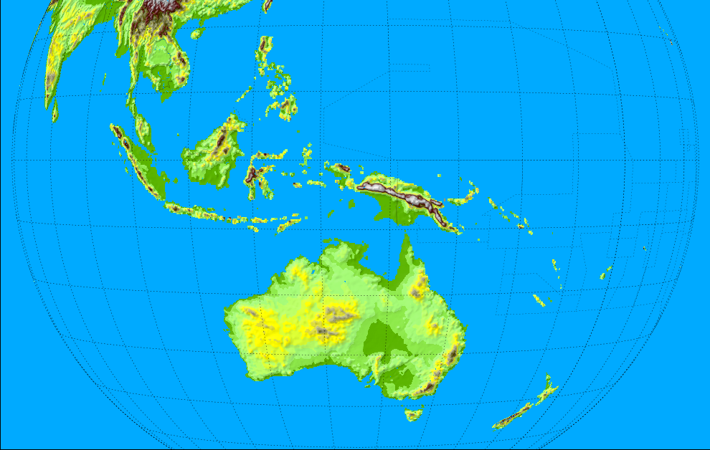



Australian VLab Centre of Excellence and RAV contacts (see also https://www.wmo-sat.info/vlab/centres-of-excellence/)
Philippines
Singapore
Peter Davidson
(Head of CoE)
DuncanTippins
(Head of CoE)
Bodo Zeschke
(Main Point of Contact)
Solomon Islands
Indonesia
Tuvalu
PNG
Fiji
Other important contacts:
JMA
EUMETSAT
CMA
KMA
Vanuatu
Samoa
RAV
Satellite Champions
RAV contacts frequently attending our training
Other RAV contacts
Melbourne
New Zealand

Slide 4

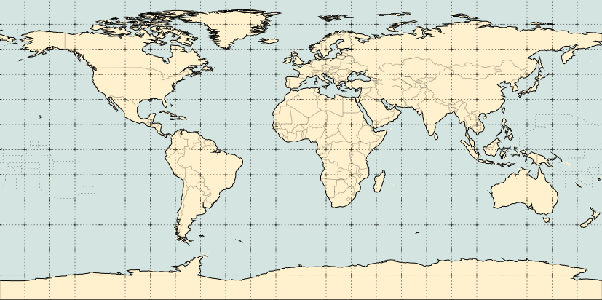
The past 5 years of Regional Focus Group meetings – statistics October 2013 to September 2018
0.1
0.5
1.6
1.0
2.4
0.6
0.3
0.4
0.1
0.9
0.1
10.1
0.1
0.2
0.3
9.4
0.5
0.2
1.1
Average number of remote participants per session
Total number of remote stakeholders attending the 60 sessions = 1821+
Average number of participants per session = 30.4+

Slide 5
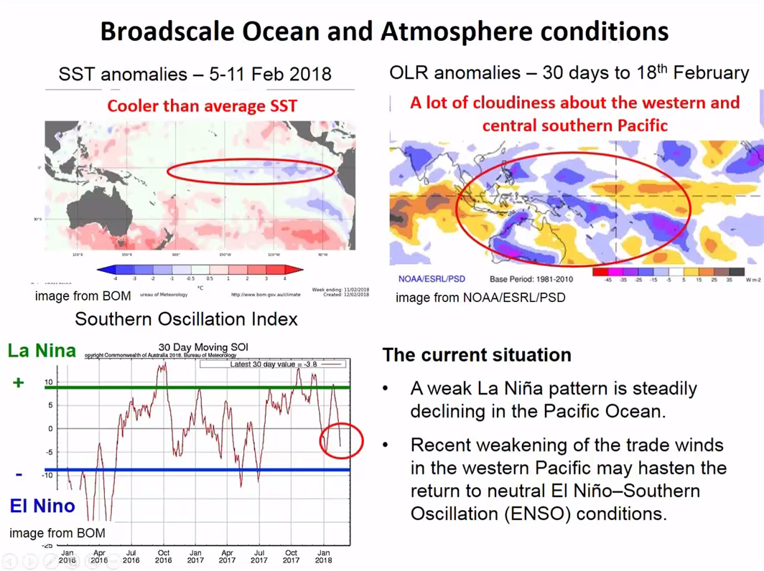
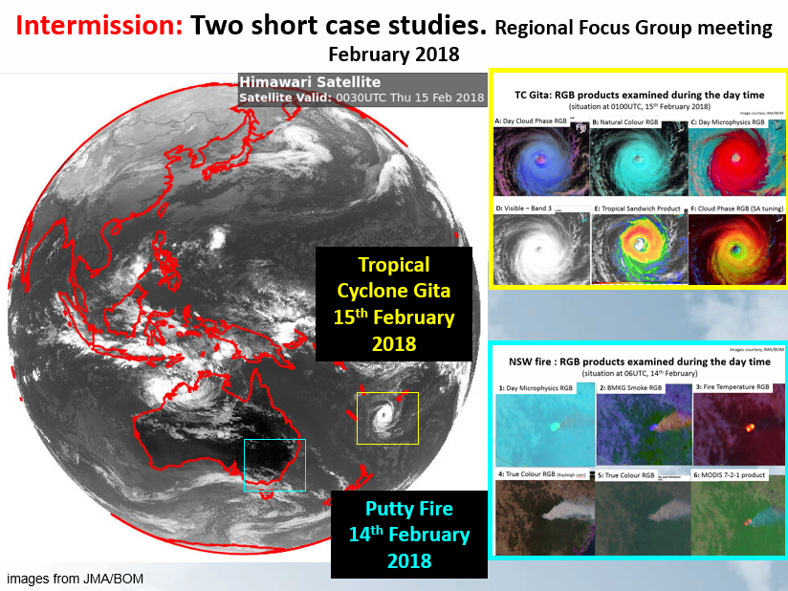
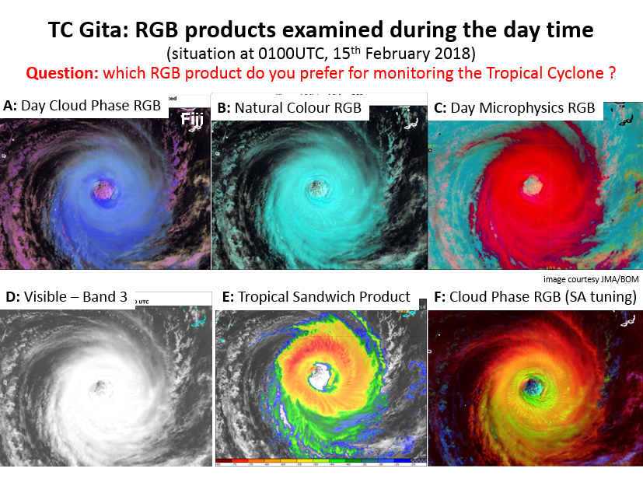
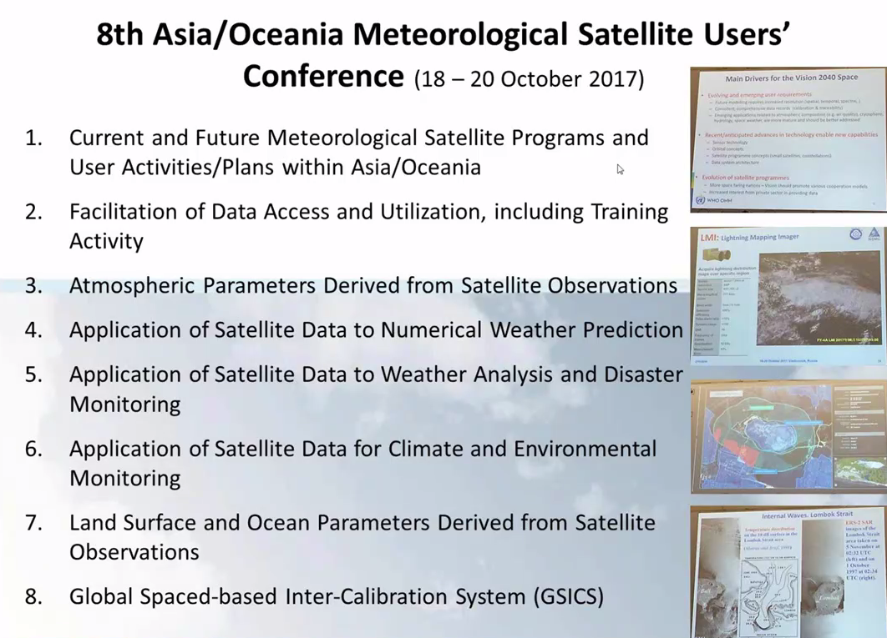
Monthly Regional Focus Group Meetings (over the past five years…)
1
2
3
4
REFERENCE SLIDE

Slide 6
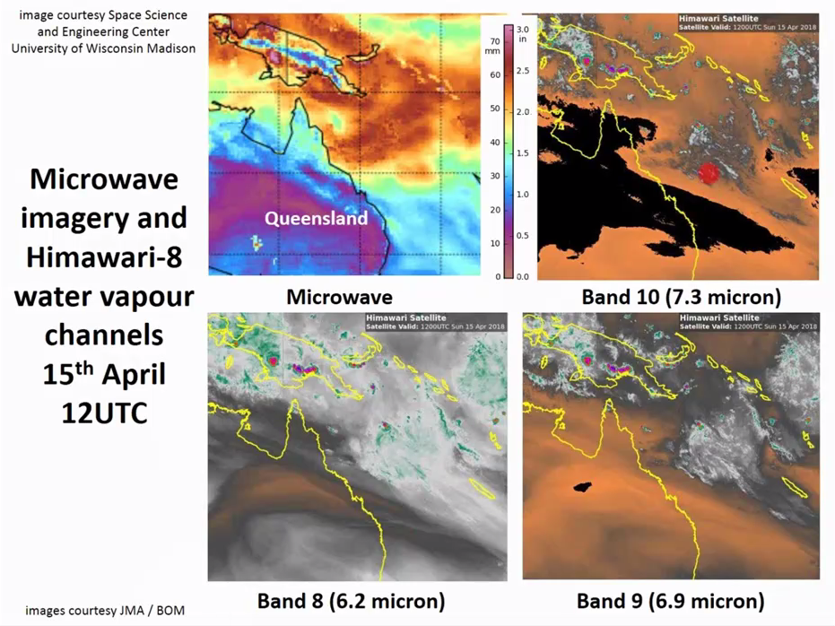
Monthly Regional Focus Group Meetings (over the past five years…)
1
2
3
4

Slide 7
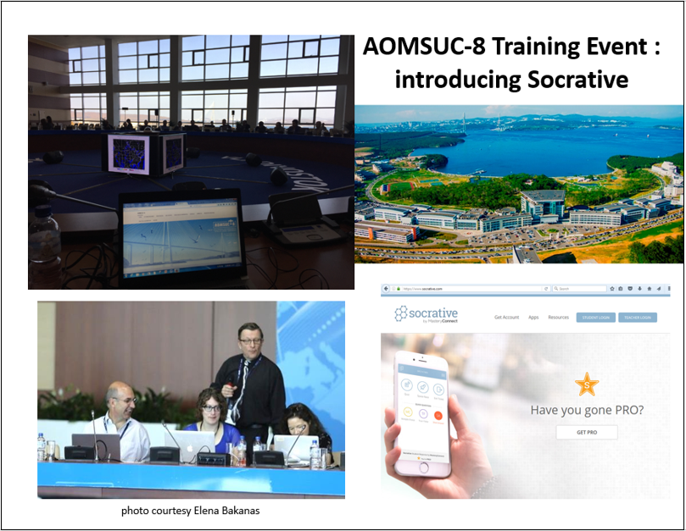
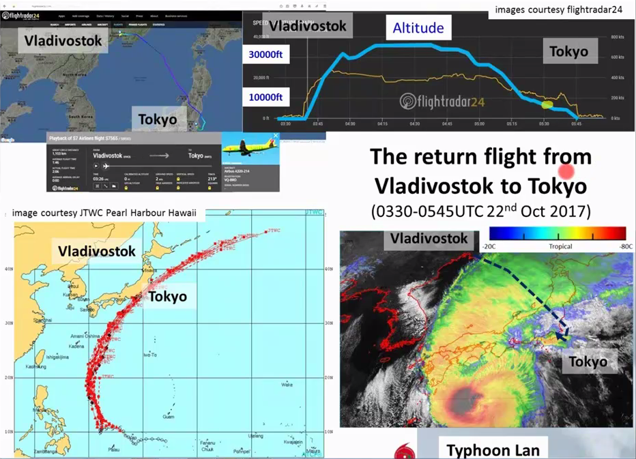
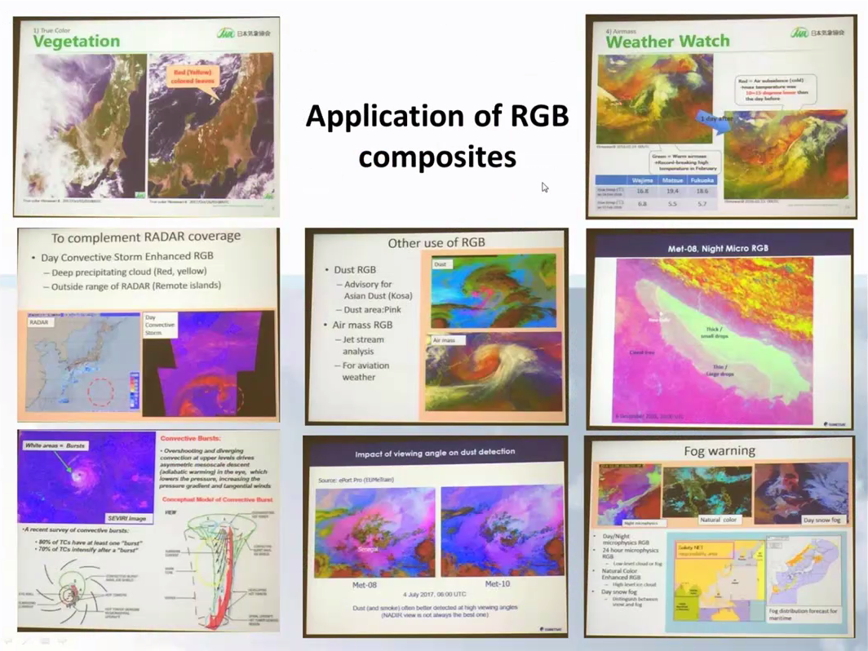
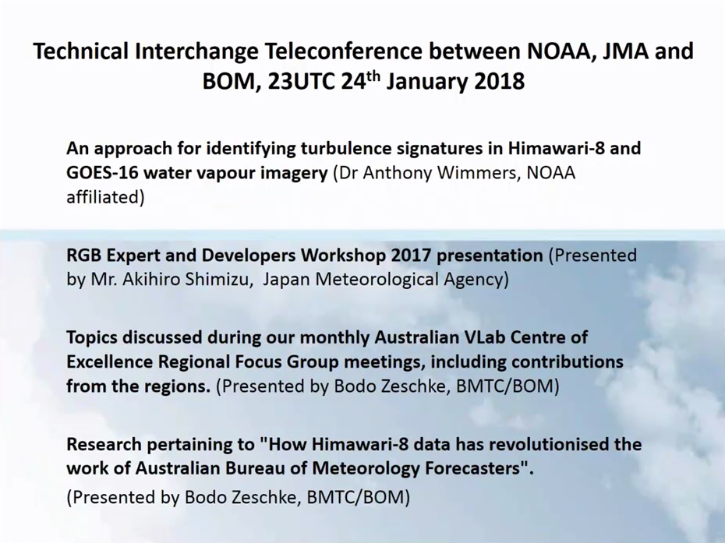
Monthly Regional Focus Group Meetings (over the past five years…)
5
6
7
8

Slide 8
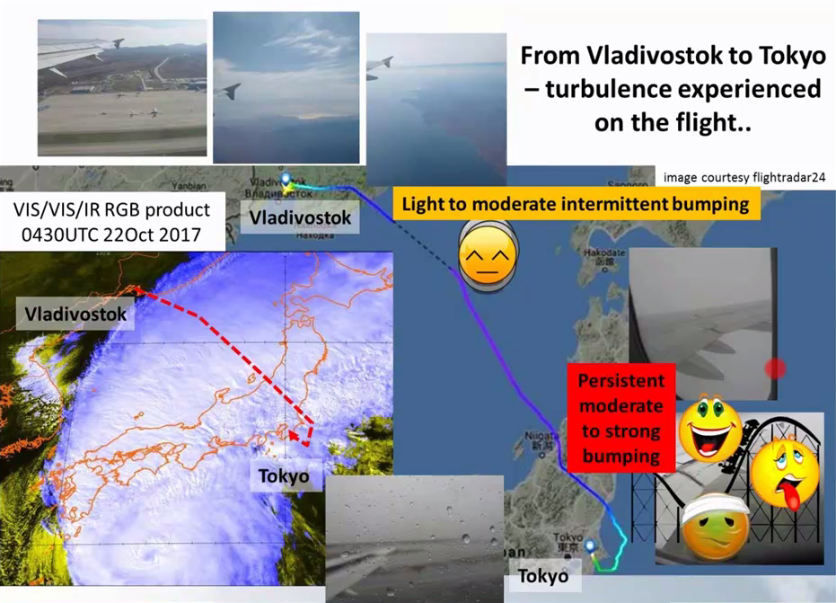
Monthly Regional Focus Group Meetings (over the past five years…)
REFERENCE SLIDE

Slide 9
An overview of Australian Vlab Centre of Excellence Regional Focus Group meetings
Main topics covered:
Weather and Forecast discussions
Case studies (mid-latitude & tropical examples, utilising Himawari-8 data)
Individual case studies showcasing various RGB composites. Also starting to use more Polar Orbiter satellite data – microwave PTW here.
Presenting useful material from conferences, training and workshops (Asia-Oceania Meteorological Satellite Users Conference-8, RGB Expert and Developers Workshop 2017)
Useful resources from AOMSUC-8 Training Event - Socrative
A short case study of the return flight from Vladivostok, my experience in approaching and sidestepping Typhoon Lan
Technical Interchange Teleconference between NOAA, JMA and BOM
REFERENCE SLIDE

Slide 10
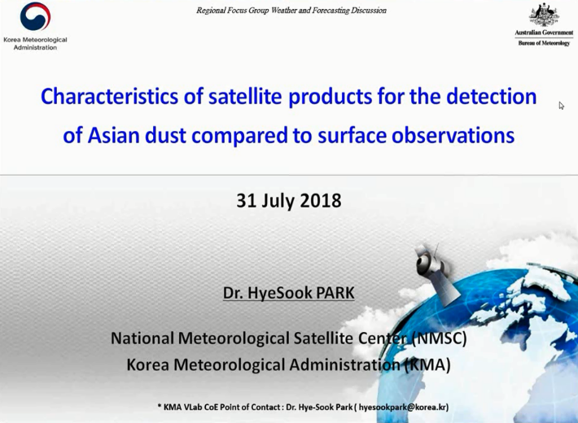
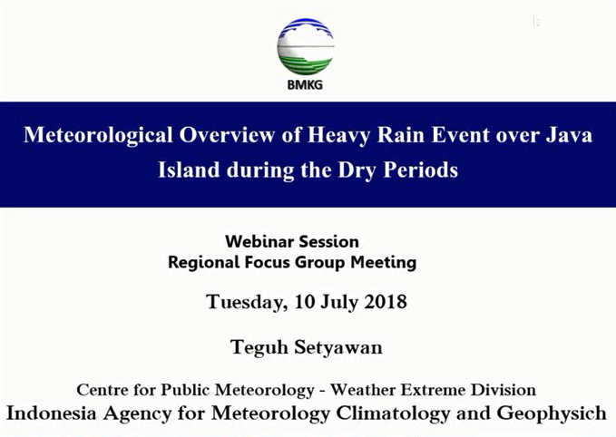
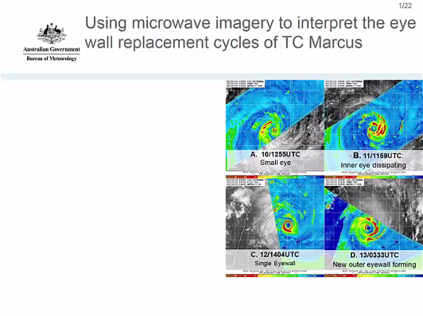



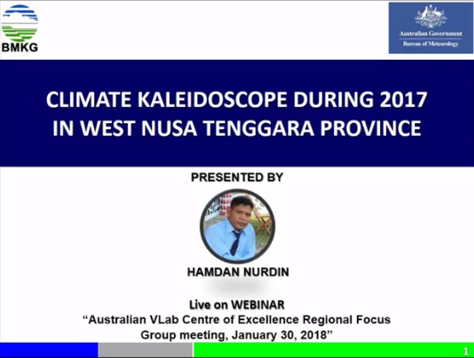
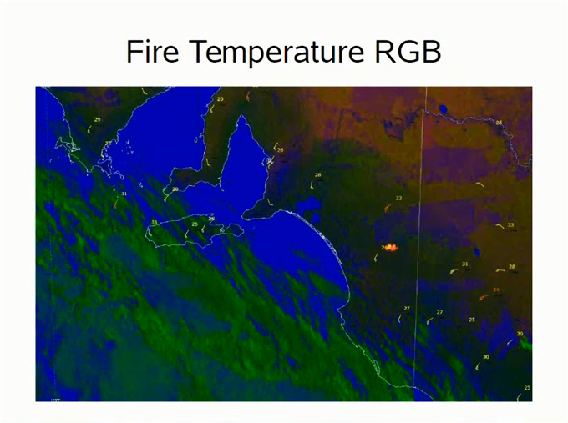
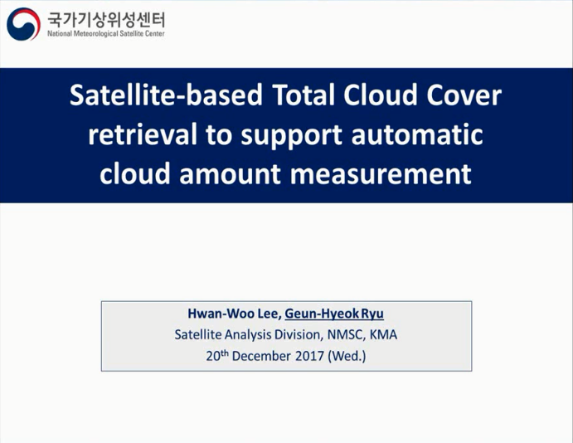
Presentations by invited speakers since AOMSUC-8
July 2018
July 2018
April 2018
January 2018
January 2018
December 2017

Slide 11
Presentations by invited speakers since AOMSUC-8
The Australian VLab Centre of Excellence has hosted presenters from Indonesia, Korea and Australia. In particular:
BMKG Indonesia presented and co-contributed to two sessions. In January 2018 Mr. Hamdan Nurdin presented "Climate Kaleidoscope during 2017 in West Nusa Tenggara Province". On the 10th July 2018 Mr. Teguh Setyawan presented "Meteorological Overview of Heavy Rain Event over Java Island during the Dry Periods".
KMA presented and co-contributed to two sessions. In December 2017 Dr. Geun-Hyeok Ryu presented "Satellite-based Total Cloud Cover retrieval to support automatic cloud amount measurement. On the 31st July 2018 Dr HyeSook Park presented "Characteristics of satellite products for the detection of Asian dust compared to surface observations".
During April 2018 Mr Joe Courtney of the Bureau of Meteorology presented "Using microwave imagery to interpret the eye wall replacement cycles of TC Marcus".
During January 2018 Ms. Naomi Benger presented "The Fire Temperature RGB product"
REFERENCE SLIDE

Slide 12
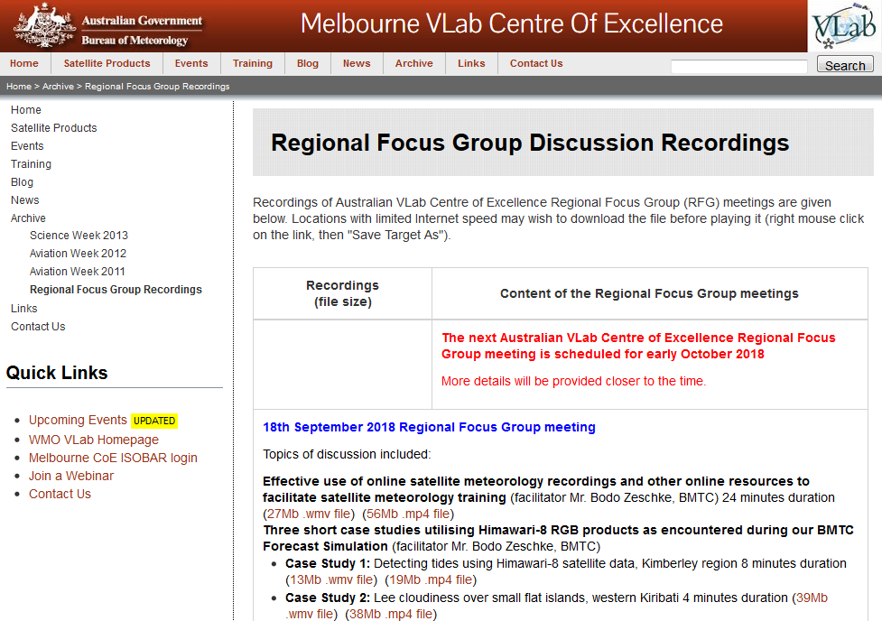
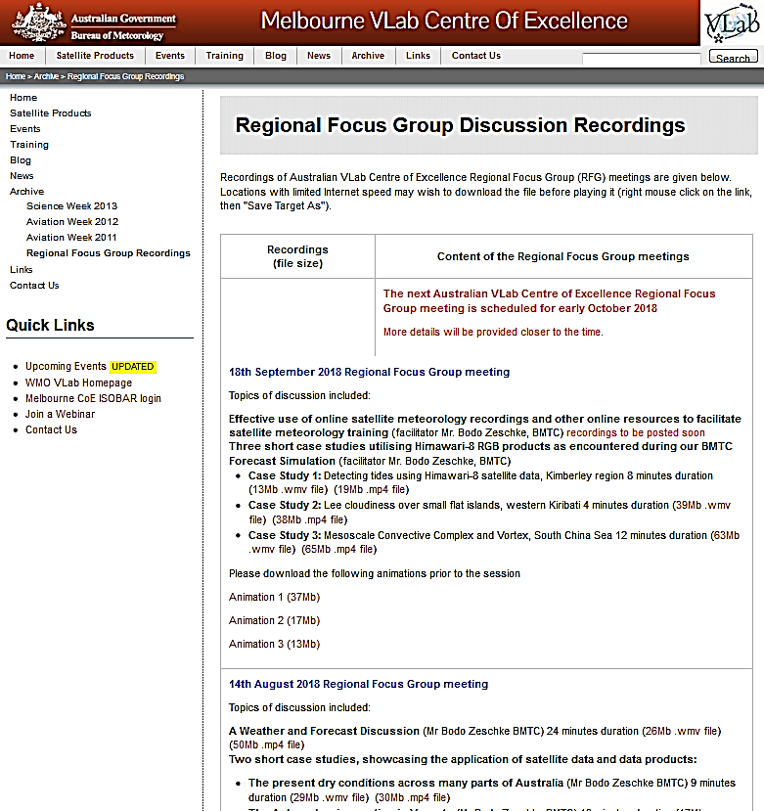
Recordings of our Regional Focus Group Discussions http://www.virtuallab.bom.gov.au/archive/regional-focus-group-recordings/

Slide 13
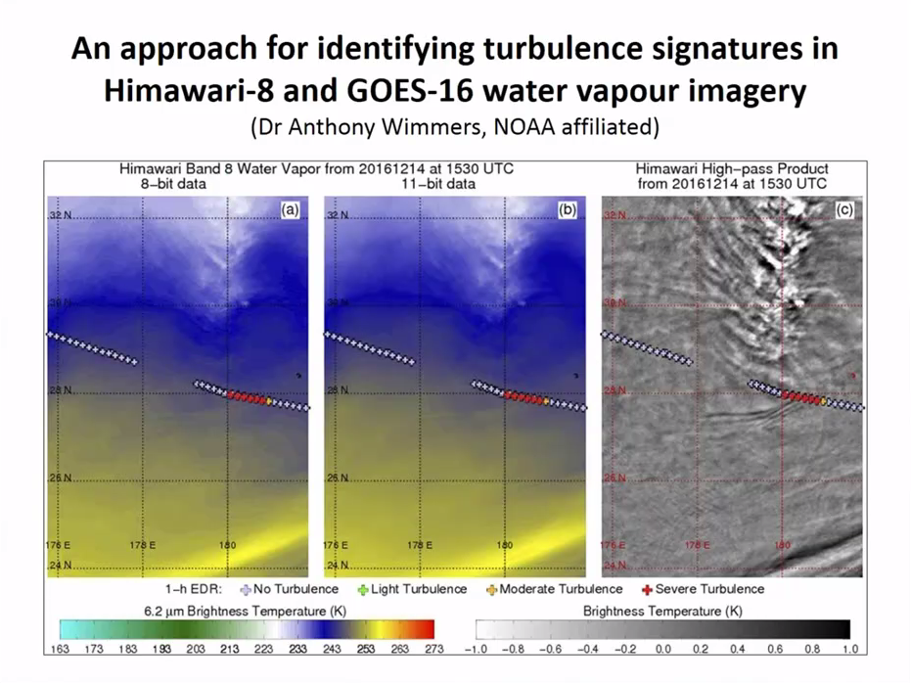
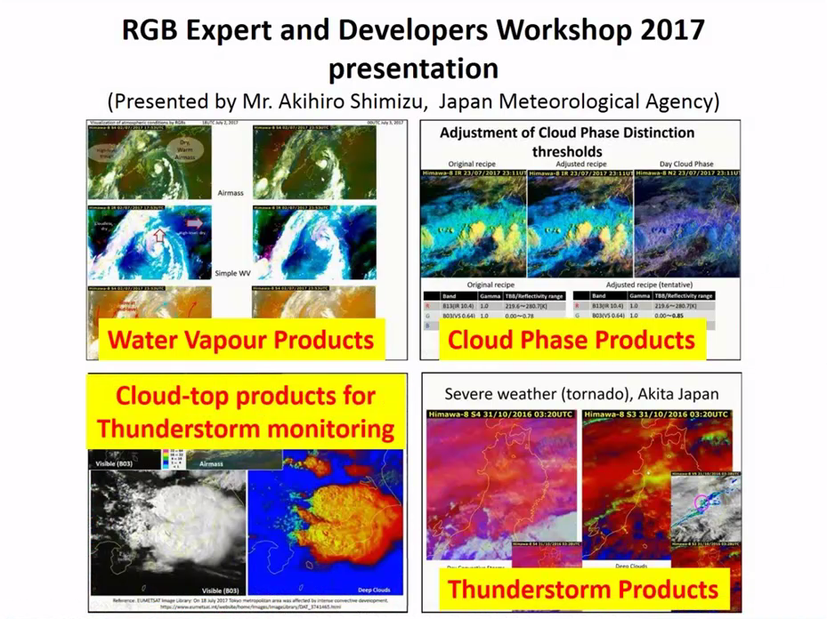
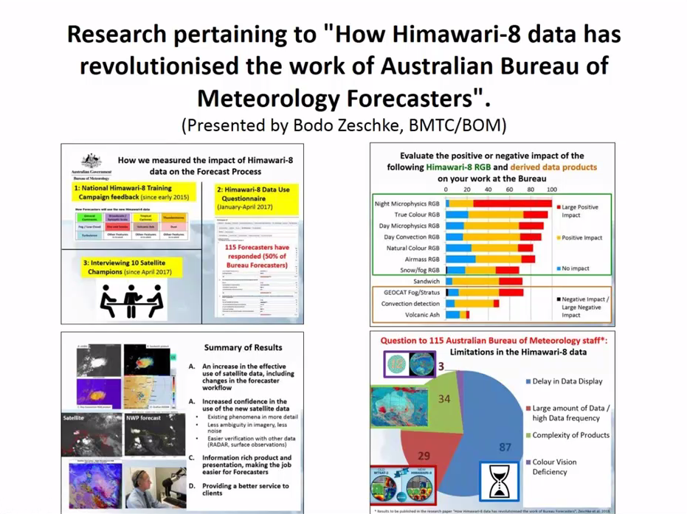
Technical Interchange Teleconference between NOAA, JMA and BOM

Slide 14
Technical Interchange Teleconference between NOAA, JMA and BOM
Technical Interchange Conference between NOAA, JMA and BOM (Jordan Gerth, Akihiro Shimizu). Instigated by Dr Jordan Gerth from NOAA
Presentations included:
"An approach for identifying turbulence signatures in Himawari-8 and GOES-16 water vapour imagery" by Dr Anthony Wimmers (NOAA affiliated)
"RGB Expert and Developers Workshop 2017 presentation" by Mr Akihiro Shimizu (JMA)
Research pertaining to "How Himawari-8 data has revolutionised the work of Australian Bureau of Meteorology Forecasters" by Mr Bodo Zeschke
A summary of this was presented at the Australian Vlab Centre of Excellence Regional Focus Group meeting of January 2018.
REFERENCE SLIDE

Slide 15
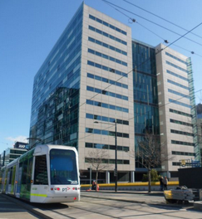
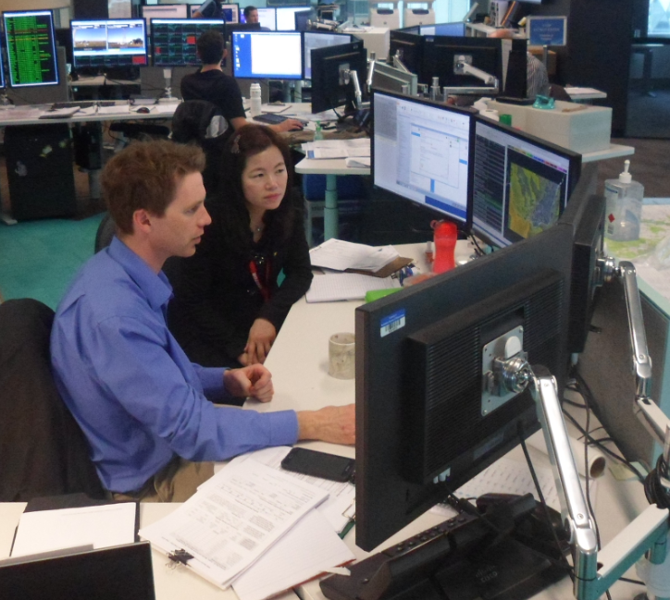
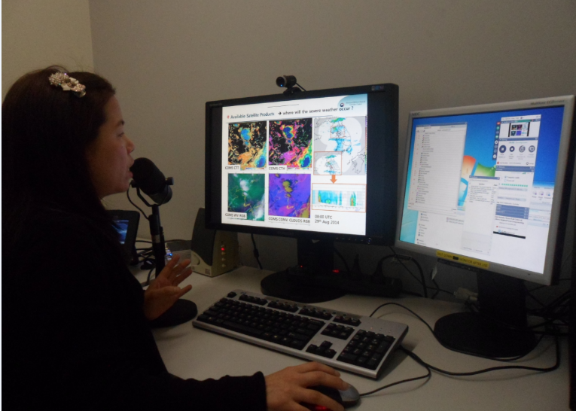
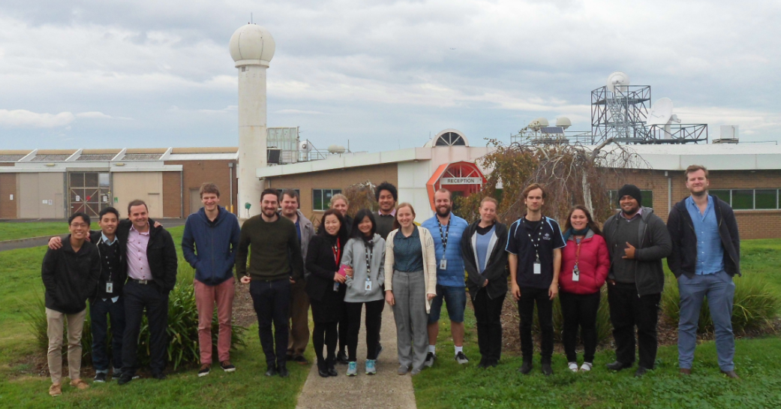
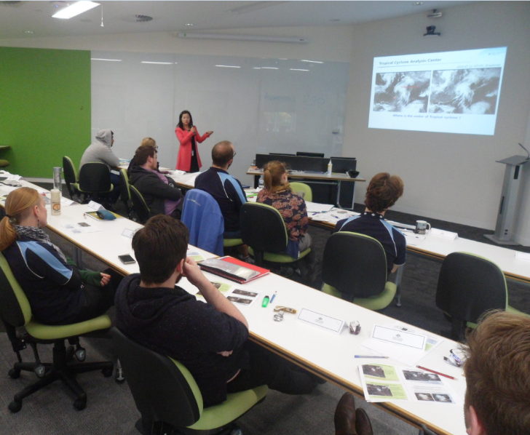
Visit of KMA VLab Centre of Excellence Point of Contact Dr HyeSook Park to BOM Australia, 13-20th May 2017
Head Office
Discussions with BOM staff Regional Focus Group meeting
Broadmeadows Campus
Collaboration in classroom activities
REFERENCE SLIDE

Slide 16
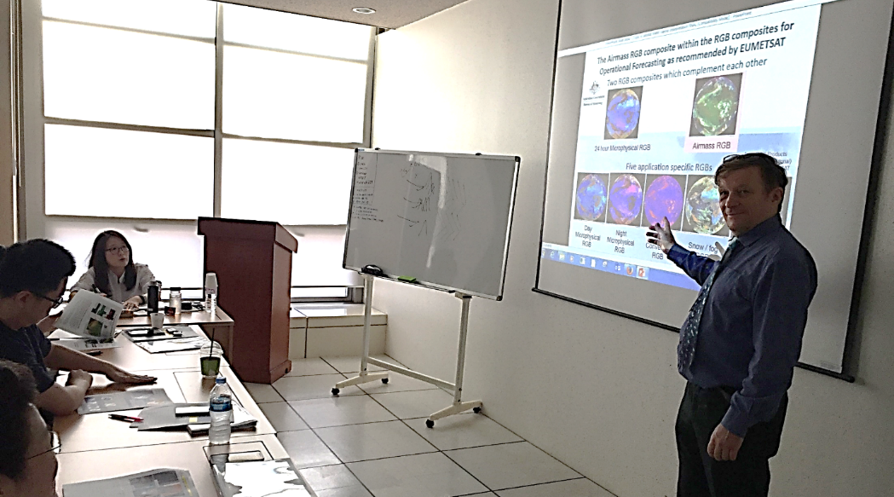
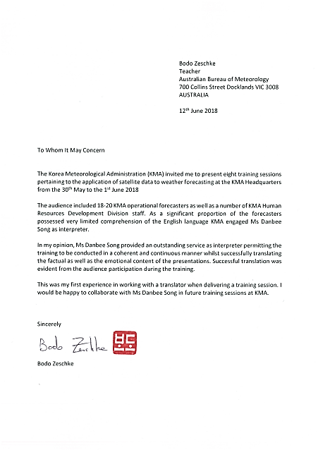
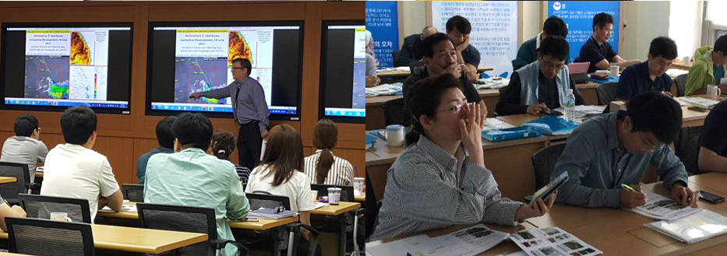
Teaching at the Korea Meteorological Administration 30th May – 1st June 2018
A Translator , Ms Danbee Song was employed by KMA
Korean examples from RFG meetings and also provided by Dr Hyesook Park
Socrative Cloud Based learning tool used
(they have used clicker previously)

Slide 17
Teaching at the Korea Meteorological Administration 30th May – 1st June 2018
The training component of this mission was included in the cooperative activities as discussed and agreed upon during the 8th Session of the Joint Working Group (JWG-8) on Cooperation in Meteorology held on the 5th April 2016 and attended by high level Bureau and Korea Meteorological Administration staff.
Previously I visited KMA for training purposes during 2016 and Dr Hyesook Park of KMA visited BMTC during 2017.
REFERENCE SLIDE

Slide 18
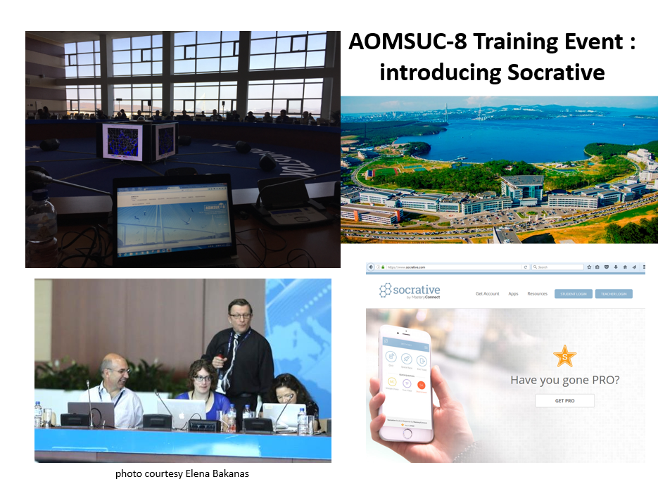

Slide 19
Socrative cloud-based student response system
This cloud-based student response system was developed by Boston-based graduate school students.
I first became aware of the Socrative cloud-based student response system whilst attending CALMET 2017.
I have used this in collaboration with Dr Mark Higgins from EUMETSAT whilst hosting a teaching session during AOMSUC-8
Socrative has also been used whilst teaching the Radiation, Basic Satellite Meteorology and Tropical Meteorology subjects at the Bureau of Meteorology Training Centre (BMTC) during 2018.
I am keen to show KMA staff the use of this software during teaching..
Attendees can access the questions posed during the sessions using their smartphones or a PC. The identity of the participants to the questions is completely anonymous, though collective results can be seen by all
REFERENCE SLIDE

Slide 20
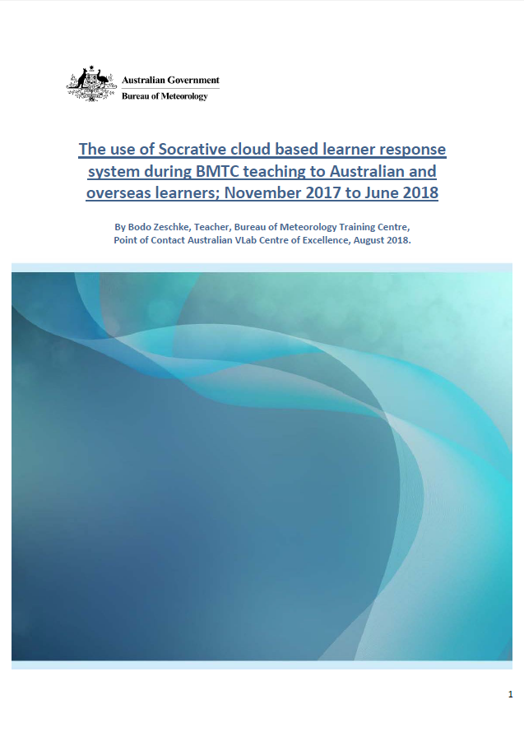
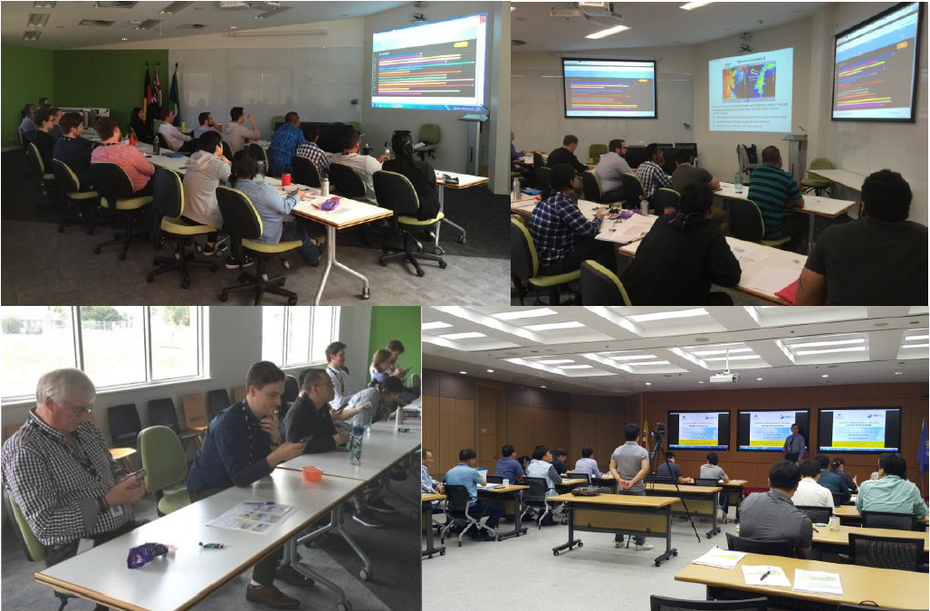
Use of the Socrative cloud based learner response system (Nov 2017 to June 2018)
34 sessions conducted during:
BMTC teaching
Regional Focus Group meetings
Korean teaching
Melbourne University presentation
A report has been written and forwarded to Bureau teaching staff and VLab contacts
"…there is a ton of knowledge in here –thanks for sharing!" Dr. Mark Higgins, Training Manager EUMETSAT

Slide 21
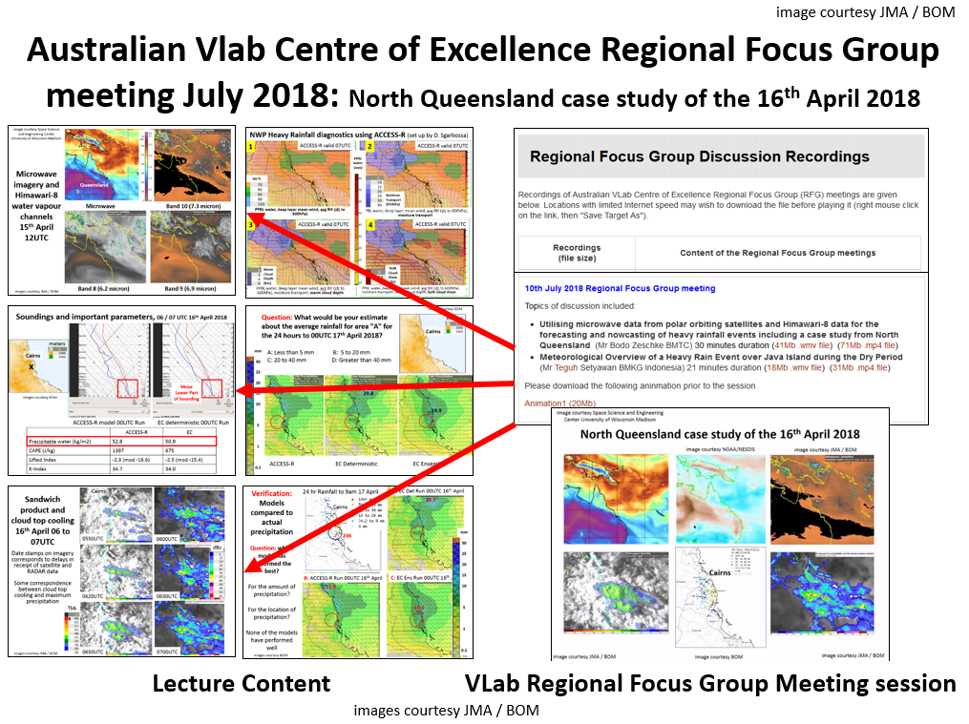
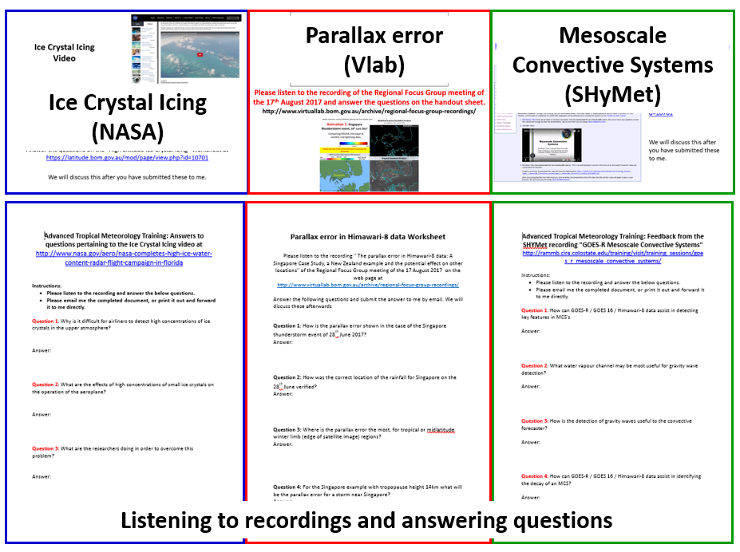
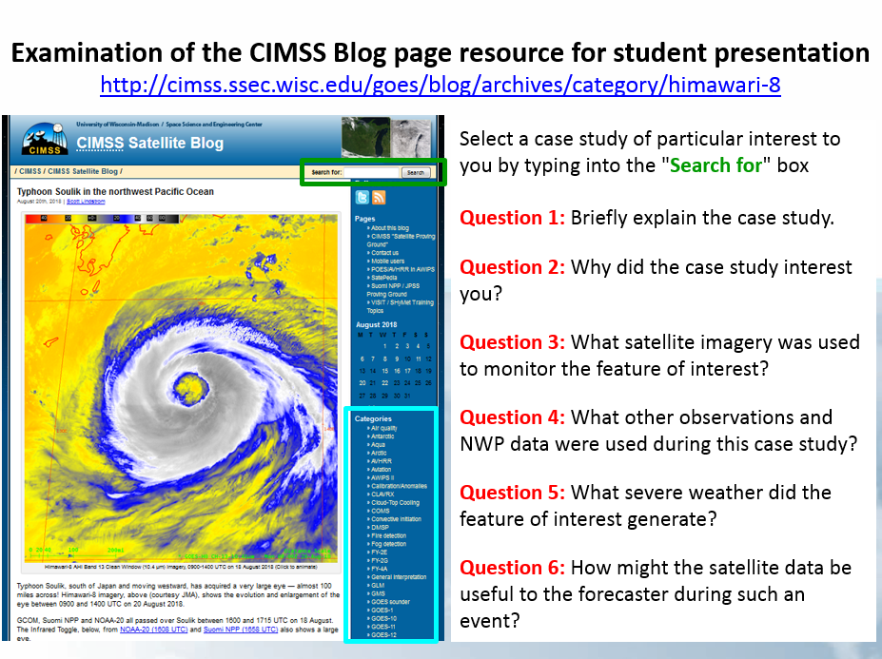
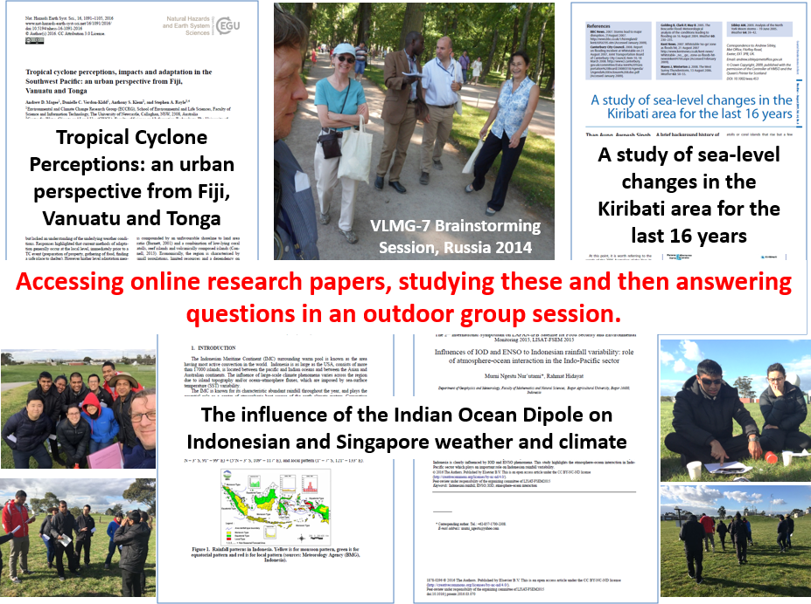
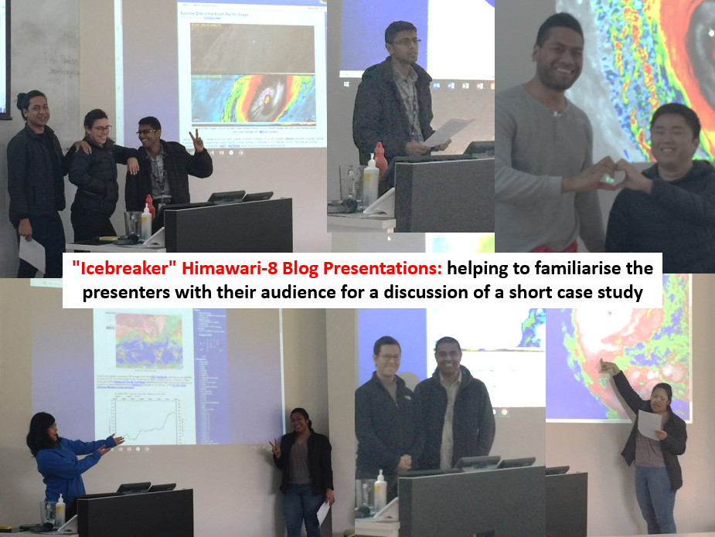
A recent presentation – Effective use of online resources to facilitate satellite meteorology teaching at BMTC.
Utilising recorded RFG meeting resources
Recordings and worksheets
Material for student presentations
Material for outdoor brainstorming sessions

Slide 22
A recent presentation – Effective use of online resources to facilitate satellite meteorology teaching at BMTC.
Utilising recorded RFG meeting resources
Recordings and worksheets
"People frequently say they want "to adapt and reuse training, but it is really difficult..." Well, you have just shown how effective it is…."
From Lu Veeck Technical Support Officer, WMO-CGMS Virtual Laboratory
Material for student presentations
Material for outdoor brainstorming sessions

Slide 23
BMTC Operational Plan and implications for the VLab
Bureau success pillar | BMTC will: | Desired outcomes
Impact and Value | Monitor programs for return on investment and improve the value and impact of our offering | Expand scope of the VLab to include contributions by additional BMTC staff
Insight and Innovation | Collaborate with external organisations to deliver mutually beneficial outcomes that harnesses expertise both inside and outside BMTC | SRTP to ensure that BMTC remains a key contributor to the VLab vision Continue monthly Regional Focus Group meetings, aiming to include contributions by additional BMTC and non-BMTC staff. Explore options for contributing to VLab beyond the Regional Focus Group meetings

Slide 24
Summary
Summarised the satellite meteorology training conducted by the Australian VLab Centre of Excellence over the past year.
Focussed upon:
The monthly Regional Focus Group meetings, including collaboration with JMA, KMA, BMKG Indonesia, NOAA/NASA.
Using the Socrative cloud based learner response system within the VLab and other training.
Effective use of online resources to facilitate satellite meteorology teaching at BMTC and within the Vlab.
Future directions and initiatives have been presented.

