Slide 1

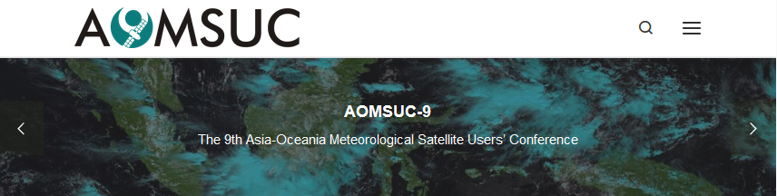

“The use of Himawari-8 data and data composites in developing case studies within the Australasia-Pacific region: The Australian VLab Centre of Excellence experience”
Asia-Oceania Meteorological Satellite Users Conference 9 (AOMSUC-9), Jakarta, Indonesia
Presenter: Bodo Zeschke. Bureau of Meteorology Training Centre, Australian VLab Centre of Excellence Point of Contact

Slide 2
Content
A summary of the development of case studies for better utilisation of Himawari-8 data by the Australian VLab Centre of Excellence over the past year.
It focusses on:
Case studies showcased within the Regional Focus Group meetings for forecaster training.
Case studies developed utilising new products introduced at conference.
Developing case studies for incorporation into a Forecast Simulator for forecaster training.

Slide 3
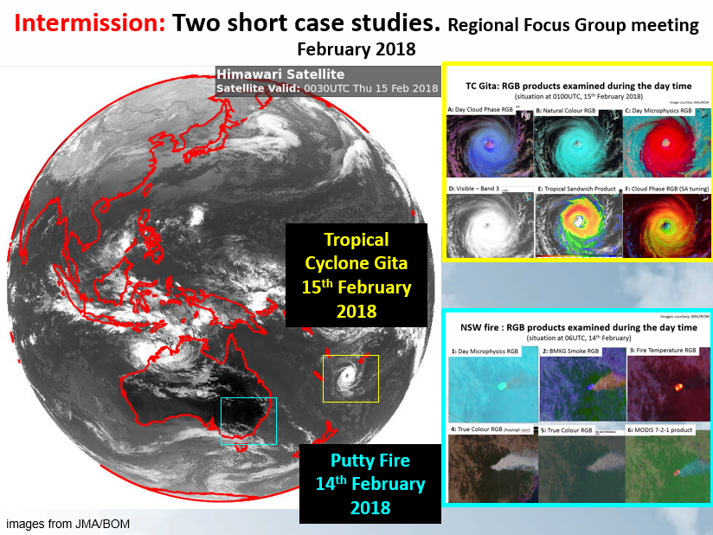
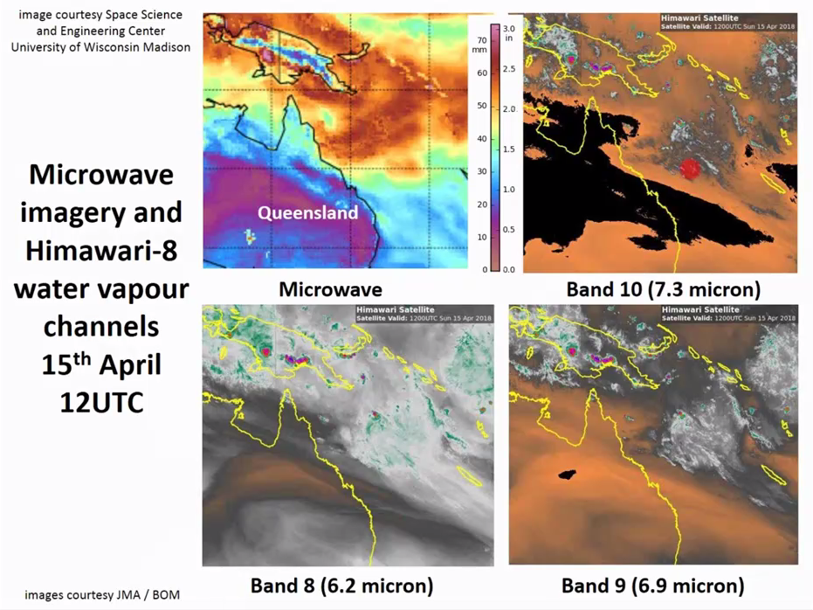
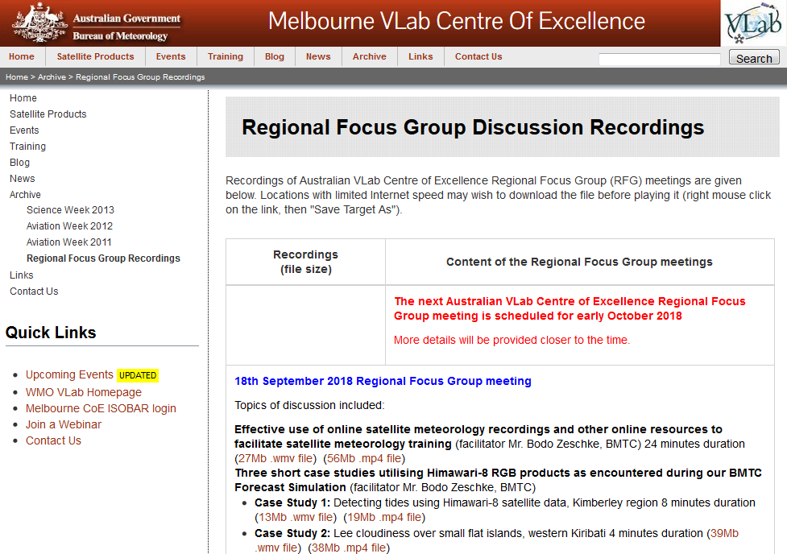
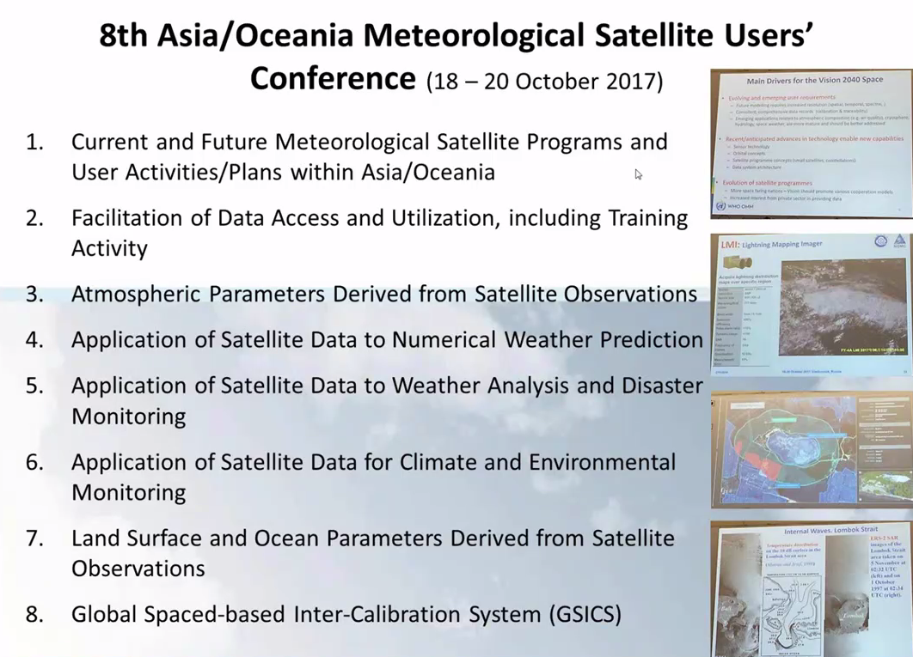
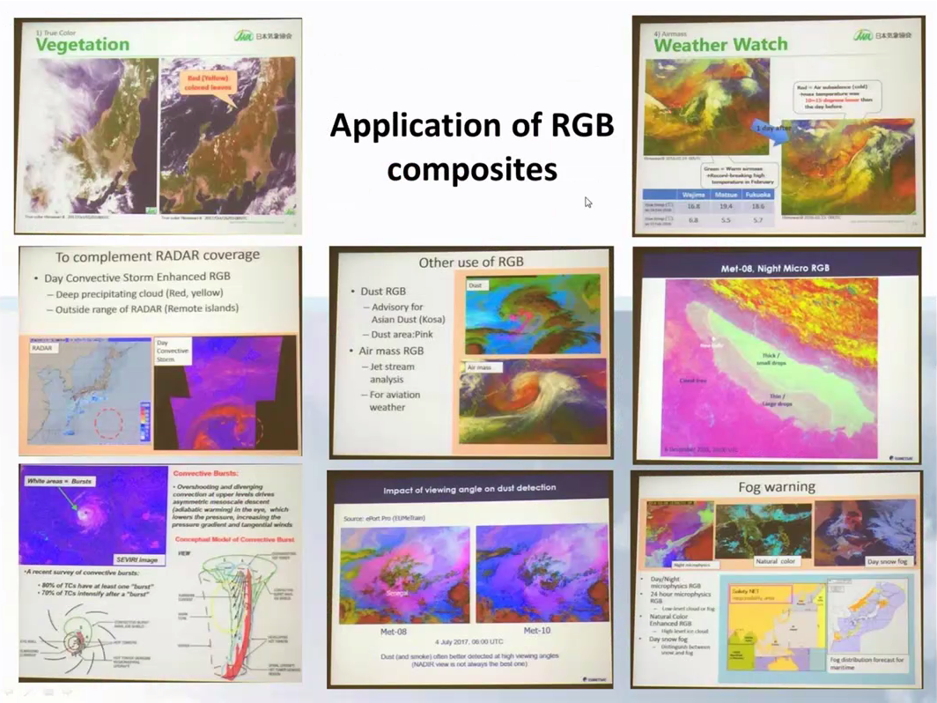
Case studies showcased within the Regional Focus Group meetings http://www.virtuallab.bom.gov.au/archive/regional-focus-group-recordings/
1
2
3
4

Slide 4
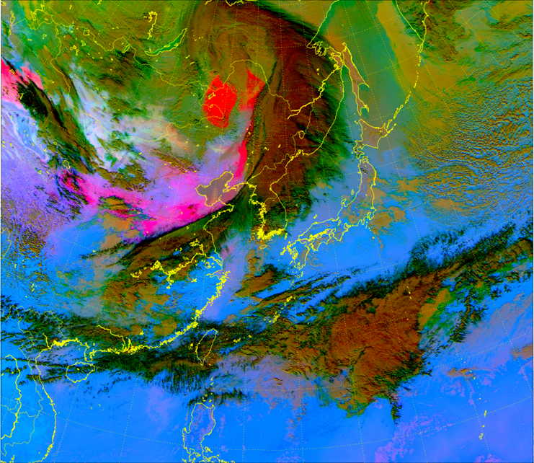
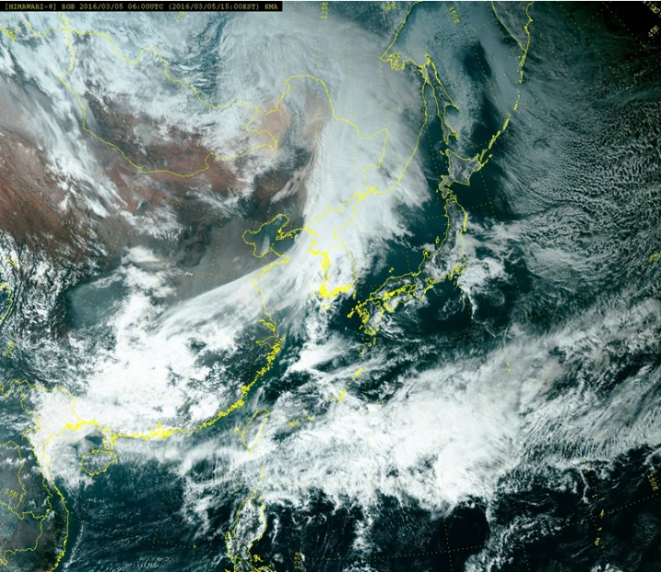
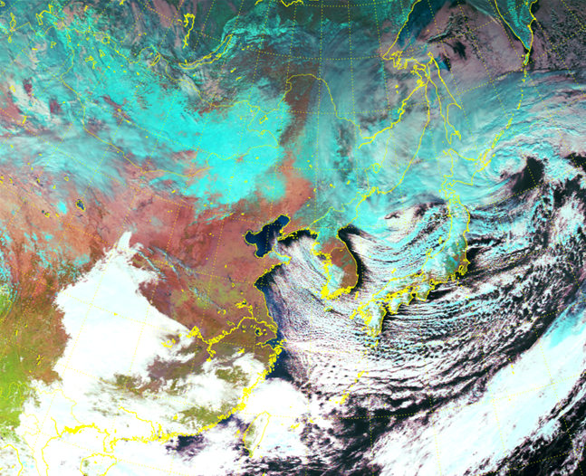
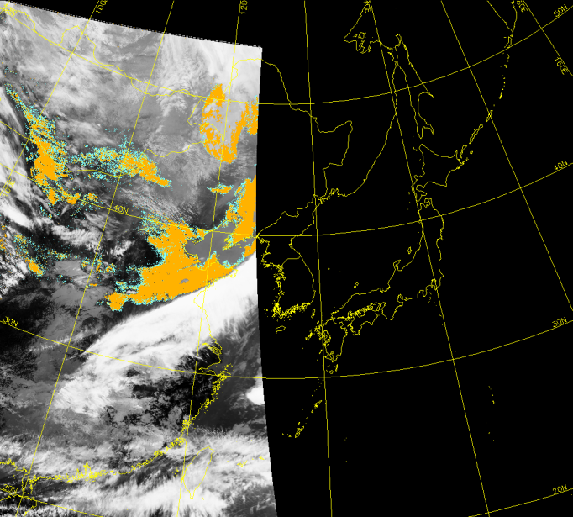
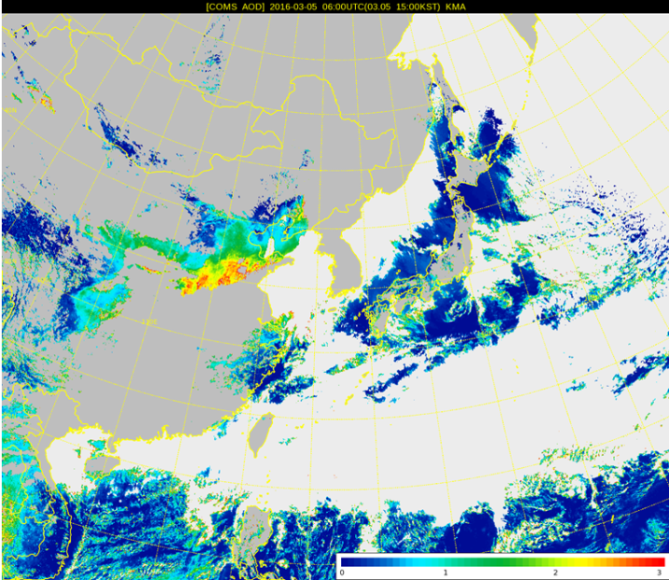
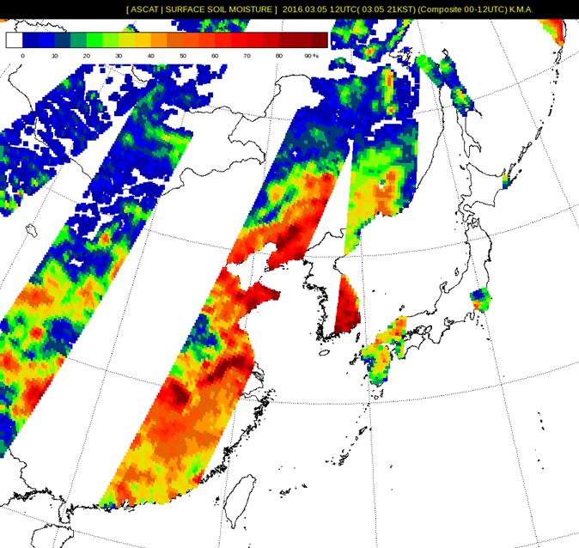
Case studies presented by guest speakers (KMA, BMKG Indonesia etc.)
Himawari-8 Natural Color RGB
(2016.1.19.04:00UTC)
Dust RGB
True Color RGB
C: Dust RGB D: True Colour RGB E: Natural Colour RGB
Dual Channel Difference form NOAA (2016.3.5.05:06UTC)
H: Channel Difference Technique I: Aerosol Index J: Surface properties
Aerosol Index(AI)
Aerosol Optical Depth(AOD)

Slide 5
An overview of Australian Vlab Centre of Excellence Regional Focus Group meetings pertaining to case studies
Main topics covered:
Case studies (mid-latitude & tropical examples, utilising Himawari-8 data)
Individual case studies showcasing various RGB composites. Also starting to use more Polar Orbiter satellite data – microwave PTW here.
Presenting useful material from conferences, training and workshops (Asia-Oceania Meteorological Satellite Users Conference-8, RGB Expert and Developers Workshop 2017)
Implementing new RGB products within case studies
Presentations by guest speakers at VLab Regional Focus Group meetings.
REFERENCE SLIDE

Slide 6
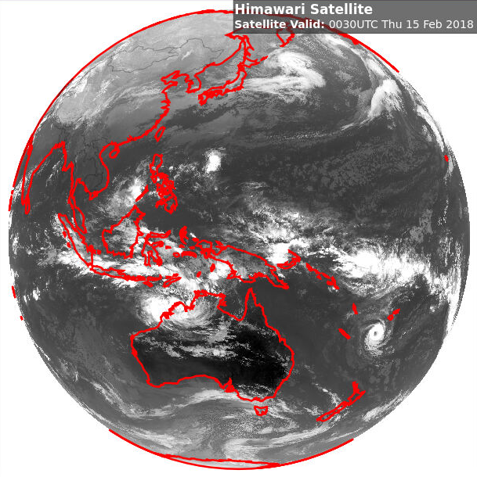
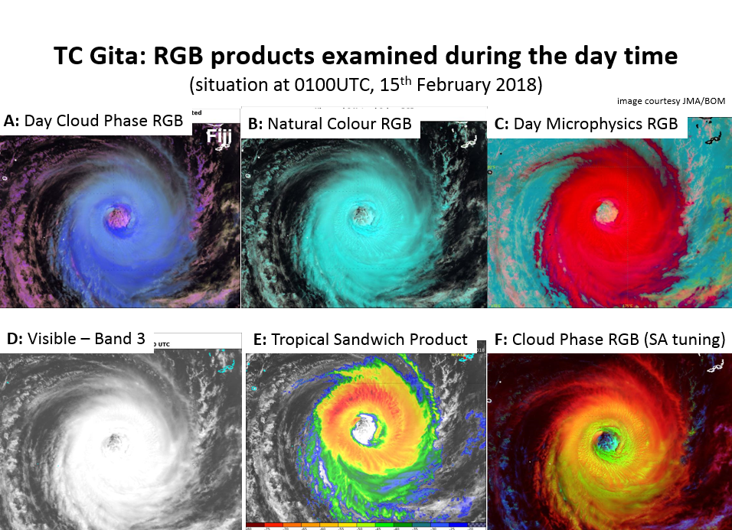
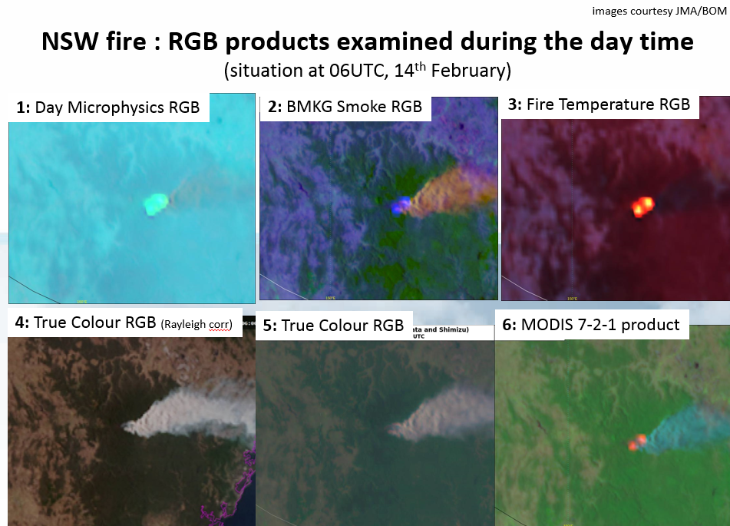
Two short case studies – Tropical and Midlatitude during Regional Focus Group meetings. Regional Focus Group meeting February 2018
Tropical Cyclone Gita
15th February 2018
Putty Fire
14th February 2018
images from JMA/BOM

Slide 7
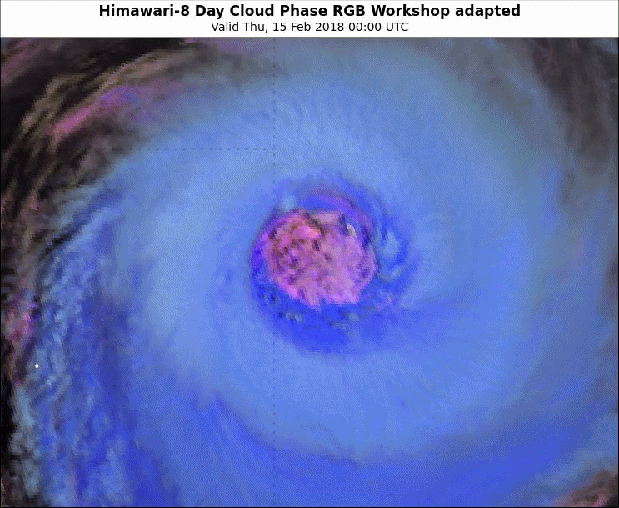
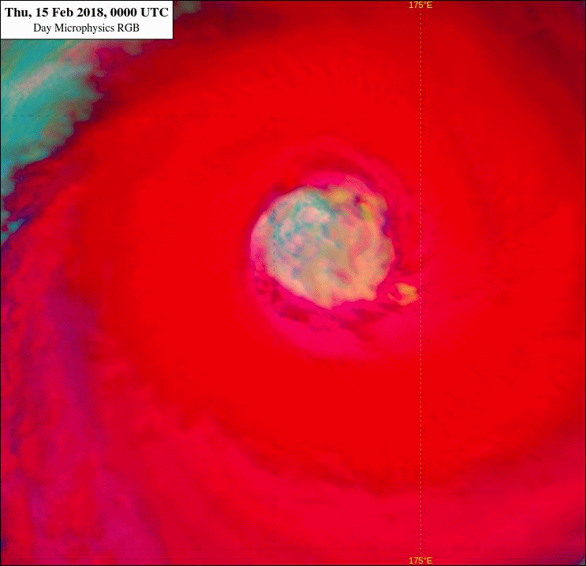
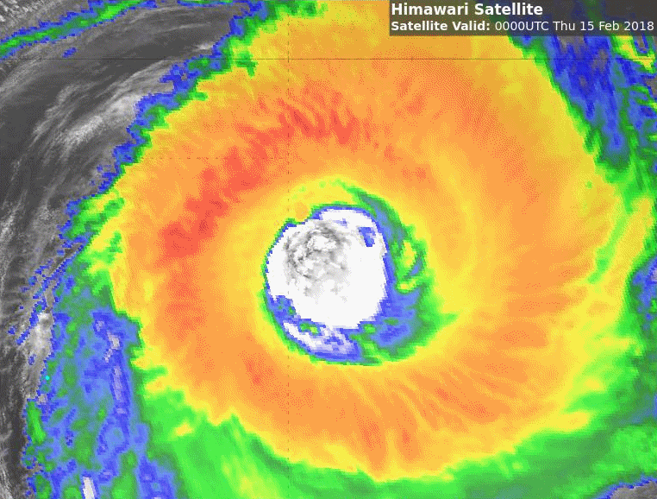
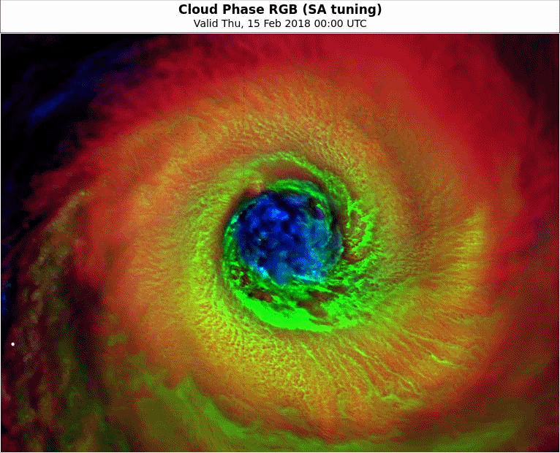
Animation 1: TC Gita some daytime RGB products
(trial of the animations from 00 to 08UTC, 15th February 2018)
Please start the Power Point Slide Show to activate the animation
animations courtesy JMA/BOM
A: Day Cloud Phase RGB
C: Day Microphysics RGB
E: Tropical Sandwich Product
F: Cloud Phase RGB (SA tuning)

Slide 8
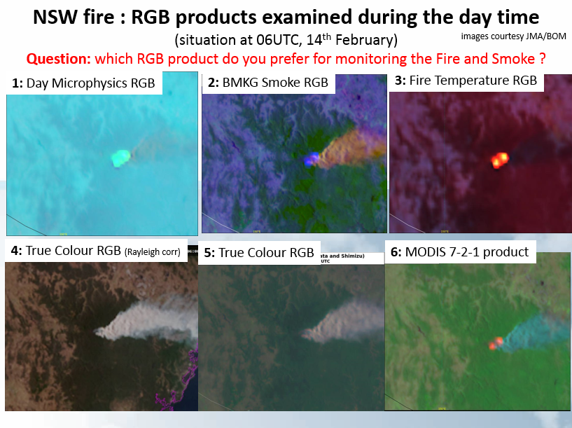
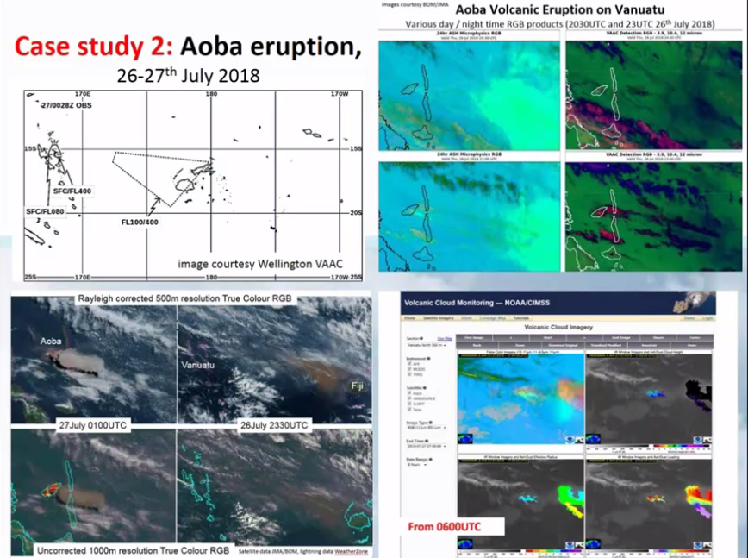
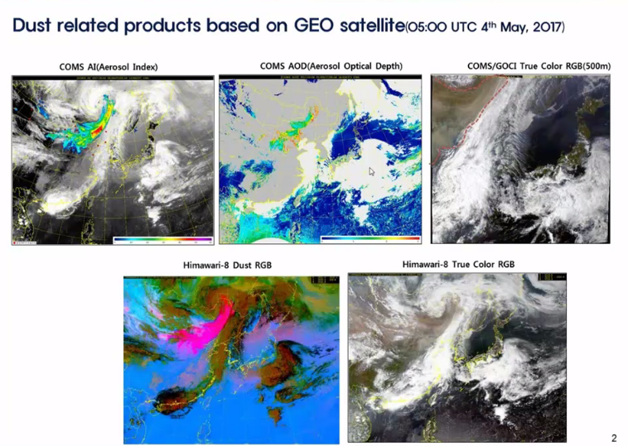
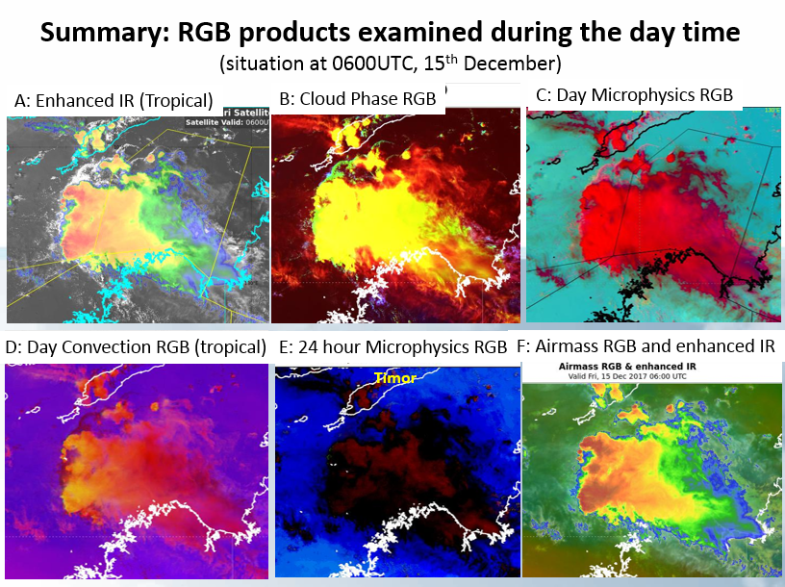
Regional Focus Group meeting case studies pertaining to a broad range of regional meteorological hazards
Fire / Smoke
Volcanic eruption
22 February 2018 Regional Focus Group meeting
14 August 2018 Regional Focus Group meeting
Dust
Storms
31 July 2018 Regional Focus Group meeting
20 December 2017 Regional Focus Group meeting

Slide 9
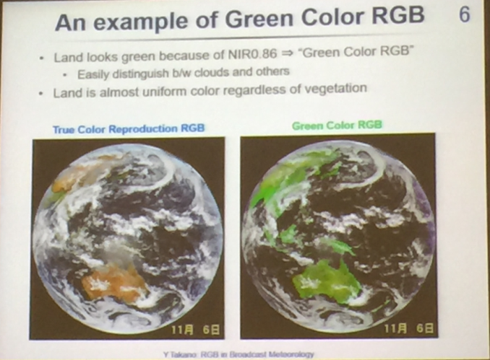
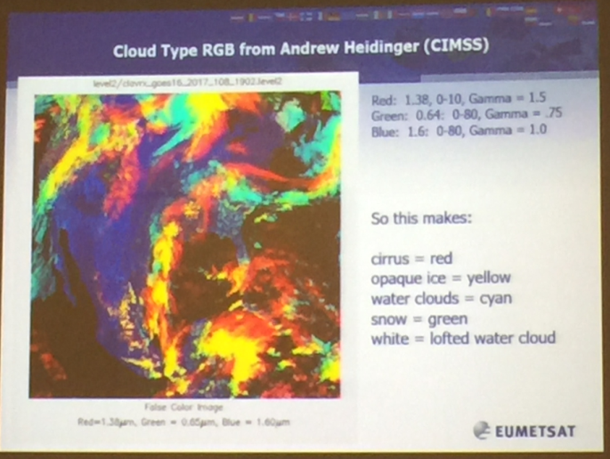
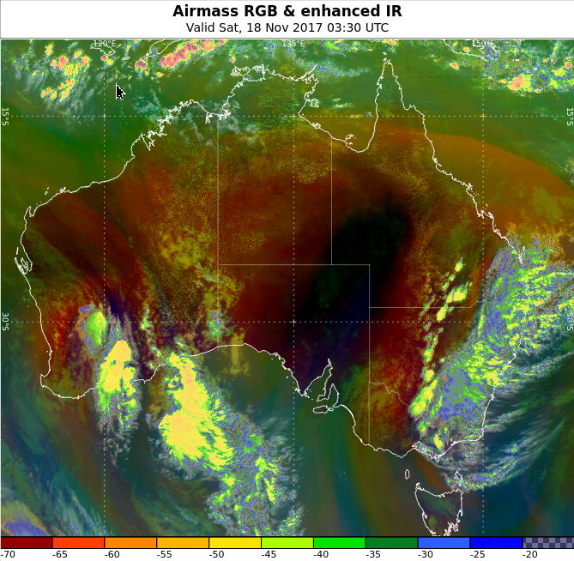
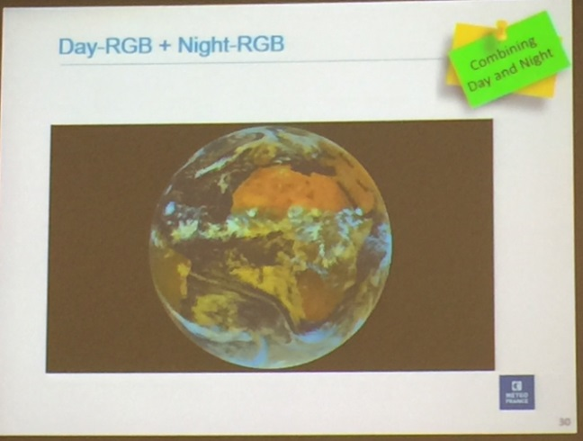
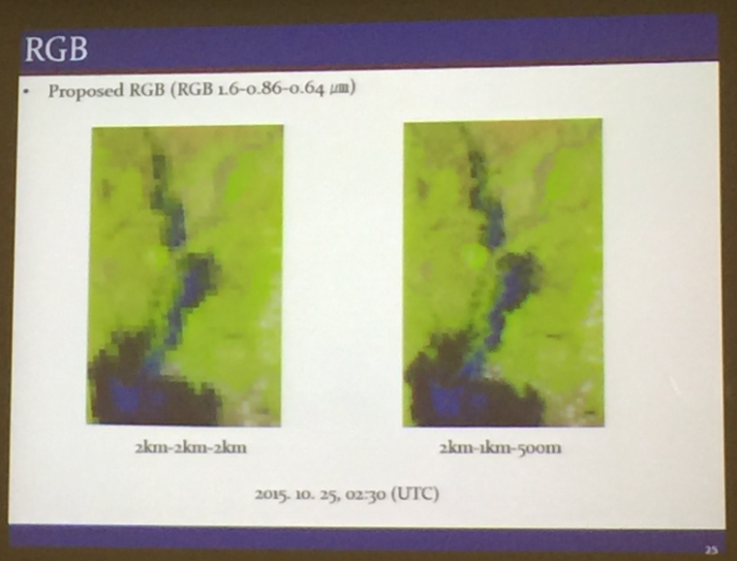
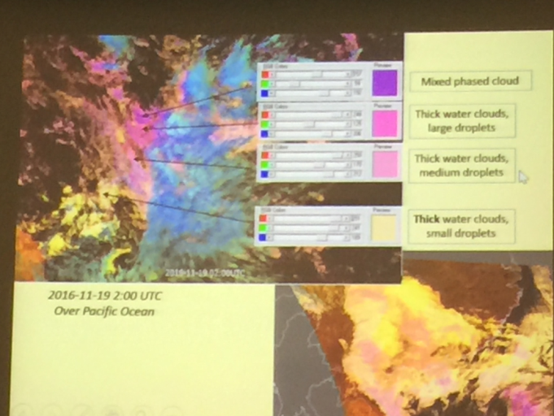
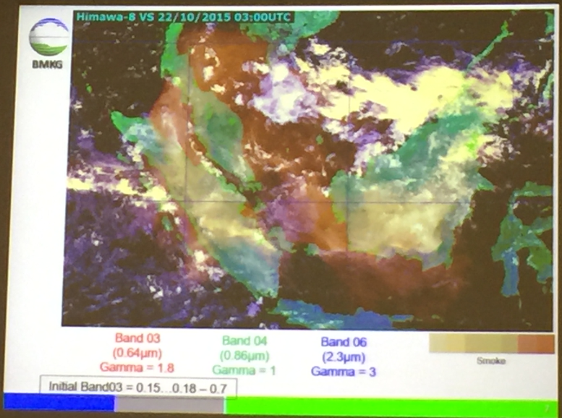
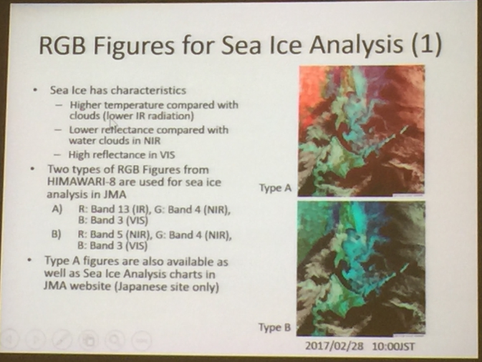
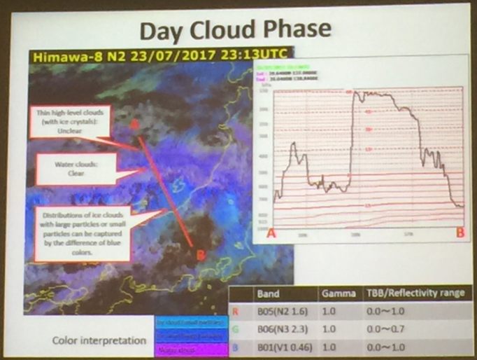
Showcasing new RGB composites from Conference

Slide 10
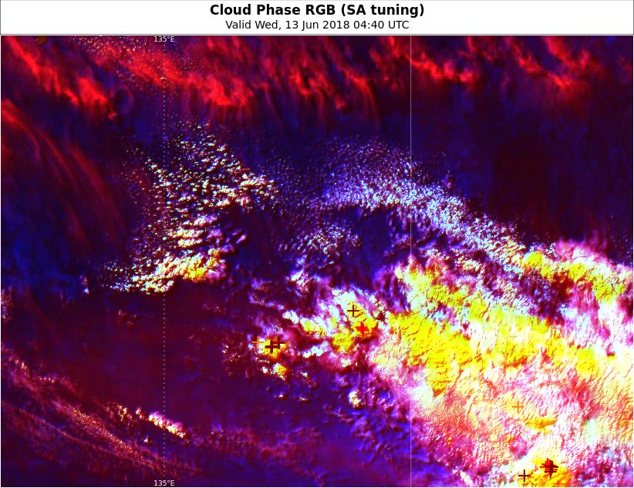
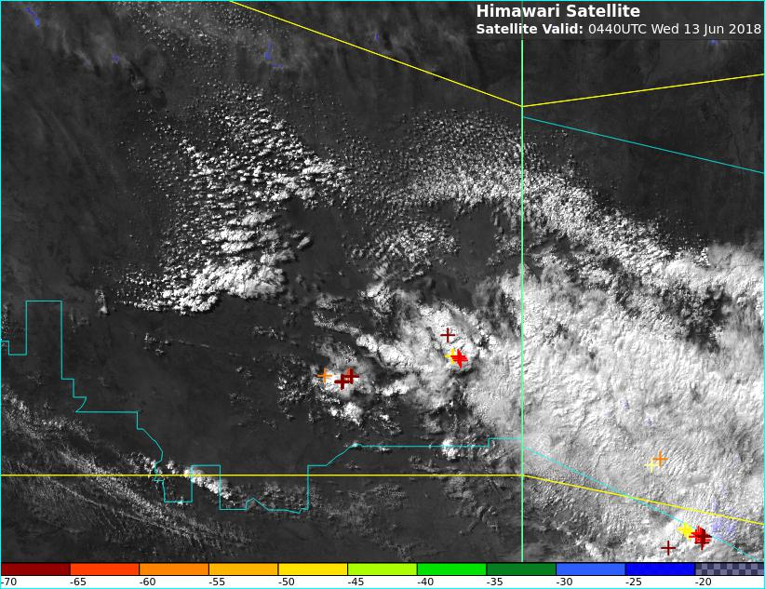
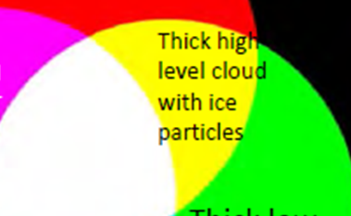

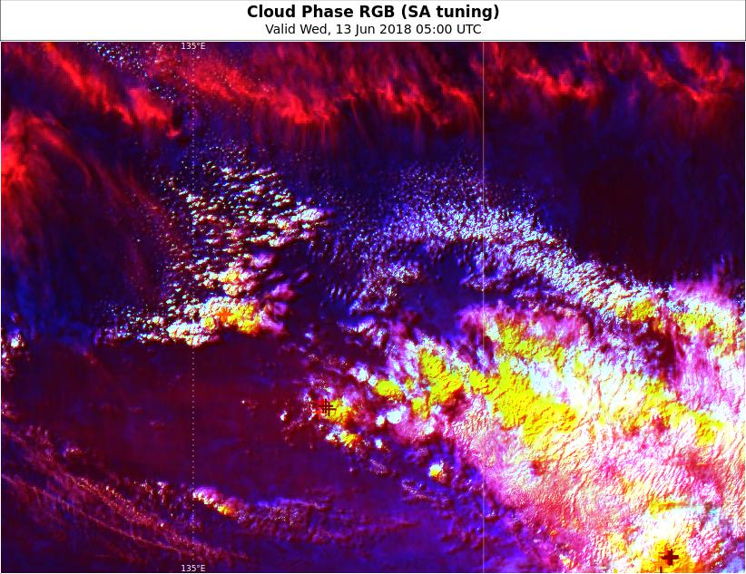
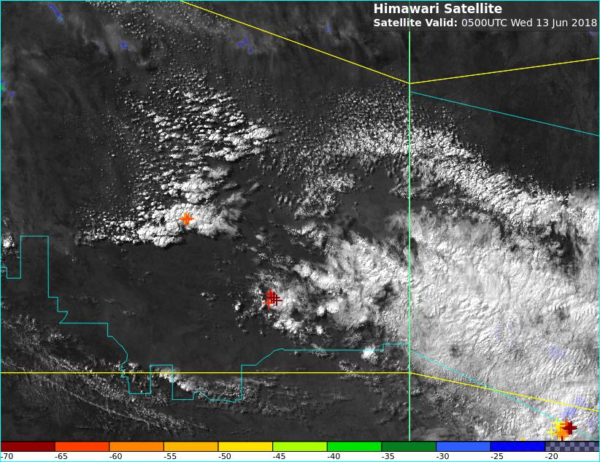
Applying new products: Comparing the Sandwich product and Cloud Phase RGB Composite, 02-06UTC 13th June 2018
Sandwich Product
Cloud Phase RGB Composite
0440UTC
Tennant
Creek
Mount
Isa
0500UTC
images courtesy BOM/JMA, lightning data WeatherZone

Slide 11
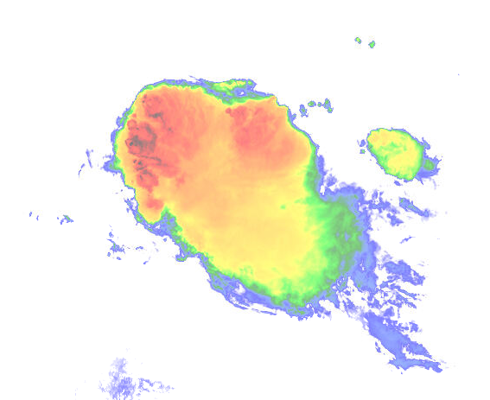

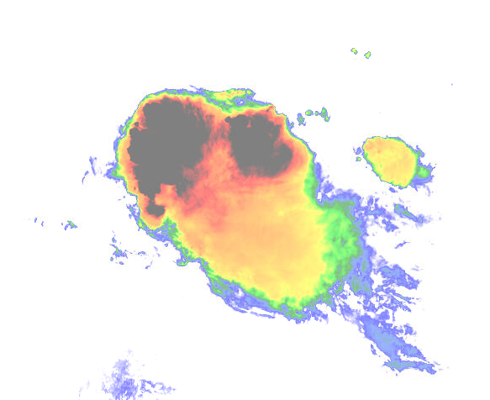
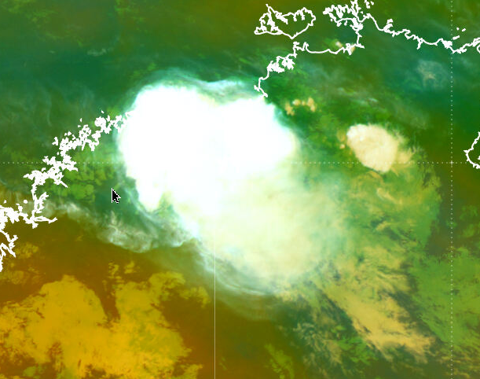
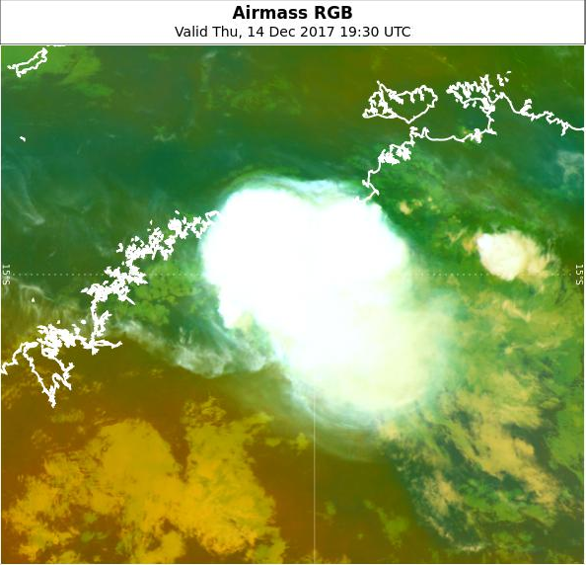
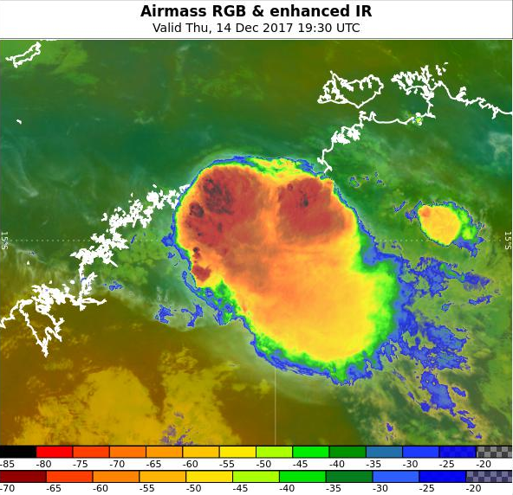
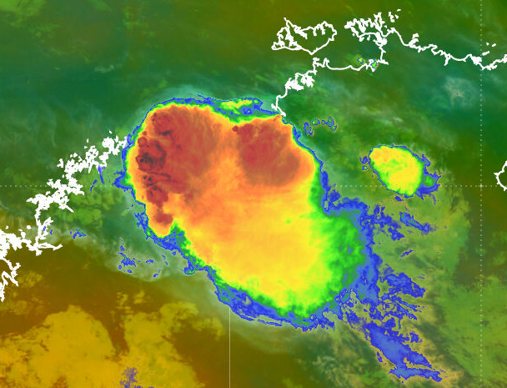
Applying new products: The "Airmass RGB Sandwich Product"
Suggested by HansPeter Roesli, modification by BOM staff, including Operational Forecasters and B.Zeschke
images courtesy JMA/BOM
Top layer: IR10.4 BT tropical scale
-20C Tropical -80C
scale as adapted from Australian Bureau of Meteorology forecasters
Mid layer: IR10.4 BT midlat scale
-20C Mid-latitude -70C
Upper and mid layer opacity set to 50%
Bottom layer (“background”): Airmass RGB (midlat tuned)
Before After
Blending options – applied to the upper layer
satellite images courtesy JMA/BOM

Slide 12
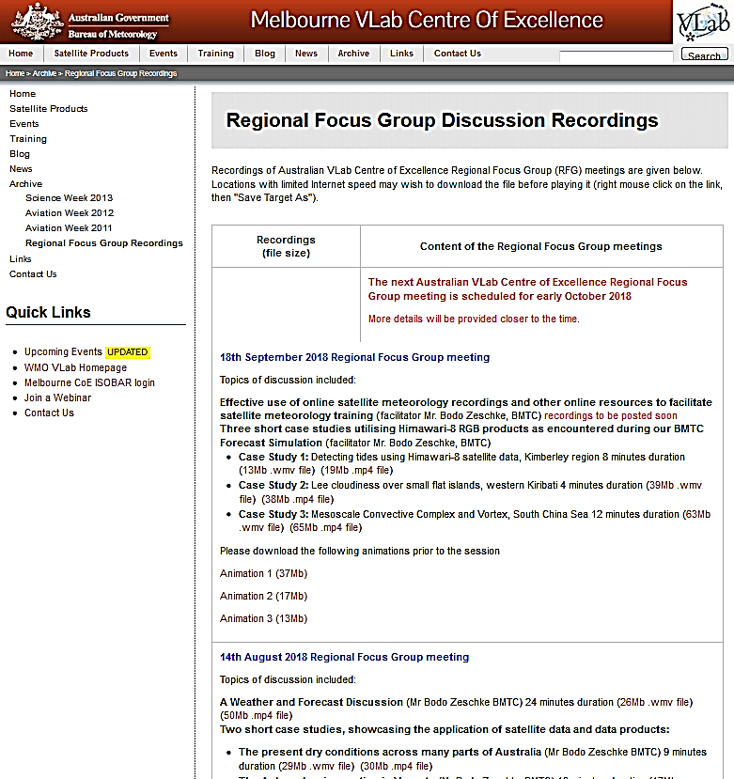
Recordings of our Regional Focus Group Discussions http://www.virtuallab.bom.gov.au/archive/regional-focus-group-recordings/

Slide 13
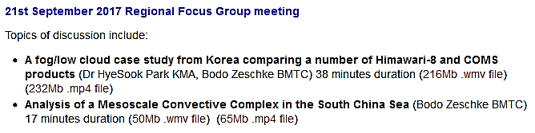
Short case study recordings for reference by forecasters http://www.virtuallab.bom.gov.au/archive/regional-focus-group-recordings/

Slide 14
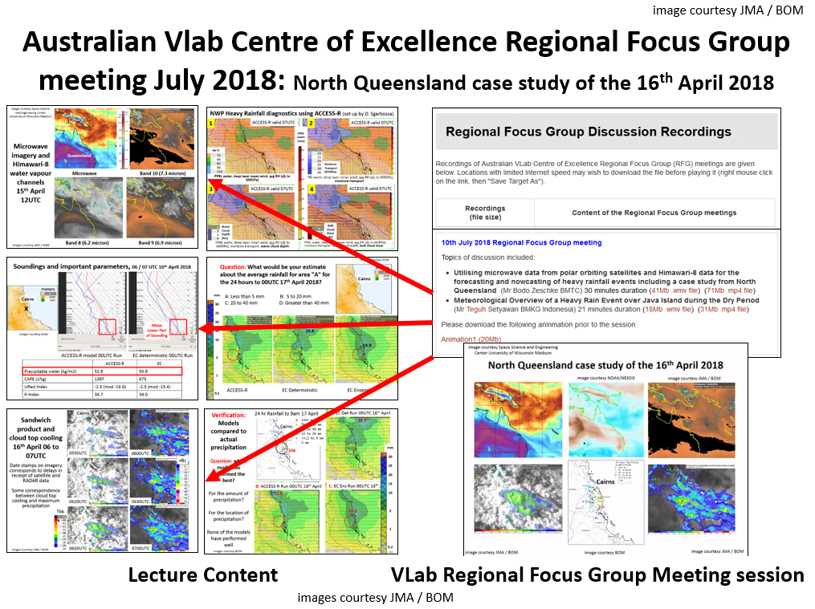
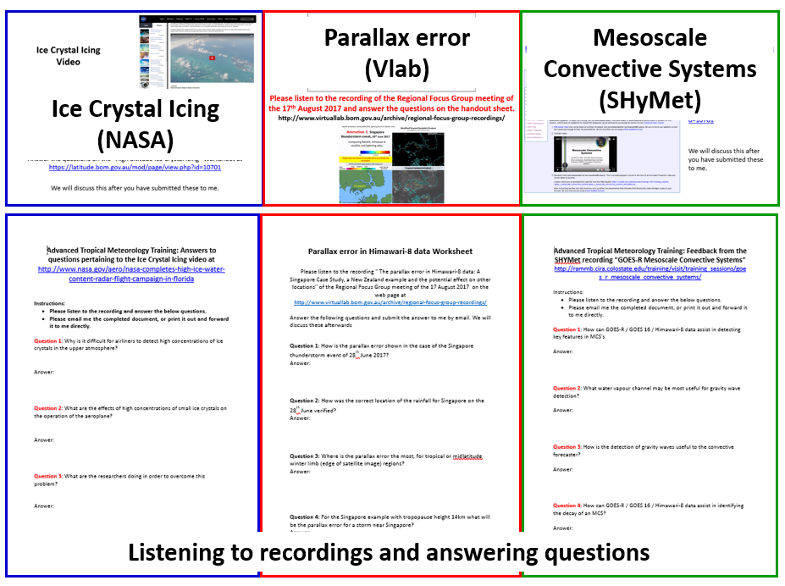
Incorporating VLab case studies into the teaching of our Trainee Meteorologists (Regional Focus Group meeting 18th /9 / 2018).
Utilising recorded RFG meeting resources in lectures
Recordings and worksheets

Slide 15
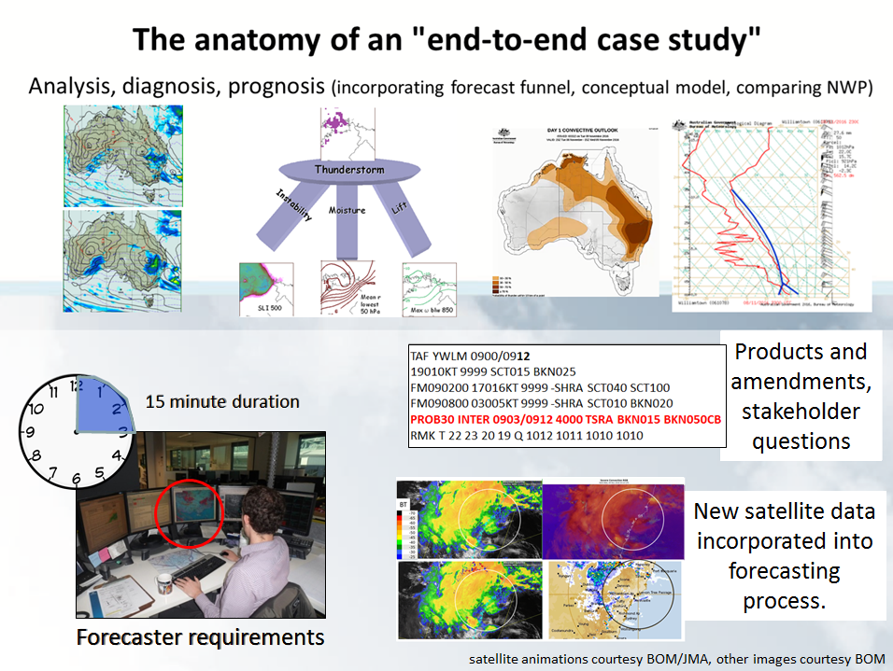
End-to-End Forecaster Friendly Case Study incorporating Himawari-8 data – Thunderstorm case study
December 2016 Regional Focus Group meeting recording at http://www.virtuallab.bom.gov.au/archive/regional-focus-group-recordings/

Slide 16
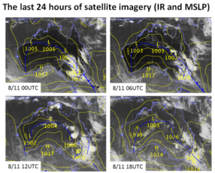
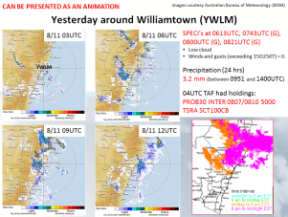












A summary of the Forecast Process - Convection Case Study Williamtown NSW, 9th November 2016.
1: Familiarisation, including analysis and diagnosis
2: Diagnosis, prognosis and making forecasts.
3: The situation developing
4: Summarising the exercise

Slide 17
Summary
This presentation summarised case studies for better utilisation of Himawari-8 data by the Australian VLab Centre of Excellence over the past year.
It focussed on:
Case studies showcased within the Regional Focus Group meetings.
Case studies developed utilising new products introduced at conference.
Developing case studies for incorporation into a Forecast Simulator for forecaster training. Student review of these.

