Slide 1

Gulf of Carpentaria smoke and seabreeze front
03 to 10UTC 23rd September 2018
Various RGB products
Assembled by B.Zeschke, BMTC, Australian Vlab Centre of Excellence

Slide 2
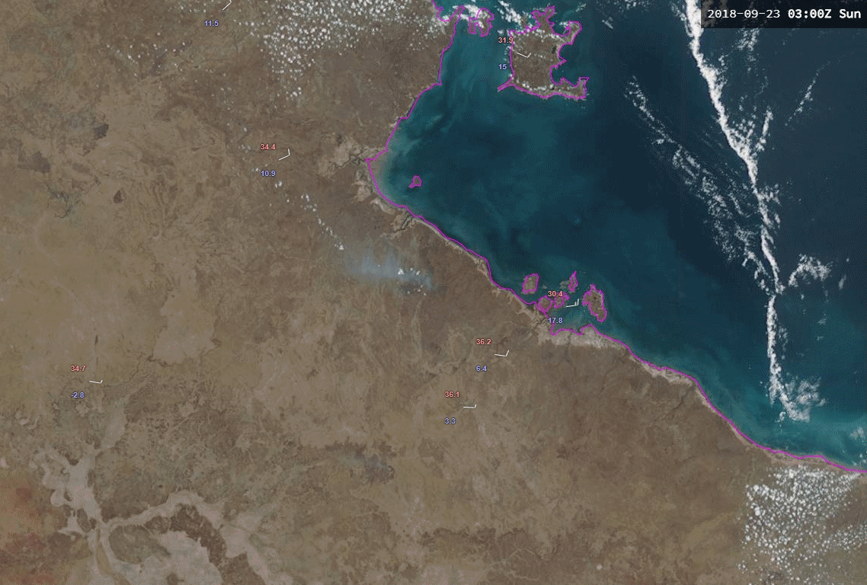
animation courtesy JMA/BOM
True Colour RGB product, 5 FPS animation
Groote Eylandt
Ngukurr
Please start the Power Point Slide Show to activate the animation

Slide 3
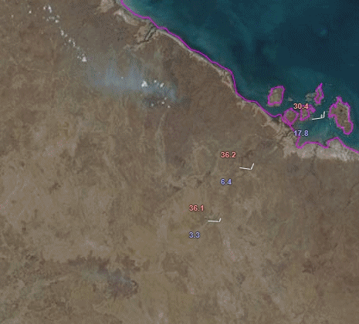
True Colour RGB product, 5 FPS animation
animation courtesy JMA/BOM
Borroloola
Please start the Power Point Slide Show to activate the animation

Slide 4
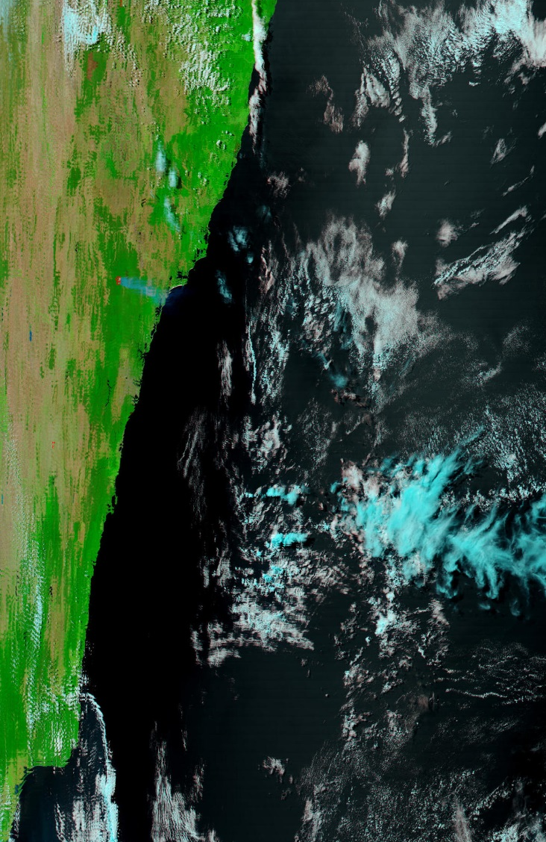
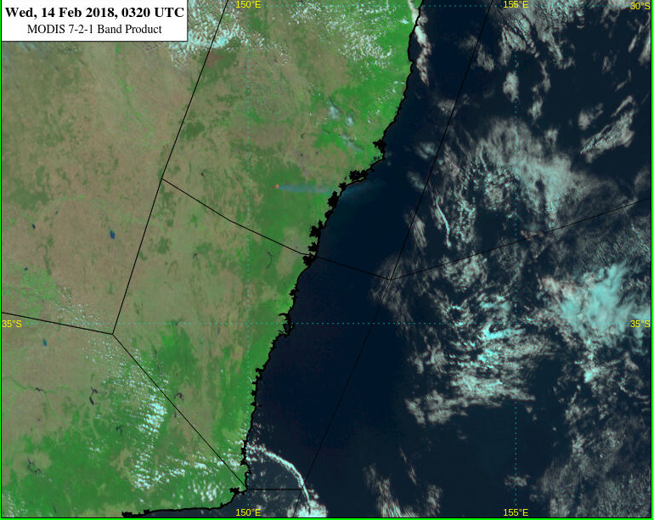
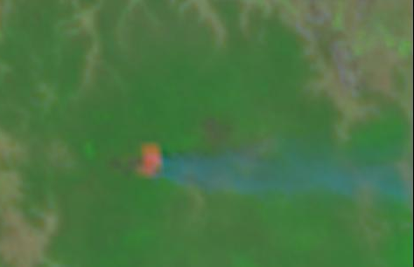
Adapting the MODIS 7-2-1 product to Himawari-8 data
MODIS 7-2-1 product | Range | Gamma
NIR 2.3 | 0 to 100% | 1.8
NIR 0.8 | 0 to 100% | 1.8
VIS 0.64 REFL | 0 to 100% | 1.8
Sydney
Burn
Scar
Fire
Smoke
Southeastern Australia 14th February 0320UTC
image courtesy JMA/BOM
image courtesy JMA/BOM

Slide 5
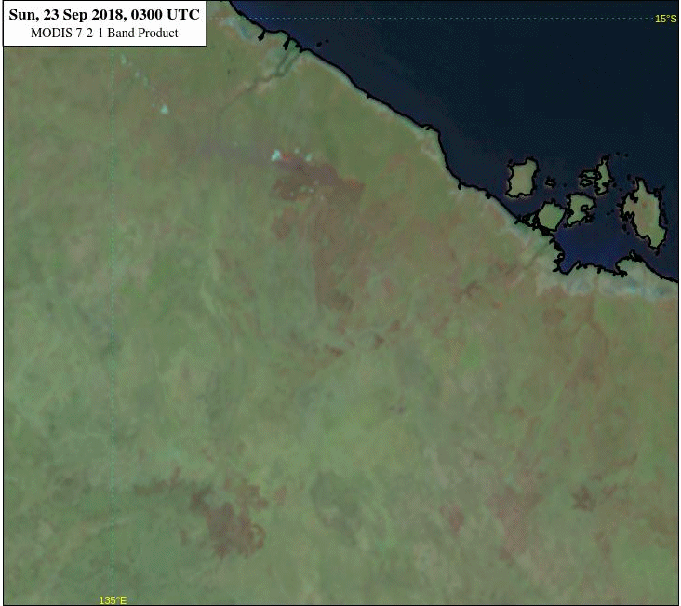
MODIS 7-2-1 RGB product, 5 FPS animation
animation courtesy JMA/BOM
Borroloola
Please start the Power Point Slide Show to activate the animation

Slide 6
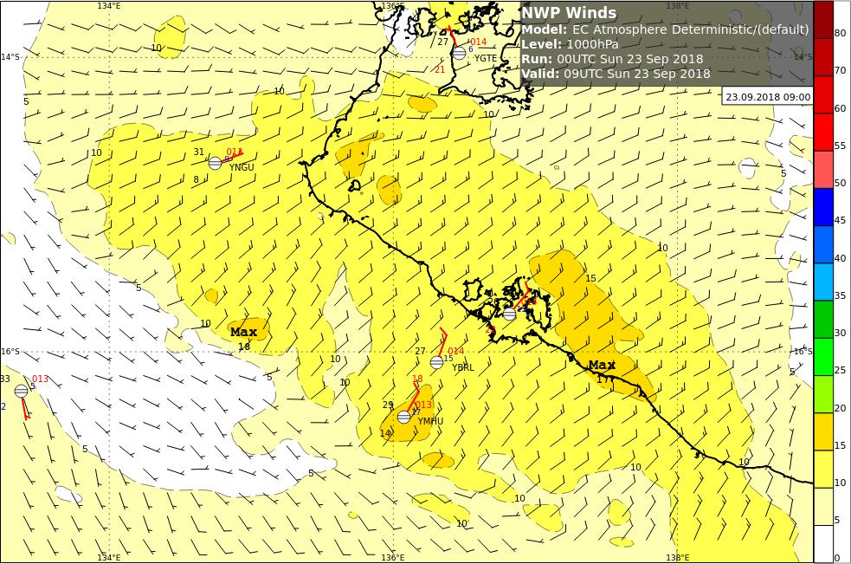
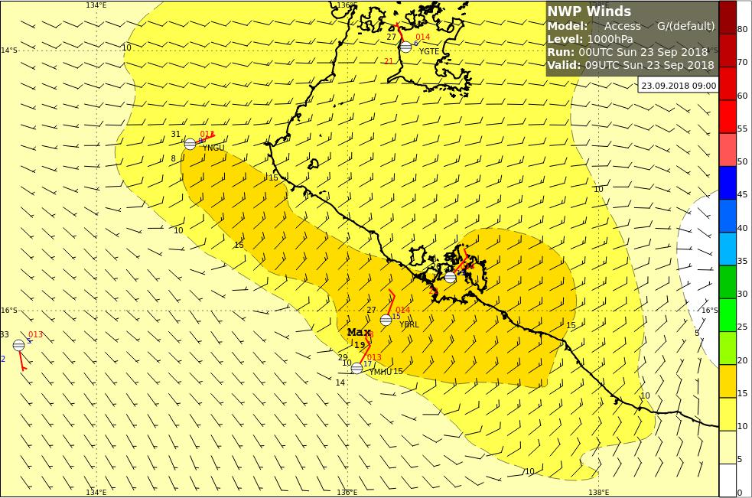
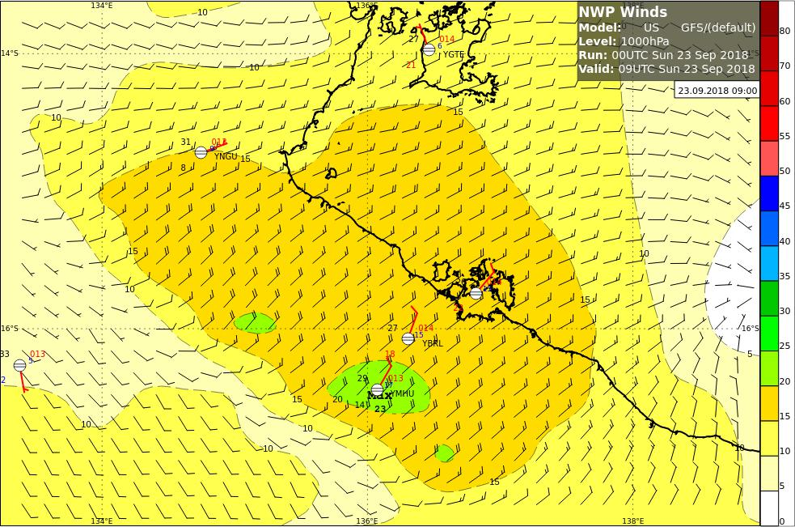
The movement of the "seabreeze front" Satellite data compared to NWP (00UTC run)
satellite image courtesy JMA/BOM, NWP data displayed by BOM
Night Microphysics RGB 09UTC
EC model 1000hPa winds 09UTC
Borroloola
ACCESS G model 1000hPa winds 09UTC
GFS model 1000hPa winds 09UTC

Slide 7
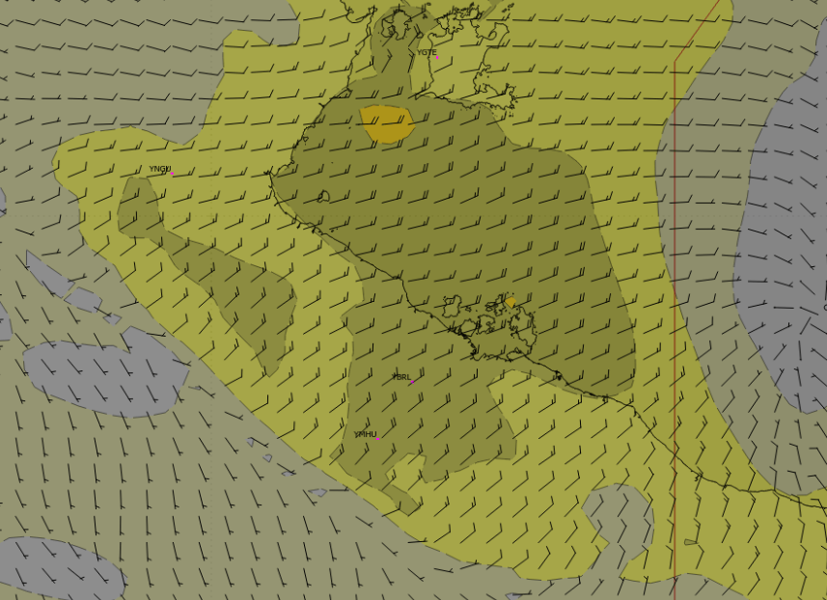
The movement of the "seabreeze front" Satellite data compared to NWP (00UTC run)
satellite image courtesy JMA/BOM, NWP data displayed by BOM
Night Microphysics RGB 09UTC
EC model 1000hPa winds 09UTC
Borroloola
ACCESS R model 1000hPa winds 09UTC
GFS model 1000hPa winds 09UTC
ACCESS R data kindly forwarded by B.Wood NTRO

