Slide 1
Impact of Himawari-8 on Bureau Operations
Dr Anthony Rea
4th Asia Oceania Meteorological Satellite Users Conference – Training Event – 7 October 2013

Slide 2
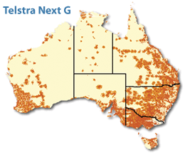
Reliance on Satellite Data and Direct Readout
Australia is a large, sparsely populated continent, surrounded by ocean
Conventional observations are prohibitively expensive for many areas of Australia and its Region
Satellite observations provide the only realistic means of gathering data in otherwise data-sparse regions
Communications limitations mean that direct reception is an economical means of obtaining required data

Slide 3
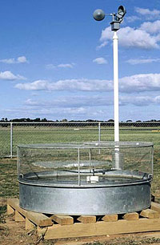
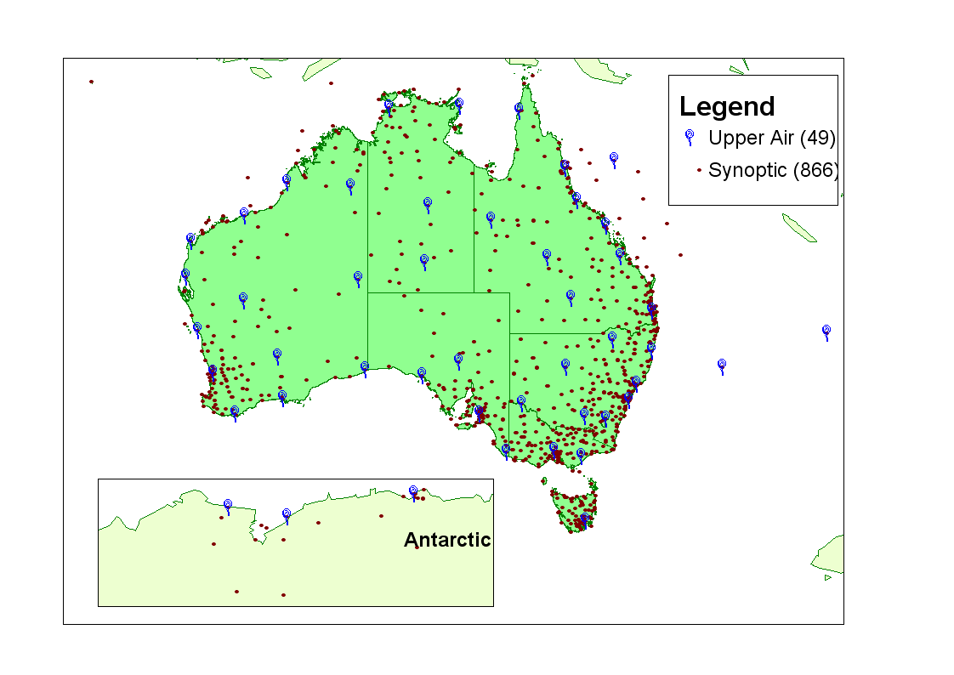
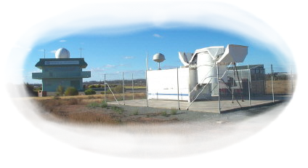
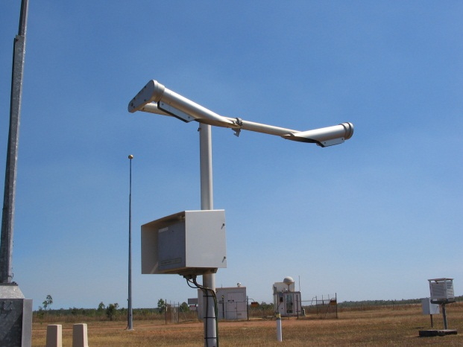
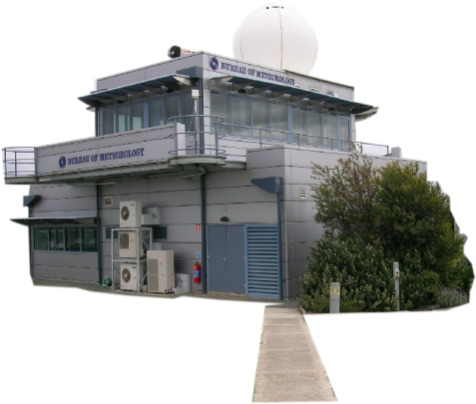
Synoptic Network
Notes:
The surface synoptic network consists of about 870 stations.
About 550 provide real-time information automatically. This is updated between hour to every minute depending on the communications technology.
Synoptic stations incorporate basic observations such as rainfall to the sophisticated such as ceilometer cloud height, lightning and horizontal visibility.
Many observations are automated. However these require a high technical capacity to maintain and calibrate the instruments.
Some observations can only be performed by human observers – things such as cloud type and weather.
In addition to our Bureau staffed network, the Bureau makes extensive use of contract (about 350) and volunteer observers (over 6000) to obtain daily information across the continent.
Automated observations are particularly useful at isolated and remote locations such as the Coral sea, offshore islands and remote communities where the local population is transient.
The Upper air network consists of about 50 Bureau staffed locations. The Bureau staff provide a comprehensive weather watch capacity at these locations.
Sophisticated technology is used to determine wind, temperature and humidity profiles 28 km up into the atmosphere.
At some locations the Bureau uses Autosondes which allow Upper Air balloons to be released and monitored remotely.
The Bureau’s network monitors meteorological parameters at a network density which explains much of the synoptic variation. However parameters such as soil moisture and soil temperature require an dense network to provide meaningful information.
The automated network provides a infrastructure which could be used to make and process other automated observations which could be used for resource monitoring – for example surface temperature, vegetation monitoring or rainfall quality.
The Bureau observations network contributes to climatology, public weather, aviation, agriculture, hydrology, and a host of other industries.
National Benchmark Network for Agrometeorology (NBNA) stations provide a minimum daily climatological dataset for agricultural modelling.
The Evaporation network contributes data which is significant to the global dimming debate which Drs Michael Roderick and Graham Farquhar of ANU are significant proponents.
Manual observations of Sand and dust storm events contribute to the DustWatch Network - A community-based project to monitor the extent and severity of Wind Erosion across Australia (http://www.griffith.edu.au/centre/riverlandscapes/dustwatch/)
The UA network is being supplemented by new initiatives with AMDAR (Aircraft Meteorological Data Relay) and GPS water vapour research. These provide new avenues to complement upper air data.
Marine network:
86 Voluntary Observing Ships
140 ARGO floats
6 XBT Expendable Bathythermograph

Slide 4
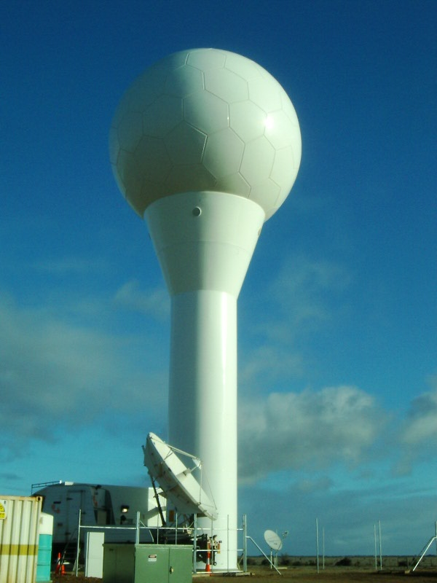
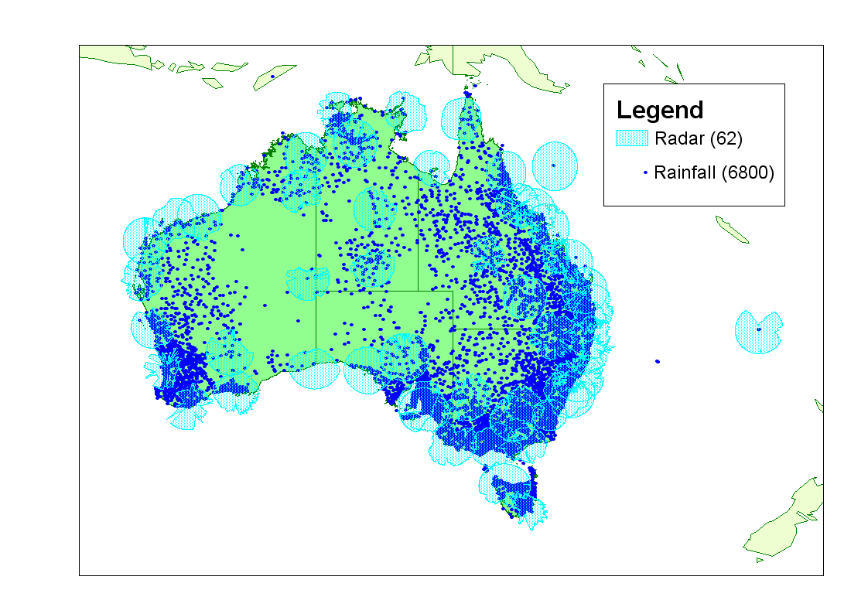
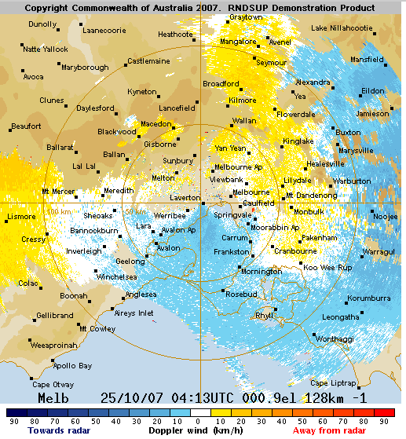
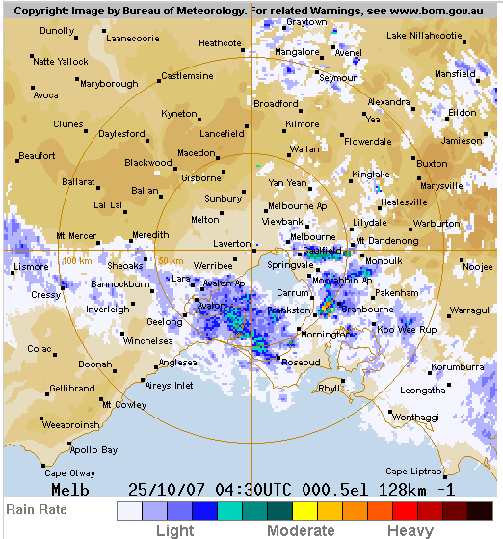
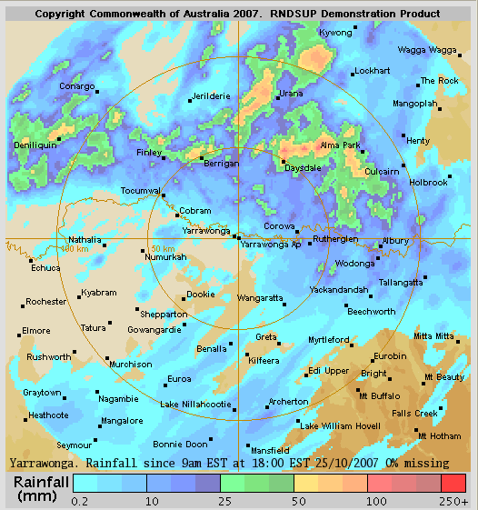
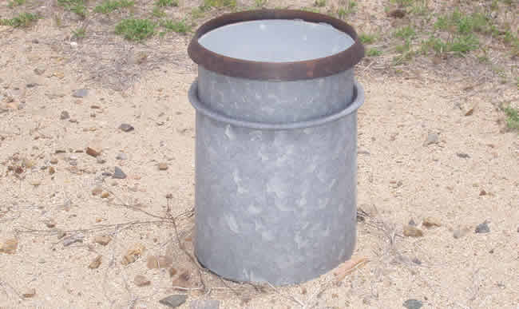
Radar & Rainfall
Notes:
There are 62 weather watch radars across the continent, including one at Willis and Norfolk Islands. These consist of both “C” and “S” band radars.
The Bureau is in the final stages of a $62 radar upgrade project which has resulted in the replacement of many radars around the country.
Four radars now have Doppler capacity and they are able to provide wind direction and accumulated daily rainfall images (on the right).
Radar imagery cover about 1/3 of Australian territory. However there is a high demand for additional radars in various parts of the country, such as NSW and QLD agricultural areas, and gaps in the northern coastal areas.
The rainfall network consists of about 1500 real-time rainfall observations locations, plus another 5300 manual observations sites which provide data monthly. Rainfall is a critical observation in Australia with a large range of uses – irrigation, drought monitoring, rainfall quality, event planning, emergency response, crop and rangeland modelling, disaster mitigation, water yield…

Slide 5
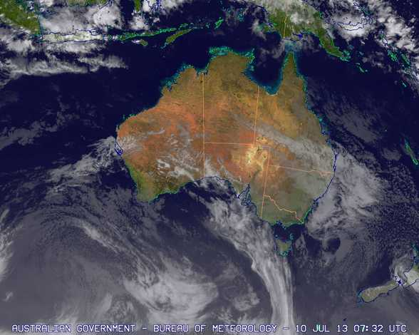
Overview of User Preparedness
Two areas of preparedness
New capability or
Improved capability over what already exists
Continuity of service provision
Critical path, maintaining services across the transition
Legacy products and services
Maximising value of service
Additional investment
New products and services

Slide 6
Opportunities and Risks
WMO
Opportunities
Capabilities improve (e.g., sampling rate, spatial resolution, spectral channels)
Leading to more accurate and timely forecasts
New products
Improved service levels
Risks
Data rates increase drastically, by factor of 50
Data formats will change
Data delivery mechanisms will change
Operational services are dependent on current spacecraft

Slide 7
Australian Bureau of Meteorology Perspective
Two major transition exercises
2003 – transition from GMS-5 – GOES-9
SVISSR to GVAR
Need to maintain continuity of service
Forecasters
Products and website
Ingest and processing systems tested
Products migrated to new satellite
2005 – transition from GOES-9 – MTSAT-1R
GVAR to HRIT

Slide 8
Satellite Data Value Chain
Different stages in the chain cover different activities and require a range of organisational capabilities
Data Acquisition
Processing and Product Generation
Data Delivery
Data Utilisation
Direct readout
Direct applications
Data Comms
Weather and Warnings
GTS WIS
Research and Development
Visualisation
Data Assimilation
Internet
Geolocation and Calibration
End users

Slide 9
Satellite Data Value Chain
Different stages in the chain require different preparatory activities
Data Acquisition
Processing and Product Generation
Data Delivery
Data Utilisation
Launch schedules
Signal characteristics
Dissemination mechanisms
Synthetic data
Pre-operational data
Documentation
Synthetic data
Spectral response functions
Algorithms
Pre-operational data
Software
Training
Pre-operational data
Agreed exchange formats
Parallel operations
Training
Proxy data
Synthetic data
Pre-operational data
Product descriptions

Slide 10
Areas of Impact
Reception Method
DB ➔ Internet
Computing and Communications Resources
Increased volumes
Single Source of Data for Australia
Products
Continuity for users
Improved Situational Awareness
Training

Slide 11
Bureau of Meteorology Plans
Completed an Advanced GEO Imager Scoping Project
Identified work to be done across the organisation
Continued engagement with JMA
High-Ice Water Content experiment
Determine impact on forecast process
2014-15 Financial Year
Investment in necessary ICT
Develop internal capability
Begin plans to migrate products

Slide 12
Thank you…
Anthony Rea
+613 9669 4222
a.rea@bom.gov.au

