Slide 1
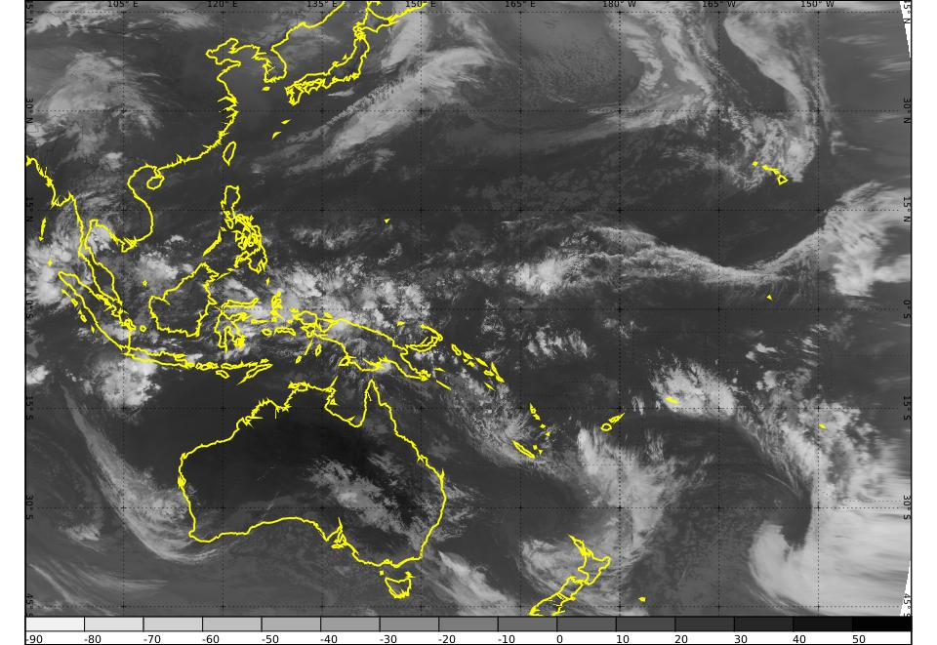
Comparing Synthetic Satellite and RADAR output forecasts with observations South Australia, Victoria 2nd and 3rd May 2018 Bodo Zeschke
Bodo Zeschke Australian VLab Centre of Excellence Point of Contact

Slide 2
Part 1: South Australian cold front and rain episode
Y
Synthetic satellite data and Himawari-8 data (hourly) animations
Synthetic RADAR and RADAR observations (10 minute) animations
Synthetic RADAR and RADAR observations 1140UTC
Synthetic RADAR and RADAR observations 1630UTC

Slide 3
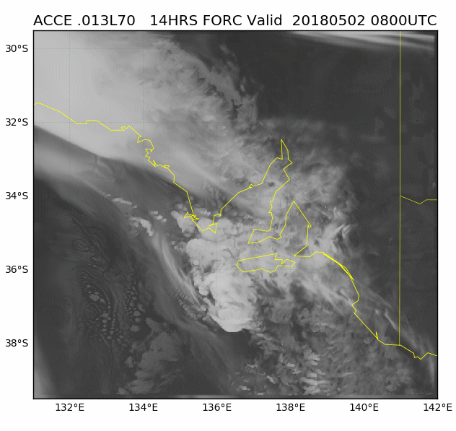
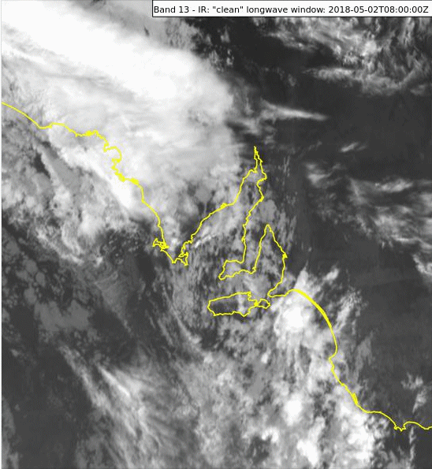

Slide 4
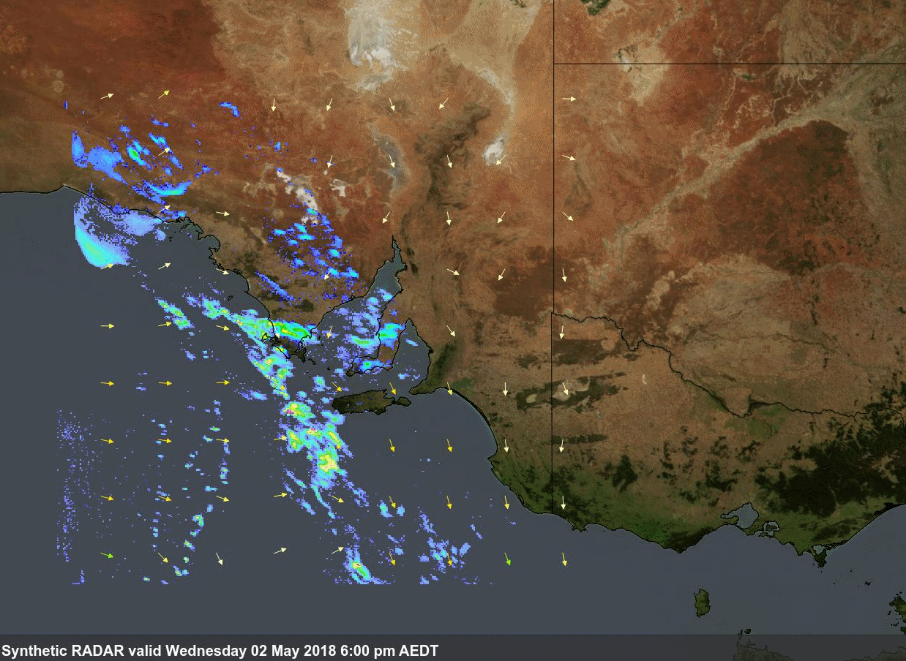
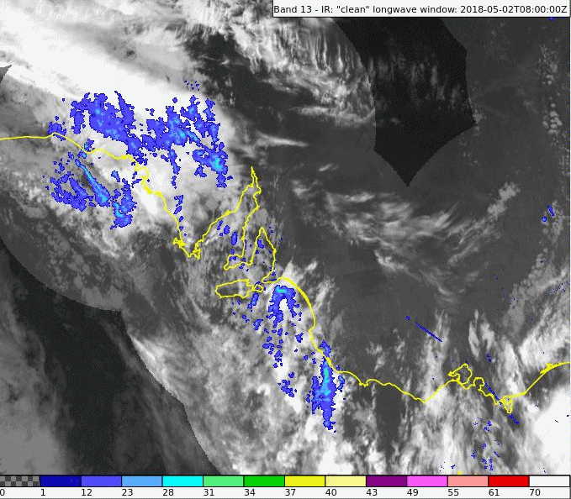

Slide 7
Part 2: Victorian cold front and rain episode
Y
Synthetic satellite data and Himawari-8 data (hourly) animations
Synthetic RADAR and RADAR observations (hourly) animations
Synthetic RADAR and RADAR observations 0130UTC
Synthetic RADAR and RADAR observations 0930UTC

Slide 8
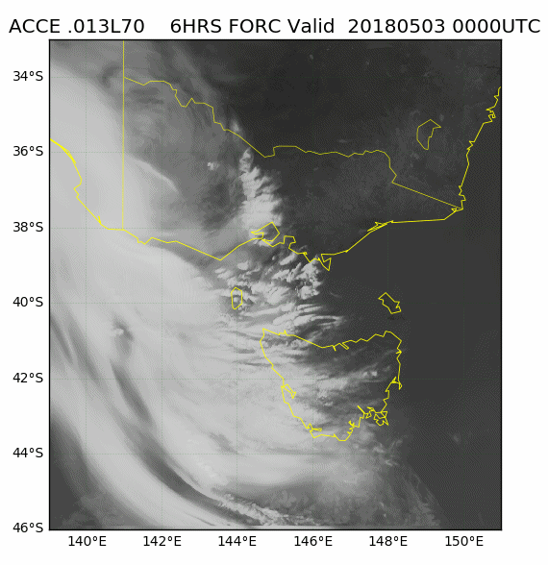
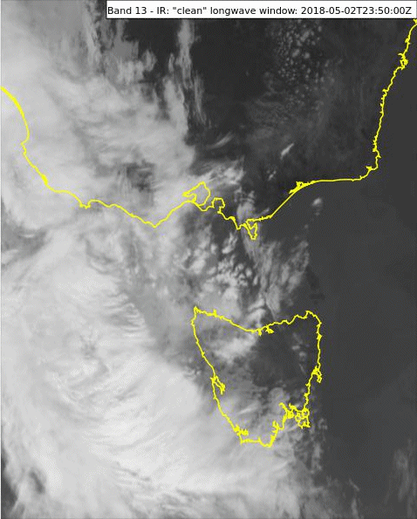

Slide 9
