Slide 1
Case studies of the Night Microphysics RGB composite including the WARO version
Bodo Zeschke
BMTC
Australian VLab Centre of Excellence
Should you use these resources please acknowledge the Australian Bureau of Meteorology Training Centre. In addition, you need to retain acknowledgement in the PowerPoint slides of the Japan Meteorological Agency (JMA), the Bureau of Meteorology (BOM) and any other sources of information.
Slide 1

Slide 2
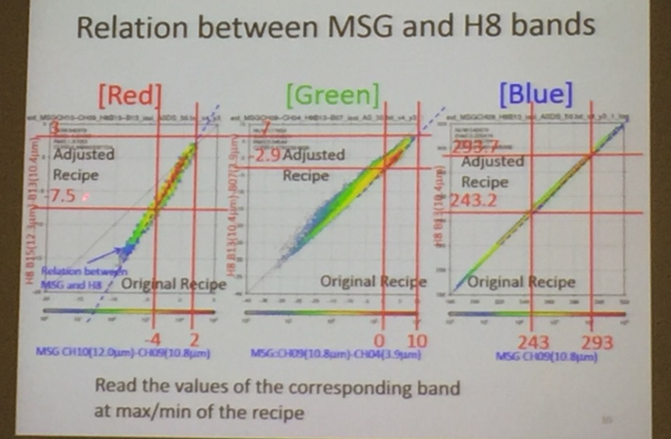
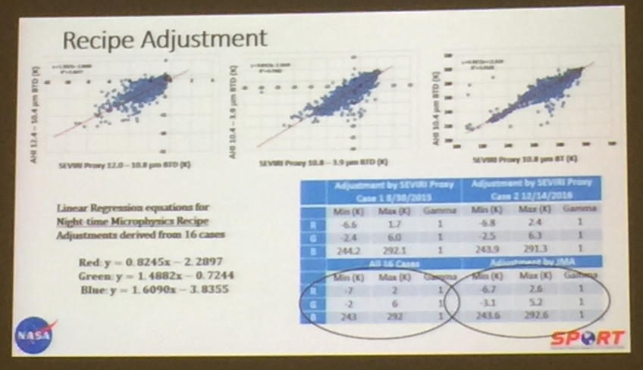
Tuning the Night Microphysics RGB composite JMA and USA work
Night Microphysics RGB (JMA tuned version 2, Murata and Shimizu 2015) | Range | Gamma
IR12.4 – IR10.4 BTD | -6.7 to 2.6 | 1.0
IR10.4 – IR3.9 BTD | -3.1 to 5.2 | 1.0
IR10.4 BT | -29.4 to 19.4 (243.6 to 292.4K) | 1.0
Night Microphysics RGB (JMA tuned version presented at RGB Expert and Developers Workshop 2017) | Range | Gamma
IR12.4 – IR10.4 BTD | -7.5 to 3.0 | 1.0
IR10.4 – IR3.9 BTD | -2.9 to 7.0 | 1.0
IR10.4 BT | -29.3 to 20.2 (243.7 to 293.2) | 1.0
Murata / Shimizu (JMA) presentation
Night Microphysics RGB (US version, Elmer et al 2016) | Range | Gamma
IR12.4 – IR10.4 BTD | -7.0 to 2.0 | 1.0
IR10.4 – IR3.9 BTD | -2.0 to 6.0 | 1.0
IR10.4 BT | -30.0 to 19.0 (243 to 292K) | 1.0
Jedlovec (NASA SPoRT) presentation
Slide 2

Slide 3
Tuning RGB composites: Night Microphysics RGB, JMA and USA Summary notes
JMA tuning of the Night Microphysics RGB composite as applied to Himawari-8 using regression analysis as described in more detail in Akihiro Shimizu's AOMSUC-6 presentation at http://www.data.jma.go.jp/mscweb/en/aomsuc6_data/presentations.html . Presentation 7 in the session "Training on meteorological satellite data usage")
The JMA tuning has been verified by subsequent US research.
This NASA SPoRT methodology to improve RGB interpretation across sensors included:
Normalisation through collocated data comparison (adjust input bands)
Reducing limb effects when comparing across polar and geostationary imagery.
The method used a proxy for SEVIRI imagery as derived from MODIS and VIIRS imagery.
Note the similar recipes that are derived from the JMA and USA tuning
Slide 3

Slide 4
Introducing the WARO Night Microphysics RGB composite
Night Microphysics RGB (WA version) | Range | Gamma
IR12.4 – IR10.4 BTD | -6 to 2 | 1.0
IR10.4 – IR3.9 BTD | -2 to 5 | 1.0
IR10.4 BT | -5 to 25 (268 to 298K) | 1.0
Night Microphysics RGB (JMA tuned version 2, Murata and Shimizu 2015) | Range | Gamma
IR12.4 – IR10.4 BTD | -6.7 to 2.6 | 1.0
IR10.4 – IR3.9 BTD | -3.1 to 5.2 | 1.0
IR10.4 BT | -29.4 to 19.4 (243.6 to 292.4K) | 1.0
WARO recipe
JMA tuning (Murata and Shimizu 2015)
Peter Newham's tuning
Night Microphysics RGB (JMA tuned version presented at RGB Expert and Developers Workshop 2017) | Range | Gamma
IR12.4 – IR10.4 BTD | -7.5 to 3.0 | 1.0
IR10.4 – IR3.9 BTD | -2.9 to 7.0 | 1.0
IR10.4 BT | -29.3 to 20.2 (243.7 to 293.2) | 1.0
Night Microphysics RGB (US version, Elmer et al 2016) | Range | Gamma
IR12.4 – IR10.4 BTD | -7.0 to 2.0 | 1.0
IR10.4 – IR3.9 BTD | -2.0 to 6.0 | 1.0
IR10.4 BT | -30.0 to 19.0 (243 to 292K) | 1.0
USA tuning (Elmer et al 2016) JMA tuning 2017
Slide 4

Slide 5
WARO Panther compared to Peter Newham web page
Peter Newham page: Night Microphysics RGB recipe adopted from Murata and Shimizu (2015)
WARO Panther
Slide 5

Slide 6
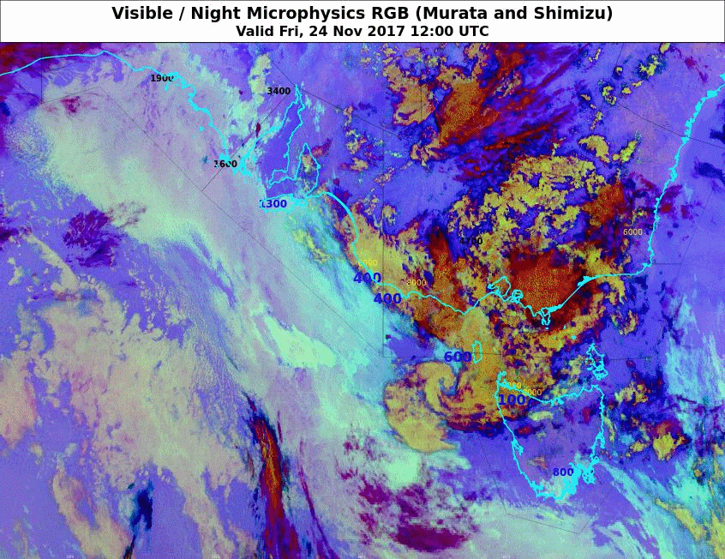
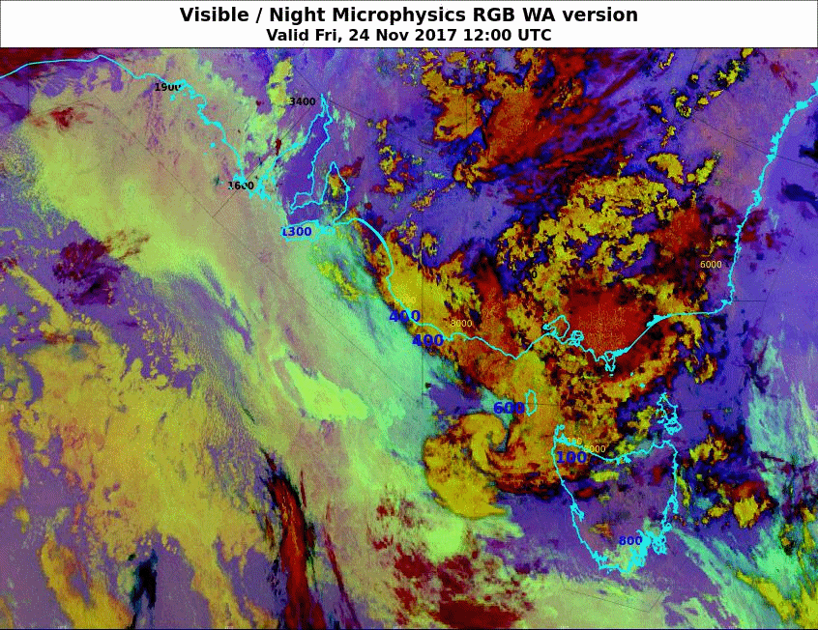
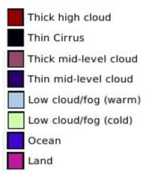
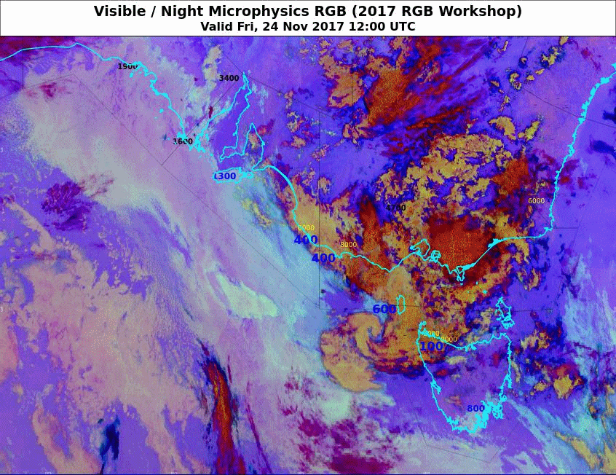
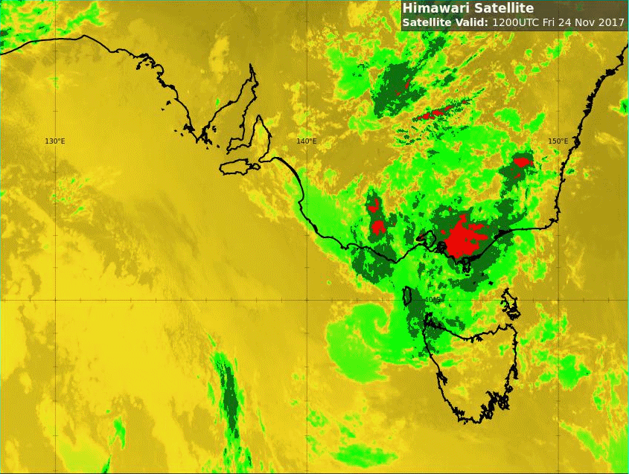
Animation 1: Fog/low cloud event South Australia 24th November 2017
Please start the Power Point Slide Show to activate the animation
A: Tuned version of Murata and Shimizu (2015)
B: WARO tuned version
C: Tuned version of Murata and Shimizu (2017)
Enhanced IR
Tbb
ice
ice/ water
water
Adelaide
Melbourne
animations courtesy JMA/BOM
Slide 6

Slide 7
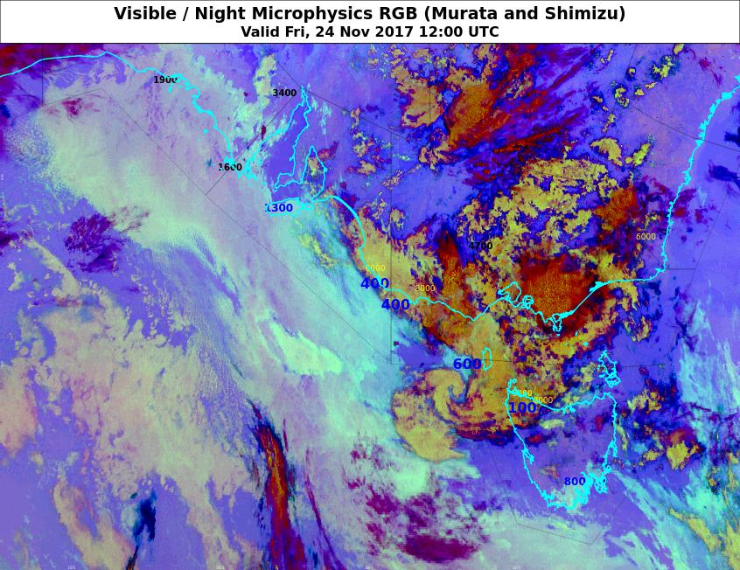
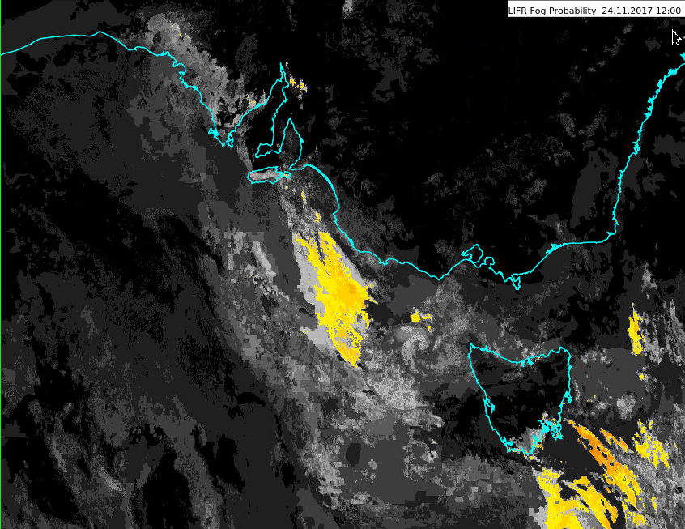
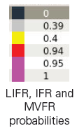
Fog/low cloud event SA 24th November 2017, 12UTC
A: Tuned version of Murata and Shimizu (2015)
B: WARO tuned version
C: Tuned version of Murata and Shimizu (2017)
LIFR probability
Adelaide
Melbourne
images courtesy JMA/BOM
Slide 7

Slide 8
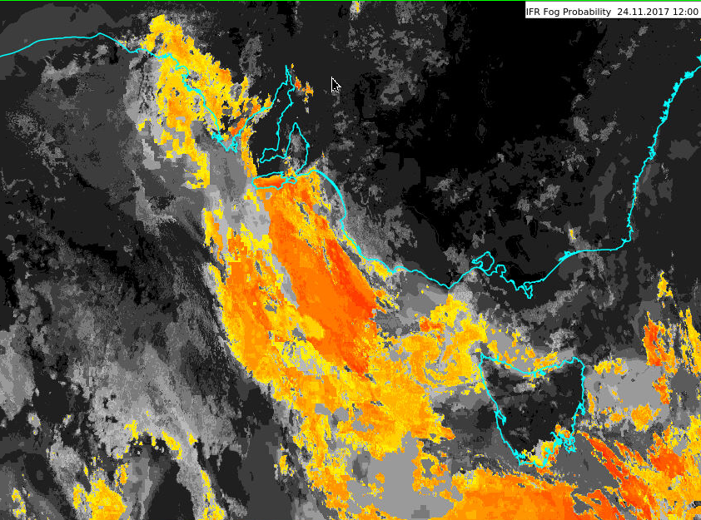
Fog/low cloud event SA 24th November 2017, 12UTC
A: Tuned version of Murata and Shimizu (2015)
B: WARO tuned version
C: Tuned version of Murata and Shimizu (2017)
IFR probability
Adelaide
Melbourne
images courtesy JMA/BOM
Slide 8

Slide 9
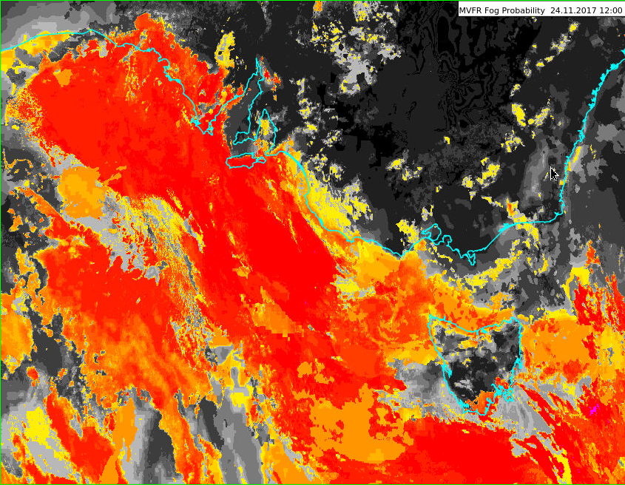
Fog/low cloud event SA 24th November 2017, 12UTC
A: Tuned version of Murata and Shimizu (2015)
B: WARO tuned version
C: Tuned version of Murata and Shimizu (2017)
IFR probability
Adelaide
Melbourne
images courtesy JMA/BOM
Slide 9

Slide 10
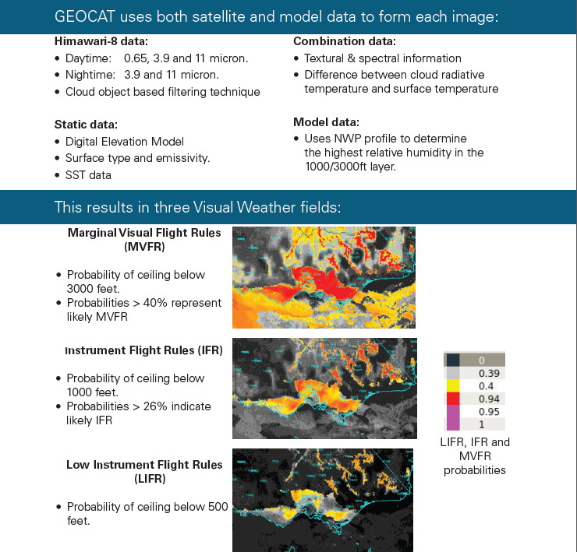
Slide 10

Slide 11
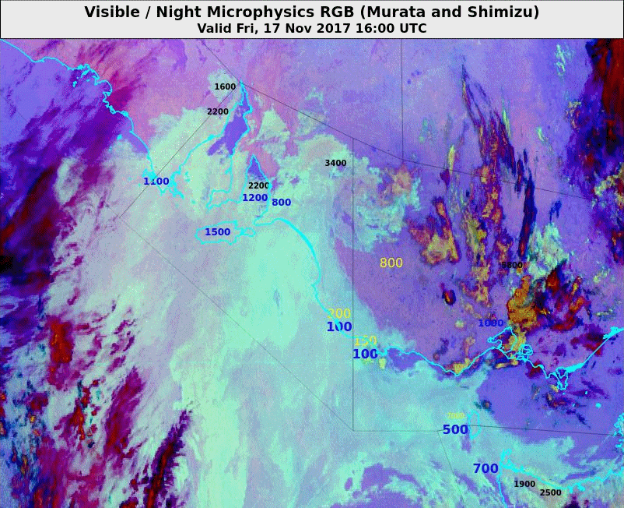
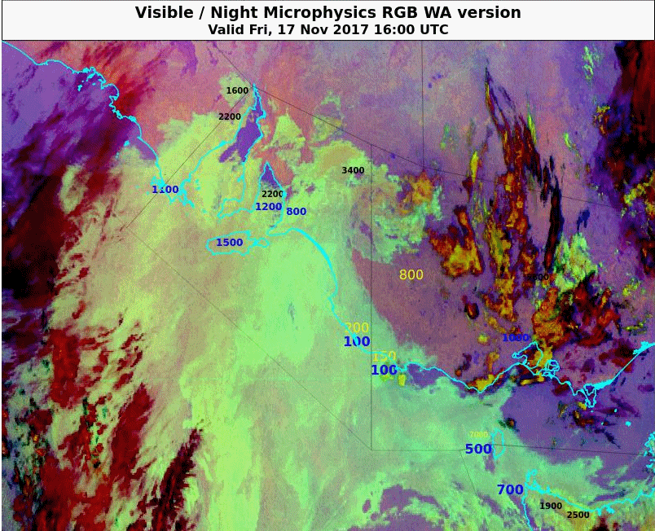
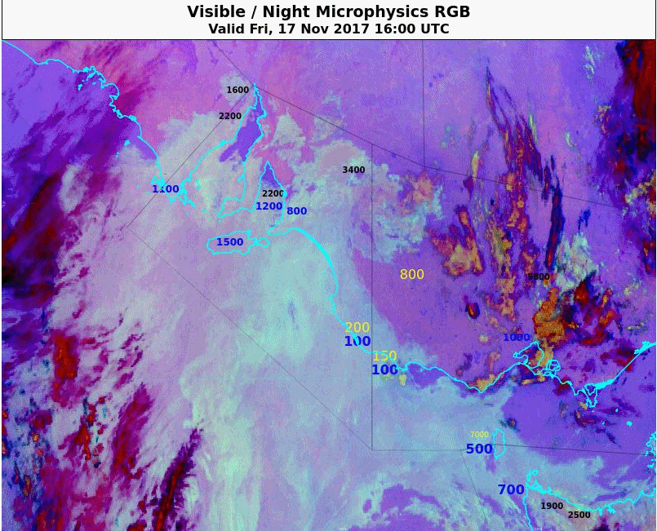
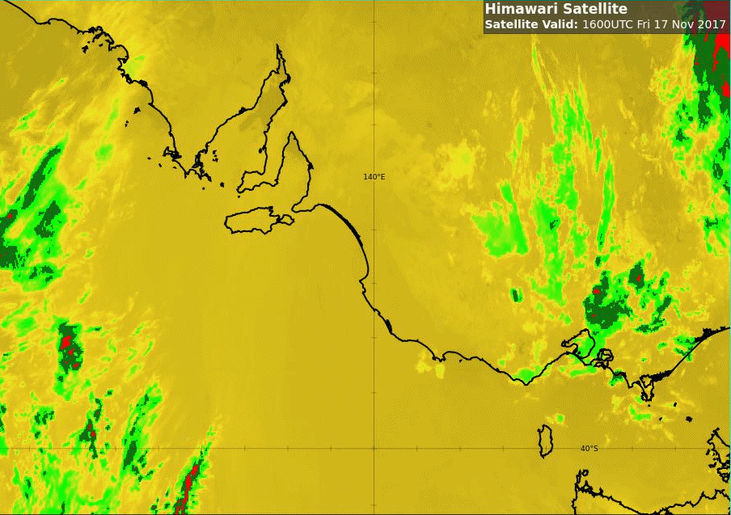
Animation 2: Fog/low cloud event SA 17th November 2017 – WARO tuning
Please start the Power Point Slide Show to activate the animation
A: Tuned version of Murata and Shimizu (2015)
B: WARO tuned version
C: Tuned version of Murata and Shimizu (2017)
Adelaide
Melbourne
animations courtesy JMA/BOM
Slide 11

Slide 12
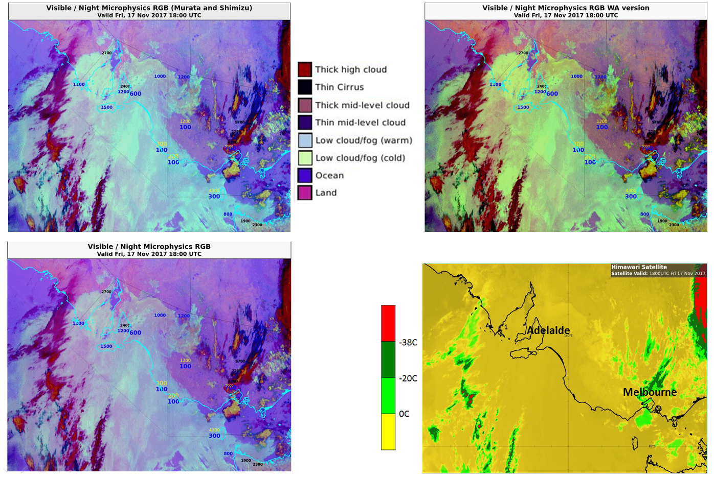
Fog/low cloud event SA 17th November 2017, 18UTC WARO tuning
A: Tuned version of Murata and Shimizu (2015)
B: WARO tuned version
C: Tuned version of Murata and Shimizu (2017)
images courtesy JMA/BOM
Slide 12

Slide 13
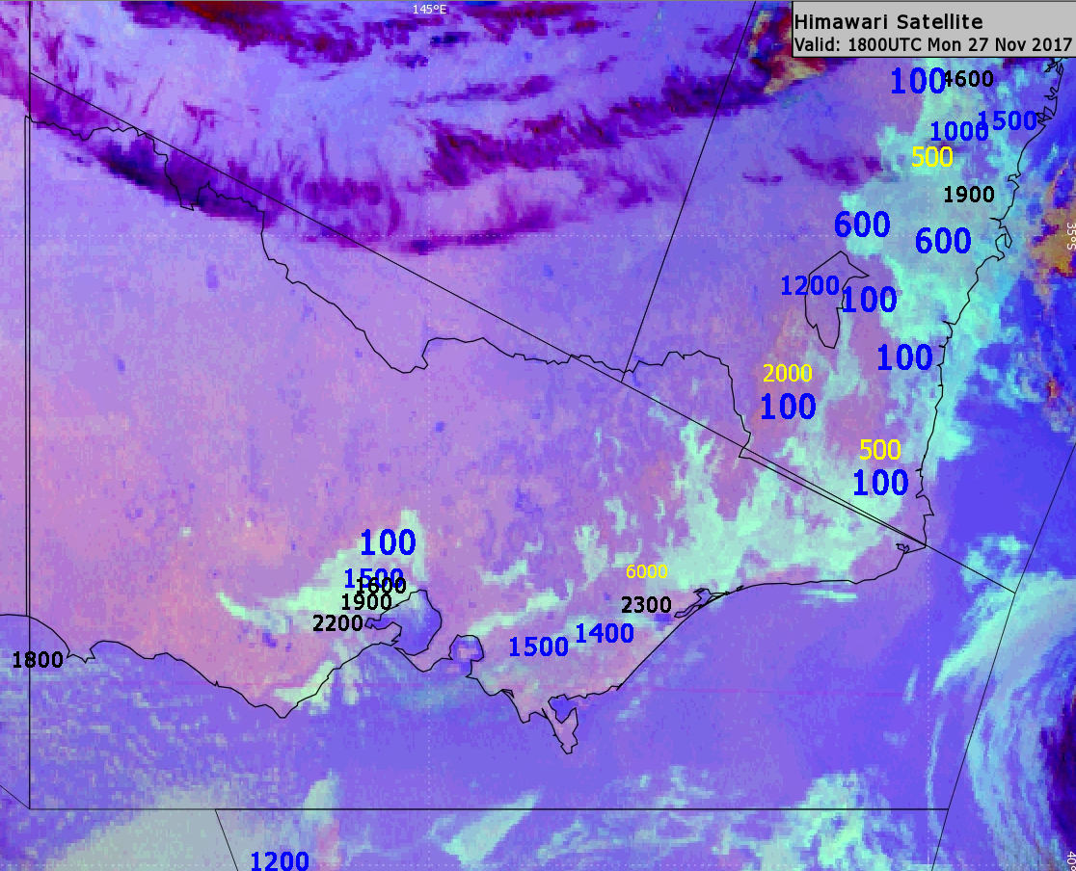
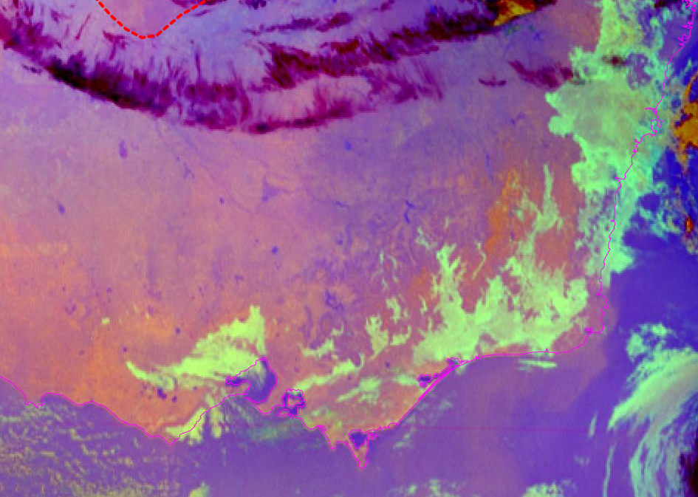
Comparison of the Night Microphysics RGB composites in revealing valley fog Southeast Australia 18UTC 27th November 2017
A: Tuned version of Murata and Shimizu (2015), as adopted by Peter Newham
B: WARO tuned version
images courtesy JMA/BOM
Slide 13

Slide 14
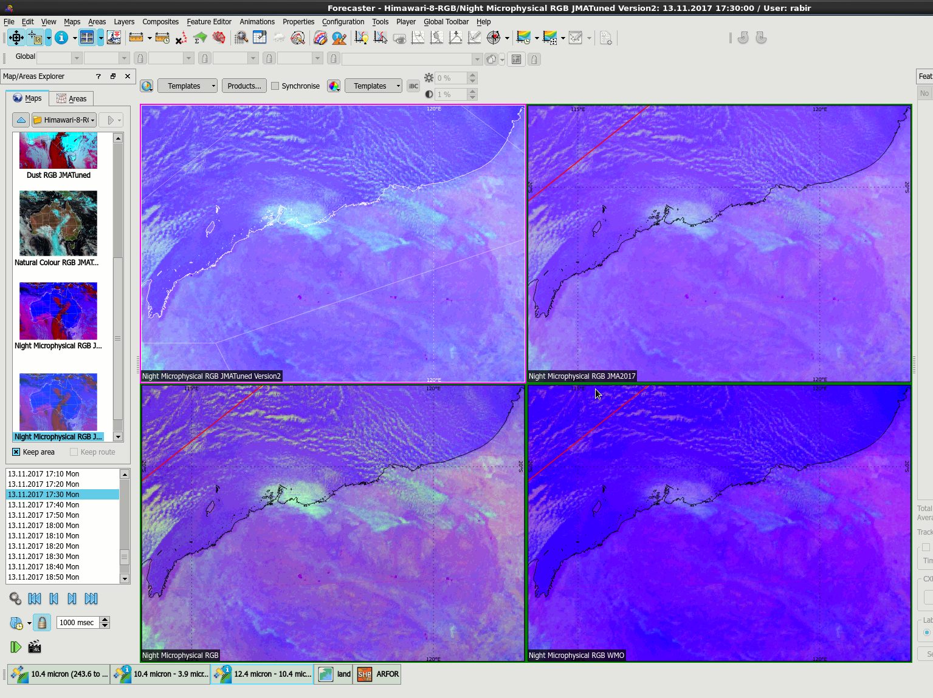
Correspondence from Rabi Rivett (WARO)
A: Tuned version of Murata and Shimizu (2015)
B: Tuned version of Murata and Shimizu (2017)
C: WARO version
D: Tuned version of Elmer et al 2016 (USA)
Slide 14

Slide 15
Correspondence from Rabi Rivett (14th November 2017)
The Panther enhancement comes from a recipe WA people (I think it was me) found for MTSAT channels prior to H8. And was probably implemented because it was able to be compared to an existing set of maps (to confirm enhancements were working).
I remember back when we first had it very low cloud would look different depending on what angle (eye to screen) it was being viewed at. So, aviation forecasters would semi regularly stand up to change the viewing angle. I think we may have tweaked the recipe to help fix that.
To me, the different recipes don't look 'very different'. There is a difference in the colour of low to lowish cloud – but its not a red vs blue difference. To me, the Panther version looks more differentiating in the range of low to very low cloud / fog – particularly in the near tropics. The JMA hot of the press 2017 version looks worse, as does the WMO one.
Attached is a screenshot of the different versions from 2017-11-13 17:30UTC, NW of WA. Top left is JMA Version 2, top right is 'hot of the press', bottom left is Panther, bottom right is WMO. Panther shows more contrast for the fog / low cloud area, hot of the press is least and JMA #2 in the middle. Given that sometimes we see fog / very low cloud in Panther looking like JMA Version 2 at different times of the year, I suspect Version 2 would have almost missed it.
Slide 15

