Slide 1
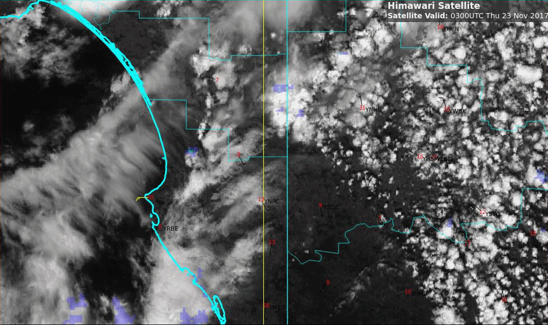
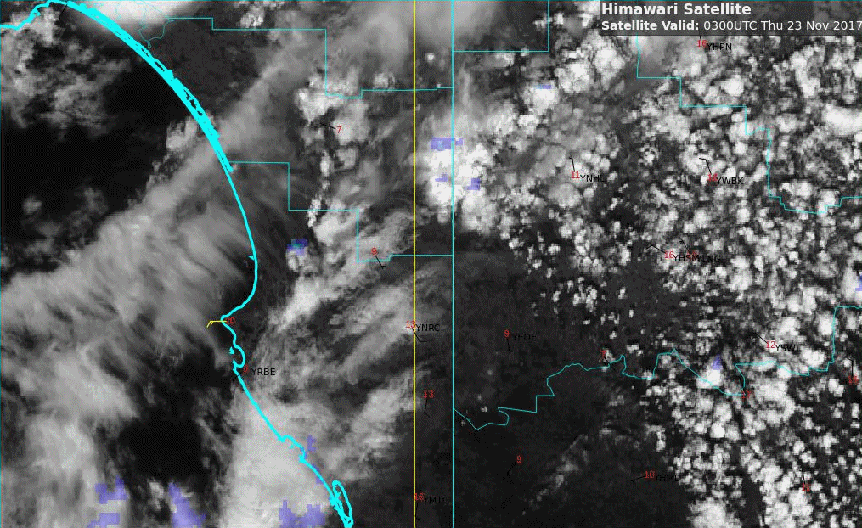
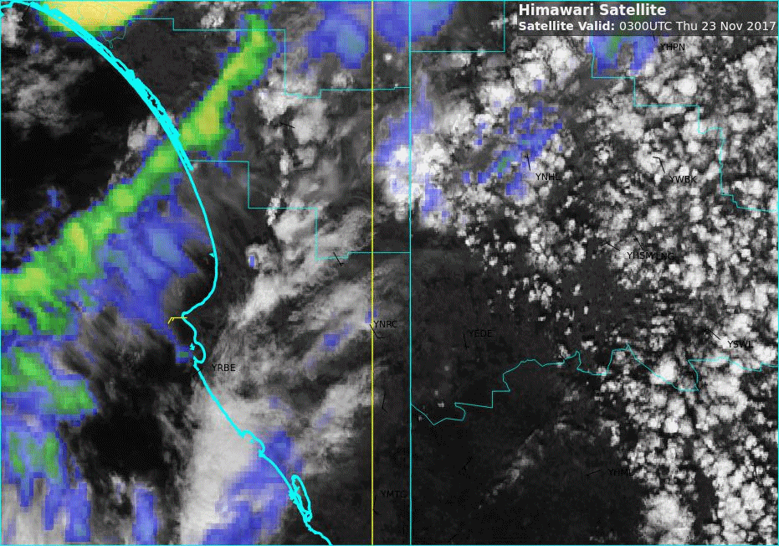
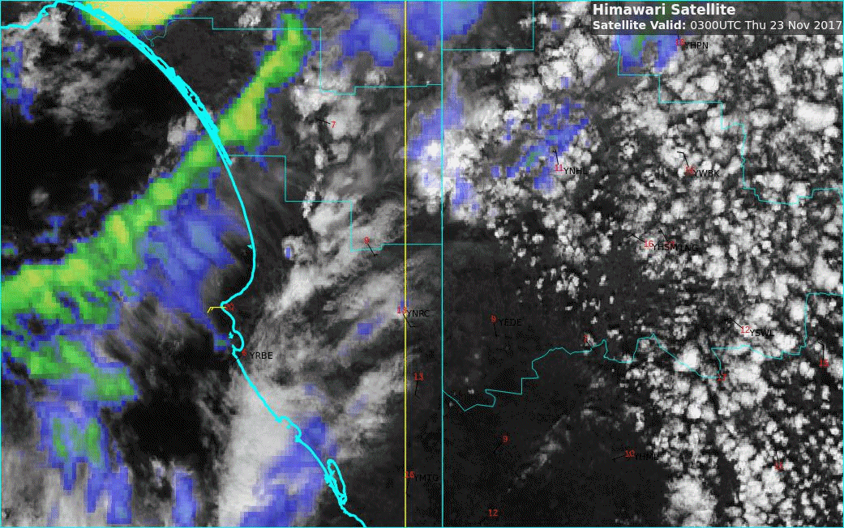
Animation: Rapidly developing storm, western VIC 03 to 07UTC 23rd November 2017
Please start the Power Point Slide Show to activate the animation
A: Visible, and RADAR
B: Visible, RADAR and lightning
Melbourne
C: Sandwich Product
D: Sandwich Product and lightning
animations courtesy JMA/BOM, lightning data courtesy GPATS

Slide 2
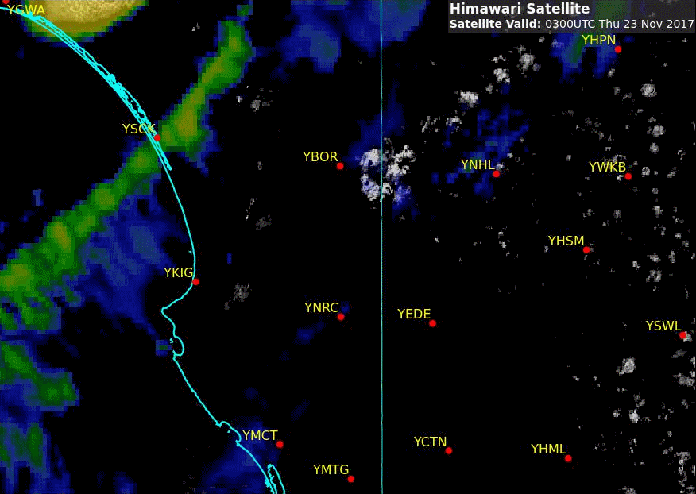
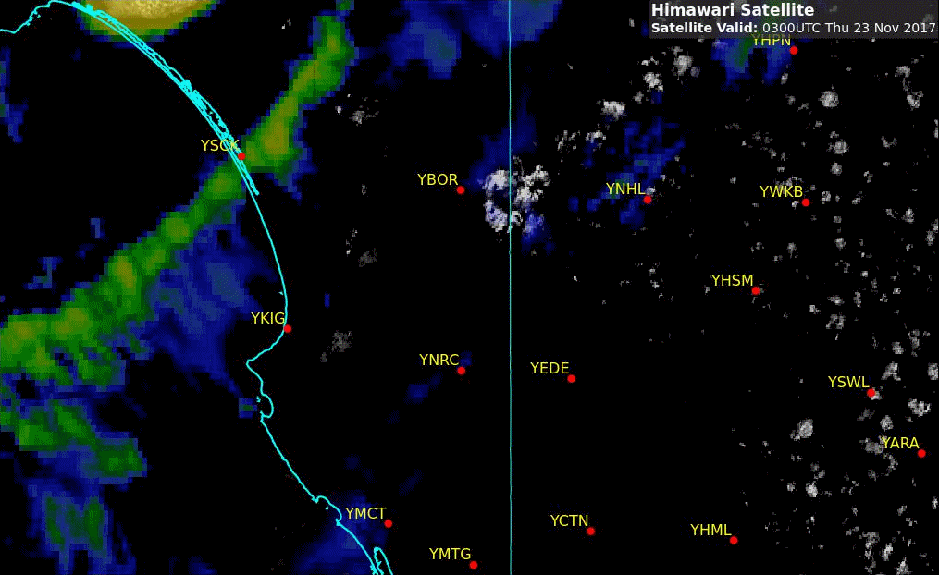
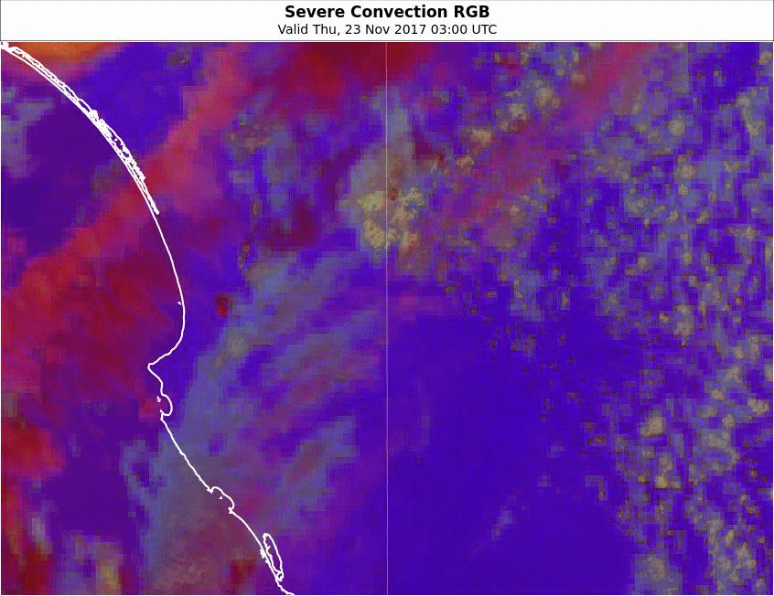
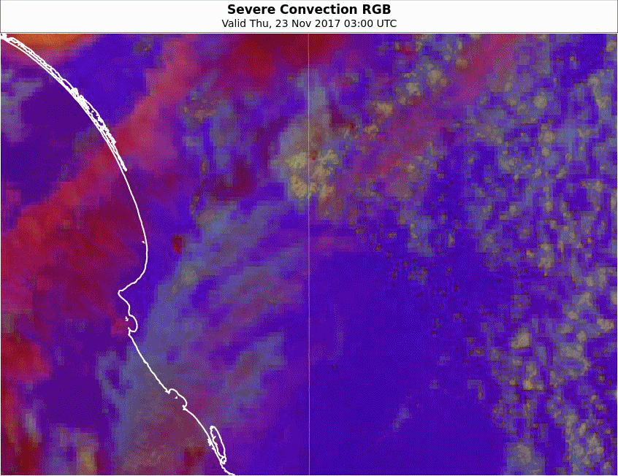
Animation: Rapidly developing storm, western VIC 03 to 07UTC 23rd November 2017
Please start the Power Point Slide Show to activate the animation
A: Enhanced Sandwich product (HRV brightness -170, contrast 400)
B: Enhanced Sandwich product and lightning
Melbourne
C: Sandwich Convection RGB Product
D: Sandwich Convection RGB Product and lightning
animations courtesy JMA/BOM, lightning data courtesy GPATS

Slide 3
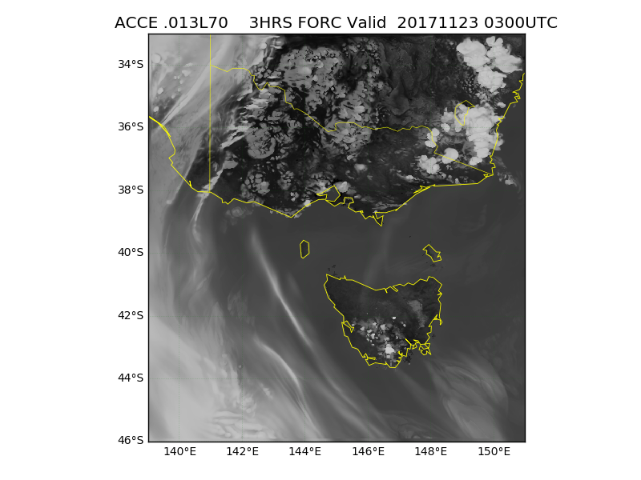
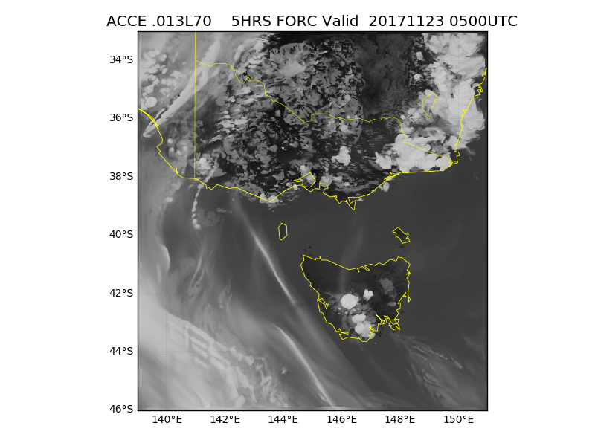
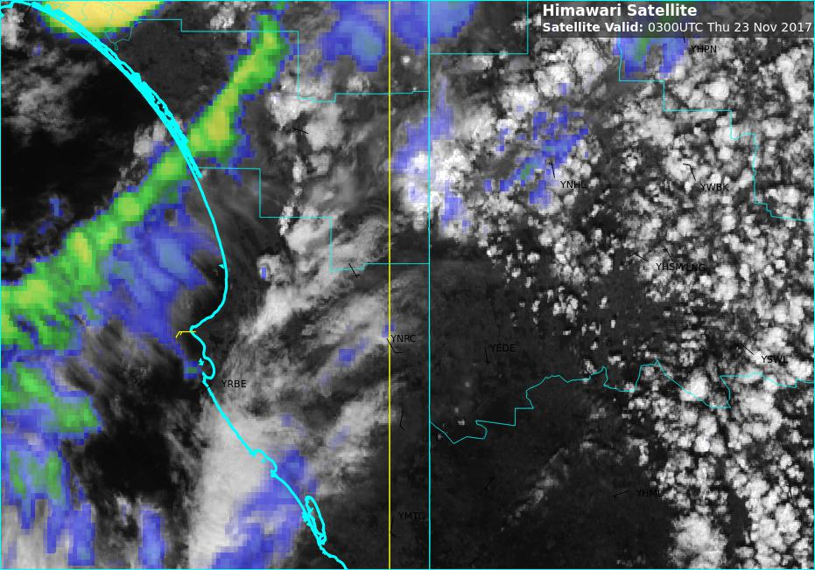
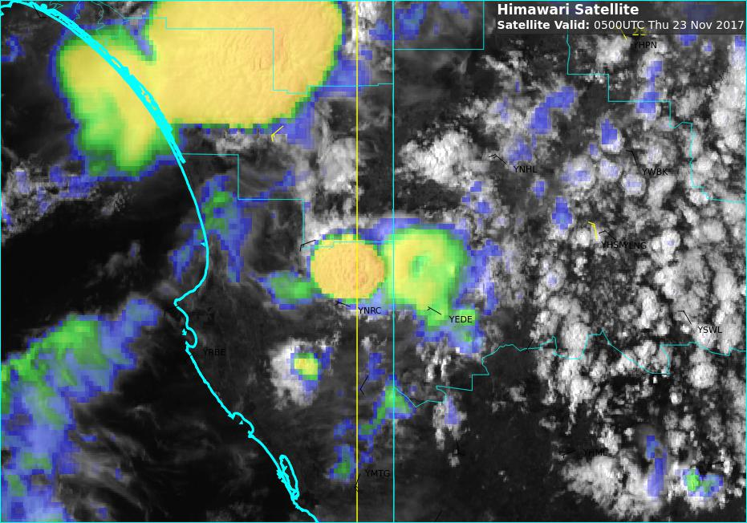
Comparing ACCESS CVT forecast to observed thunderstorm development 03 and 05UTC 23rd Nov 2017
images courtesy JMA/BOM, lightning data courtesy GPATS

Slide 4
Comparing ACCESS CVT forecast to observed thunderstorm development 03 and 05UTC 23rd Nov 2017
images courtesy JMA/BOM, lightning data courtesy GPATS

