Slide 1
"AHI RGB products and modification to these as applied over the Australasian/Pacific regions with relevant case studies; the Australian VLab Centre of Excellence Experience".
RGB Expert Workshop, Tokyo, Japan
Presenter: Bodo Zeschke. Bureau of Meteorology Training Centre, Australian VLab Centre of Excellence Point of Contact
Should you use these resources please acknowledge the Australian Bureau of Meteorology Training Centre. In addition, you need to retain acknowledgement in the PowerPoint slides of the Japan Meteorological Agency, EUMETSAT, the Bureau of Meteorology and any other sources of information.

Slide 2
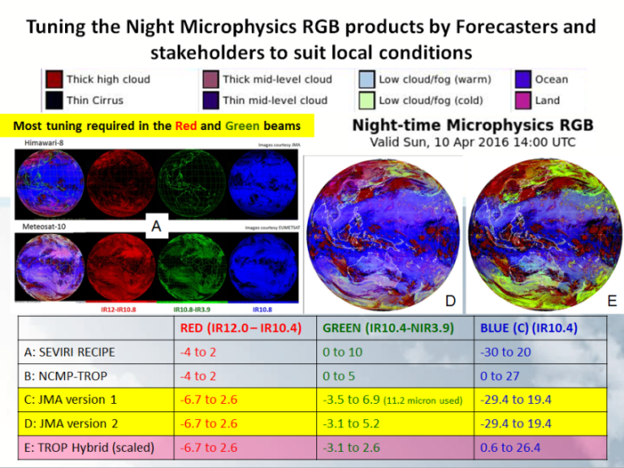
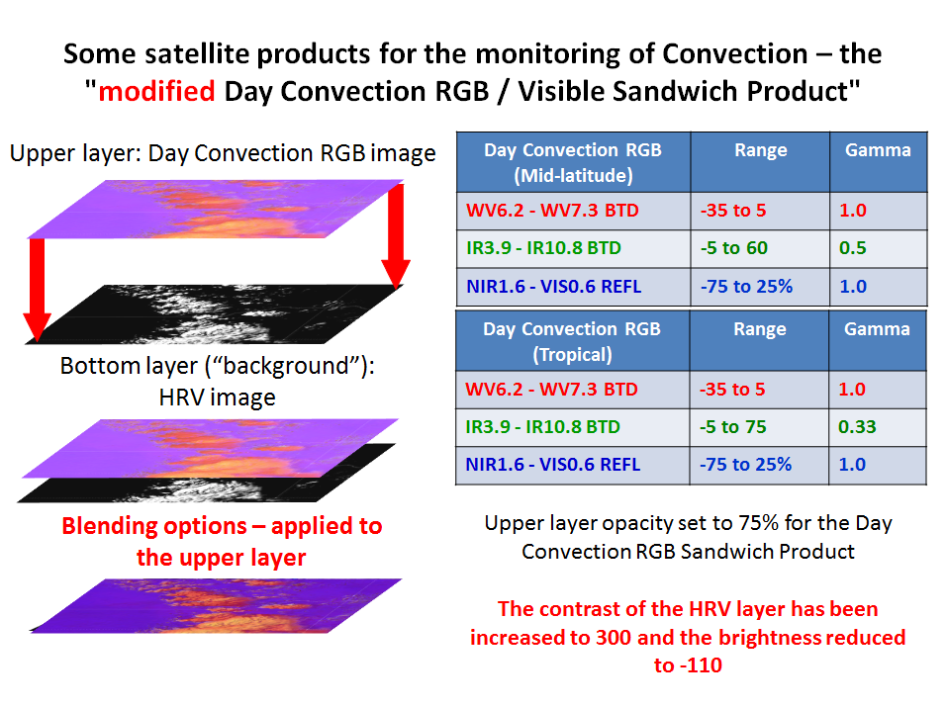
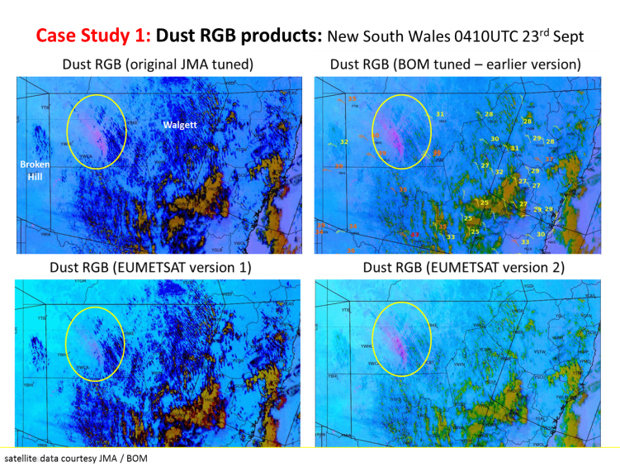
Contents of this session
Night Microphysics RGB product and variations
Day Convection RGB product and variations
Our adaptation of the Day Microphysics RGB product
Dust RGB product and variations

Slide 3
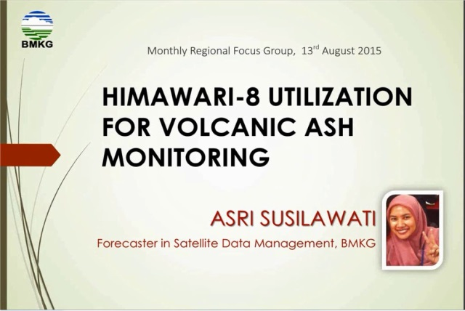
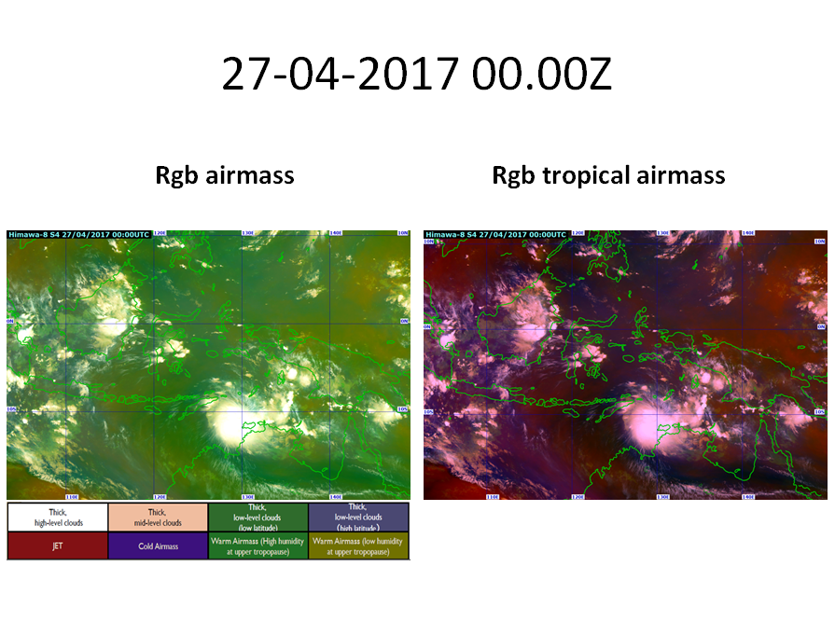
Other important WMO RAV work pertaining to RGB products (outside of the scope of this presentation)
BMKG Indonesia,
August 2015 RFG meeting
Meteorological Service Singapore
BMKG Indonesia,

Slide 4
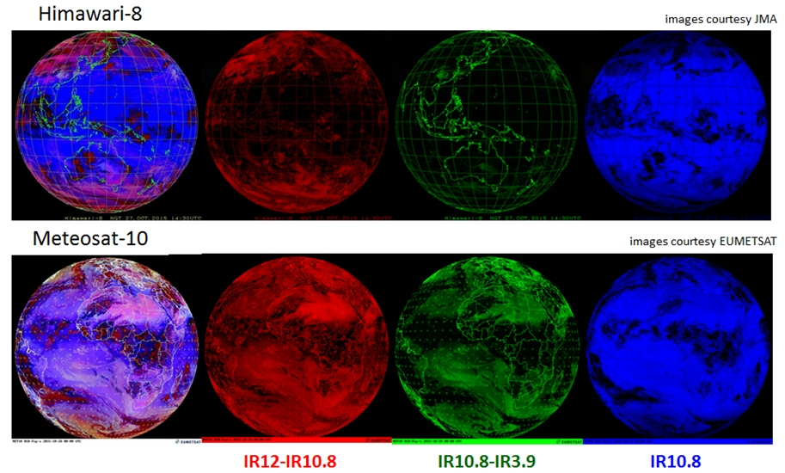
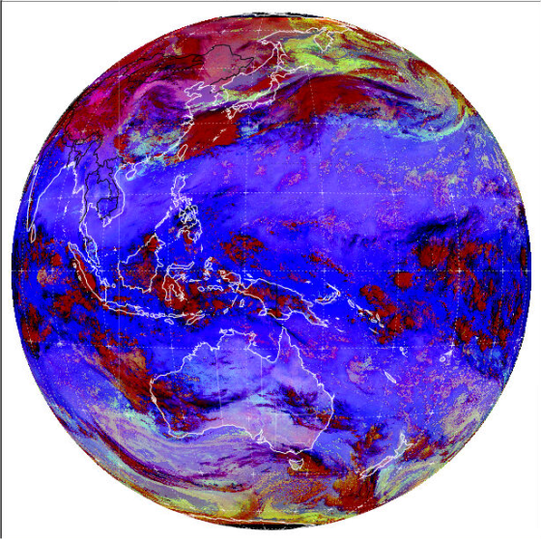
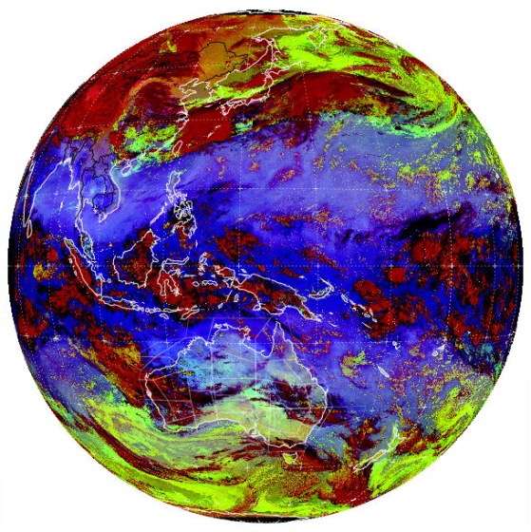
Tuning the Night Microphysics RGB products by Forecasters and stakeholders to suit local conditions
Most tuning required in the Red and Green beams
A
D
E
 | RED (IR12.0 – IR10.4) | GREEN (IR10.4-NIR3.9) | BLUE (C) (IR10.4)
A: SEVIRI RECIPE | -4 to 2 | 0 to 10 | -30 to 20
B: NCMP-TROP | -4 to 2 | 0 to 5 | 0 to 27
C: JMA version 1 | -6.7 to 2.6 | -3.5 to 6.9 (11.2 micron used) | -29.4 to 19.4
D: JMA version 2 | -6.7 to 2.6 | -3.1 to 5.2 | -29.4 to 19.4
E: TROP Hybrid (scaled) | -6.7 to 2.6 | -3.1 to 2.6 | 0.6 to 26.4

Slide 5
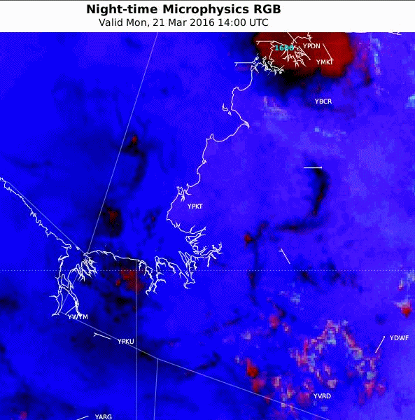
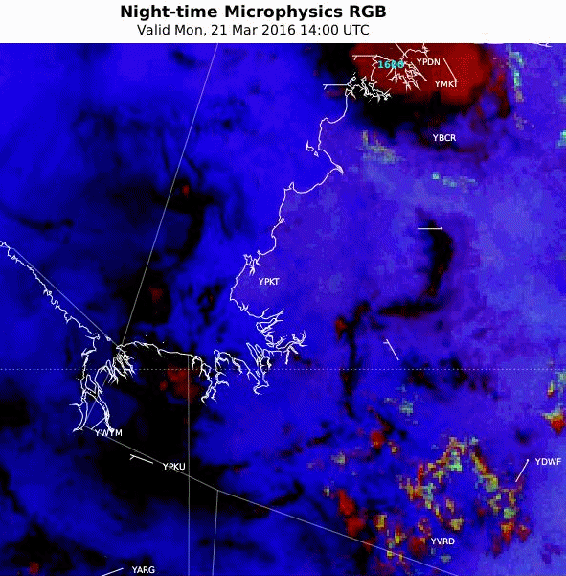
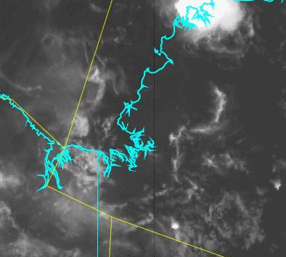
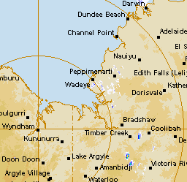
Animation: Northern Territory, 21st March 2016, 14 – 22UTC
10 May 2016 Regional Focus Group meeting; Animation 2
JMA version 2
TROP Hybrid (scaled)
10.4 micron IR
Wyndham RADAR
Question 1: What RGB product do you prefer?
Why?
Port Keats
satellite animations courtesy BOM/JMA
radar animation courtesy BOM
Notes:
http://www.theweatherchaser.com/radar-loop/IDR072-wyndham/2016-03-21-12/2016-03-21-23
http://flurry-dm.bom.gov.au:8008/radar/request_radar.php

Slide 6
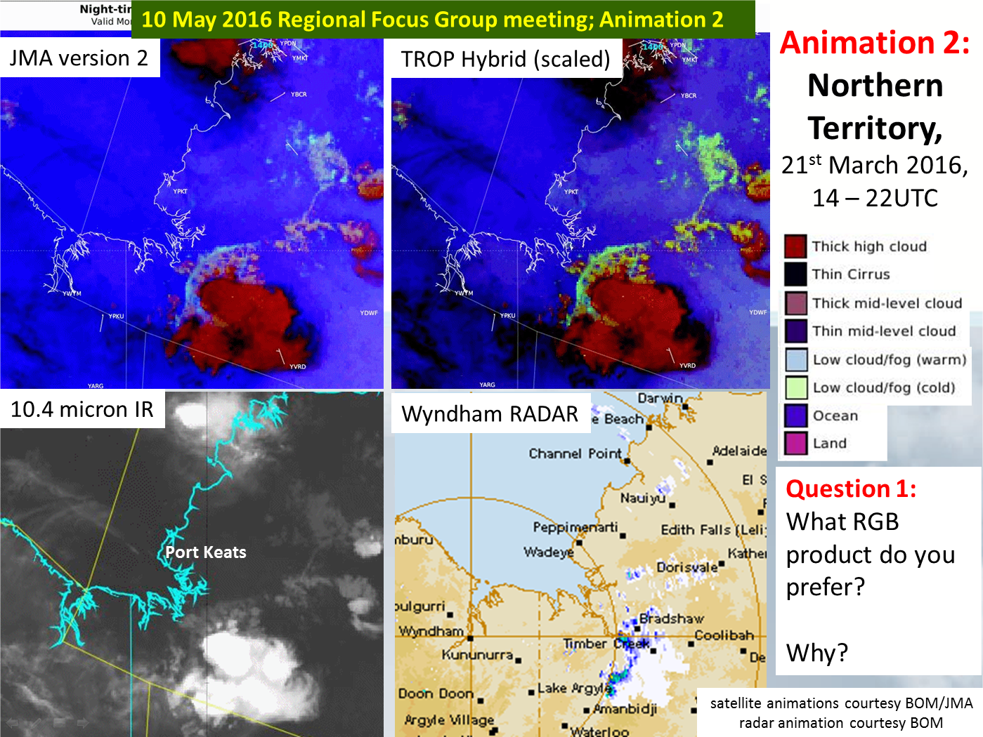
Notes:
http://www.theweatherchaser.com/radar-loop/IDR072-wyndham/2016-03-21-12/2016-03-21-23
http://flurry-dm.bom.gov.au:8008/radar/request_radar.php

Slide 7
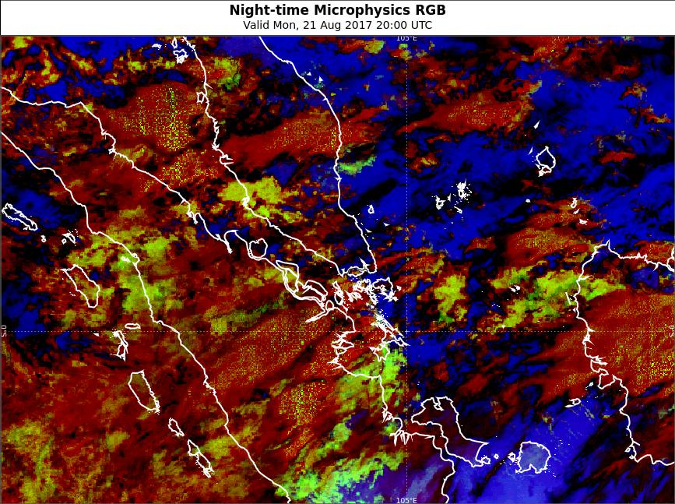
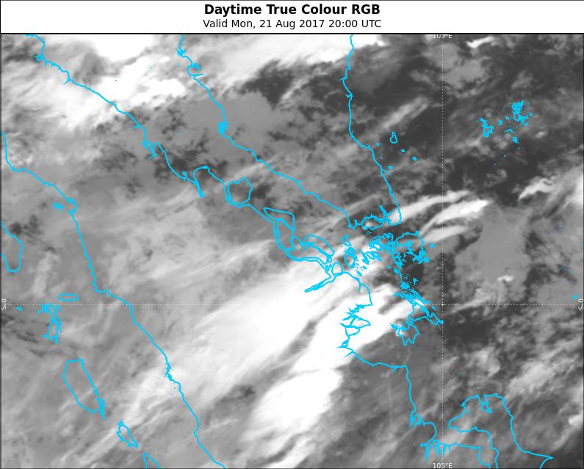
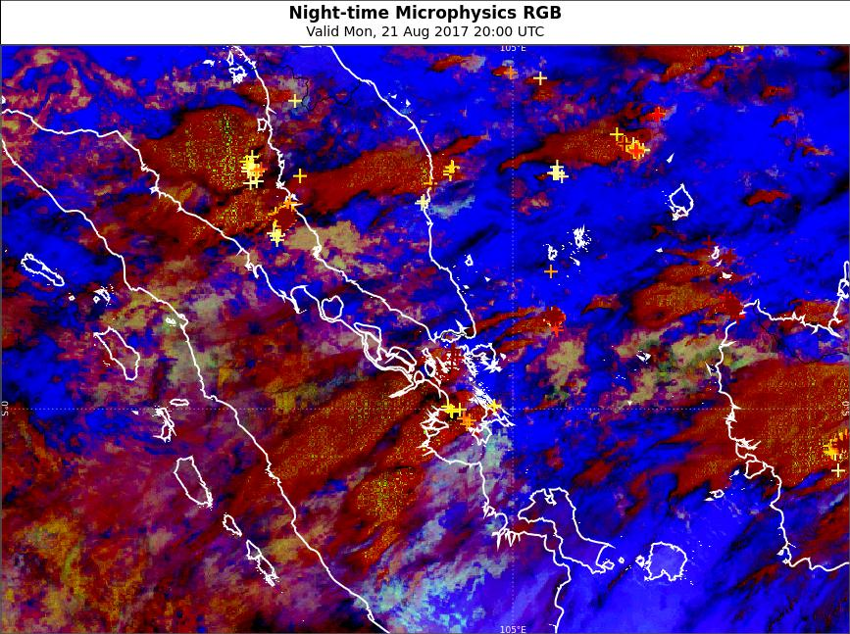
Example where the tropical version of the Night Microphysical RGB product does not work well Singapore/Malaysia/Indonesia area 20UTC 22nd August 2017
images courtesy BOM/JMA
Tropical tuned Night Microphysics RGB
Mid-level cloud
Low cloud
IR (Band 13)
Mid-latitude tuned Night Microphysics RGB
Singapore

Slide 8
Night Microphysics RGB product variation developed in South Australia (N. Benger) Australian region 28 Feb 2016
images courtesy BOM/JMA
JMA version 2 South Australian variation
Thin low cloud
Thick low cloud
 | RED IR12.0 – IR10.4 | GREEN IR10.4-NIR3.9 | BLUE (C) IR10.4
A: JMA version 2 | -6.7 to 2.6 | -3.1 to 5.2 | -29.4 to19.4
B: SA variation | -4 to 2 (Gamma1=0.5, Gamma2 = 1.5) | -5 to 5 (Gamma1=0.5, Gamma2 = 1.5) | -30 to 20 (Gamma1=0.5, Gamma2 = 1.5)

Slide 9
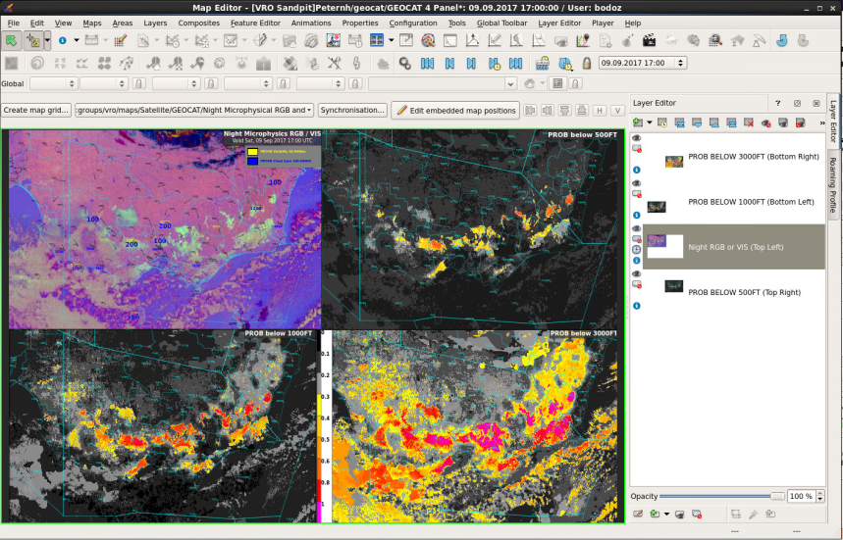
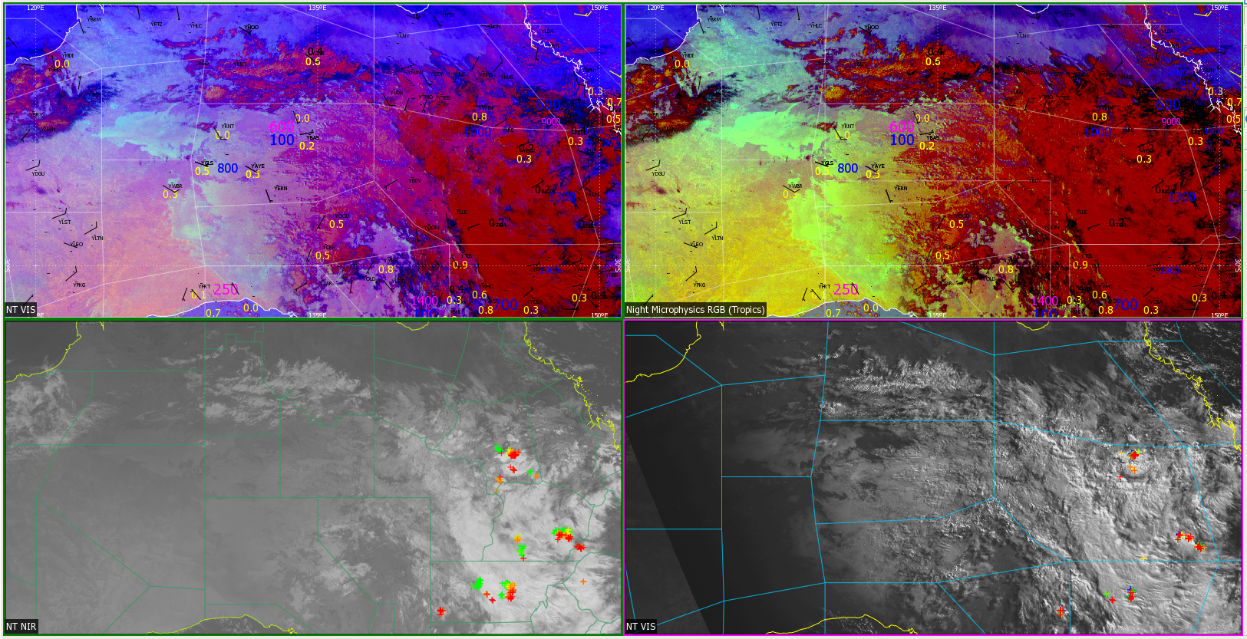
Multi-panel display of the data
images courtesy BOM/JMA
Night Microphysics RGB (Midlat)
Night Microphysics RGB (Tropics)
SWIR
VIS/IR

Slide 10
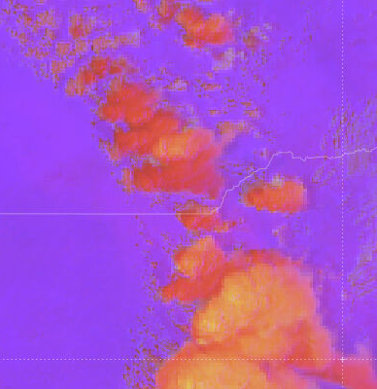
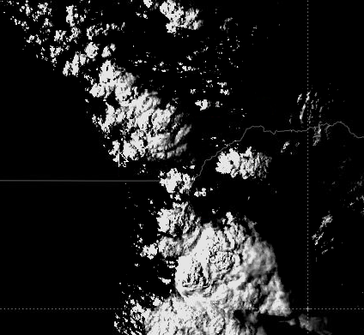
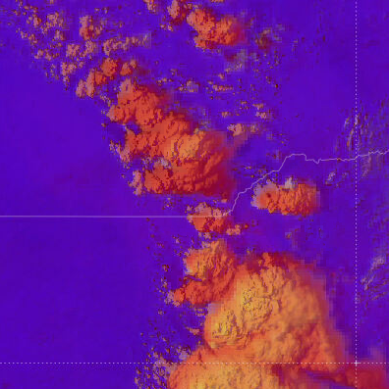
The Tropical and Midlatitude versions of the Day Convection RGB product and the "modified Day Convection RGB / Visible Sandwich Product"
Upper layer: Day Convection RGB image
Day Convection RGB (Mid-latitude) | Range | Gamma
WV6.2 - WV7.3 BTD | -35 to 5 | 1.0
IR3.9 - IR10.8 BTD | -5 to 60 | 0.5
NIR1.6 - VIS0.6 REFL | -75 to 25% | 1.0
Bottom layer (“background”): HRV image
Day Convection RGB (Tropical) | Range | Gamma
WV6.2 - WV7.3 BTD | -35 to 5 | 1.0
IR3.9 - IR10.8 BTD | -5 to 75 | 0.33
NIR1.6 - VIS0.6 REFL | -75 to 25% | 1.0
Blending options – applied to the upper layer
Upper layer opacity set to 75% for the Day Convection RGB Sandwich Product
The contrast of the HRV layer has been increased to 300 and the brightness reduced to -110

Slide 11
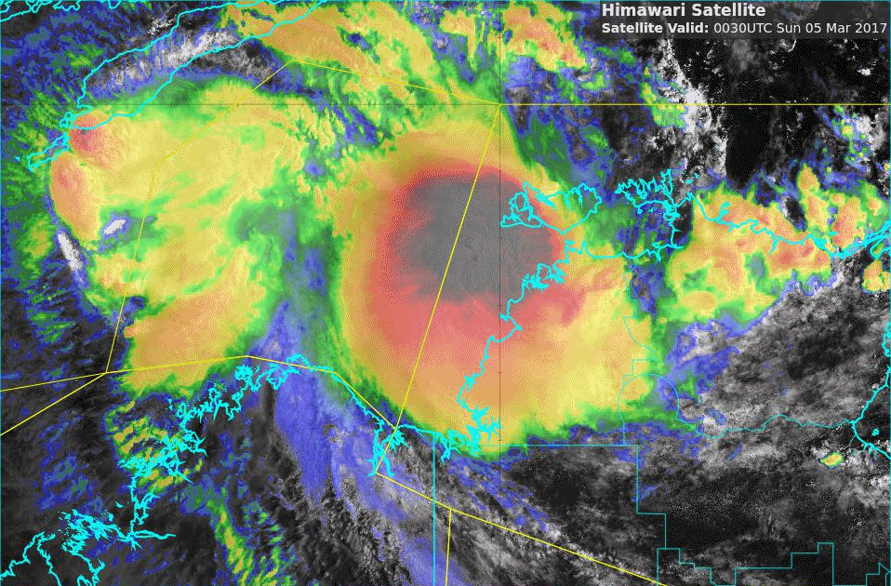
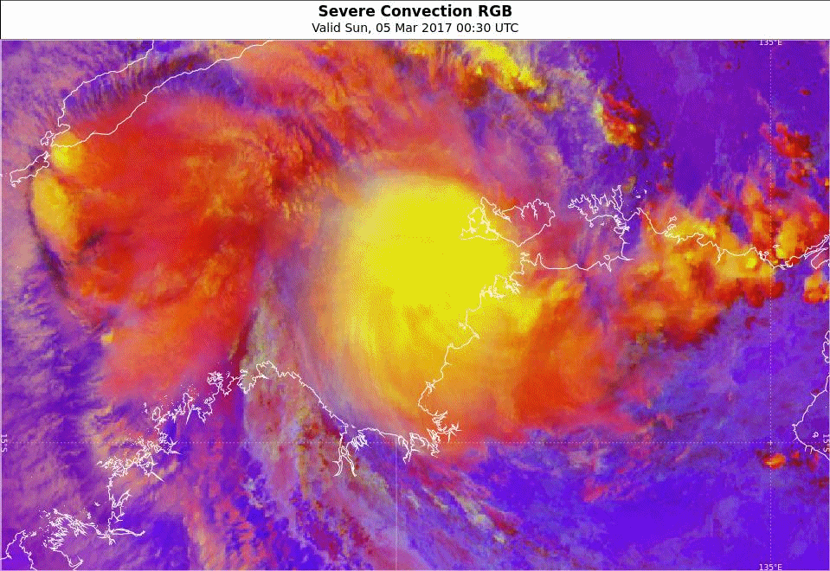
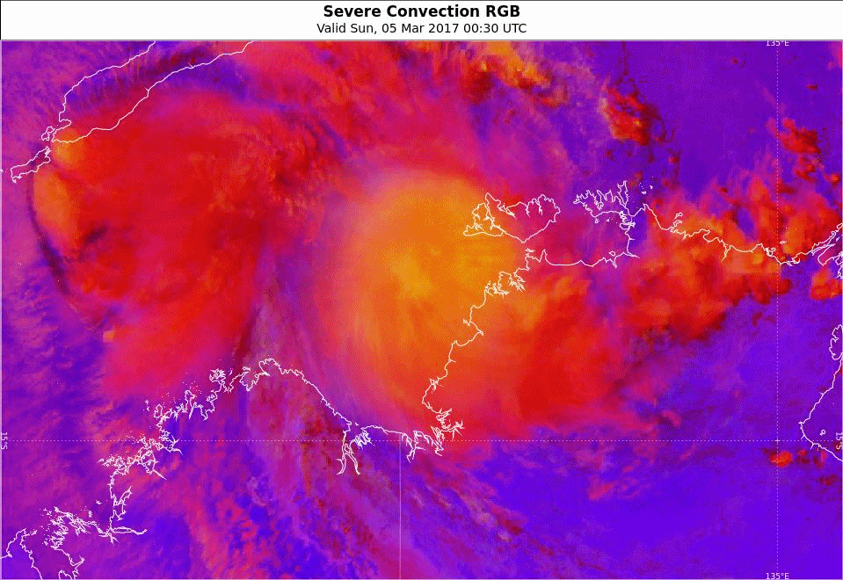
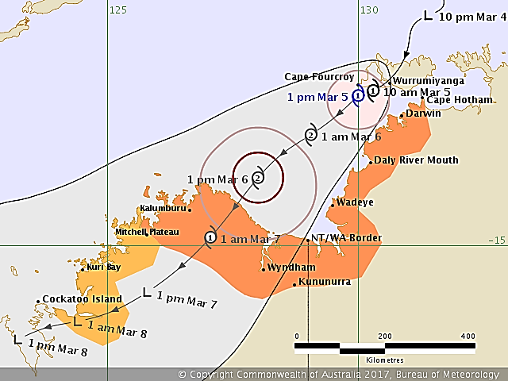
Animation : Convection associated with Tropical Cyclone Blanche Sandwich and Day Convection RGB products 5th March 2017, 0030 to 0230 UTC
Please start the Power Point Slide Show to activate the animation
21 March 2017 Regional Focus Group meeting; Animations 4
A: Sandwich Product (tropical tuned)
B: Day Convection RGB (mid-latitude tuned)
Darwin
C: Day Convection RGB (tropical tuned)
Tropical Cyclone Threat Map
Darwin
Darwin
animations courtesy JMA/BOM
Threat map courtesy BOM

Slide 12
The situation at 0110UTC, 5th March 2017

Slide 13
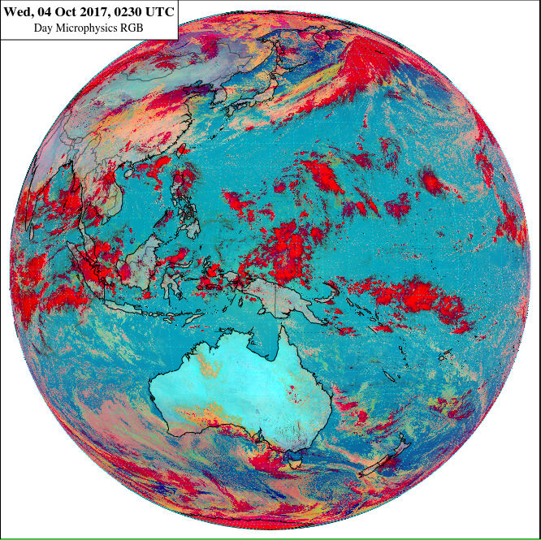
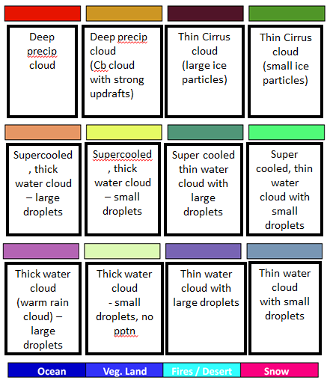
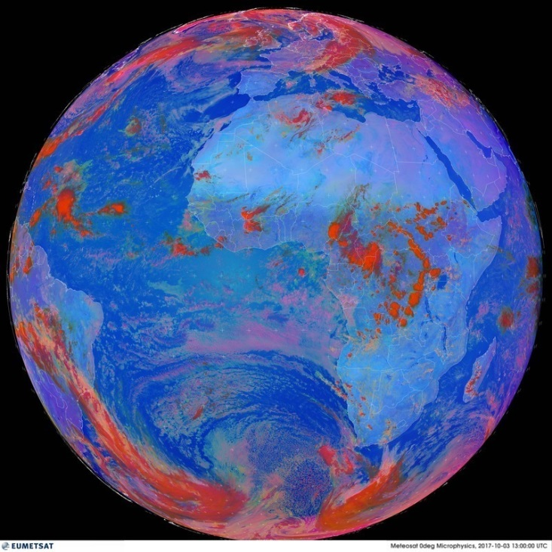
Day Microphysics RGB modification.
Day Microphysics RGB (BOM version) | Range | Gamma
VIS0.8 REFL | 0 to 100% | 1.2
IR3.9 TOTAL SIGNAL | 0 to 60% | 1.8
IR10.4 BT | -75 to 25% | 0.8
Day Microphysics RGB (EUMETSAT version) | Range | Gamma
VIS0.8 REFL | 0 to 100% | 1.0
IR3.9 REFL | 0 to 60% | 2.5
IR10.8 BT | +203 to +323K | 1.0
Notes:
Hi Tina
Thanks for taking the time to pass on the useful information regarding Himawari-8 data use.
In turn I have forwarded a photo of the display screen showing the True Colour RGB / Night Microphysics RGB product at the VICRO RFC
Also, I have attached some screenshots showing the tuning of the Day Microphysics RGB product in Visual Weather as per the VICRO RFC menu. As you can see this compares well with the display on Peter Newham’s Web Based display (see attachment “DayMicroRGBcalibrated1.jpg” attachment.
Also, I have attached the xml file so that you can import it into the Visual Weather running on your machine and display it right away J
Cheers
Bodo

Slide 14
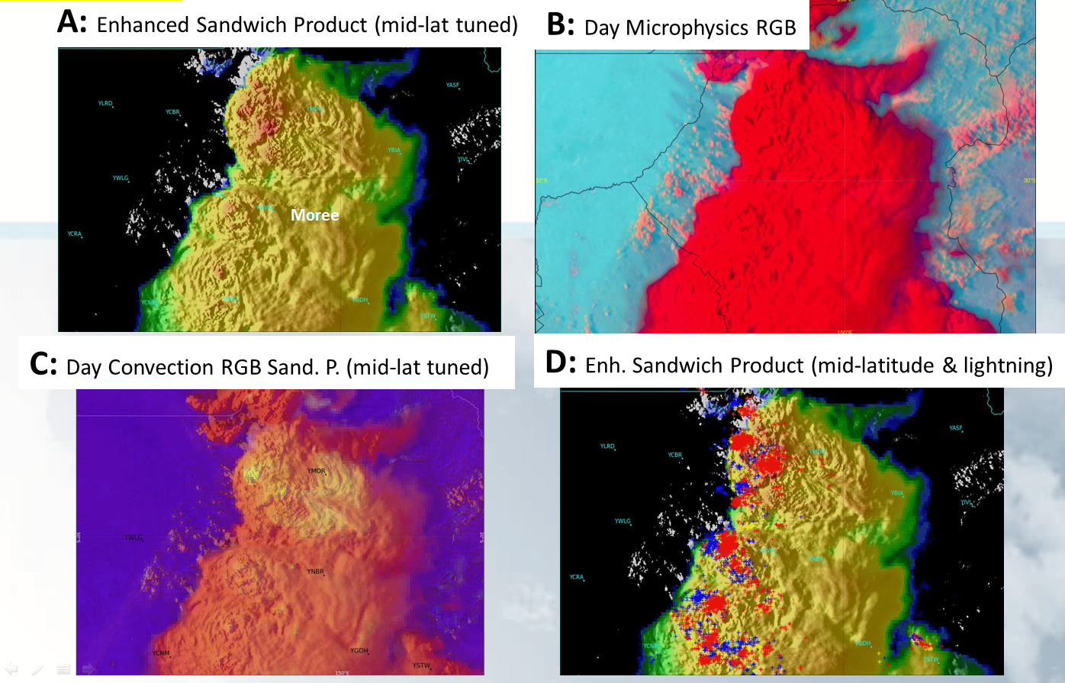
satellite data courtesy BOM/JMA
lightning data courtesy Global Position and Tracking Systems Pty Ltd (GPATS)
Comparing Day Microphysics product with other RGB products
NSW Convection, 0550UTC 13 March 2017
Moist soil
Storm outflow
Gravity Waves
Small Ice Crystals
March 2017 RFG meeting

Slide 15
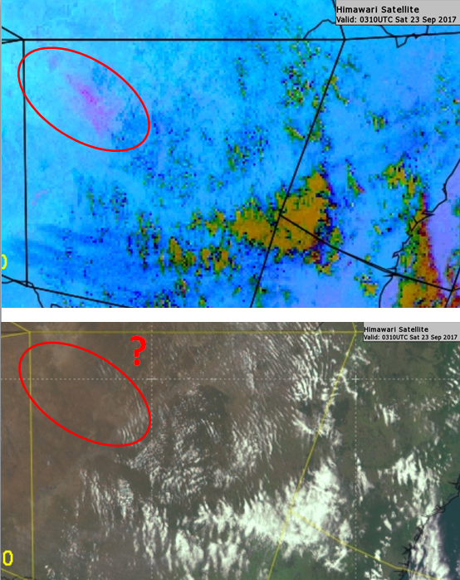
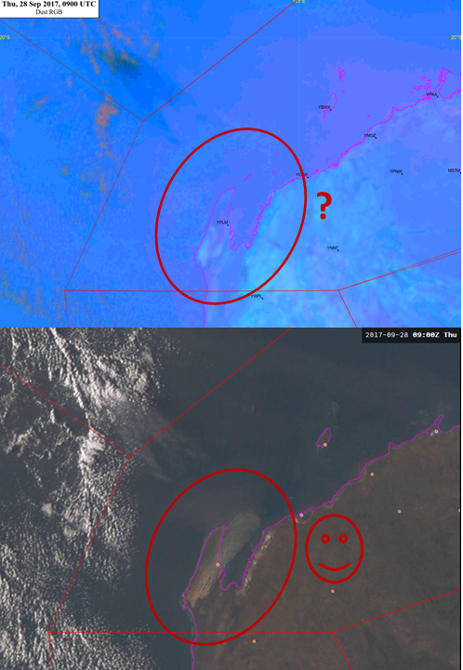
Dust and True Colour RGB product for two Australian dust events
satellite data courtesy JMA / BOM
Dust RGB product
Dust RGB product
True Colour RGB product
True Colour RGB product
Case Study 1: New South Wales dust storm
0310UTC 23rd September 2017.
Case Study 2: Western Australian dust storm 09UTC 28th September 2017.
forwarded by Gianni Colangelo, WARO Forecaster.

Slide 16
Case Study 1: Dust RGB products: New South Wales 0410UTC 23rd Sept
satellite data courtesy JMA / BOM

Slide 17
Case Study 1: Dust RGB products: New South Wales 0710UTC 23rd Sept
satellite data courtesy JMA / BOM

Slide 18
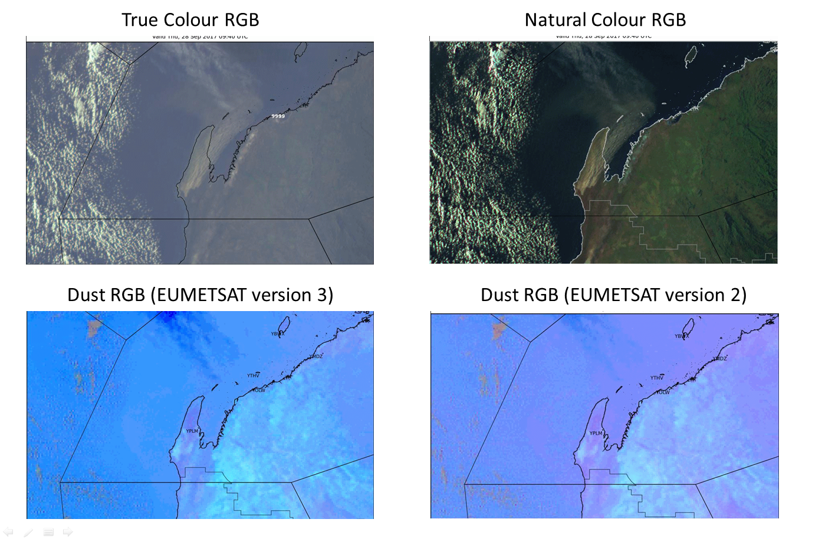
Case Study 2: West Australian Dust 28th September 0940 UTC
satellite data courtesy JMA / BOM

Slide 19
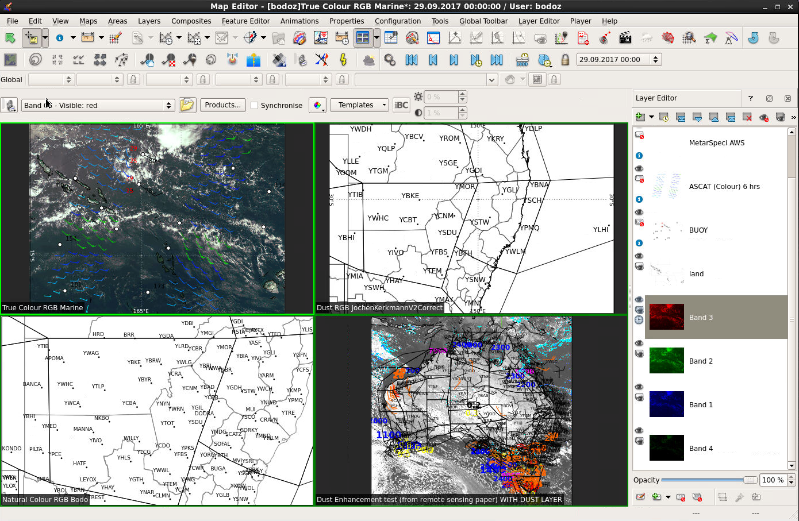
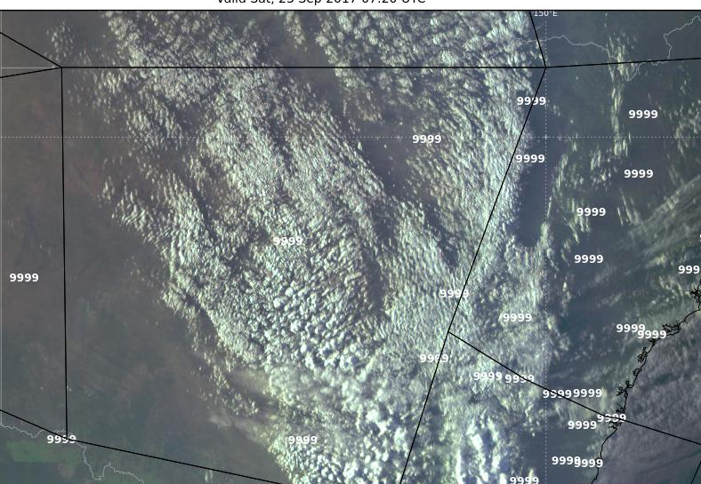
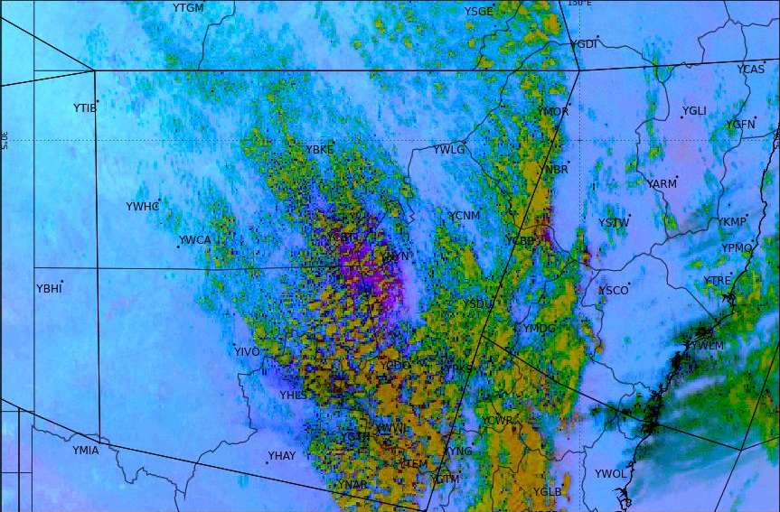
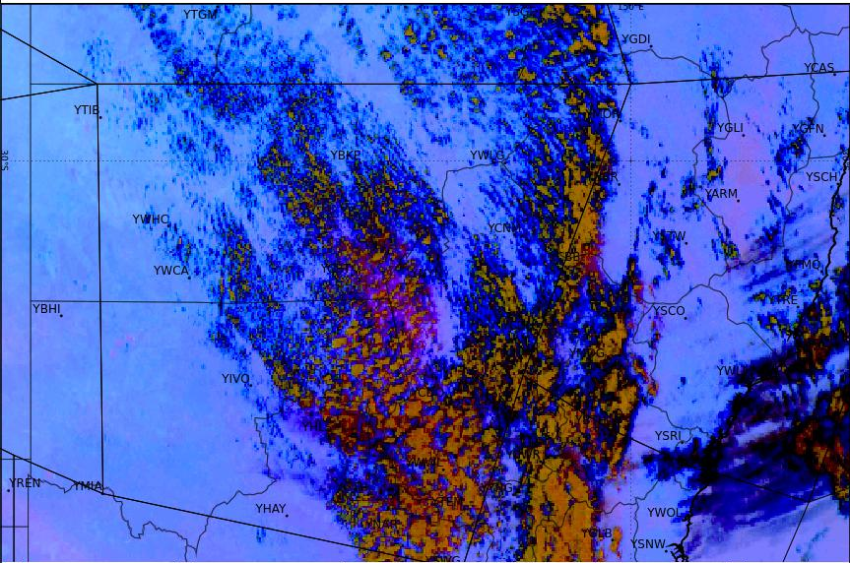
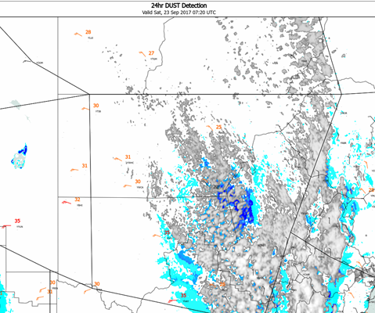
A recommended way to monitor the dust
True Colour RGB
(station visibility in meters)
Dust RGB (EUMETSAT version 2)
Dust RGB (original JMA tuned)
Dust detection algorithm
(adapted by Peter Newham)
satellite data courtesy JMA / BOM, derived product courtesy P. Newham

Slide 20
Summary of the session
Tuning Himawari-8 data products
Tropical and mid-latitude versions of the Night Microphysics RGB product
Comparison with GEOCAT FLS product
North Australian case study
Indonesian case study
Tropical and mid latitude versions of the Day Convection RGB Product
TC Blanche case study
Day Microphysics RGB product modifications
Australian case study
Dust RGB product work
A New South Wales and West Australian case study

