Slide 1
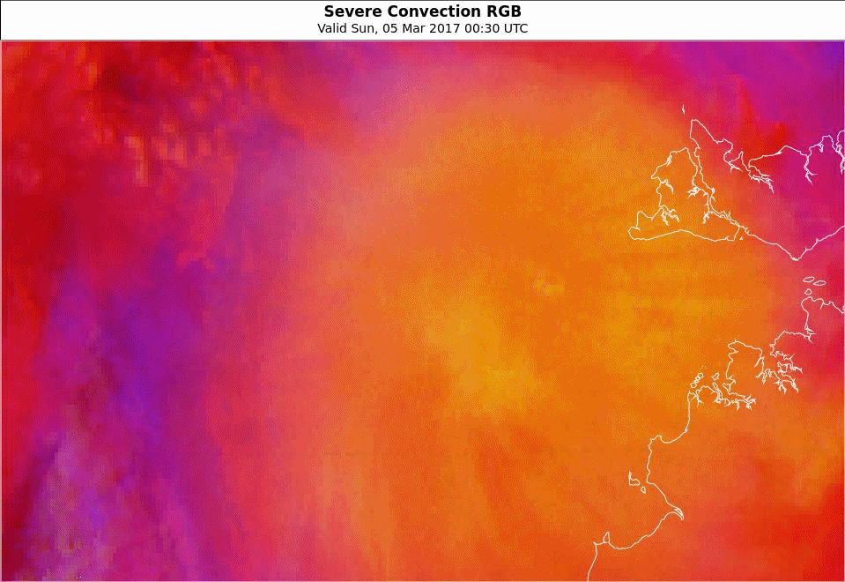
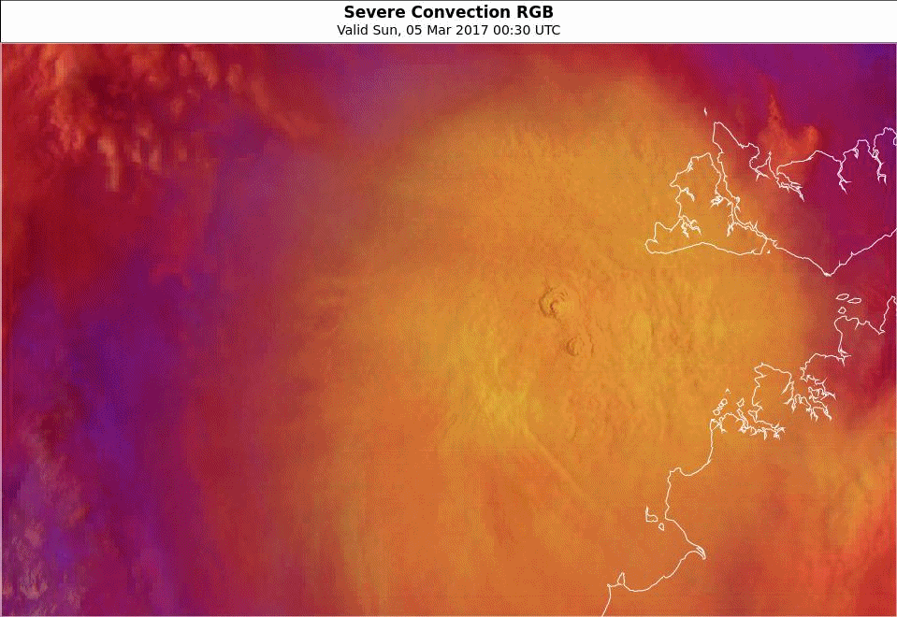
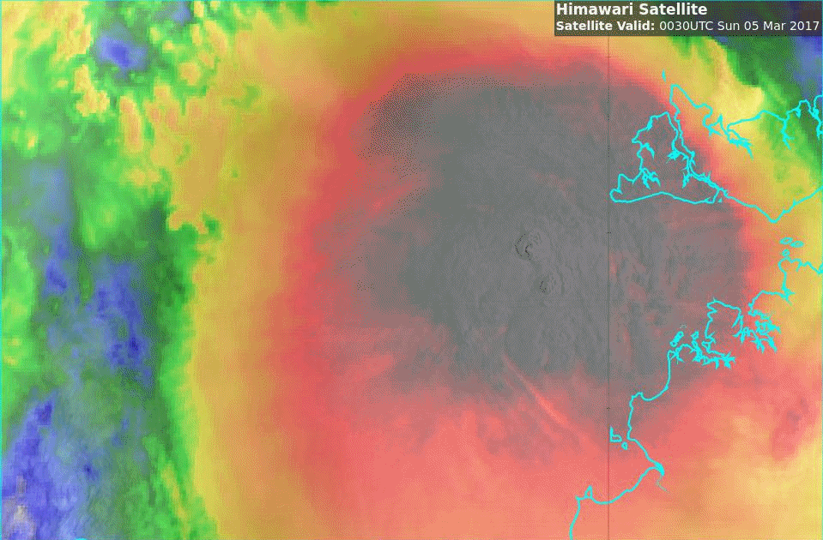
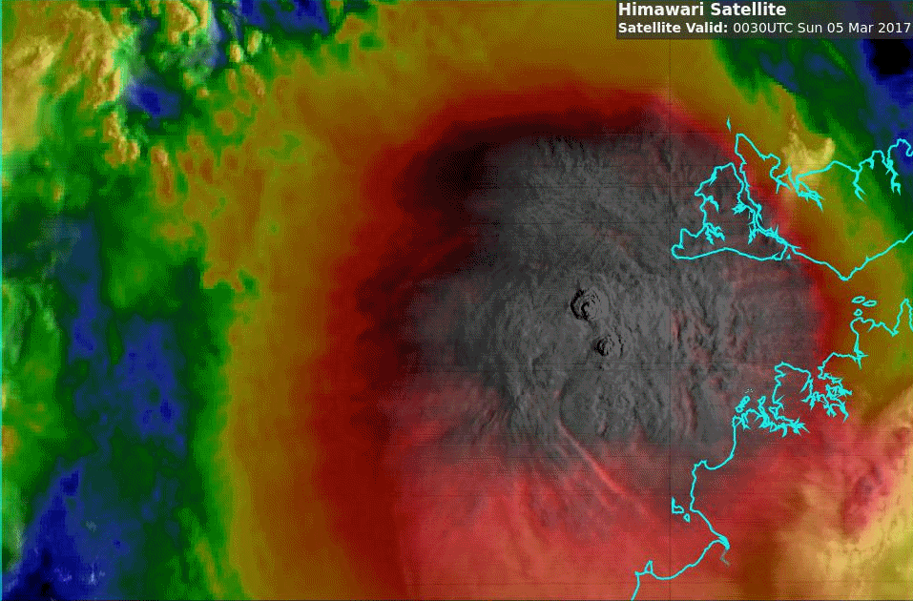
Animation: A closer look – Convection RGB / Sandwich product variations TC Blanche convection 5th March 2017, 0030 to 0230 UTC
Please start the Power Point Slide Show to activate the animation
animations courtesy BOM/JMA
animations courtesy JMA/BOM
lightning data courtesy GPATS
Question 2: What product do you prefer for monitoring convective development ?
A: Day Convection RGB (tropical tuned & lightning)
B: Day Convection RGB (tropical) Sandwich Product
Brightness -110% Contrast 300% Transparency 75% for HRVIS
Darwin
C: Sandwich Product (tropical tuned)
D: Sandwich Product Version 2
Brightness -170%, Contrast 400% for HRVIS. Transparency of enhanced IR as 50%

