Slide 1
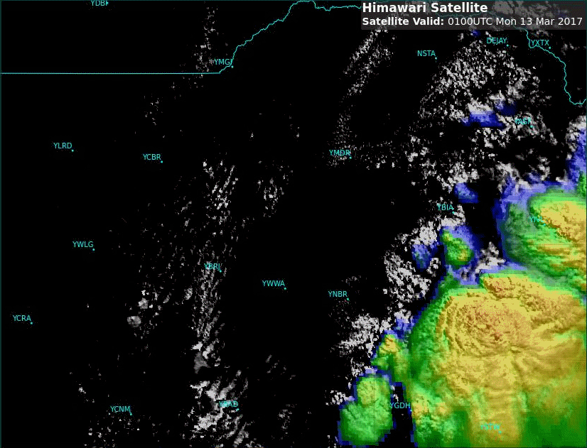
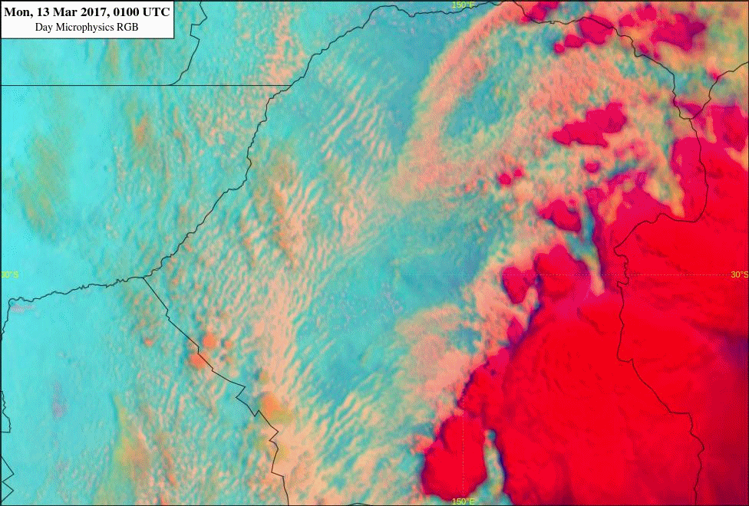
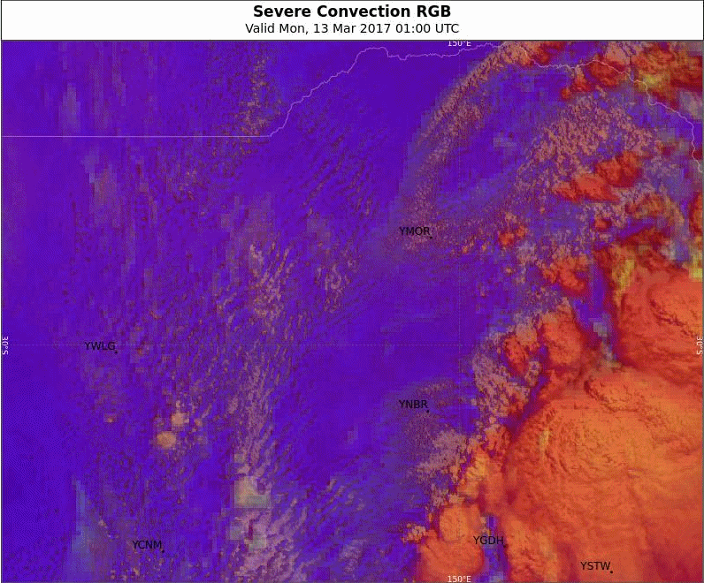
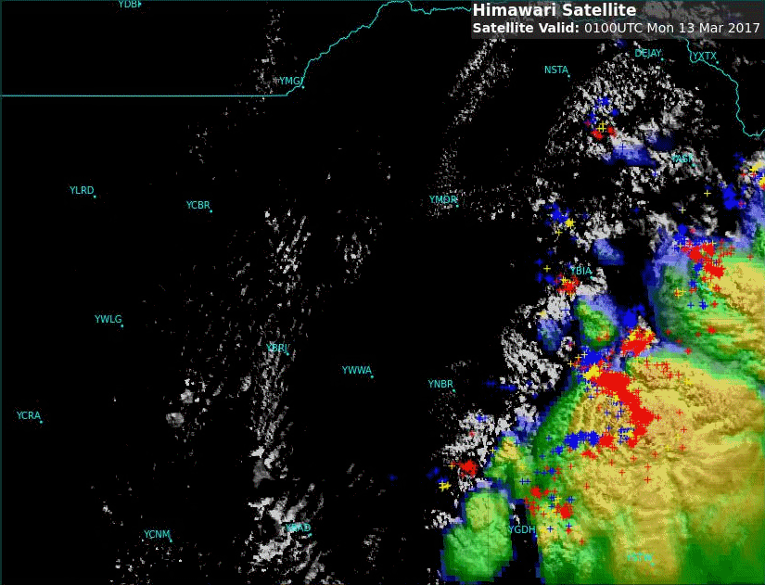
Animation: NSW Convection, 13 March 2017 Comparing Sandwich and RGB products, 0100 to 0800 UTC
animations courtesy BOM/JMA
Please start the Power Point Slide Show to activate the animation
lightning data courtesy Global Position and Tracking Systems Pty Ltd (GPATS)
March 2017 RFG meeting
A: Enhanced Sandwich Product (mid-lat tuned)
B: Day Microphysics RGB
Moree
C: Day Convection RGB Sand. P. (mid-lat tuned)
D: Enh. Sandwich Product (mid-latitude & lightning)

