Slide 1



“Satellite Meteorology Training in WMO RAV during 2016/17; the Australian VLab Centre of Excellence experience”
Asia-Oceania Meteorological Satellite Users Conference 8 (AOMSUC-8), Vladivostok, Russian Federation
Presenter: Bodo Zeschke. Bureau of Meteorology Training Centre, Australian VLab Centre of Excellence Point of Contact

Slide 2
Contents
This presentation is a summary of the Himawari-8 training conducted by the Australian VLab Centre of Excellence over the past year.
It focusses on:
The monthly Regional Focus Group meetings
Collaboration with WMO and other Centres of Excellence within the context of the WMO Global Campus.

Slide 3
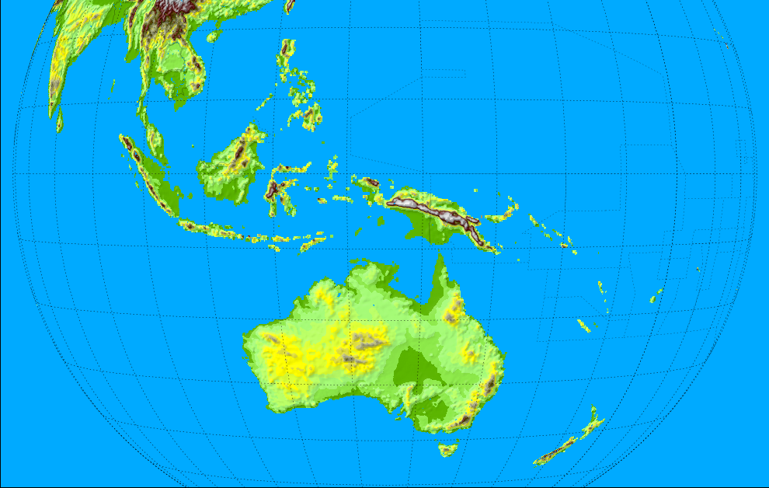


Australian VLab Centre of Excellence and RAV contacts
(see also https://www.wmo-sat.info/vlab/centres-of-excellence/)
Philippines
RAV
Singapore
DuncanTippins
(Head of CoE)
Bodo Zeschke
(Main Point of Contact)
Solomon Islands
Indonesia
Tuvalu
PNG
Fiji
Other important contacts:
JMA
EUMETSAT
CMA
KMA
Vanuatu
Samoa
Satellite Champions
RAV contacts frequently attending our training
Other RAV contacts
Melbourne
New Zealand

Slide 4

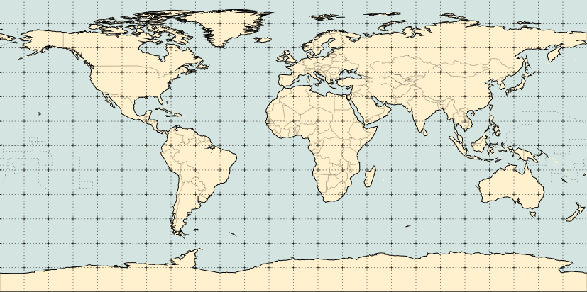
The past year of Regional Focus Group meetings – statistics October 2016 to September 2017
0.1
0.1
0.1
0.9
5.3
2.3
1.7
1.3
0.2
0.6
0.1
0.2
0.2
0.1
0.2
1.1
0.2
8.3
0.3
0.3
0.1
0.3
0.3
6.7
0.1
0.7
Average number of remote participants per session
Total number of remote stakeholders attending the 12 sessions = 374
Average number of participants per session = 31.2

Slide 5
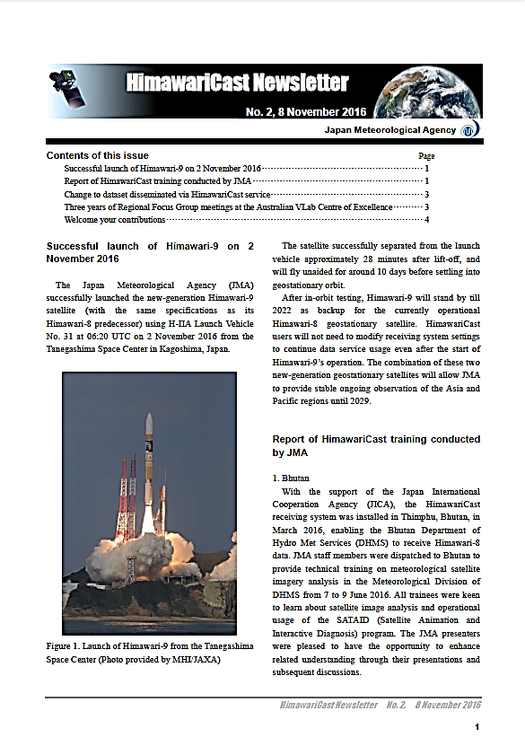
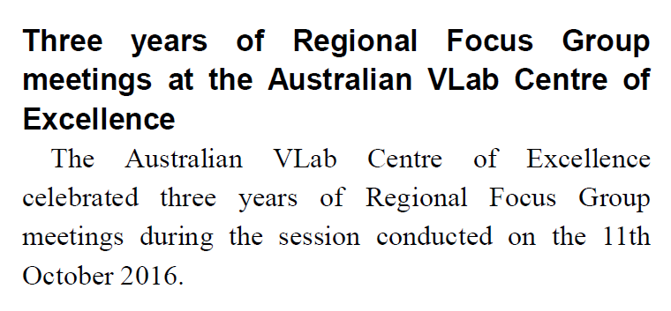
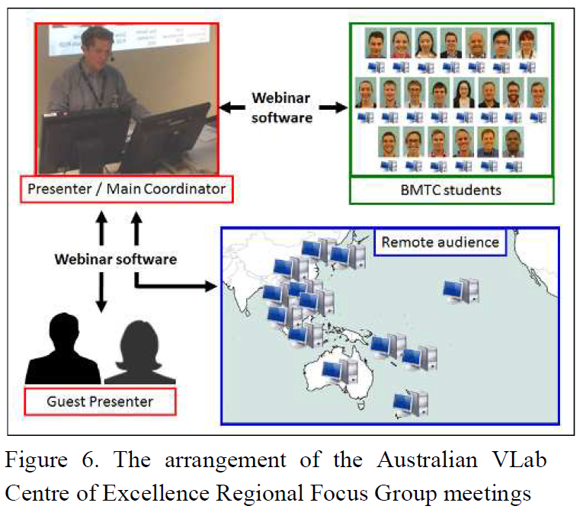

Slide 6
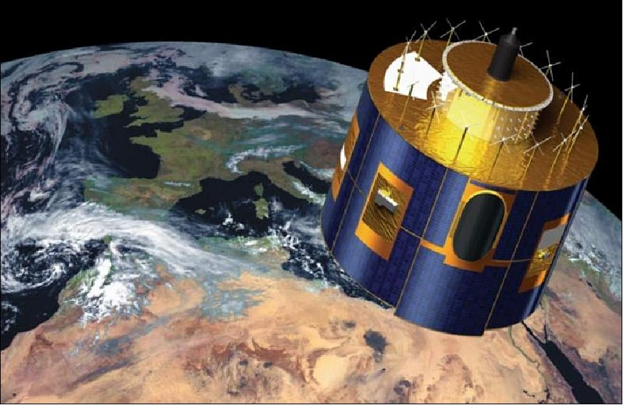

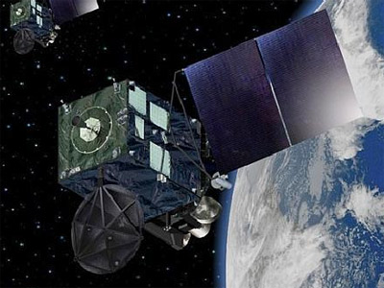
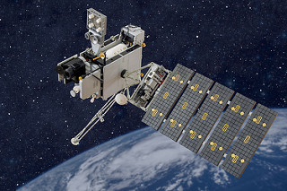
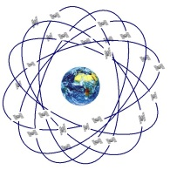
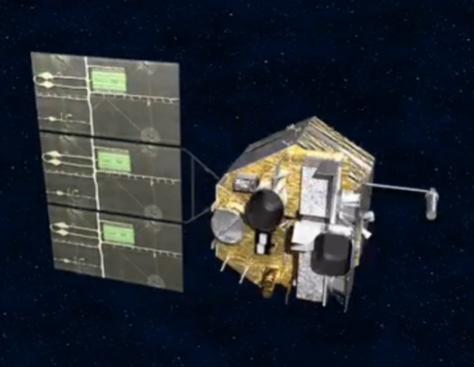
4th

Slide 7
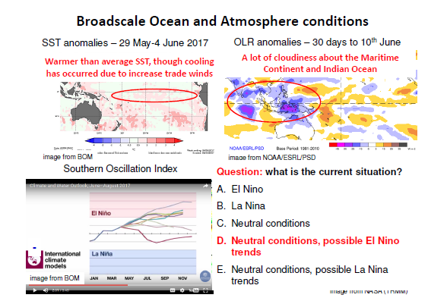
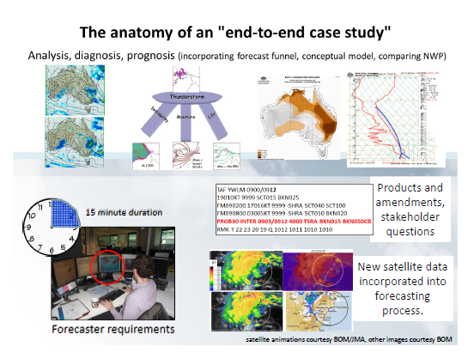
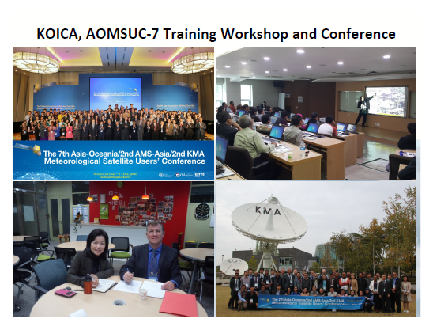
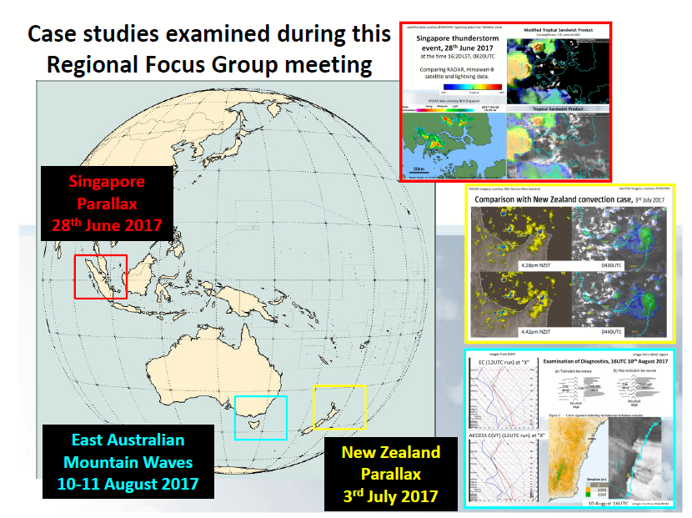
Monthly Regional Focus Group Meetings
(over the past year..)
1
2
4
3

Slide 8
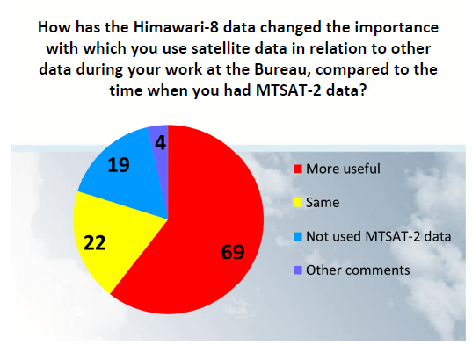
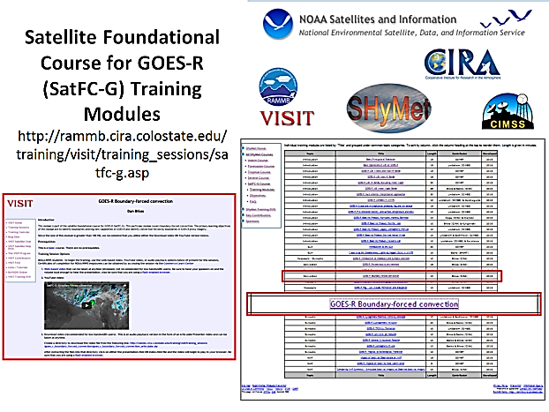
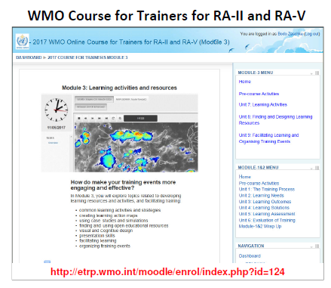
Monthly Regional Focus Group Meetings
(over the past year..)
5
6
7

Slide 9
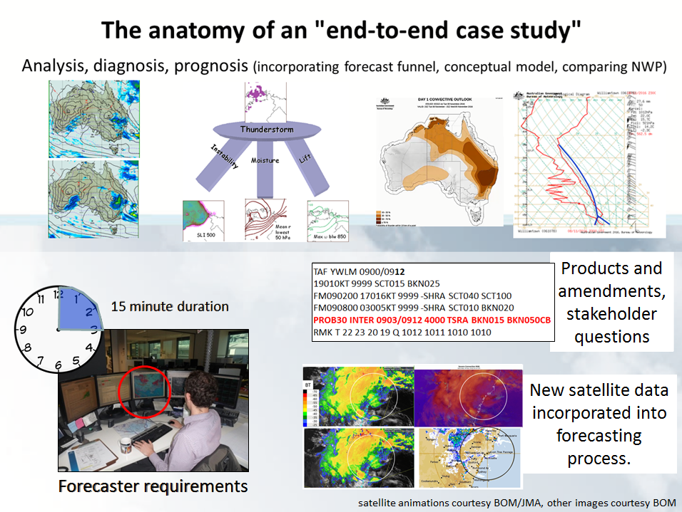
End-to-End Forecaster Friendly Case Study incorporating Himawari-8 data
December 2016 Regional Focus Group meeting recording at http://www.virtuallab.bom.gov.au/archive/regional-focus-group-recordings/

Slide 10
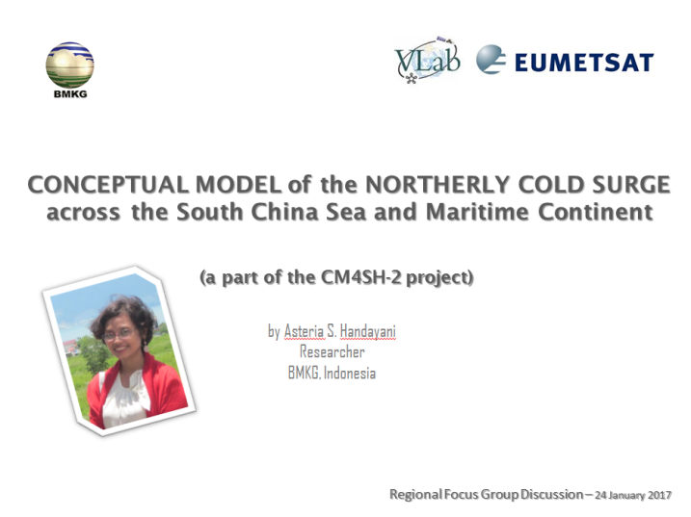
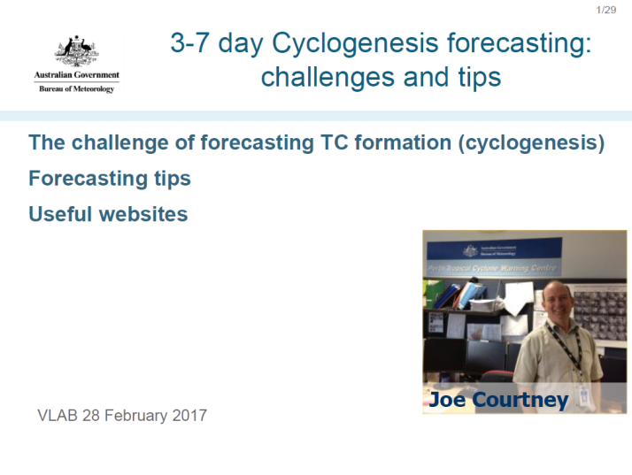
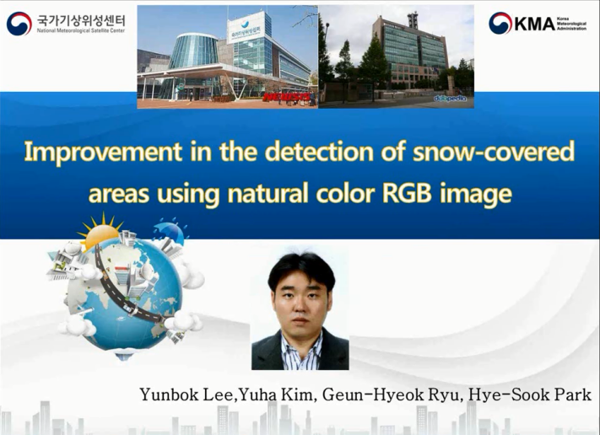



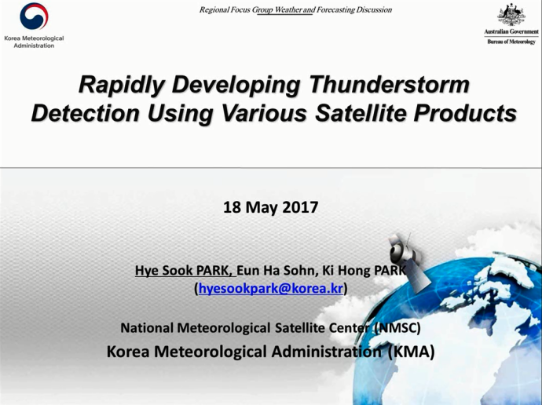
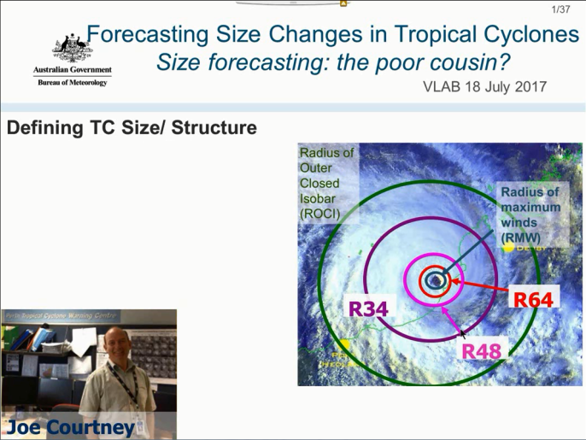
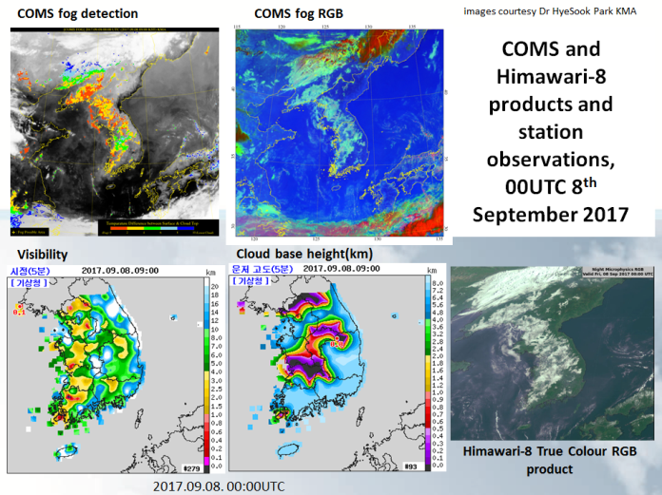
Presentations by invited speakers during during the last year
January 2017
February 2017
April 2017
May 2017
July 2017
September 2017

Slide 11
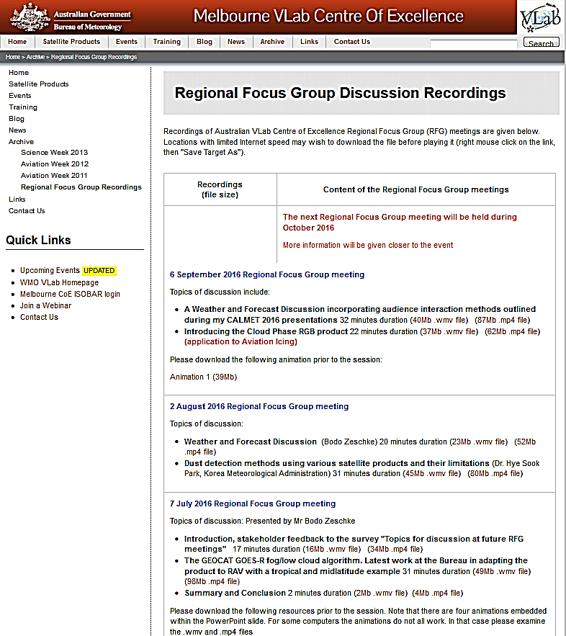
Recordings of our Regional Focus Group Discussions http://www.virtuallab.bom.gov.au/archive/regional-focus-group-recordings/

Slide 12
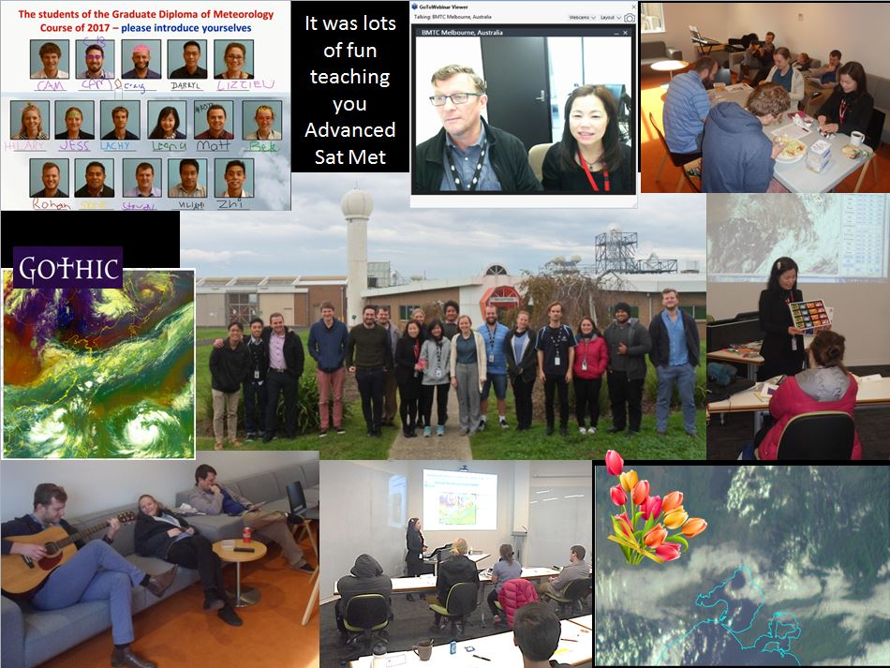
Visit of KMA VLab Centre of Excellence Point of Contact Dr HyeSook Park to BOM Australia, 13-20th May 2017

Slide 13
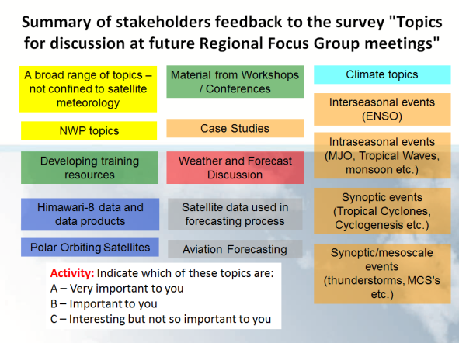

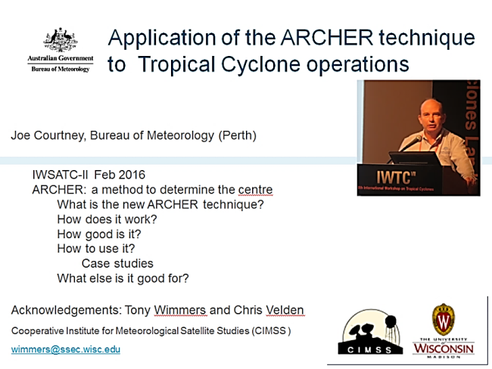
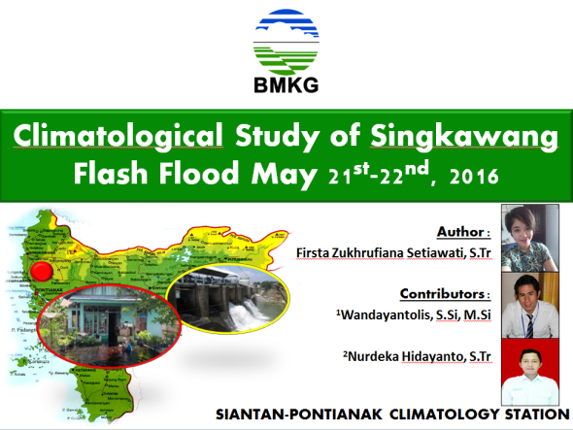
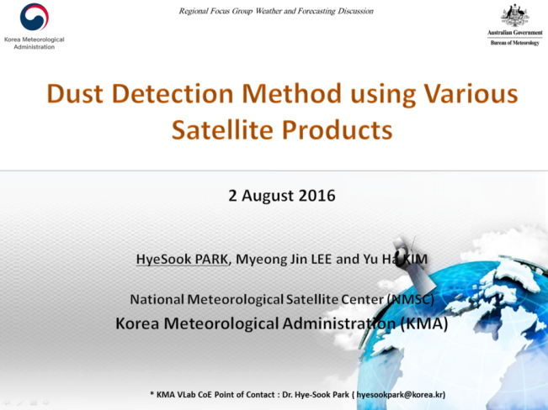
Future directions / initiatives
1
WMO Global Campus
http://public.wmo.int/en/resources/meteoworld/wmo-global-campus
2
Korea CoE
EUMETSAT / JMA
Beijing CoE
Nanjing CoE
BMKG
3
Australian CoE

