Slide 1
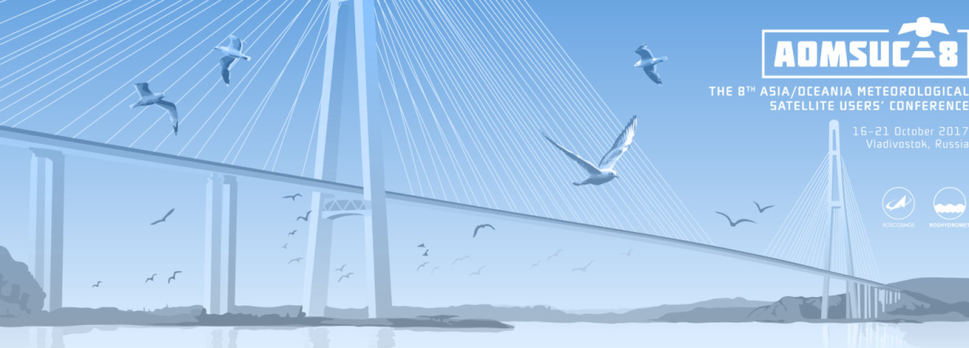
“How Himawari-8 data has revolutionised the work of Australian Bureau of Meteorology Forecasters”
Asia-Oceania Meteorological Satellite Users Conference 8 (AOMSUC-8), Vladivostok, Russian Federation
Presenter: Bodo Zeschke. Bureau of Meteorology Training Centre, Australian VLab Centre of Excellence Point of Contact

Slide 2
Contents of this session
Motivation : to assess the impact of Himawari-8 data on the work of the Australian Bureau of Meteorology forecaster
A summary of feedback of 115 Bureau Forecasting staff .
Key themes include:
An increase in the effective use of satellite data
An increased confidence in the use of the new data
Improved presentation of the new data
A better service to stakeholders when using the data
Continuing challenges in the operational use of the data.

Slide 3
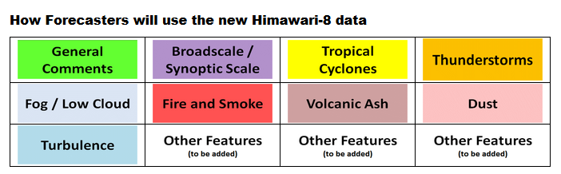
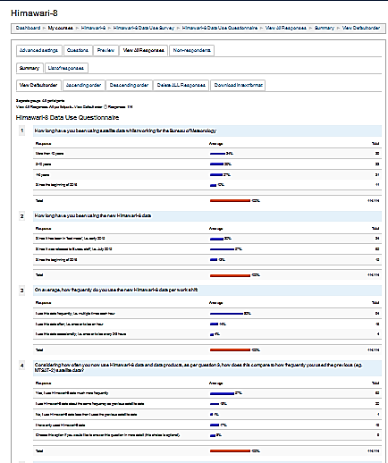
How we measured the impact of Himawari-8 data on the Forecast Process
1: National Himawari-8 Training Campaign feedback (since early 2015)
2: Himawari-8 Data Use Questionnaire
(January-April 2017)
115 Forecasters have responded (50% of Bureau Forecasters)
3: Interviewing 10 Satellite Champions (since April 2017)

Slide 4
How has the Himawari-8 data changed the importance with which you use satellite data in relation to other data during your work at the Bureau, compared to the time when you had MTSAT-2 data?

Slide 5
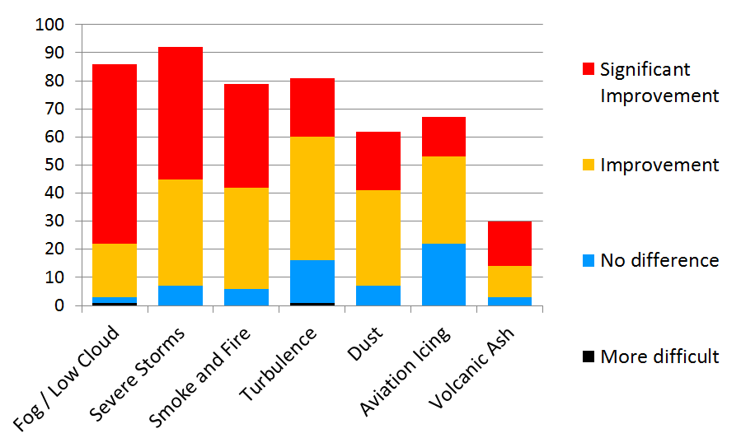
How has the new Himawari-8 data improved your ability in detecting / monitoring the following severe weather elements, when compared to the previous satellite data?

Slide 6
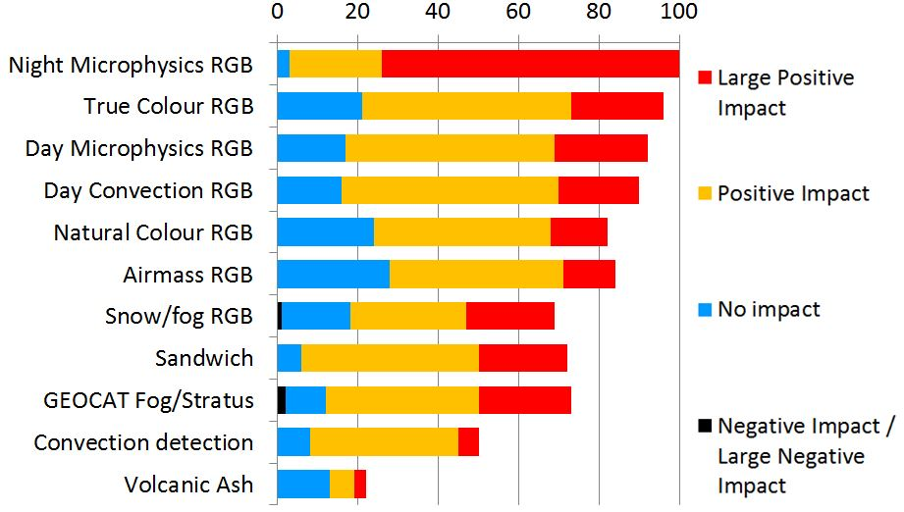
Evaluate the positive or negative impact of the following Himawari-8 RGB and derived data products on your work at the Bureau

Slide 7
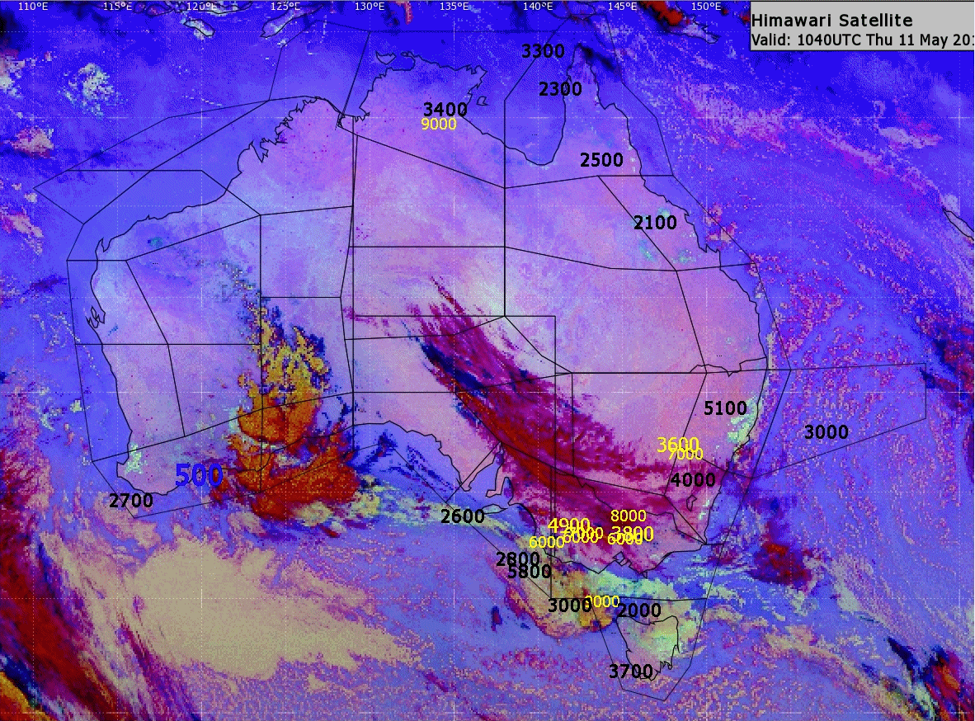
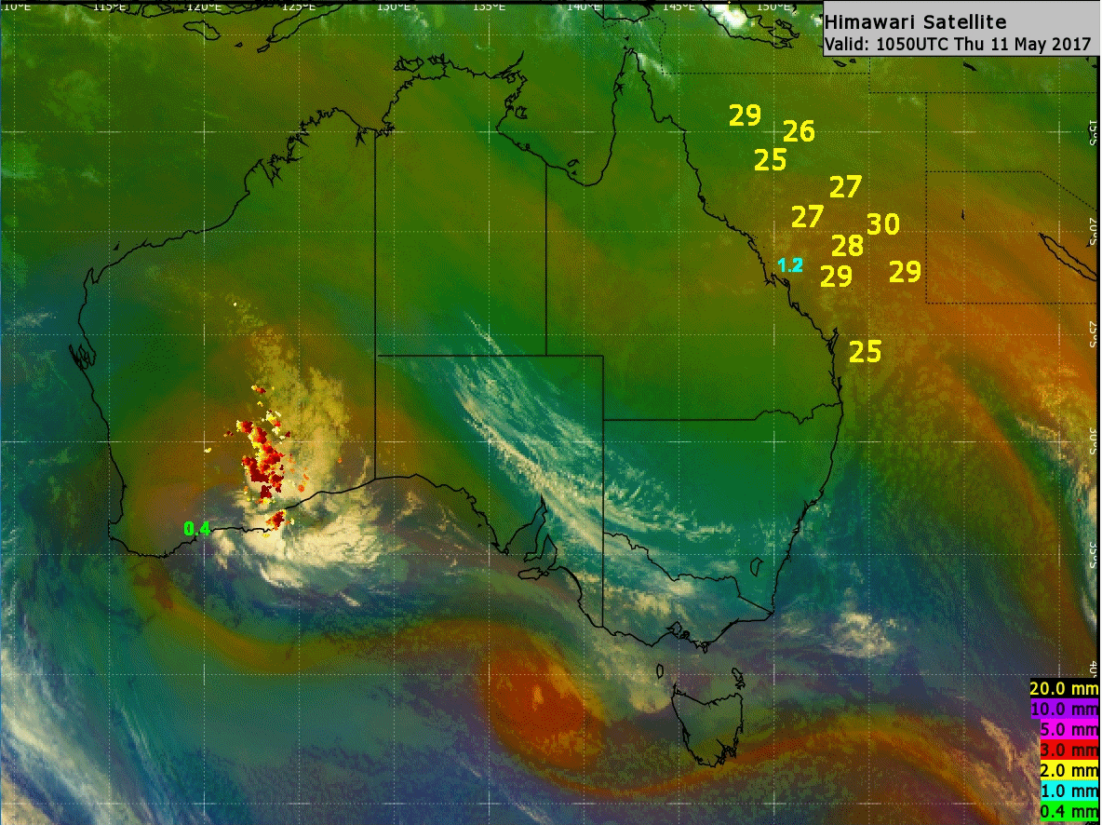
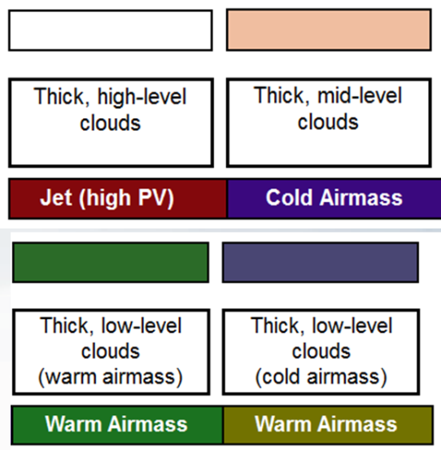
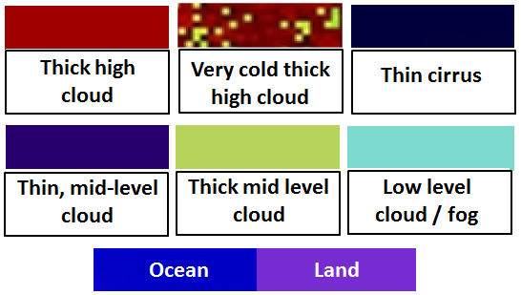
Animation 1: Which RGB product do you prefer – for clarity of signal?
A
B
Night Microphysics RGB Airmass RGB
METAR cloud base and visibility shown
Lightning, surface wind gusts and hourly pptn shown
Please start the Power Point Slide Show to activate the animation

Slide 8
How useful have you found the new Himawari-8 data when briefing stakeholders (pilots etc.)?

Slide 9
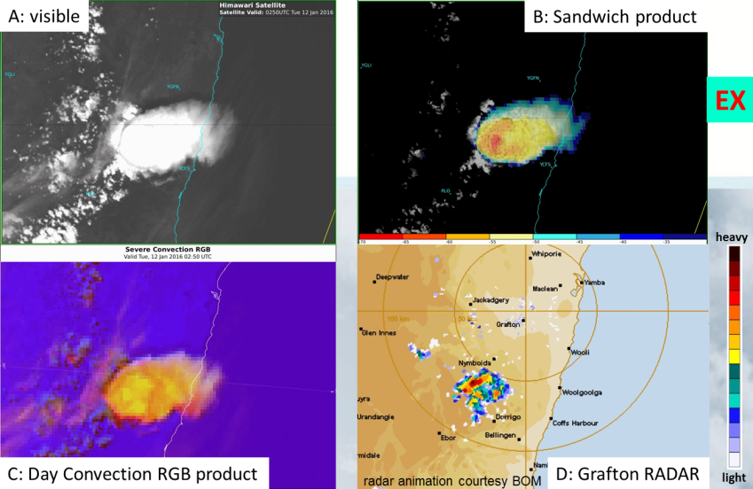
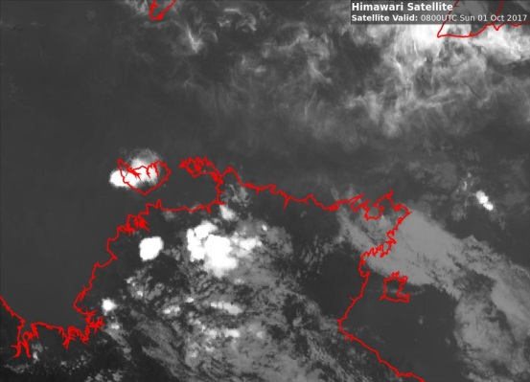
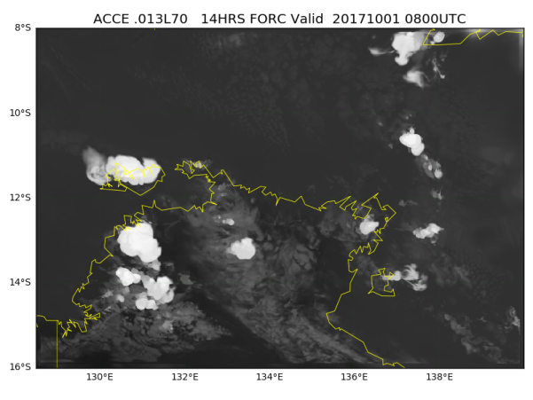
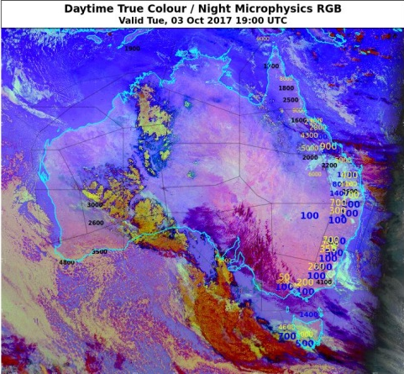
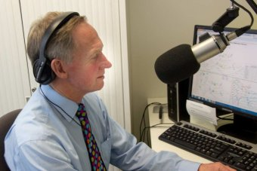
Summary of Results
An increase in the effective use of satellite data, including changes in the forecaster workflow
Increased confidence in the use of the new satellite data
Existing phenomena in more detail
Less ambiguity in imagery, less noise
Easier verification with other data (RADAR, surface observations)
Information rich product and presentation, making the job easier for Forecasters
Providing a better service to clients
Satellite
NWP forecast

Slide 10
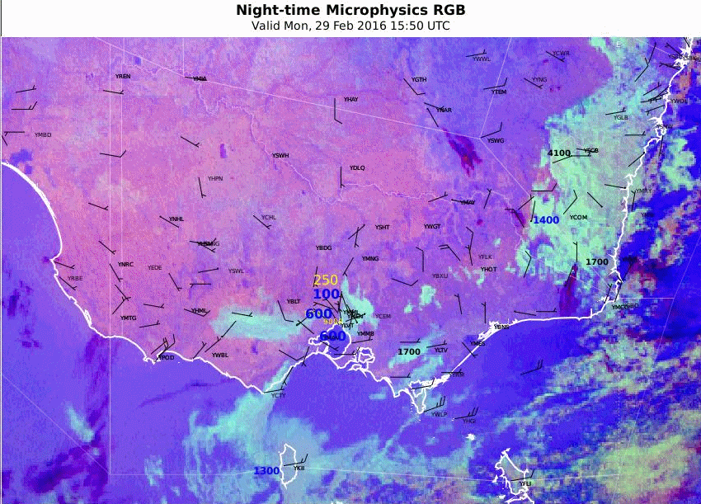
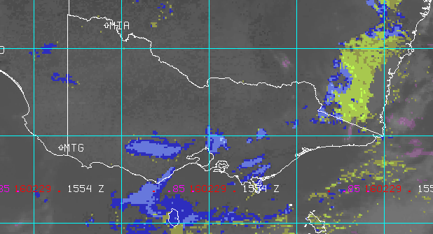
Animation 2: Comparing MTSAT-2 and Himawari-8 Products (Victoria fog/low cloud development, 29th Feb 2016)
Please start the Power Point Slide Show to activate the animation
images courtesy JMA/BOM
MTSAT-2 Fog/Low Cloud enhancement
Himawari-8 Night Microphysics RGB product
Fog/low cloud
Fog/low cloud
Higher spatial, temporal and spectral resolution in the Himawari-8 data:
Fog/low cloud signal clearer with less "noise".
Easier to follow the evolution of the fog/low cloud.
Easier discrimination between cloud types.
Land surface resolved.

Slide 11
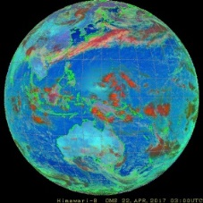
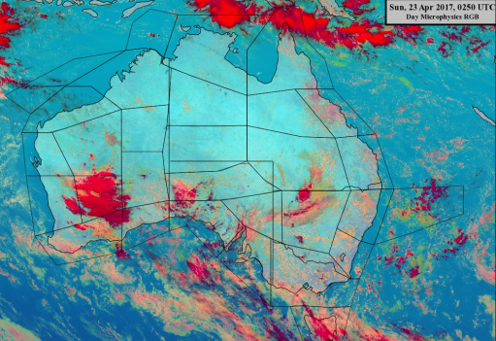
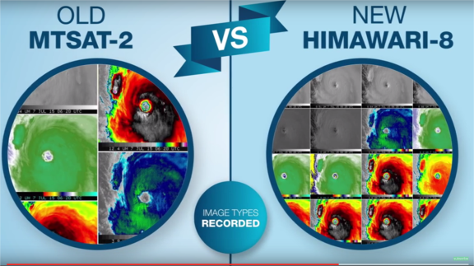
Room for further Improvement

Slide 12
Future Plans
Ongoing collaboration with stakeholders to:
Disseminate the information and encourage national and international collaboration.
Develop Training Resources
Further improve the performance of the visualisation software in rendering Himawari-8 data
A paper will be published as a result of this work, co-authored by Bodo Zeschke, Mike Willmott, Agnes Lane and Anthony Rea

