Slide 1
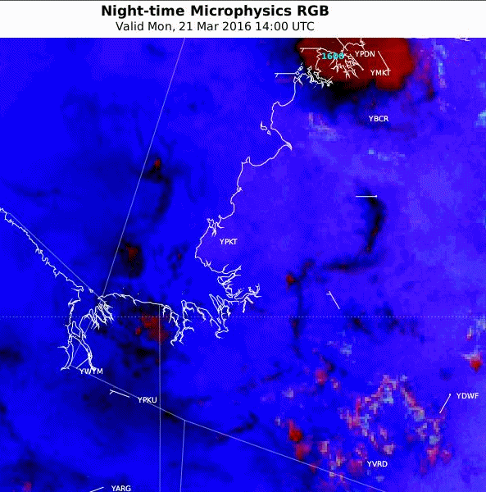
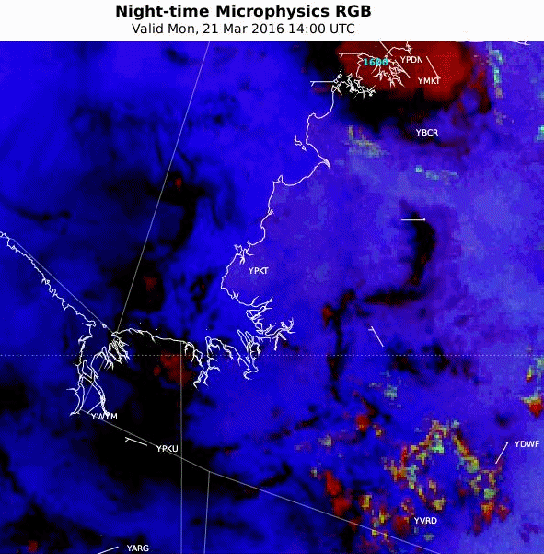
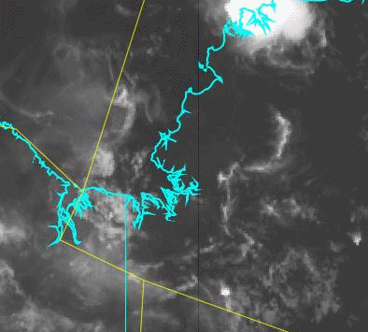
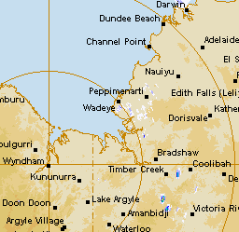
Animation: Northern Territory, 21st March 2016, 14 – 22UTC
10 May 2016 Regional Focus Group meeting; Animation 2
JMA version 2
TROP Hybrid (scaled)
10.4 micron IR
Wyndham RADAR
Question 1: What RGB product do you prefer?
Why?
satellite animations courtesy BOM/JMA
radar animation courtesy BOM
Notes:
http://www.theweatherchaser.com/radar-loop/IDR072-wyndham/2016-03-21-12/2016-03-21-23
http://flurry-dm.bom.gov.au:8008/radar/request_radar.php

