Slide 1
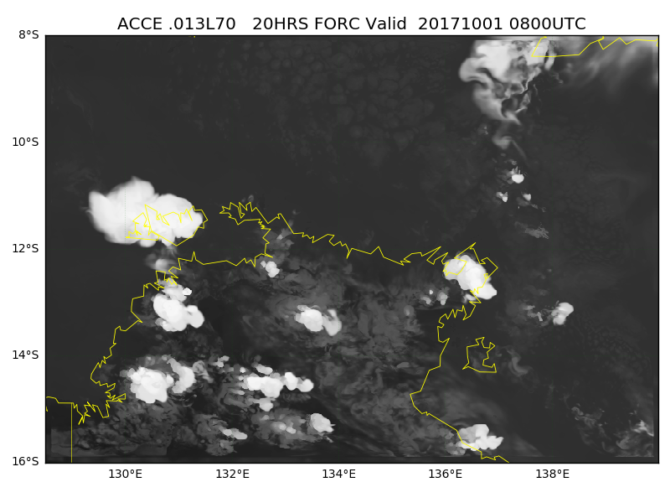
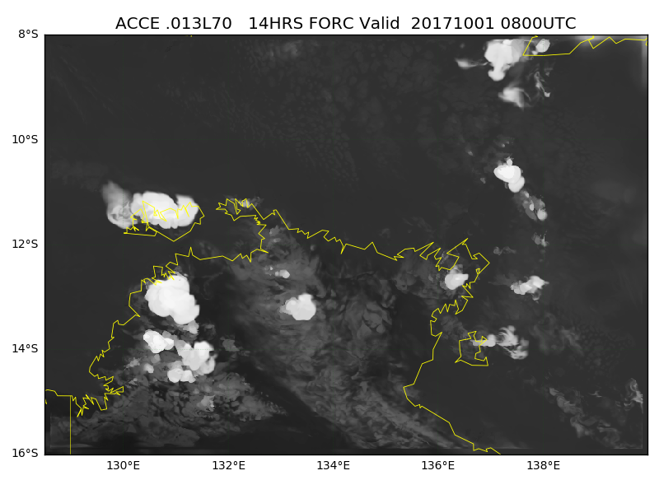
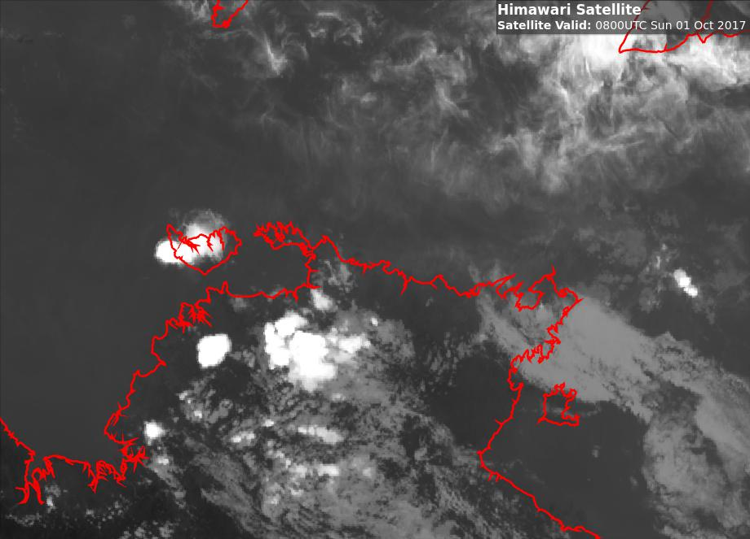
Question 5: at the commencement of widespread convection (08UTC) where did the model perform well?
synthetic satellite data courtesy L.Rikus BOM
ACCESS-C 12UTC Analysis
D
C
A
Darwin
Gove
B
satellite data courtesy JMA / BOM
Himawari-8 Band 13
ACCESS-C 18UTC Analysis
D
D
C
C
A
A
B
B

