Slide 1
Volcanic Ash and Dusting Monitoring with Geostationary Satellite
Yukio Kurihara (Mr.), Meteorological Satellite Center (MSC) / Japan Meteorological Agency (JMA)
yukio.kurihara-a@met.kishou.go.jp

Slide 2
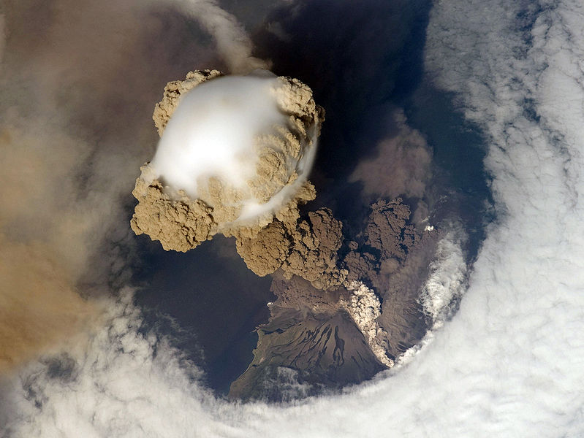
Contents
Introduction
  VAAC Tokyo / JMA
  Japanese Geostationary Satellite (MTSAT-1R/2)
Volcanic Ash Detection
RGB method
Estimation of Physical Quantities of Volcanic Ash
NASA/ISS Expedition 20

Slide 3
Volcanic Ash Advisory Center (VAAC)
The International Civil Aviation Organization (ICAO) and World Meteorological Organization (WMO) established a framework for the International Airways Volcano Watch (IAVW) in 1993
Nine Volcanic Ash Advisory Centers (VAACs) started operations under the framework of IAVW
JMA operates the VAAC

Slide 4
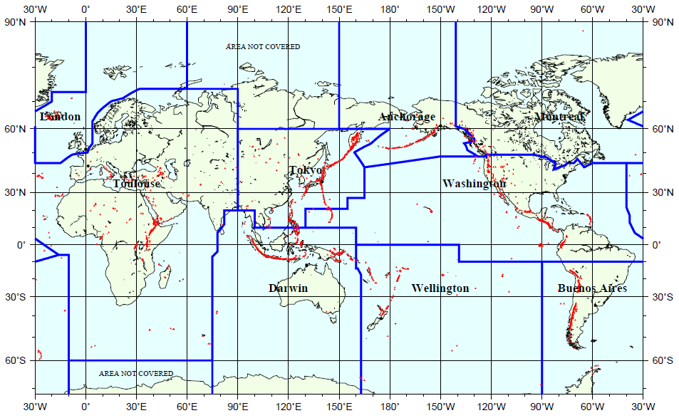
Volcanic Ash Advisory Centers (VAACs)
VAAC Tokyo, JMA

Slide 5
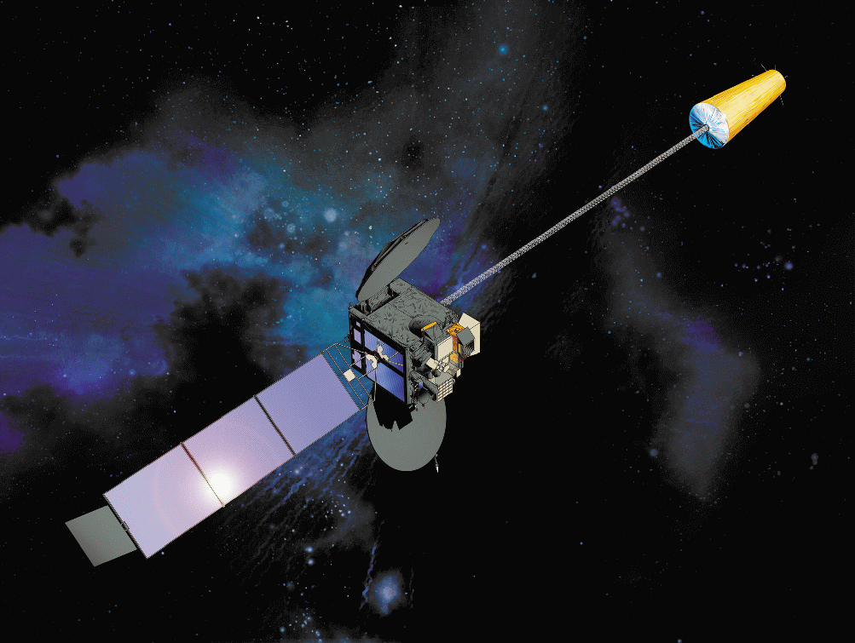
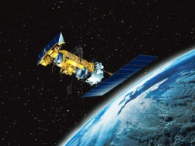
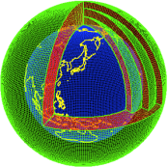
Information Flow of Volcanic Ash Advisory
Volcano Information
Pilot Reports
Satellite
Observations
NWP GPV
Tokyo VAAC is responsible for
Monitoring and Analysis
of Volcanic Ash Cloud
Forecasting of Volcanic Ash Cloud
Issue of Volcanic Ash Advisory
Tokyo VAAC/JMA
ICAO volcanic ash products
Text Information (FVFE01)
Graphic Information (VAG)
Volcanic
Activity Reports
Foreign VAACs
Meteorological Watch Offices
in area of responsibility
Aviation Weather Service Centers
in Japan
Civil Aviation Authorities and Other Related Organizations

Slide 6
Operational Meteorological Satellite
JMA

Slide 7
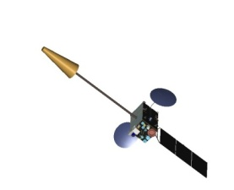
MTSAT-1R/2 Imager
Channel | Wave length (µm) | Horizontal resolution （nadir point） | Radiometric resolution | Feature
VIS | 0.55 - 0.90 | 1 km | 1024 | Detect sunlight reflection. Image is as same as human’s vision.
10.8μm (IR1) | 10.3 - 11.3 | 4 km | 1024 | Detect infrared radiation from surface and cloud. We can detect even at night.
12μm (IR2) | 11.5 - 12.5 |  |  | Same as above. In many cases, it is used with IR1.
 |  |  |  | Detect amount of upper and middle layer water vapor.
Water vapor （IR3） | 6.5 - 7.0
 |  |  |  | Detect sunlight reflection (only daytime) and radiation from objects. Using for fog distinction.
3.8µm （IR4） | 3.5 - 4.0

Slide 8
JMA operates VAAC Tokyo
VAAC Tokyo monitors and forecasts volcanic ash and issues Volcanic Ash Advisory (VAA) to aviation users
Darwin VAAC and VAAC Tokyo are in backup relationship
MSC / JMA generates satellite-based products and provides them to VAAC Tokyo

Slide 9
Volcanic Ash Detection Algorithm
Name | Principle | Reference
Reverse Absorption | 2-band IR (11 and 12 um) | Prata (1989)
Ratio | 2-band IR (11 and 12 um) | Holasek and Rose (1991)
4-Band | IR + Visible | Mosher (2000)
TVAP | 3-band IR (3.9, 11 and 12 um) | Ellrod et al. (2003)
Principle Component method | Multi-band principal components | Hillger and Clark (2002)
Water Vapor Correction method | 2-band IR + water vapor correction | Yu et al. (2002)
RAT (Ratio method) | 3-band IR (3.5, 11 and 12 um) | Pergola et al. (2004)
3-Band | 3-band (IR + Visible) | Pavolonis et al. (2006)
β-ratios | Multi-band, optimal estimation | Pavolonis (2010)

Slide 10
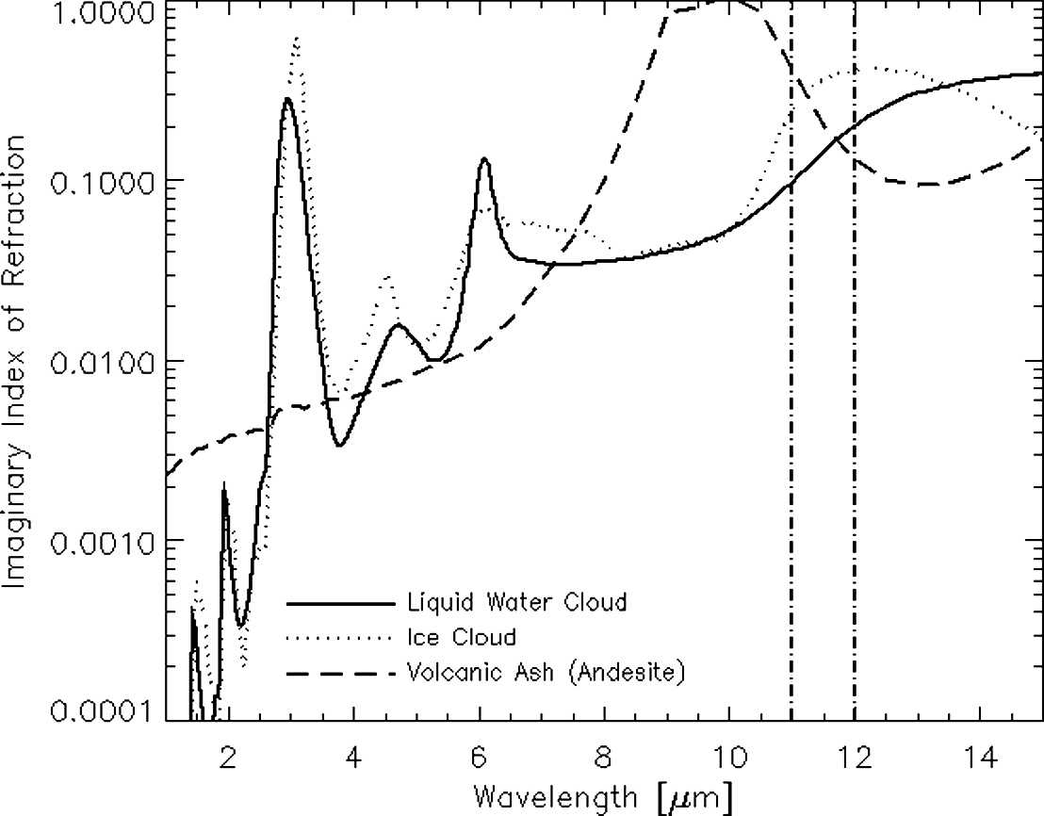
Volcanic Ash Detection / Reverse Absorption
Imaginary index of refraction is directly proportional to absorption intensity
Absorption by liquid water cloud or ice cloud at 11 um will be weaker than it at 12 um
Absorption by volcanic ash cloud at 11 um will be stronger than it at 12 um
IR1
IR2
Pavolonis et al. 2006

Slide 11
Volcanic Ash Detection / Reverse Absorption
T(10.8) > T(12.0)
T(10.8) < T(12.0)
thin cloud
Volcanic ash
T(10.8) – T(12.0) > 0 (positive)
T(10.8) – T(12.0) < 0 (negative)

Slide 12
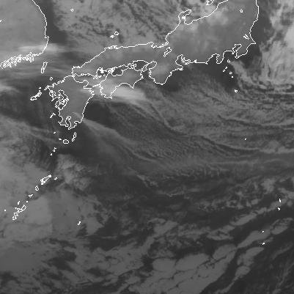
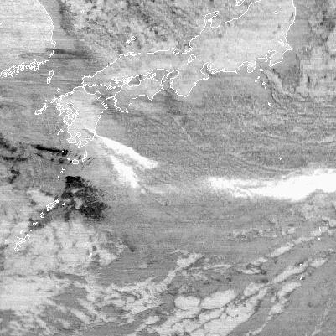
Volcanic Ash Detection / Reverse Absorption
T(10.8)
T(10.8)-T(12.0)
high <-- BT(10.8) --> low
positive <-- BT(10.8-12.0) --> negative
movie : movie1_btd_shinmoe_201101_avi/gif

Slide 13
Volcanic Ash Detection / Reverse Absorption
Infrared radiation is absorbed by volcanic ash more strongly at 10.8 um channel than at 12 um channel
while the radiation is absorbed by water or ice cloud more weakly at 10.8 um channel than at 12 um channel
Volcanic ash is characterized by negative T(10.8)-T(12)
Reverse absorption is the most basic and very powerful algorithm for volcanic ash detection
but limited by
  T(10.8)-T(12) can be negative by strong temperature inversion near surface
  T(10.8)-T(12) can be negative over desert surface under clear sky condition
  T(10.8)-T(12) can be negative at the cloud top which overshoot the tropopause
  Very thick ash clouds sometimes have positive T(10.8)-T(12)
  Very high water vapor can make T(10.8)-T(12) via ash cloud positive
  Instrument noise

Slide 14

Volcanic Ash Detection / RGB composite image
Red | Green | Blue | Focus
VIS | T(3.8) | T(10.8) | low/mid/high level cloud
T(12)-T(10.8) | T(10.8)-T(3.8) | T(10.8) | low/mid/high level cloud, convective or thick cloud
VIS | T(3.8)-T(10.8) | T(10.8) | Severe Convection
T(10.8)-T(12) | T(10.8)-T(3.8) | T(10.8) | Ash, Dust
VIS | T(3.8) | T(10.8) | Snow/Ice coverage
#FF0000
#FFFF00
#FF00FF
#FFFFFF
#00FF00
#00FFFF
#0000FF
COLOR HEX: #XXXXXX
three primary colors of lights

Slide 15
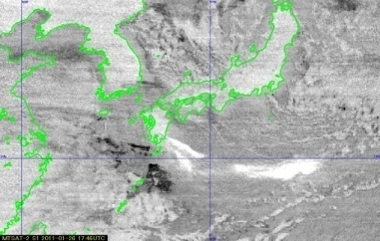
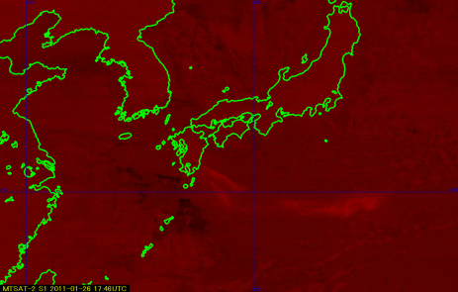
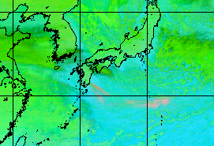
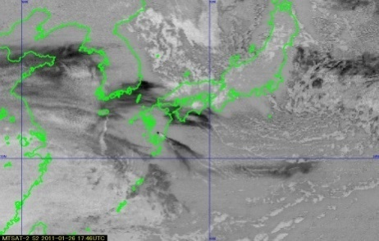
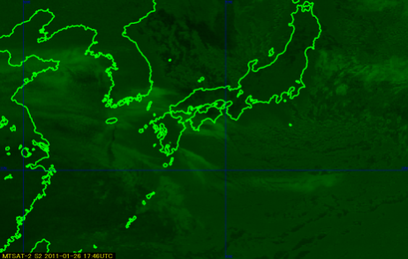
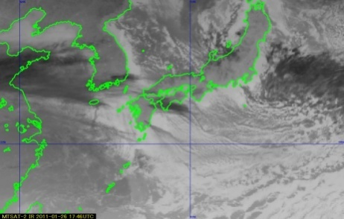
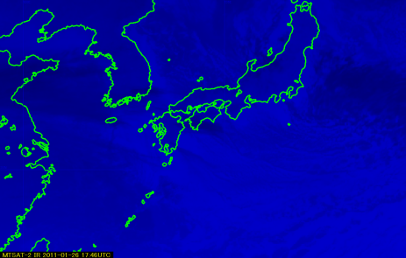

Volcanic Ash Detection / RGB composite image
Dark ---> Bright
0 254
T(10.8)-T(12)
 | Parameter | From (K) | To (K)
R | T(10.8)-T(12) | 2.0 | -4.0
G | T(10.8)-T(3.8) | -40.0 | 5.0
B | T(10.8) | 243 | 293
R
high <-- T(10.8-12.0) --> low
T(10.8)-T(3.8)
G
high <-- T(3.8-10.8) --> low
T(10.8)
B
Volcanic ash
high <-- T(10.8) --> low
15

Slide 16
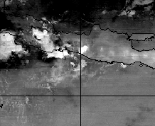
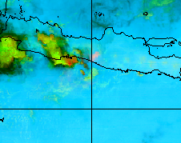
Volcanic Ash Detection / RGB composite image / Example
Mt. Merapi, Indonesia, Nov. 2011
T(10.8)-T(12)
RGB

Slide 17
Volcanic Ash Detection / RGB composite image
RGB composite image provides visible information which is useful for human processing
Volcanic ash can be detected easily from RGB composite image
Operators need training to master RGB image

Slide 18
Estimation of Physical Quantities of Volcanic Ash
Height, particle size, optical depth and mass loading can be estimated from satellite data
Information on heights, mass loadings and particle sizes are important for dispersion forecasting and aviation safety
There are some estimation algorithms by Dr. Prata (2011), by Dr. Pavolonis (2013), by UKMO and so on
Estimation accuracy will be improved by up-coming multi-channel imagers such as Advanced Himawari Imager (AHI) of Himawari-8/9, Advanced Baseline Imager (ABI) of GOES-R and so on
Now MSC / JMA is developing new volcanic ash product which provide information on physical quantities of volcanic ash

Slide 19
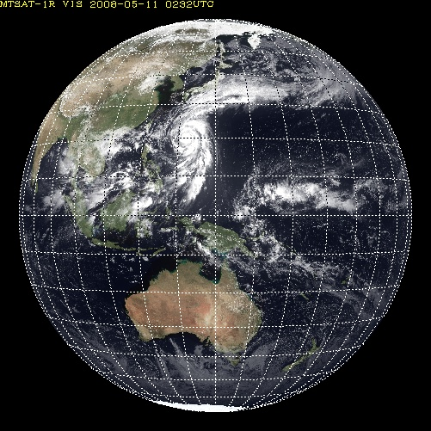
Specification of “Himawari-8/9” Imager (AHI)
*Himawari-8 and 9 will be launched in 2014 and 2016
HIMAWARI-8/9
Full Color Disk Image
every 10 minutes
Band | Central Wavelength [μｍ] | Spatial Resolution
1 | 0.43 - 0.48 | 1Km
2 | 0.50 - 0.52 | 1Km
3 | 0.63 - 0.66 | 0.5Km
4 | 0.85 - 0.87 | 1Km
5 | 1.60 - 1.62 | 2Km
6 | 2.25 - 2.27 | 2Km
7 | 3.74 - 3.96 | 2Km
8 | 6.06 - 6.43 | 2Km
9 | 6.89 - 7.01 | 2Km
10 | 7.26 - 7.43 | 2Km
11 | 8.44 - 8.76 | 2Km
12 | 9.54 - 9.72 | 2Km
13 | 10.3 - 10.6 | 2Km
14 | 11.1- 11.3 | 2Km
15 | 12.2 - 12.5 | 2Km
16 | 13.2 - 13.4 | 2Km
RGB
Composited
Full Color Image
Water
Vapour
as of MTSAT-1R/2
SO2
Band | Central Wavelength [μｍ] | Spatial Resolution
1 | 0.55 – 0.90 | 1Km
2 | 3.50 – 4.00 | 4Km
3 | 6.50- 7.00 | 4Km
4 | 10.3 – 11.3 | 4Km
5 | 11.5 – 12.5 | 4Km
O3
Atmospheric
Windows
CO2

Slide 20
Estimation of Physical Quantities of Volcanic Ash / Movie
movie2_shinmoe_201101_avi/gif
movie3_merapi_201011_avi/gif

Slide 21
Mt. Shinmoe
1420.77-meter volcano in the south of Kyushu Is. , Japan
Volcanic activity started end of January in 2011
Ash reached to about 1,500 meters by the explosion around 0640 UTC, 26 January and 2,500 meters by the explosion around 0640 UTC, 27 January
Data from MTSAT-2 is used for the detection and the quantitative estimation of volcanic ash
Volcanic ash was detected with the algorithm by MSC
Physical quantities are estimated with the algorithm by Dr. Prata (2011)

Slide 22
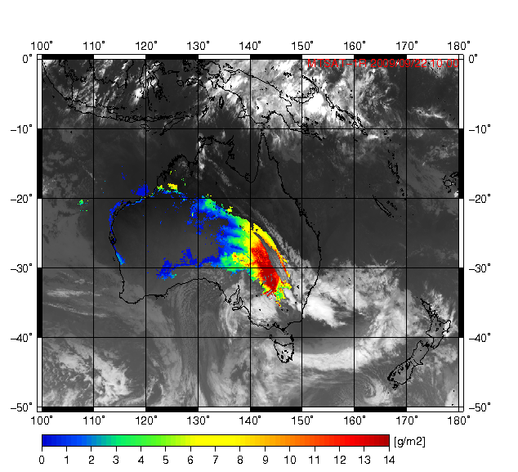
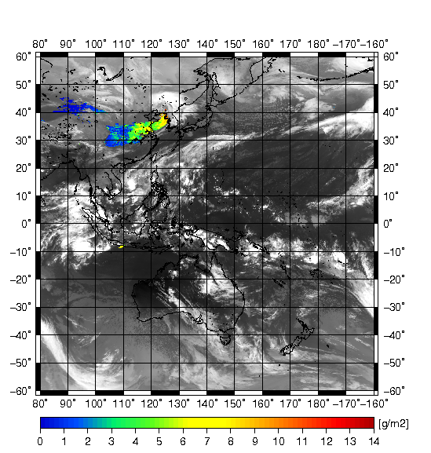
Bonus (Dust)
Because of components of dust similar to volcanic ash, dust and its physical quantities can be retrieved with algorithm for volcanic ash too
Dust storm, 22 Sectember 2009, 10 UTC, Australia
Yellow Dust, 11 November 2010, 10 UTC

Slide 23
References
Pavolonis, M., J., 2006: A Daytime Complement to the Reverse Absorption Technique for Improved Automated Detection of Volcanic Ash, Journal of atmospheric and oceanic technology, Vol. 23, 1422-1444.
Pavolonis, M., J., 2010: Advances in Extracting Cloud Composition Information from Spaceborne Infrared Radiances – A Robust Alternative to Brightness Temperatures. Part I: Theory, Journal of Applied Meteorology and Climatology, Vol. 49, 1992-2011.
Pavolonis, M., J., Heidinger, A., K., Sieglaff, J., 2013: Automated retrievals of volcanic ash and dust cloud properties from upwelling infrared measurements, Journal of geophysical research: atmospheres, Vol. 118, 1-23, doi:10.1002/jgnd.50173.
Prata, A., J., 1989: Observations of volcanic ash clouds in the 10-12micron window using AVHRR/2 Data, Int. J. Remote Sens., 10, 751-761.
Prata, A., J., Grant, I., F., 2001: Retrieval of microphysical and morphological properties of volcanic ash plumes from satellite data: Application to Mt. Ruapehu, New Zealand, Q. J. R. Meteorol. Soc., 127, pp. 2153-2179.
Prata, F., 2011: Volcanic Information Derived from Satellite Data, NILU.

Slide 24
Thank you

